Slide 1
Proactive Spectrum Planning
July 2021
Date: 2021-07-12
Authors:
Notes:
September 2012

Slide 2
Abstract
Meeting spectrum needs is a complex and an excruciatingly time consuming process. This presentation explores how IEEE 802 could better manage the process by being proactive.
Notes:
September 2012
doc.: IEEE 802.11-09/0301r1
March 2009
Stephen McCann, RIM
Page 2

Slide 3
Problem Statement
EXAMPLE: The 6 GHz band was recently added for IEEE 802.11
  The process has taken 4+ years and tremendous resources (so far)
  It is not (yet) globally harmonized
    5925 MHz to 7125 MHz in some regulatory domains, limited to 5925 MHz to 6425 MHz in others
    Very Low Power, Indoor only, geolocation restrictions, etc.
  Technology is ready, but rollout will be slow and torturous
    Many regulatory domains not available
    Different specifications based on locale
    Portability hampered by geolocation requirements
  We got a lot less than we hoped for
Can we do a better job to ensure the standards we create have the RF spectrum they need at the time of their ratification?

Slide 4
RF Spectrum Complexities
Radio Frequency spectrum is poorly allocated
  Developed over the course of decades
    Frequency allocations were driven by technology limitations; not optimized for applications
    With no incentive to move, licensees continue in sub-optimal frequency bands
  Lack of accurate spectrum inventory leaves some spectrum unused or underused
    Expired licenses, obsolete applications, etc.
  Opportunities for spectrum sharing are limited
If we could start over…
  Short range devices best in highest frequency bands; long range in mid and low bands
  All allocations should have sharing provisions
…but we can’t

Slide 5
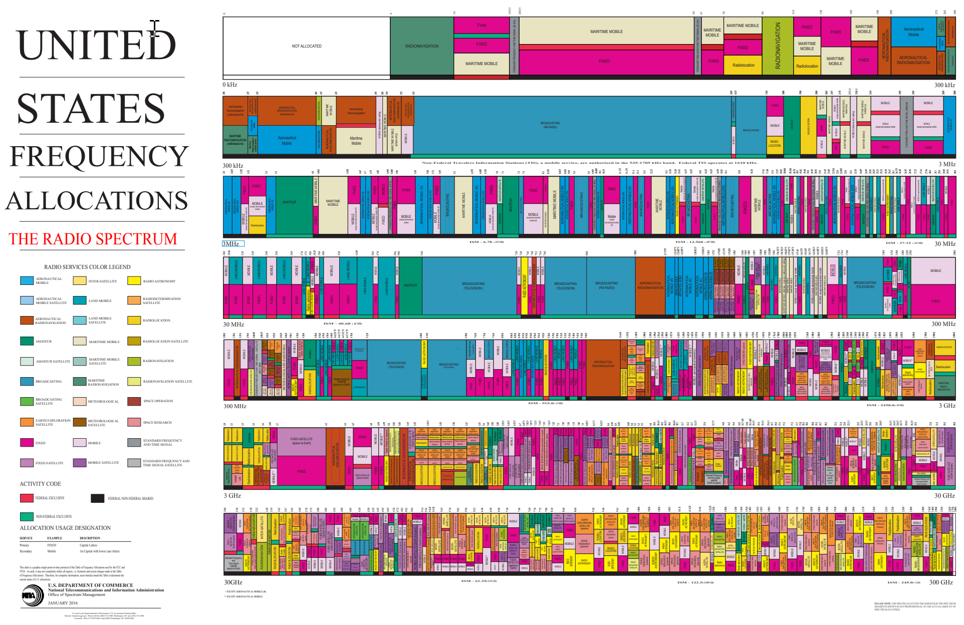
The Art of Spectrum Complexity

Slide 6
Optimizing From Where We Are Today
Comprehensive spectrum inventory is necessary
  We can only fix what we know for certain is broken
Regulators are required to be technology neutral [but they aren’t]
  Licensed and licensed-exempt (unlicensed) should be granted equal opportunities
  IEEE 802.11/15 have both proven that sharing is viable and valuable
  Biases hamper spectrum optimization; cellular spectrum generates revenues
New or replacement allocations should be optimized
  Spectrum bands allocations should be selected based on application requirements
  Provision for sharing should be taken into account in any new allocations

Slide 7
What Can IEEE 802 Do?
Proactivities
  Survey existing spectrum bands (low, mid, high) for potential sharing candidates
    Applications should drive band selections
  Set up a task force for spectrum discussions (802.18?)
    With the cellular industry*, the fixed services and satellite services industries
    With regulators
  Work with the spectrum incumbents on sharing opportunities
    Can we avoid the competition that slows the process?
    Extol the successes of license-exempt/unlicensed wireless technologies and their value as part of cellular networks
  Build a coalition of industry leaders [it worked for the 6 GHz band]
    To lobby for spectrum inventory globally
    To work on changing the regulations
  *Most likely they are looking at expanding into the same spectrum

Slide 8
What Else Can IEEE 802 Do?
For our discussion with regulators and incumbents
  Show the success of IEEE 802 wireless technologies
  Show how unlicensed wireless technologies create opportunities for underserved and poor populations
  Show how our wireless standards assure that we are committed to sharing within the IEEE 802 wireless family

Slide 9
Next Steps
Radio Regulatory TAG engagement
  Fine tune this proposal
  Begin surveying existing allocations for sharing opportunities generally
    Focus on recent sharing successes, e.g. 6 GHz
    Technology advances make mmWave bands more suitable for low-cost technologies today
  Closely monitor both 802.11 and 802.15 WNG groups for potential new spectrum requirements

Slide 10
References
US FCC Table of Frequencies
  https://transition.fcc.gov/oet/spectrum/table/fcctable.docx
European Table of Frequency Allocations
  https://docdb.cept.org/download/2ca5fcbd-4090/attachments/2013_ERCRep025.pdf
  ECO Frequency Information System (cept.org)

