Slide 1
Enhanced Sub 1 GHz Study Group:
Study Group Closing Report
Date: 2023-11-06
Authors:
Name | Affiliations | email
Benjamin Rolfe | BCA | Ben.Rolfe @ ieee.org
Notice: This document has been prepared to assist IEEE 802.19. It is offered as a basis for discussion and is not binding on the contributing individual(s) or organization(s). The material in this document is subject to change in form and content after further study. The contributor(s) reserve(s) the right to add, amend or withdraw material contained herein.

Slide 2
Session Objectives
Objective: Review and resolve comments received on the PAR and CSD
Comments received from:
  802.11
  802.15
  802.3
  802.1

Slide 3
Session Outcome
Responses to all comments received
  Responses captured in: https://mentor.ieee.org/802.19/dcn/23/19-23-0025-02-ES1G-par-comments-review.pptx
Updated PAR and CSD
  PAR updated using myproject, generated PDF in: https://mentor.ieee.org/802.19/dcn/23/19-23-0017-03-0000-19-3a-par-draft.pdf
  Revised CSD: https://mentor.ieee.org/802.19/dcn/23/19-23-0018-03-0000-802-19-3a-csd-draft.doc

Slide 4
WG Motions:
Motion: Request that the responses to received PAR and CSD review comments contained in document 802.19-23/0025r1 be approved for submission to the EC. The 802.19 working group chair is authorized to make additional modifications to the responses as needed.
Moved/Seconded: Ben Rolfe (BCA) / Yuki Nagai (MELCO)
Result: Yes/No/Abstain: 9/0/0
Motion: Move that the PAR and CSD contained in documents 802.19-23/0017r3 and 802.19-23/0018r3, respectively, be approved by the IEEE 802.19 WG and that the EC be requested to forward the PAR to NesCom. The 802.19 working group chair is authorized to make additional modifications to the PAR and CSD as needed to reflect EC discussion at its closing meeting.
Moved/Seconded: Ben Rolfe (BCA) / Jim Petranovich
Result: Yes/No/Abstain: 9/0/0

Slide 5
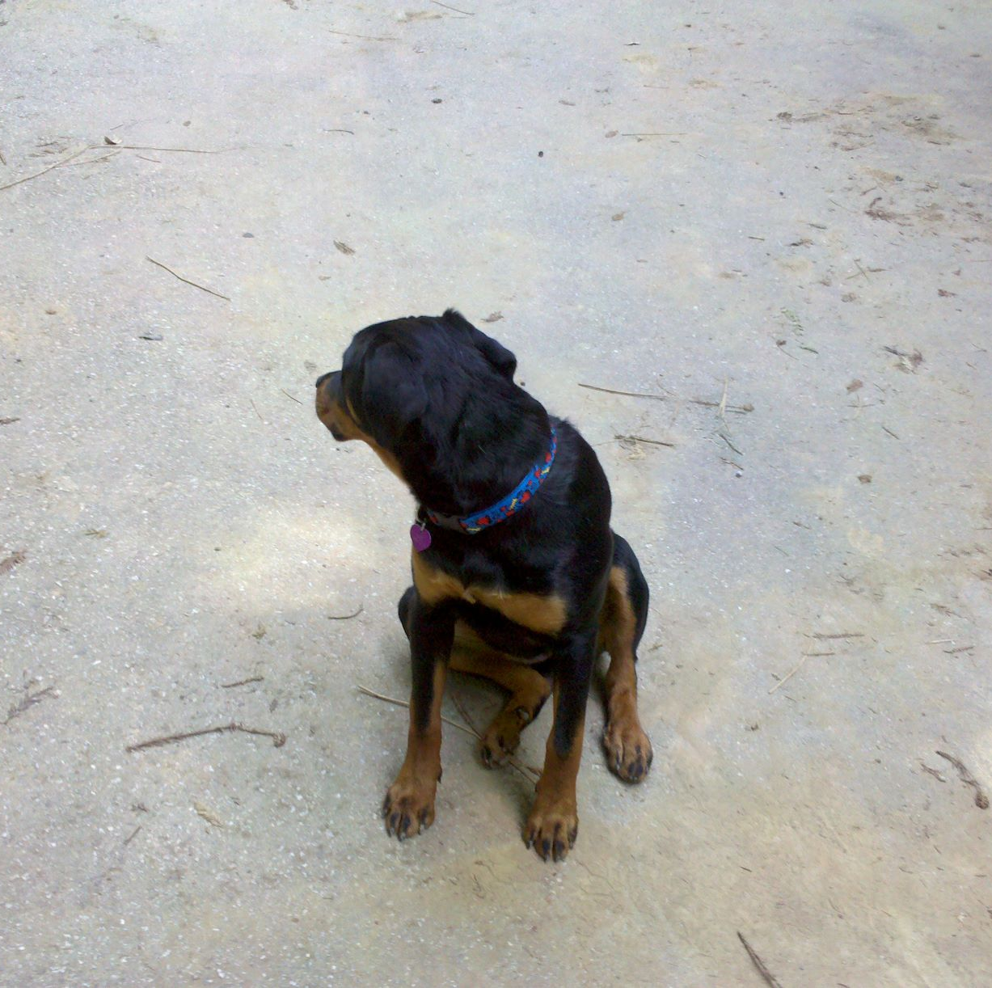
The End

