Slide 1
IEEE 802.11ah and IEEE 802.15.4g
SUN OFDM PHY Coexistence Simulation
Date: 2024-09-09
Authors:
Notice: This document has been prepared to assist IEEE 802.19. It is offered as a basis for discussion and is not binding on the contributing individual(s) or organization(s). The material in this document is subject to change in form and content after further study. The contributor(s) reserve(s) the right to add, amend or withdraw material contained herein.

Slide 2
Summary
Presentation to TG3a of simulation update for coexistence of IEEE 802.15.4g and IEEE 802.11ah using new simulation parameters for smart utility use cases.
  Case 1: This slide (IEEE 802.15.4g-OFDM PHY and IEEE 802.11ah)
  Case 2 – 3: Following meetings
This document gathers relevant material from 19-24/0018r0, 19-19/0019r1, 19-18/0056r3, 19-18/0039r1 and 19-19/0021r2.

Slide 3
Background: S1G Coexistence Simulations in TG3
Developed the coexistence simulator based on NS-3.23, which support IEEE 802.15.4g-FSK (400 KHz bandwidth) and IEEE 802.11ah (1 MHz bandwidth) for IEEE 802.19.3.
Extended this simulator to support IEEE 802.15.4-OFDM (400 KHz bandwidth) to evaluate IEEE 802.19.3a.
Simulation parameters and simulator deployment were discussed in TG3, and simulation results were also shared.
  19-24/0018r0, 19-19/0019r1, 19-18/0056r3, 19-18/0039r1 and 19-19/0019r2
FSK PHY (200 or 400 KHz)
OFDM PHY (200 or 400 KHz)
OFDM PHY (1 MHz, so far)
Simulation Model by NS-3

Slide 4
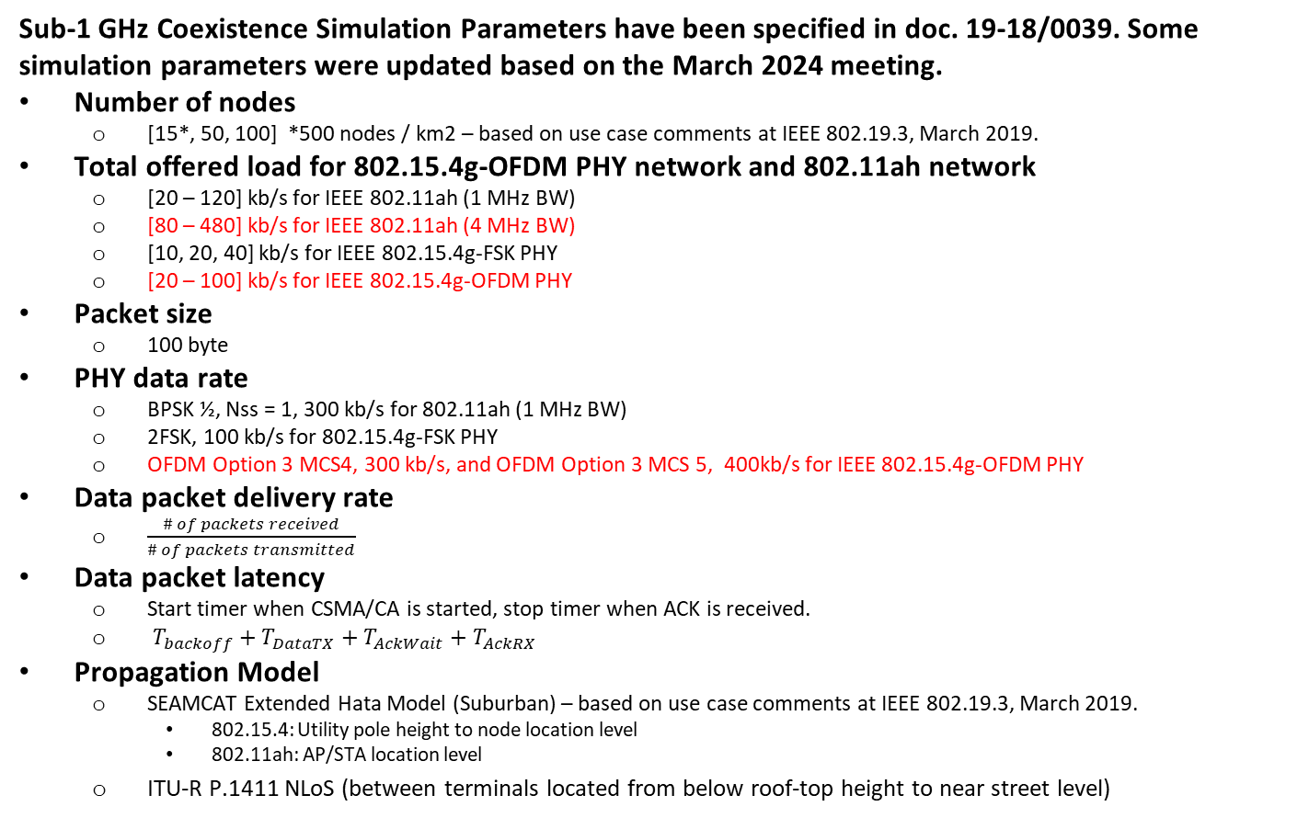
Simulation Parameters and Performance Metrics
Sub-1 GHz Coexistence Simulation Parameters have been specified in doc. 19-18/0039. Some simulation parameters were updated based on the March 2024 meeting.
Number of nodes
  [15*, 50, 100] *500 nodes / km2 – based on use case comments at IEEE 802.19.3, March 2019.
Total offered load for 802.15.4g-OFDM PHY network and 802.11ah network
  [20 – 120] kb/s for IEEE 802.11ah (1 MHz BW)
  [80 – 480] kb/s for IEEE 802.11ah (4 MHz BW)
  [10, 20, 40] kb/s for IEEE 802.15.4g-FSK PHY
  [20 – 100] kb/s for IEEE 802.15.4g-OFDM PHY
Packet size
  100 byte
PHY data rate
  BPSK ½, Nss = 1, 300 kb/s for 802.11ah (1 MHz BW)
  2FSK, 100 kb/s for 802.15.4g-FSK PHY
  OFDM Option 3 MCS4, 300 kb/s, and OFDM Option 3 MCS 5, 400kb/s for IEEE 802.15.4g-OFDM PHY
Data packet delivery rate
  $\frac{\# of packets received}{\# of packets transmitted}$
Data packet latency
  Start timer when CSMA/CA is started, stop timer when ACK is received.
  $T_{backoff}+T_{DataTX}+T_{AckWait}+T_{AckRX}$
Propagation Model
  SEAMCAT Extended Hata Model (Suburban) – based on use case comments at IEEE 802.19.3, March 2019.
    802.15.4: Utility pole height to node location level
    802.11ah: AP/STA location level
  ITU-R P.1411 NLoS (between terminals located from below roof-top height to near street level)

Slide 5
Node Deployment : 15 nodes (500 nodes/km2)*
802.11ah (AP/STA) #1
802.11ah (AP/STA) #2
802.11ah (AP/STA) #3
802.15.4g (PANC)
*
802.15.4g (NODE)
*Same condition discussed in TG3

Slide 6
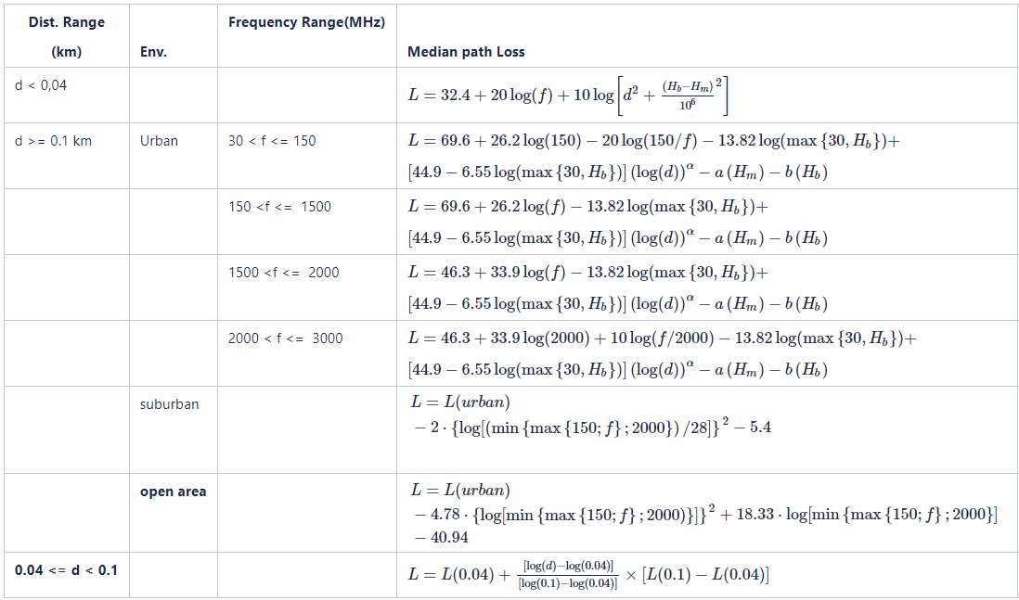

Propagation Model*
In consideration of device location, SEAMCAT Extended Hata Model (Suburban) was also added for simulation.
Device location
  802.15.4: Utility pole height to node location level
  802.11ah: AP/STA location level
SEAMCAT Extended Hata Model
ITU-R P.1411
Models for propagation between terminals located from below roof-top height to near street level
*Same condition discussed in TG3

Slide 7
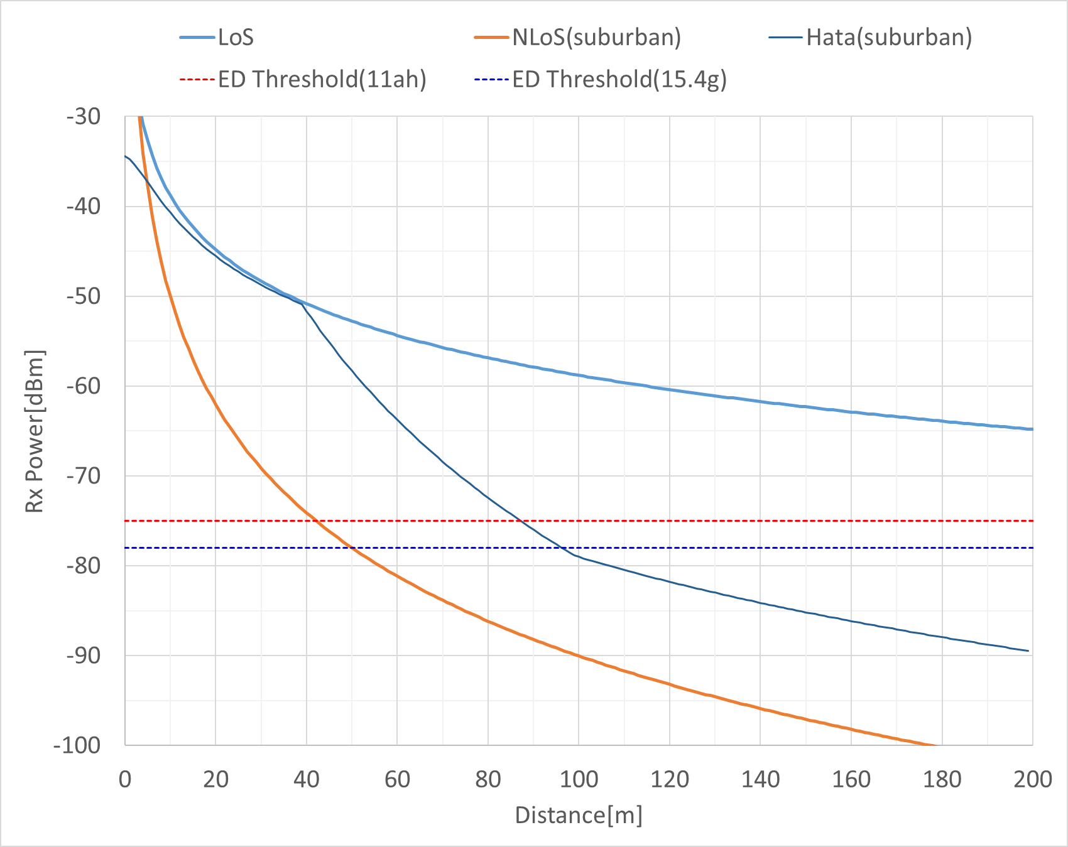
Propagation Model*
SEAMCAT Extended Hata Model (Suburban)
802.15.4g
*Same condition discussed in TG3

Slide 8
Simulation Matrix for TG3 and TG3a
4 types of PHY combination are possible.
Starting implementation in the following order.
Simulation for Case 1 has done for this meeting comparing to TG3 condition.
 | IEEE 802.11ah (1 MHz) | IEEE 802.11ah (4 MHz)
IEEE 802.15.4g-FSK PHY | ✓ (TG3) | (2)
IEEE 802.15.4g-OFDM PHY | (1) | (3)

Slide 9
Simulation Result (Case 1)
IEEE 802.11ah (1 MHz) - IEEE 802.15.4g-OFDM PHY
802.15.4g offered load is 10 kbps
When 802.11ah offered load is higher, only 802.15.4g delivery rate decreases, not only when FSK is used but also when OFDM is used.
When 802.11ah offered load is higher than 60 kbps, 802.11ah delivery rate does not decrease, but delay increases rapidly.

Slide 10
Simulation Result (Case 1)
IEEE 802.11ah (1 MHz) - IEEE 802.15.4g-OFDM PHY
802.15.4g offered load is 20 kbps
The trend is similar to the case of 802.15.4g offered load of 10 kbps.
802.15.4g delivery rate is lower than that of 802.15.4g offered load of 10 kbps.

Slide 11
Simulation Result (Case 1)
IEEE 802.11ah (1 MHz) - IEEE 802.15.4g-OFDM PHY
802.15.4g offered load is 40 kbps
802.11ah delivery rate is decreased when the 802.11ah offer load is higher than 60 kbps.
On the other hand, 802.15.4g delivery rate is significantly lower when the 802.15.4g offer load is higher than 20 kbps.

Slide 12
Simulation Result (Case 1)
IEEE 802.11ah (1 MHz) - IEEE 802.15.4g-OFDM PHY
802.15.4g offered load is 60 kbps
Even if 802.15.4g OFDM PHY is used, the delivery rate will not reach 100% even when 802.11ah interference is low due to the large overhead of 802.15.4g CSMA/CA.
With 802.11ah offered load below 60 kbps, the 802.11ah delivery rate is close to 100%.

Slide 13
Simulation Result (Case 1)
IEEE 802.11ah (1 MHz) - IEEE 802.15.4g-OFDM PHY
802.15.4g offered load is 100 kbps
The 802.15.4g delivery rate is at most 30% even with OFDM PHY due to 802.15.4g CSMA/CA overhead.
The delivery rate for 802.11ah is about 70% when the 802.11ah offered load is 100 kbps. 802.15.4g delivery rate is 10%.

Slide 14
Summary
802.11ah impacts 802.15.4g SUN OFDM PHY packet delivery
802.15.4g SUN OFDM PHY impacts 802.11ah packet latency
802.11ah packet latency is unbounded
  CCA is required in each backoff slot
  Backoff counter decreases only if the channel is idle
802.15.4g packet latency is bounded
  CCA is not required during random backoff period
  CCA is performed after random backoff period
We would like the IEEE 802.19.3a to continue the discussion of simulation as inputs for Recommended Practice
  Future Plan:
    Case 2 in November
    Case 3 in January
    Suspendable CSMA/CA of IEEE 802.15.4me feature under coexistence situation.

