Slide 1
IEEE 802.19 WG Introduction
Date: 2025-01-10
Authors:
Name | Affiliations | email
Tuncer Baykas | Ofinno | tbaykas@ieee.org
Notice: This document has been prepared to assist IEEE 802.19. It is offered as a basis for discussion and is not binding on the contributing individual(s) or organization(s). The material in this document is subject to change in form and content after further study. The contributor(s) reserve(s) the right to add, amend or withdraw material contained herein.

Slide 2
IEEE 802.19 Working Group Introduction
Tuncer Baykas
IEEE 802 Wireless Interim Standard Workshop Kobe

Slide 3





IEEE 802.19 Chair
IEEE 802 Public Visibility SC Chair
IEEE TAB COS Member
IEEE Region 8 Standards Committee Member
IEEE Türkiye Vice Chair
IEEE Türkiye Comsoc Chair

Slide 4
IEEE 802.19 Working Group
IEEE 802.19 group reviews coexistence assessment documents (CAD) produced by working groups developing new wireless standards for unlicensed devices.
IEEE 802.19 develops standards for coexistence between wireless standards of unlicensed devices.
IEEE 802.19 has 53 voters.
Position | Person
Working Group Chair | Tuncer Baykas (Ofinno)
Working Group Vice Chair | Steve Shellhammer (Qualcomm)
Work Group Secretary | Yukimasa Nagai (Mitsubishi Electric)
Task Group 3a Chair | Ben Rolfe (Blind Creek Associates)

Slide 5
Coexistence Assurance Document
The Coexistence Assurance Document shall address coexistence with all relevant active IEEE 802 LMSC wireless standards specifying devices for unlicensed operation. The Working Group should consider other specifications in their identified target band(s) in the CA document.
The IEEE 802.19 Working Group shall have one vote in Working Group letter ballots that include Coexistence Assurance Document. The IEEE 802.19 Working Group evaluates the Coexistence Assurance Document, and submits comments on the CA document to the WG letter ballot.

Slide 6
802.19 WG Published Standards
  In 2014 the standard entitled “IEEE Std 802.19.1-2014: TV White Space Coexistence Methods” is published, which enables effective use of TV White Spaces by standards via coexistence methods.
  In 2017 the amendment “IEEE Std 802.19.1a-2017: Coexistence Methods for Geo-location Capable Devices Operating under General Authorization” is published.
  In 2018 name changed to: “IEEE Std 802.19.1-2018: Wireless Network Coexistence Methods”
  In 2021 recomended practice “IEEE Std 802.19.3-2021: Coexistence Methods for IEEE 802.11 and IEEE 802.15.4 Based Systems Operating in the Sub 1 GHz Frequency Bands” is published.

Slide 7
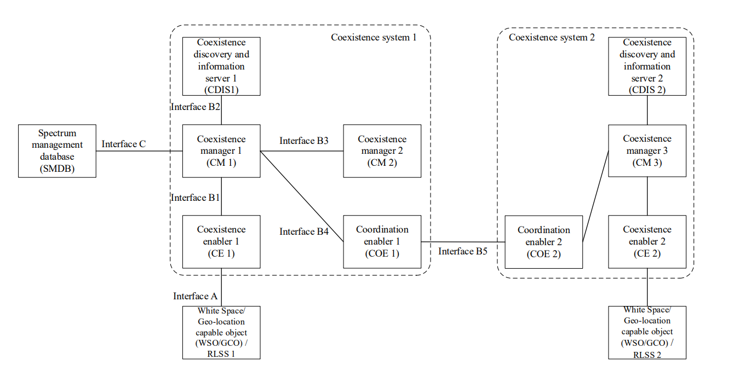
IEEE Std 802.19.1-2018:
Wireless Network Coexistence Methods
The standard is defined for geolocation-capable devices operating under general authorization such as television white spaces (TVWS), the 5 GHz license-exempt bands, and the general authorized access in the 3.5 GHz Bands.

Slide 8
IEEE Std 802.19.1-2018:
Wireless Network Coexistence Methods
  The coexistence discovery and information server (CDIS) provides coexistence discovery service to the coexistence managers (CMs) it serves. Within this service the CDIS informs the CMs about potential neighbors of the white space/geolocation-capable objects (WSOs/GCOs) served by these CMs.
  The CM provides either information or management service to the WSOs/GCOs it serves. Communication between the CM and the WSOs/GCOs is performed via their coexistence enablers (CEs).
  The coordination enabler (COE) is an interface element that represents one or more CMs to communicate with the other COE in another independent coexistence system.

Slide 9
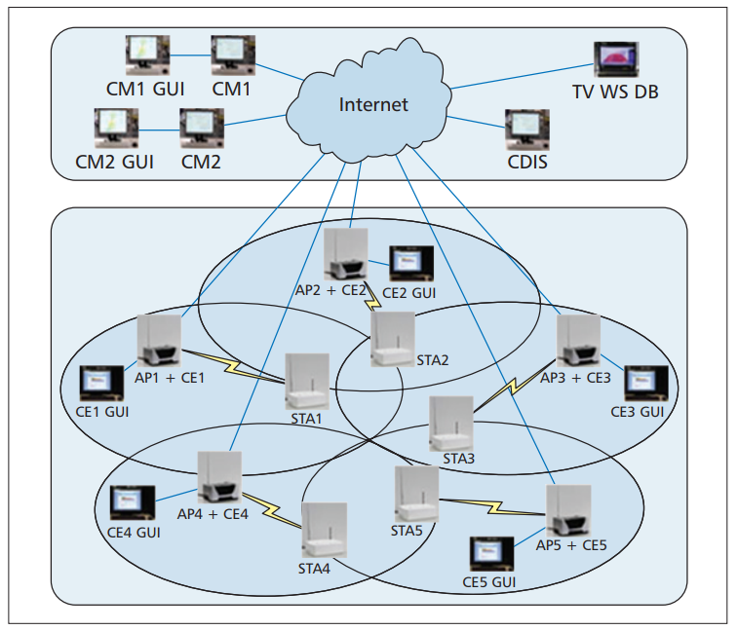
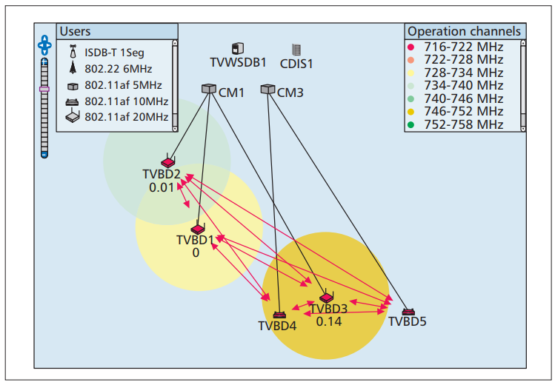
Implementation Example
S. Filin, T. Baykas, H. Harada, F. Kojima and H. Yano, "IEEE Standard 802.19.1 for TV white space coexistence," in IEEE Communications Magazine, vol. 54, no. 3, pp. 22-26, March 2016

Slide 10
IEEE Std 802.19.3-2021: Coexistence Methods for
IEEE 802.11 and IEEE 802.15.4 Based Systems Operating in the Sub 1 GHz Frequency Bands
This recommended practice enables IEEE Std 802.15.4 and IEEE Std 802.11ah to effectively operate in license exempt sub-1 GHz frequency bands by providing best practices and coexistence methods.
This recommended practice uses existing features of the referenced standards and provides guidance to implementers and users of IEEE 802® wireless standards.
J. Guo et al., "IEEE 802.19.3 Coexistence Recommendations for IEEE 802.11 and IEEE 802.15.4 Based Systems Operating in SUB-1 GHz Frequency Bands," in IEEE Communications Standards Magazine, vol. 7, no. 2, pp. 72-82,

Slide 11
Sub 1 GHz Band and Standards
Sub 1 GHz bands are well suited for IOT applications, thanks to their range. However frequency band allocation is region dependent, for example, 902–928 MHz band in the United States and 863-868 MHz band in Europe. 915-928 MHz band has been identified for use in Japan.
IEEE 802.15.4g was developed to address applications in a smart utility network (SUN) with modest data volume requirements, high tolerance to latency, and a requirement for ubiquitous and reliable delivery.
IEEE 802.11ah defines an OFDM PHY with a minimum 1 MHz channel spacing. This makes it suitable for IoT applications. 802.11ah introduces several features, such as restricted access window (RAW) for spectrum efficiency and power efficiency.
SIGFOX and LORA are other standards operating in Sub 1 GHz.

Slide 12
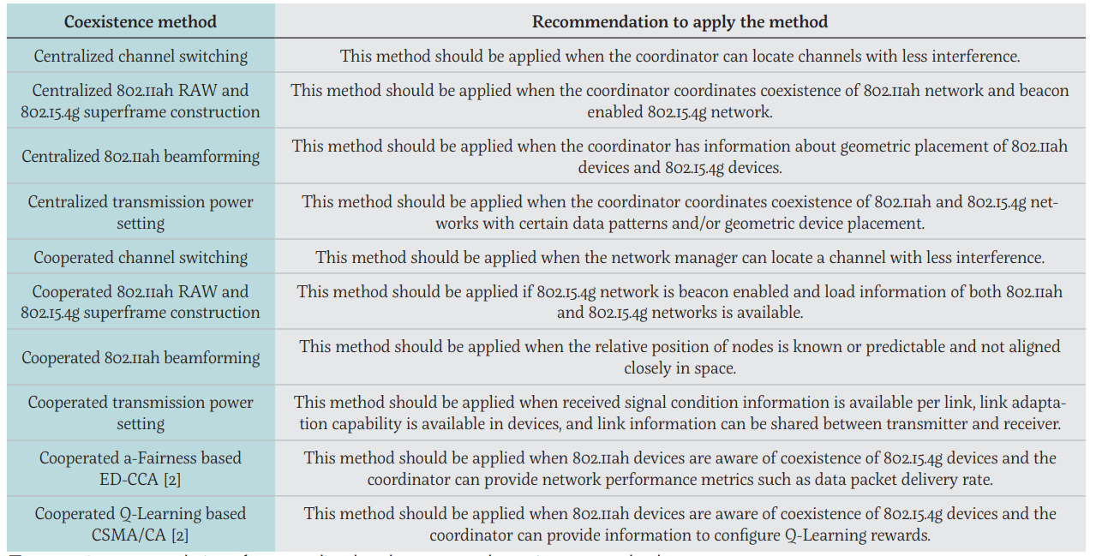
Centralized and cooperated coexistence methods

Slide 13
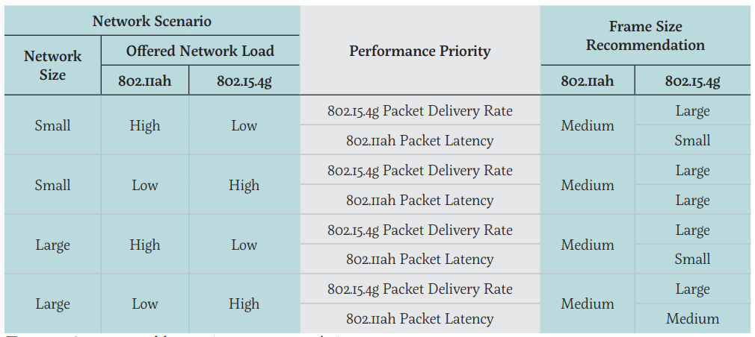
Frame size recommendations

Slide 14
What are the members of 802.19 doing now?
802.19.3a Task Group to amend IEEE 802.19.3.
This amendment updates and expands coexistence recommendations to address new market requirements, increasing data traffic, greater device density of devices, and increased potential for congestion based on both IEEE Std 802.11-2020 and IEEE Std 802.15.4 sub-1 GHz standards.
Task Group Chair | Benjamin Rolfe
Task Group Technical Editor | Shoichi Kitazawa
Task Group Vice Chair | Kazuto Yano
Task Group Vice Chair | Joerg Robert
Task Group Recording Secretary | Yukimasa Nagai

Slide 15
Some presentations in the Task Group
19-24/0038, “Measurement results of radio noise over Sub-1 GHz band emitted from mini PC and laptop PC” Kazuni Yato et. al.
19-24/0032,“IEEE 802.11ah and IEEE 802.15.4g SUN OFDM PHY Coexistence Simulation” Takenoro Sumi et. al
19-24/0016,“ Interference Spectrum Measurements” Joerg Robert

Slide 16
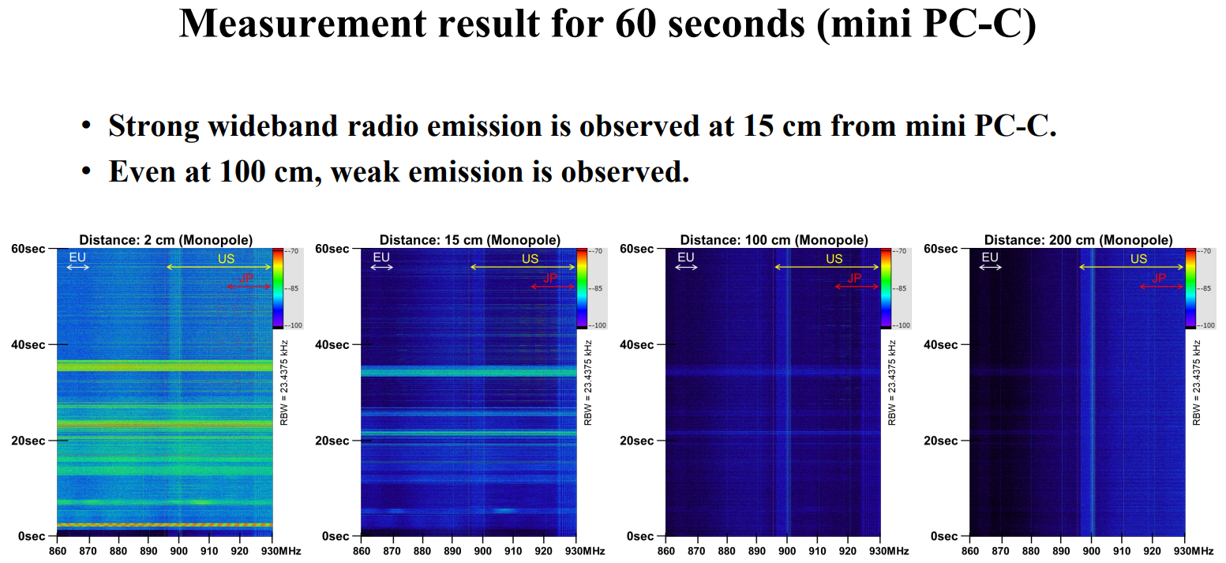
Measurement results of radio noise over Sub-1 GHz band emitted from mini PC and laptop PC” Kazuni Yato et. al.

Slide 17

Public Visibility SC Activities of IEEE 802
    IEEE 802 has a linkedin page
    LinkedIn – https://www.linkedin.com/company/ieee802

Slide 18
How to participate?
All 802.19 related documents
https://mentor.ieee.org/802.19/documents
Presentation of your results to the group online or in person
tbaykas@ieee.org

