Slide 1
TG 19.3a Agenda and Meeting Slides
March 2025
Date: 2025-01-11
Authors:
Name | Affiliations | email
Benjamin Rolfe | BCA, MERL | Ben.rolfe @ ieee.org
Notice: This document has been prepared to assist IEEE 802.19. It is offered as a basis for discussion and is not binding on the contributing individual(s) or organization(s). The material in this document is subject to change in form and content after further study. The contributor(s) reserve(s) the right to add, amend or withdraw material contained herein.

Slide 2
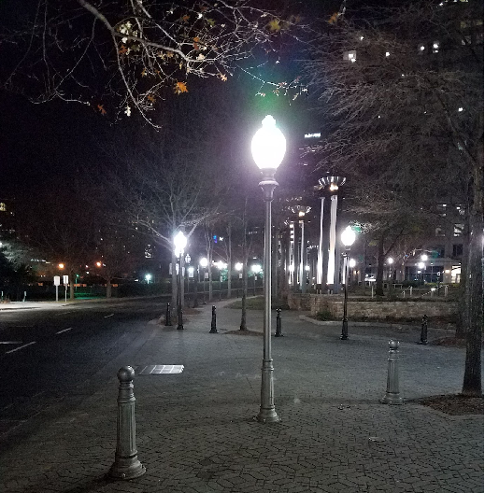
Tg19.3a
802 Plenary Session, March 2025
Atlanta, GA, USA
And remotely world-wide

Slide 3
Project Overview
PAR approved: https://development.standards.ieee.org/myproject-web/app#viewpar/14995/11032
Scope of the project: This amendment updates and expands coexistence recommendations to address new market requirements, increasing data traffic, greater device density of devices, and increased potential for congestion based on both IEEE Std 802.11-2020 and IEEE Std 802.15.4 sub-1 GHz standards. This amendment includes recommendations with respect to new devices, as well as compatibility with deployed legacy devices.

Slide 4
Proposed Focus for March
Continue information gathering and sharing
Review technical requirements and conditions driving new and updated recommendations
  Significant changes in regulations and expected conditions
  New features available in each standard
  New coexistence methods
Consider technical proposals for recommendations
  Recommendations to change
  New recommendations
  New coexistence strategies and methods

Slide 5
TG Overview
1 | Task Group Chair | Benjamin Rolfe
2 | Task Group Technical Editor | Shoichi Kitazawa
3 | Task Group Vice Chair | Kazuto Yano
4 | Task Group Vice Chair | Joerg Robert
5 | Task Group Recording Secretary | Yukimasa Nagai

Slide 6
Agenda
 | Topic | Presenter | Time
 | Monday 11-November
1 | Intro and overhead | Chair | 00:05
1.1 | Agenda Review | Chair | 00:05
1.2 | Approval of minutes | Chair | 00:05
2 | Technical Contributions and Discussion
2.1 | Ideas and Discussions on IEEE 802.19.3a Recommended Practice | Jianlin Guo | 00:30
2.2 | Follow up on measurement of radio noise over Sub-1 GHz band emitted from mini PC and laptop PC, and its impact on communication performance of IEEE 802.11ah | Kazuto Yano | 00:30
3 | Recess

Slide 7
Agenda
 | Topic | Presenter | Time
3 | Recess
4 | Thursday 14-November
5 | Opening reminders and Agenda review | Chair | 00:05
6 | Technical Contributions and Discussion
6.1 | Additional simulations for coexistence | Takenori Sumi | 00:30
6.2 | Experimental results using IEEE 802.11ah and IEEE 802.15.4g | Takenori Sumi | 00:30
6.3 | More measurement updates | Jorge Robert | 00:10
6.4 | Updated features in 802.15.4 | Ben Rolfe | 00:30
7 | Next Steps | Chair | 00:05
8 | Aob |  | 00:10
9 | Adjourn

Slide 8

Recess

Slide 9

Next Steps

Slide 10
Near Term Milestones
PAR Approval
Officer appointment
Call for contributions for May 2024 Wireless interim
Collect background information
  Use cases
  Technical constraints and characteristics
  Supporting data (simulation, measurements)
    Simulation planned
    Empirical studies planned
Develop technical content

Slide 11
Any Other Business?

Slide 12

Adjourn

