Slide 1
OFDM Windowing for Improved Reception Performance
Date: 2025-03-13
Authors:
Notice: This document has been prepared to assist IEEE 802.19. It is offered as a basis for discussion and is not binding on the contributing individual(s) or organization(s). The material in this document is subject to change in form and content after further study. The contributor(s) reserve(s) the right to add, amend or withdraw material contained herein.

Slide 2
Motivation
The sub-GHz bands are getting more and more crowded
Some systems do not use LBT, resulting in unavoidable interference
The effect of narrow-band interference on OFDM systems can be reduced significantly using optimized receivers without any need to change the standard

Slide 3
“Classical” OFDM Reception
Classical reception and synchronization of OFDM is e.g. described in [2]
Cylic
Prefix
“Useful” Part
Time
FFT

Slide 4
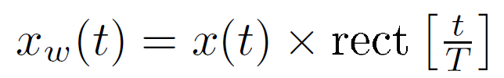
What is the Problem ( I / III )?
Cutting out the “useful” part out of the time signal is a windowing function
The classical window is a rectangular window
In the frequency domain after the FFT we get
As the payload data is also a fu function the window-sinc function has no effect

Slide 5

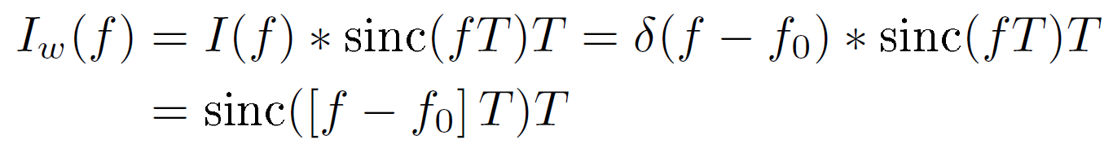
What is the Problem ( II / III )?
We now have a narrow-band interfering signal
After the FFT we get the following spectrum
Depending on the frequency f₀ of the narrow-band interferer we get a sinc-function added on the payload data

Slide 6
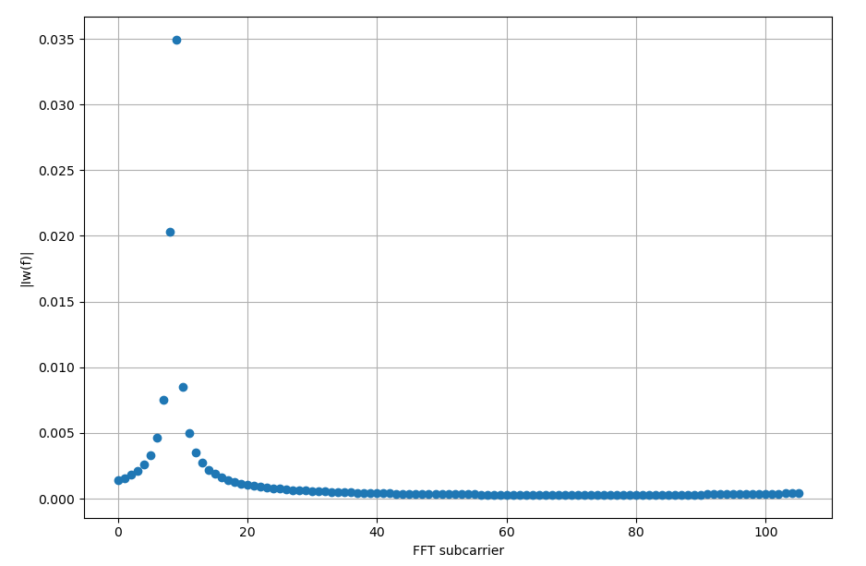
What is the Problem ( III / III )?
Example for 802.15.4g OFDM with N=128 and 106 active carriers
The narrow-band interferer spreads out

Slide 7
“Windowed” OFDM Reception ( I / III )
OFDM symbol is cut out with Nyquist roll-off [1]
The data is stuffed with zeros to match 2 times the FFT
Only the first half of the carriers are used
Cylic
Prefix
“Useful” Part
Time
2xFFT

Slide 8
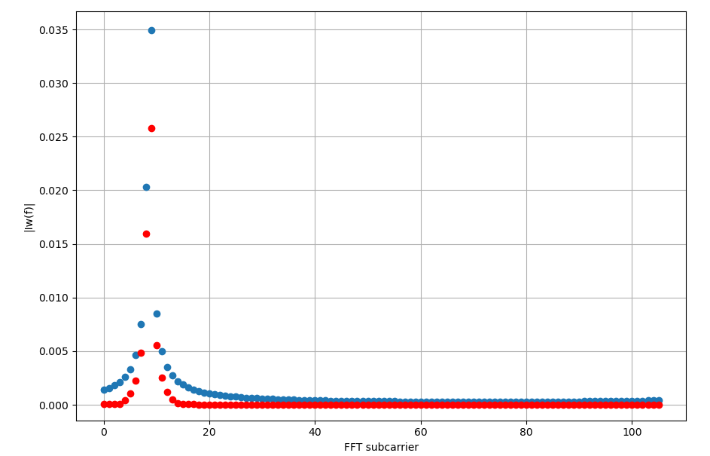
“Windowed” OFDM Reception ( II / III )
Effect of narrow-band interferer with (red) and without windowing (blue)
Interferer remains more localized

Slide 9
“Windowed” OFDM Reception ( III / III )
The interfered OFDM sub-carriers still have to be detected and the data recovered by means of the forward error correction
A longer the Nyquist roll-off leads to a better localization of the interferer
BUT
This also consumes the useable cyclic prefix
Optimization required, e.g. as proposed in [3] for mobile reception
The use of the Nyquist roll-off does not have to be specified in the standard, but a sufficient cyclic prefix length is required

Slide 10
References
[1] C. Muschallik, "Improving an OFDM reception using an adaptive Nyquist windowing," in IEEE Transactions on Consumer Electronics, vol. 42, no. 3, pp. 259-269, Aug. 1996
[2] M. Speth, S. Fechtel, G. Fock and H. Meyr, "Optimum receiver design for OFDM-based broadband transmission .II. A case study," in IEEE Transactions on Communications, vol. 49, no. 4, pp. 571-578, April 2001
[3] J. Robert, J. Zoellner and M. Slimani, "Adaptive Windowing for OFDM with Dense Subcarrier Spacing in Mobile Channels," OFDM 2012; 17th International OFDM Workshop 2012 (InOWo'12), Essen, Germany, 2012

