Slide 1
Plan of coexistence experiment between IEEE 802.15.4g and IEEE 802.11ah systems
Date: 2025-05-15
Authors:
Notice: This document has been prepared to assist IEEE 802.19. It is offered as a basis for discussion and is not binding on the contributing individual(s) or organization(s). The material in this document is subject to change in form and content after further study. The contributor(s) reserve(s) the right to add, amend or withdraw material contained herein.

Slide 2
Introduction
To confirm what happens when IEEE 802.11ah and IEEE 802.15.4g SUN PHYs coexist, some simulation has been conducted [1].
In addition, an initial coexistence experiment between IEEE 802.11ah and IEEE 802.15.4g systems has been conducted [2]. Through this experiment, it was confirmed that IEEE 802.11ah communications can cause performance degradation of IEEE 802.15.4g communications.
This contribution shows further experimental plan to support the simulation results in several conditions for developing IEEE 802.19.3a Recommended Practice.

Slide 3
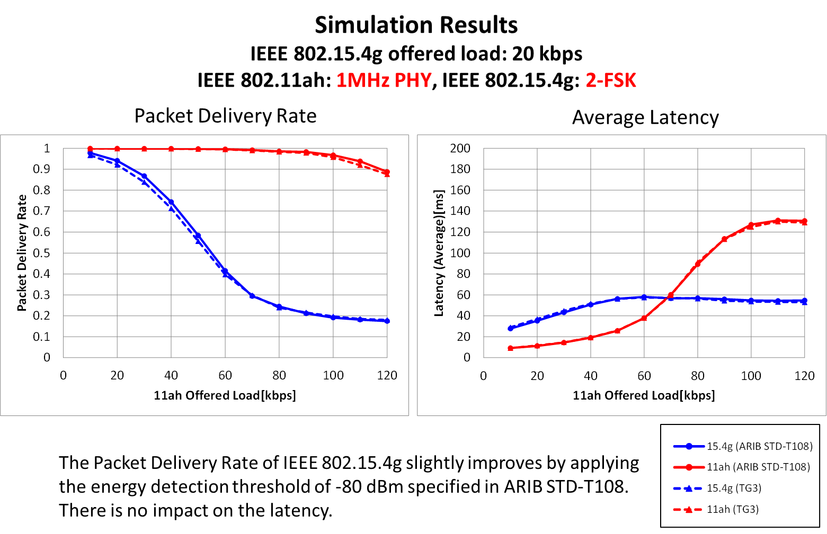
Example of simulation results in [1]
Packet delivery rate and latency are evaluated with different offered load of IEEE 802.15.4g and/or IEEE 802.11ah systems.

Slide 4
Plan for new experiment
To confirmed the performance trends observed through the simulations, we plan to conduct further experiment in an anechoic chamber with different configurations of IEEE 802.15.4g and IEEE 802.11 systems.
Performance metric: The following performance of UDP traffic.
  Packet delivery rate
  Average latency

Slide 5
Layout plan for experiment
We plan to conduct further experiment in an anechoic chamber. A layout plan of IEEE 802.15.4g and IEEE 802.11ah systems are shown below.
  One PANC/AP and two NODEs/STAs are employed for each system.
IEEE 802.15.4g
PANC
IEEE 802.11ah
AP
5 m
5 m
5 m
IEEE 802.15.4g
NODE
IEEE 802.11ah
STA
1.5 m
1.5 m

Slide 6
Combinations of PHY and MAC configurations to be evaluated
Two types of PHY (FSK PHY and OFDM PHY) are listed as possible PHY configurations for IEEE 802.15.4g in [3].
Two types of channel access mechanism (normal CSMA/CA and suspendable-CSMA/CA) have been evaluated through simulations [4].
Two bandwidth (1 MHz and 4 MHz) are listed as possible PHY configurations for IEEE 802.11ah in [3]. In the simulations in [1], Nss = 1 and MCS 0 were assumed.

Slide 7
Combinations of PHY and MAC configurations to be evaluated (cont.)
Therefore, we should conduct experiment with the combinations of PHY/MAC features in the table shown below.
We plan to conduct experiments for the combinations indicated by “X”. (The other combination depends on the availability of devices.)
PHY/MAC features of IEEE 802.15.4g |  | Bandwidth of IEEE 802.11ah
PHY of IEEE 802.15.4g | Channel access mechanism of IEEE 802.15.4g | 1 MHz | 4 MHz
FSK-PHY | Normal CSMA/CA | X | X
 | Suspendable-CSMA/CA | X | X
OFDM-PHY | Normal CSMA/CA | X | X
 | Suspendable-CSMA/CA | If devices are available. | If devices are available.

Slide 8
PHY Parameters for experimental evaluation
In the conducted simulations, following PHY configurations MCSs for IEEE 802.15.4g PHY are used [1].
  IEEE 802.15.4g PHY MCS
    2-FSK (400 kHz)
    Option 3 (400 kHz): OFDM MCS 4
    Option 3 (400 kHz): OFDM MCS 5
  IEEE 802.15.4g PHY MCS: MCS 0
  Transmission power: 13 dBm
We plan to use the same MCS configurations in the new experimental evaluation.
  Transmission power will be set to the minimum level of used equipment due to the difference of the size of the evaluation area between in the simulation and experiment.

Slide 9
Plan of channel configurations
A plan of channel configurations for IEEE 802.15.4g and IEEE 802.11ah systems are shown below. The frequency channel of IEEE 802.15.4g will be set to overlap the spectra of IEEE 802.15.4g and IEEE 802.11ah each other.
For 1 MHz IEEE 802.11ah
For 4 MHz IEEE 802.11ah
IEEE 802.15.4g
(Center: 924.1 MHz))
IEEE 802.15.4g
(Center: 924.6 MHz))
IEEE 802.11ah
(Center: 924.5 MHz)
IEEE 802.11ah
(Center: 924.0 MHz)
Freq.
Freq.

Slide 10
Parameters of IEEE 802.15.4g MAC for experimental evaluation
In the simulations in [1], following MAC parameters for IEEE 802.15.4g MAC are evaluated. We plan to use the same configurations in the new experiment.
  macMinBe: 3
  macMaxBe: 5
  BE: [macMinBe, macMaxBe]
  RetryLimit: 4
    RetryLimit was set to 20 in the initial experiment [2]. In the new experiment, we will set to the same value in [1] to comply with the simulations.
  Backoffs: 4
  CW: 1

Slide 11
Parameters of IEEE 802.11ah MAC for experimental evaluation
In the simulations, following parameters for IEEE 802.11ah MAC are evaluated through the simulations [1]. We plan to use the same configurations in the new experiment.
  CWmin: 15
  CWmax: 1023
  CW: [CWmin, CWmax]
  RetryLimit: 7

Slide 12
Parameters of data traffic for experimental evaluation
Simulation parameters of data traffic used in [1] are as follows.
  Total offered load:
    IEEE 802.15.4g-FSK PHY : {10, 20, 40} kb/s
    IEEE 802.15.4g-OFDM PHY : [20 – 100] kb/s
    IEEE 802.11ah (1 MHz bandwidth) : [20 – 120] kb/s
    IEEE 802.11ah (4 MHz bandwidth) : [80 – 480] kb/s
  Packet size: 100 Bytes
We plan to use similar configurations in the new experiment.
  Total offered load:
    IEEE 802.15.4g: [10 – 40] kb/s (both for FSK PHY and OFDM PHY)
    IEEE 802.11ah: [10 – 120] kb/s (for 1 MHz), [40 – 480] kb/s (for 4 MHz)
  Packet size: 100 Bytes, 200 Bytes (200 Bytes are added to confirm the trend of the simulation results described in the IEEE 802.19.3 Recommended Practice.)

Slide 13
Summary
We plan to conduct to further experimental evaluation of the impact of the coexistence of IEEE 802.15.4g and IEEE 802.11ah systems on the communication performances of these systems.
This contribution showed the planned PHY/MAC configurations of both systems, node layout and traffic configurations for the new experiment.

Slide 14
Reference
[1] doc. IEEE 802.19-25/0018r1
[2] doc. IEEE 802.19-25/0019r0
[3] doc. IEEE 802.19-24/0018r0
[4] doc. IEEE 802.19-25/0006r0

