Slide 1
Summary of Coexistence Simulation Evaluation for IEEE 802.11ah and IEEE 802.15.4g
Date: 2025-5-15
Authors:
Notice: This document has been prepared to assist IEEE 802.19. It is offered as a basis for discussion and is not binding on the contributing individual(s) or organization(s). The material in this document is subject to change in form and content after further study. The contributor(s) reserve(s) the right to add, amend or withdraw material contained herein.

Slide 2
Summary
Presentation to TG3a of simulation evaluation for coexistence of IEEE 802.15.4g and IEEE 802.11ah using new simulation parameters for smart utility use cases.
This document summarizes the simulation results reported to TG3a to date, including 19-19/0019r0, 19-18/0056r3, 19-24/0032r0, 19-24/0042r1 and 19-25/0006r0.
This document gathers relevant material from 19-24/0018r0 and 19-18/0039r1 for simulation conditions and use cases.

Slide 3
Background: S1G Coexistence Simulations in TG3
Developed the coexistence simulator based on NS-3.23, which support IEEE 802.15.4g-FSK (400 KHz bandwidth) and IEEE 802.11ah (1 MHz bandwidth) for IEEE 802.19.3.
Extended this simulator to support IEEE 802.15.4-OFDM (400 KHz bandwidth) and IEEE 802.11ah (4MHz bandwidth) to evaluate IEEE 802.19.3a.
Simulation parameters and simulator deployment were discussed in TG3.
  [19-18/0039r1] Steve Shellhammer, “Sub-1GHz Coexistence Simulation Parameters”
  [19-19/0021r2] Yukimasa Nagai, “S1G Coexistence Simulation Profile”
  [19-18/0071r0] Takenori Sumi, “Sub-1GHz Coexistence Simulation Models Update”
Simulation parameters were updated in TG3a.
  [19-24/0018r0] Yukimasa Nagai, “Simulation Parameter Update for S1G Bands OFDM systems”
Simulation results were also shared in TG3.
  19-19/0019r1, 19-18/0056r3

Slide 4
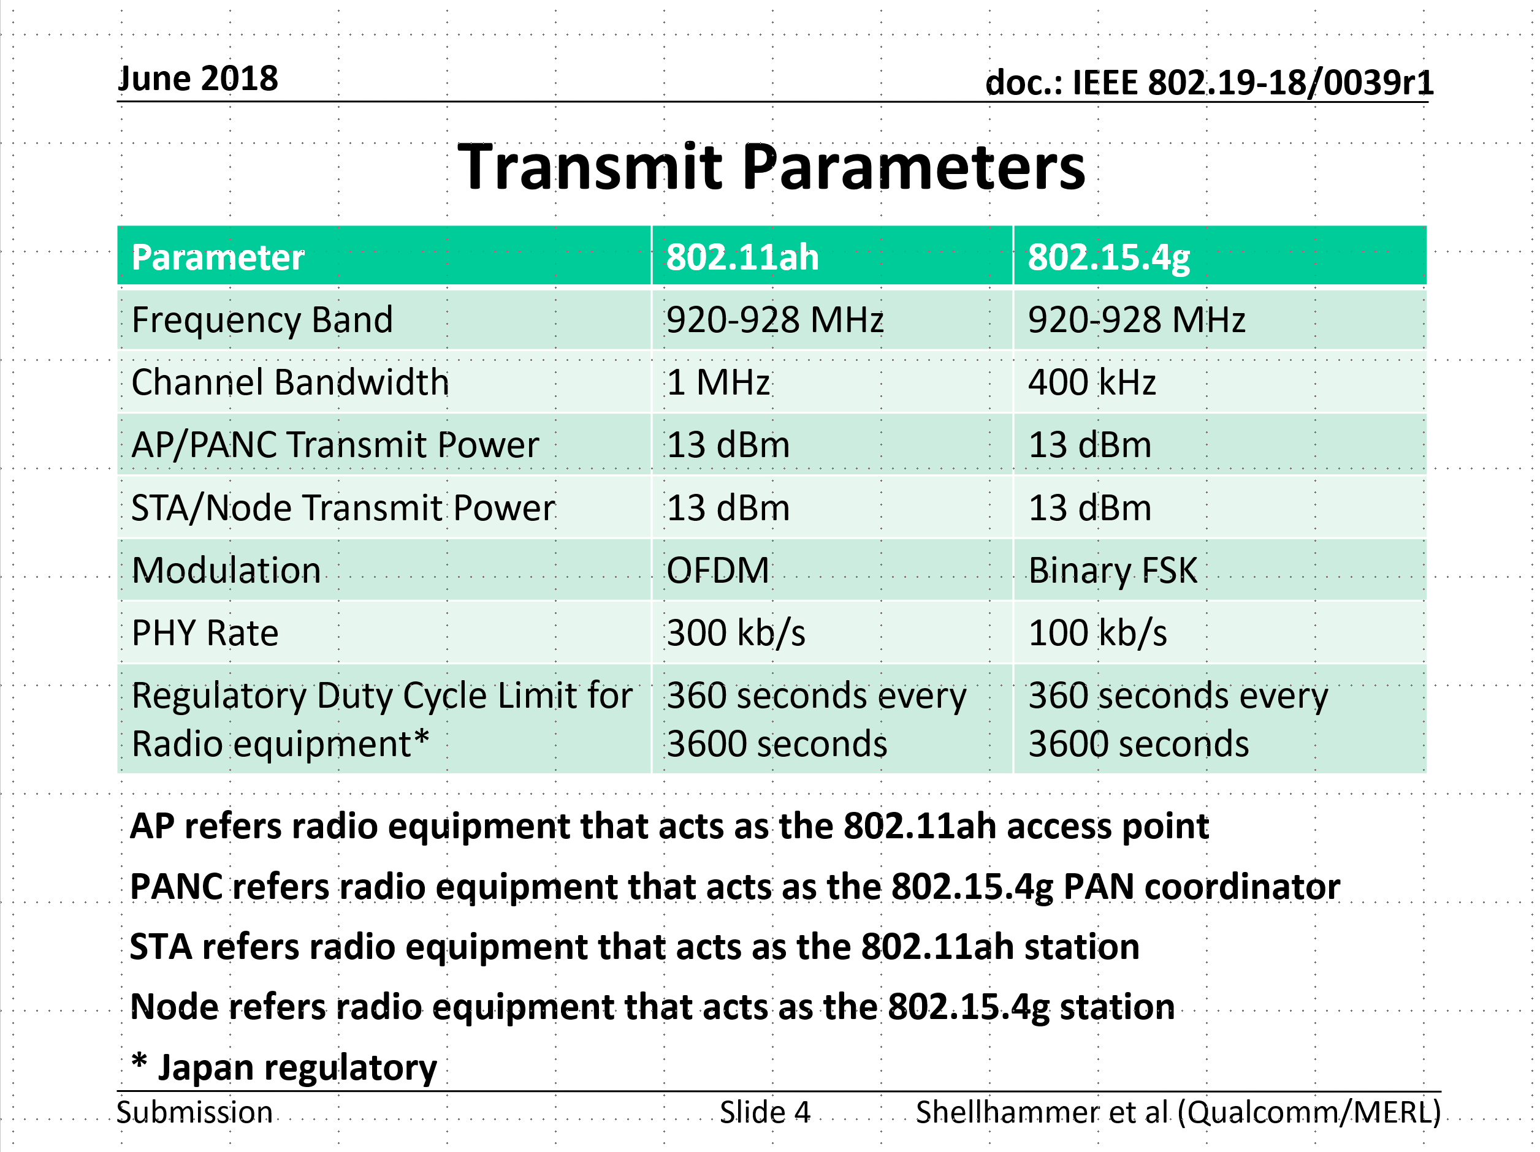
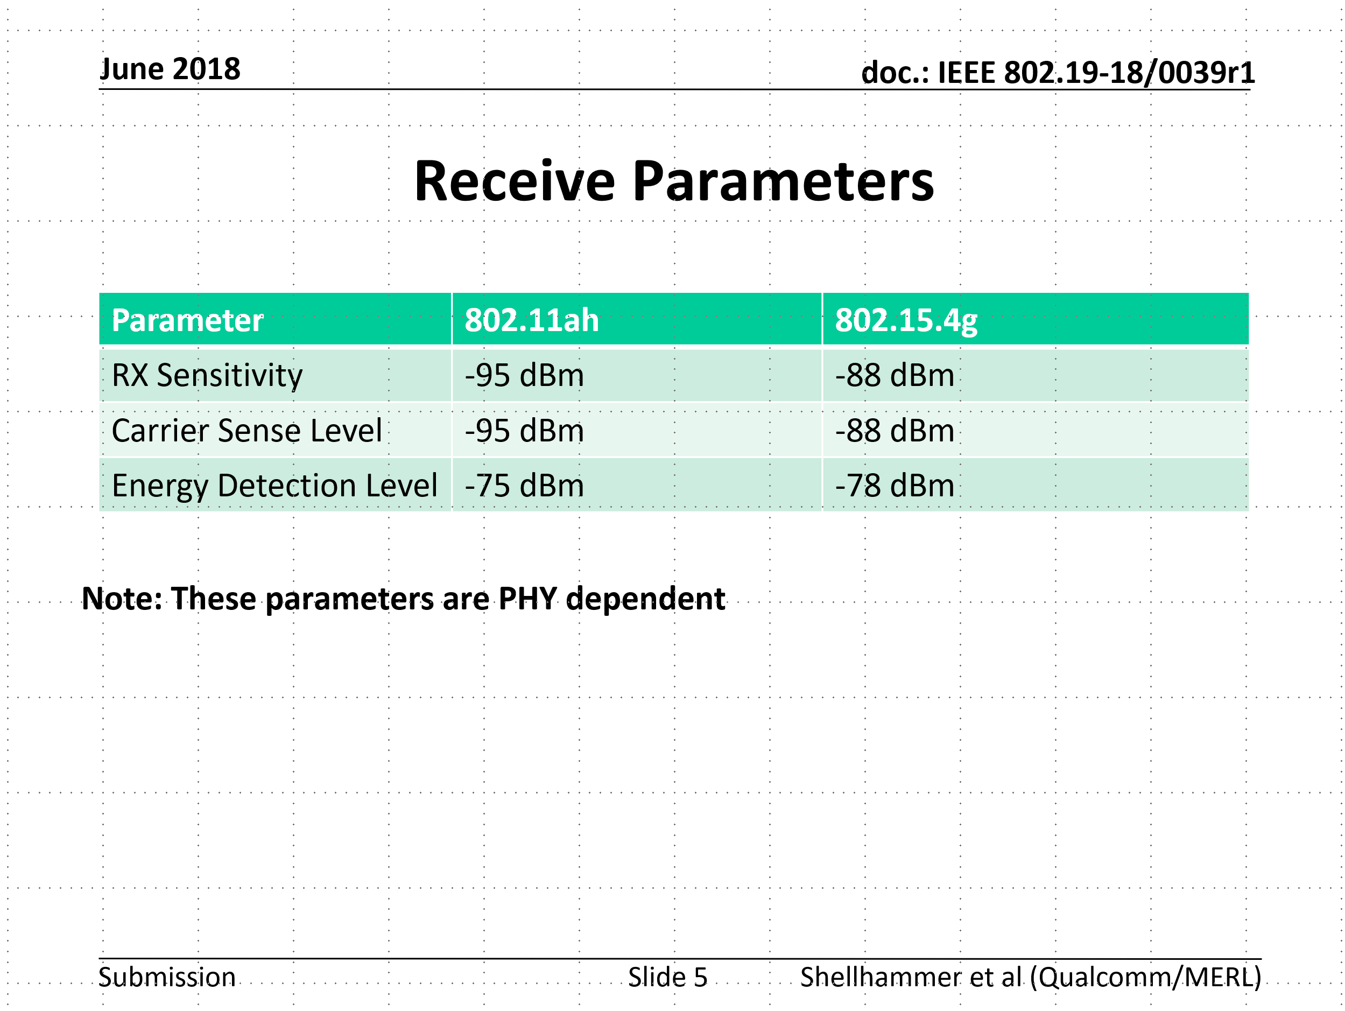
Simulation parameters discussed in TG3
Refer to 19-18/0039r1

Slide 5
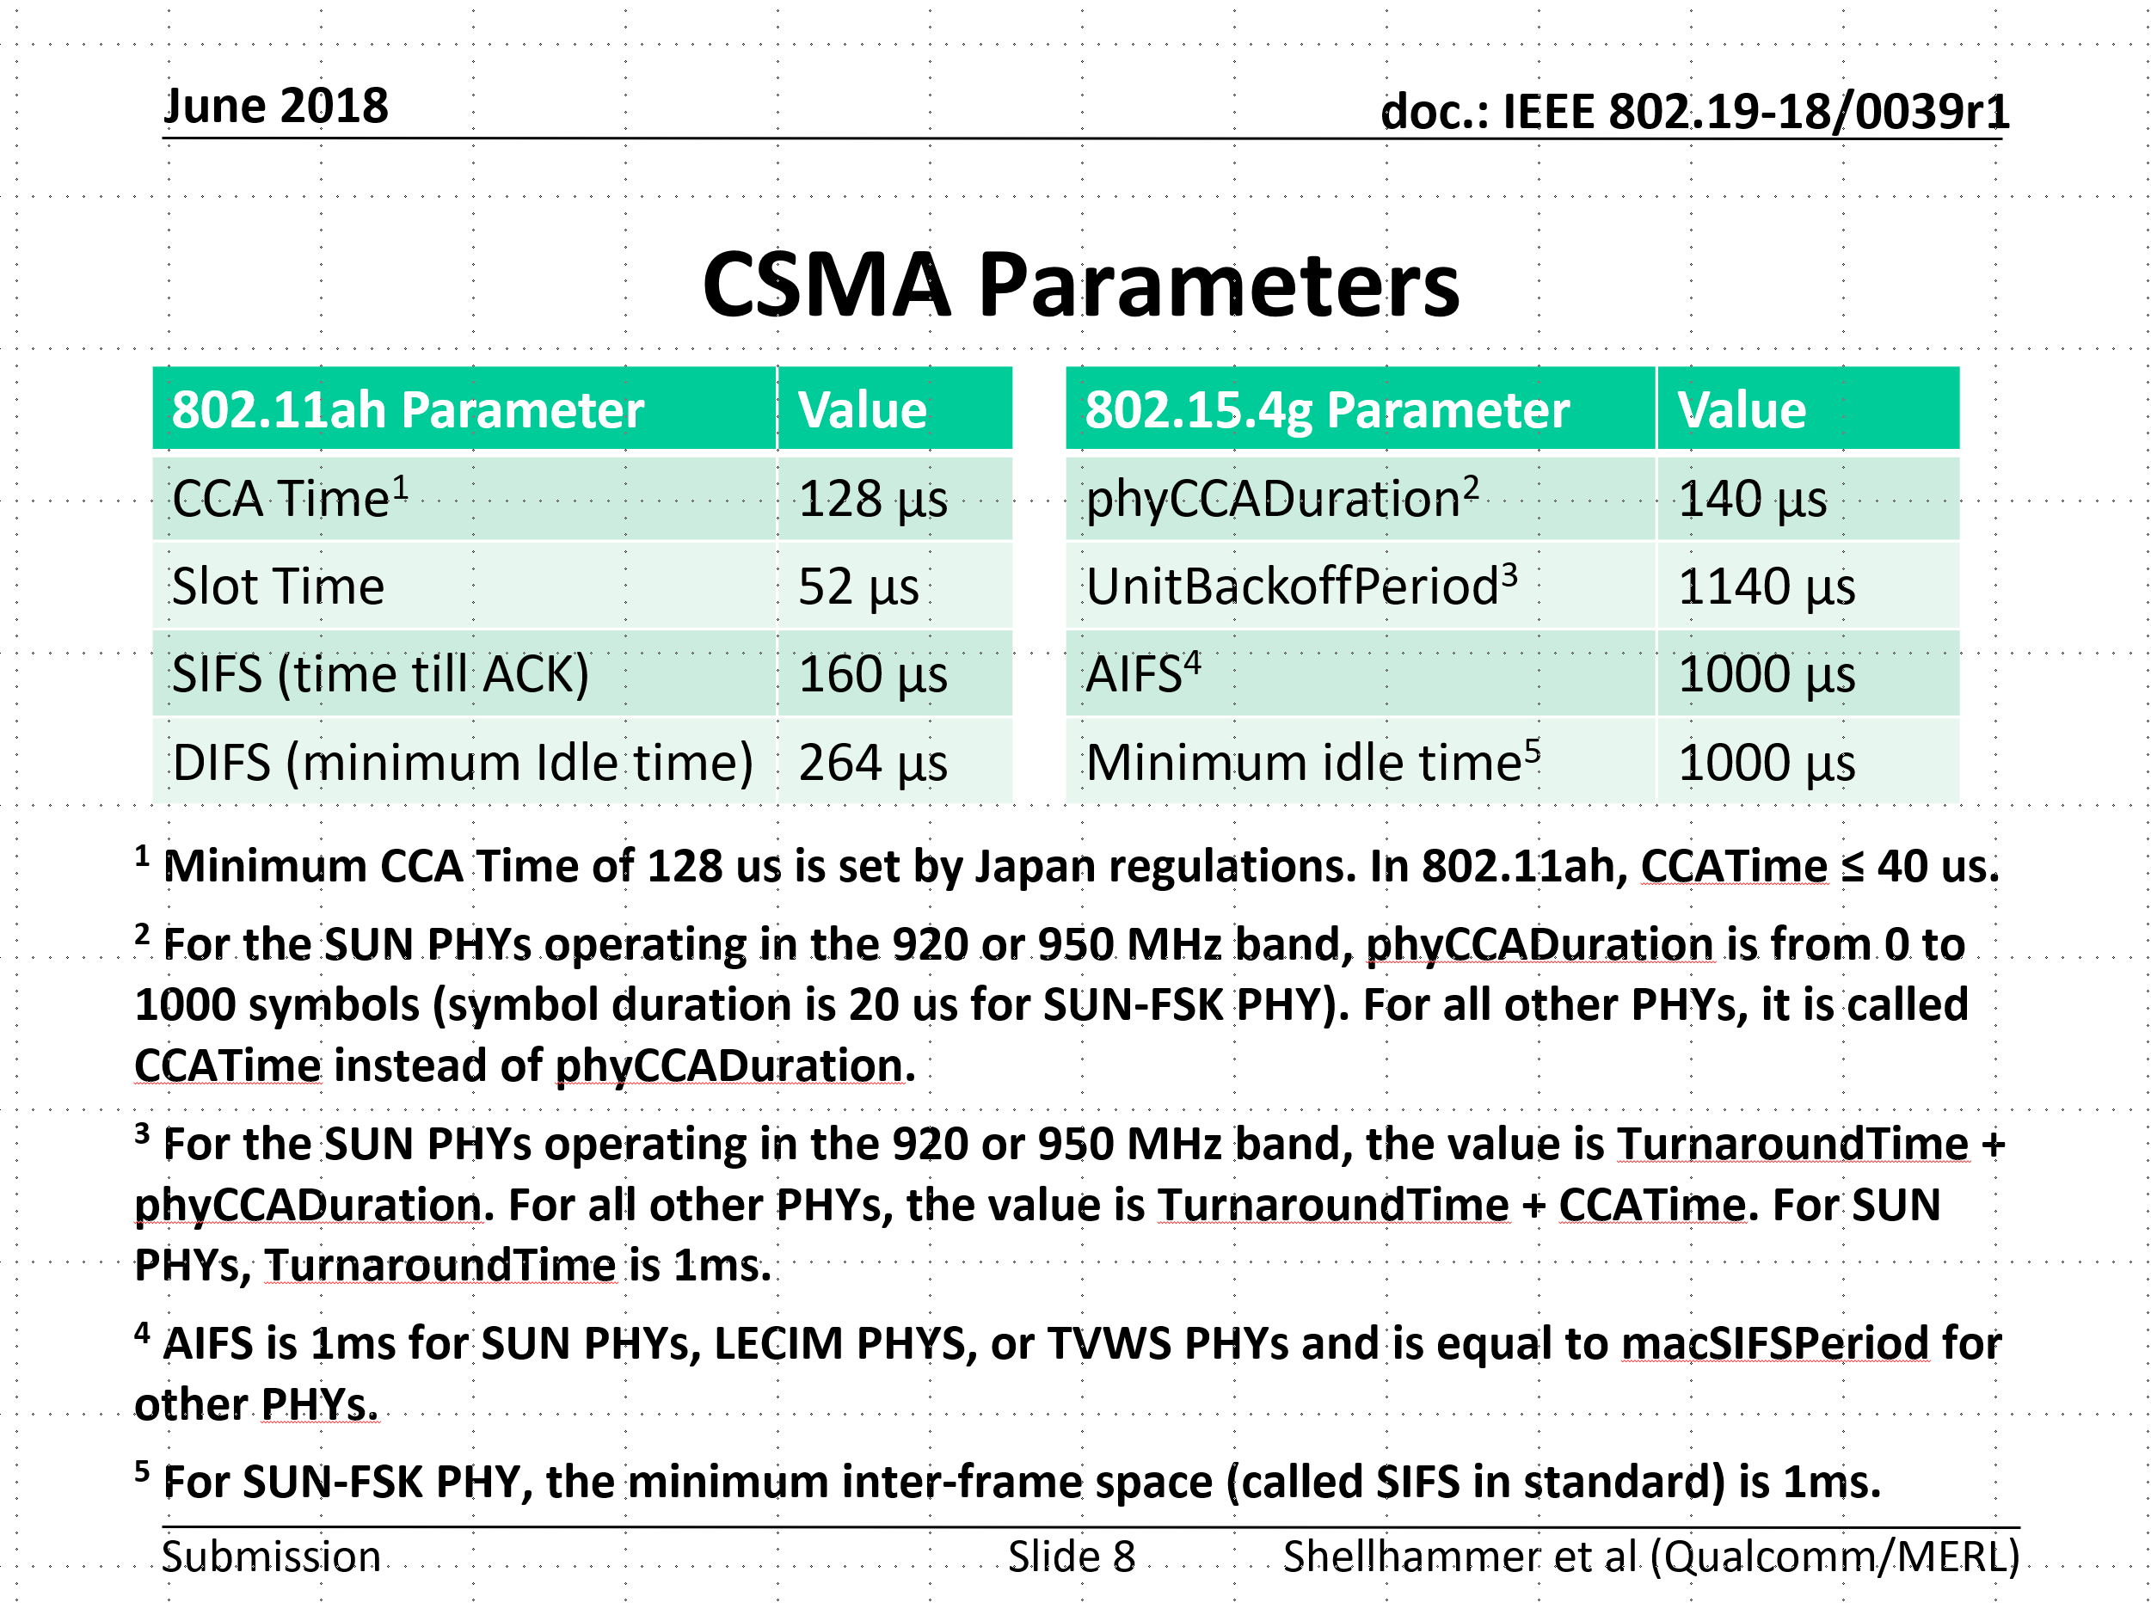
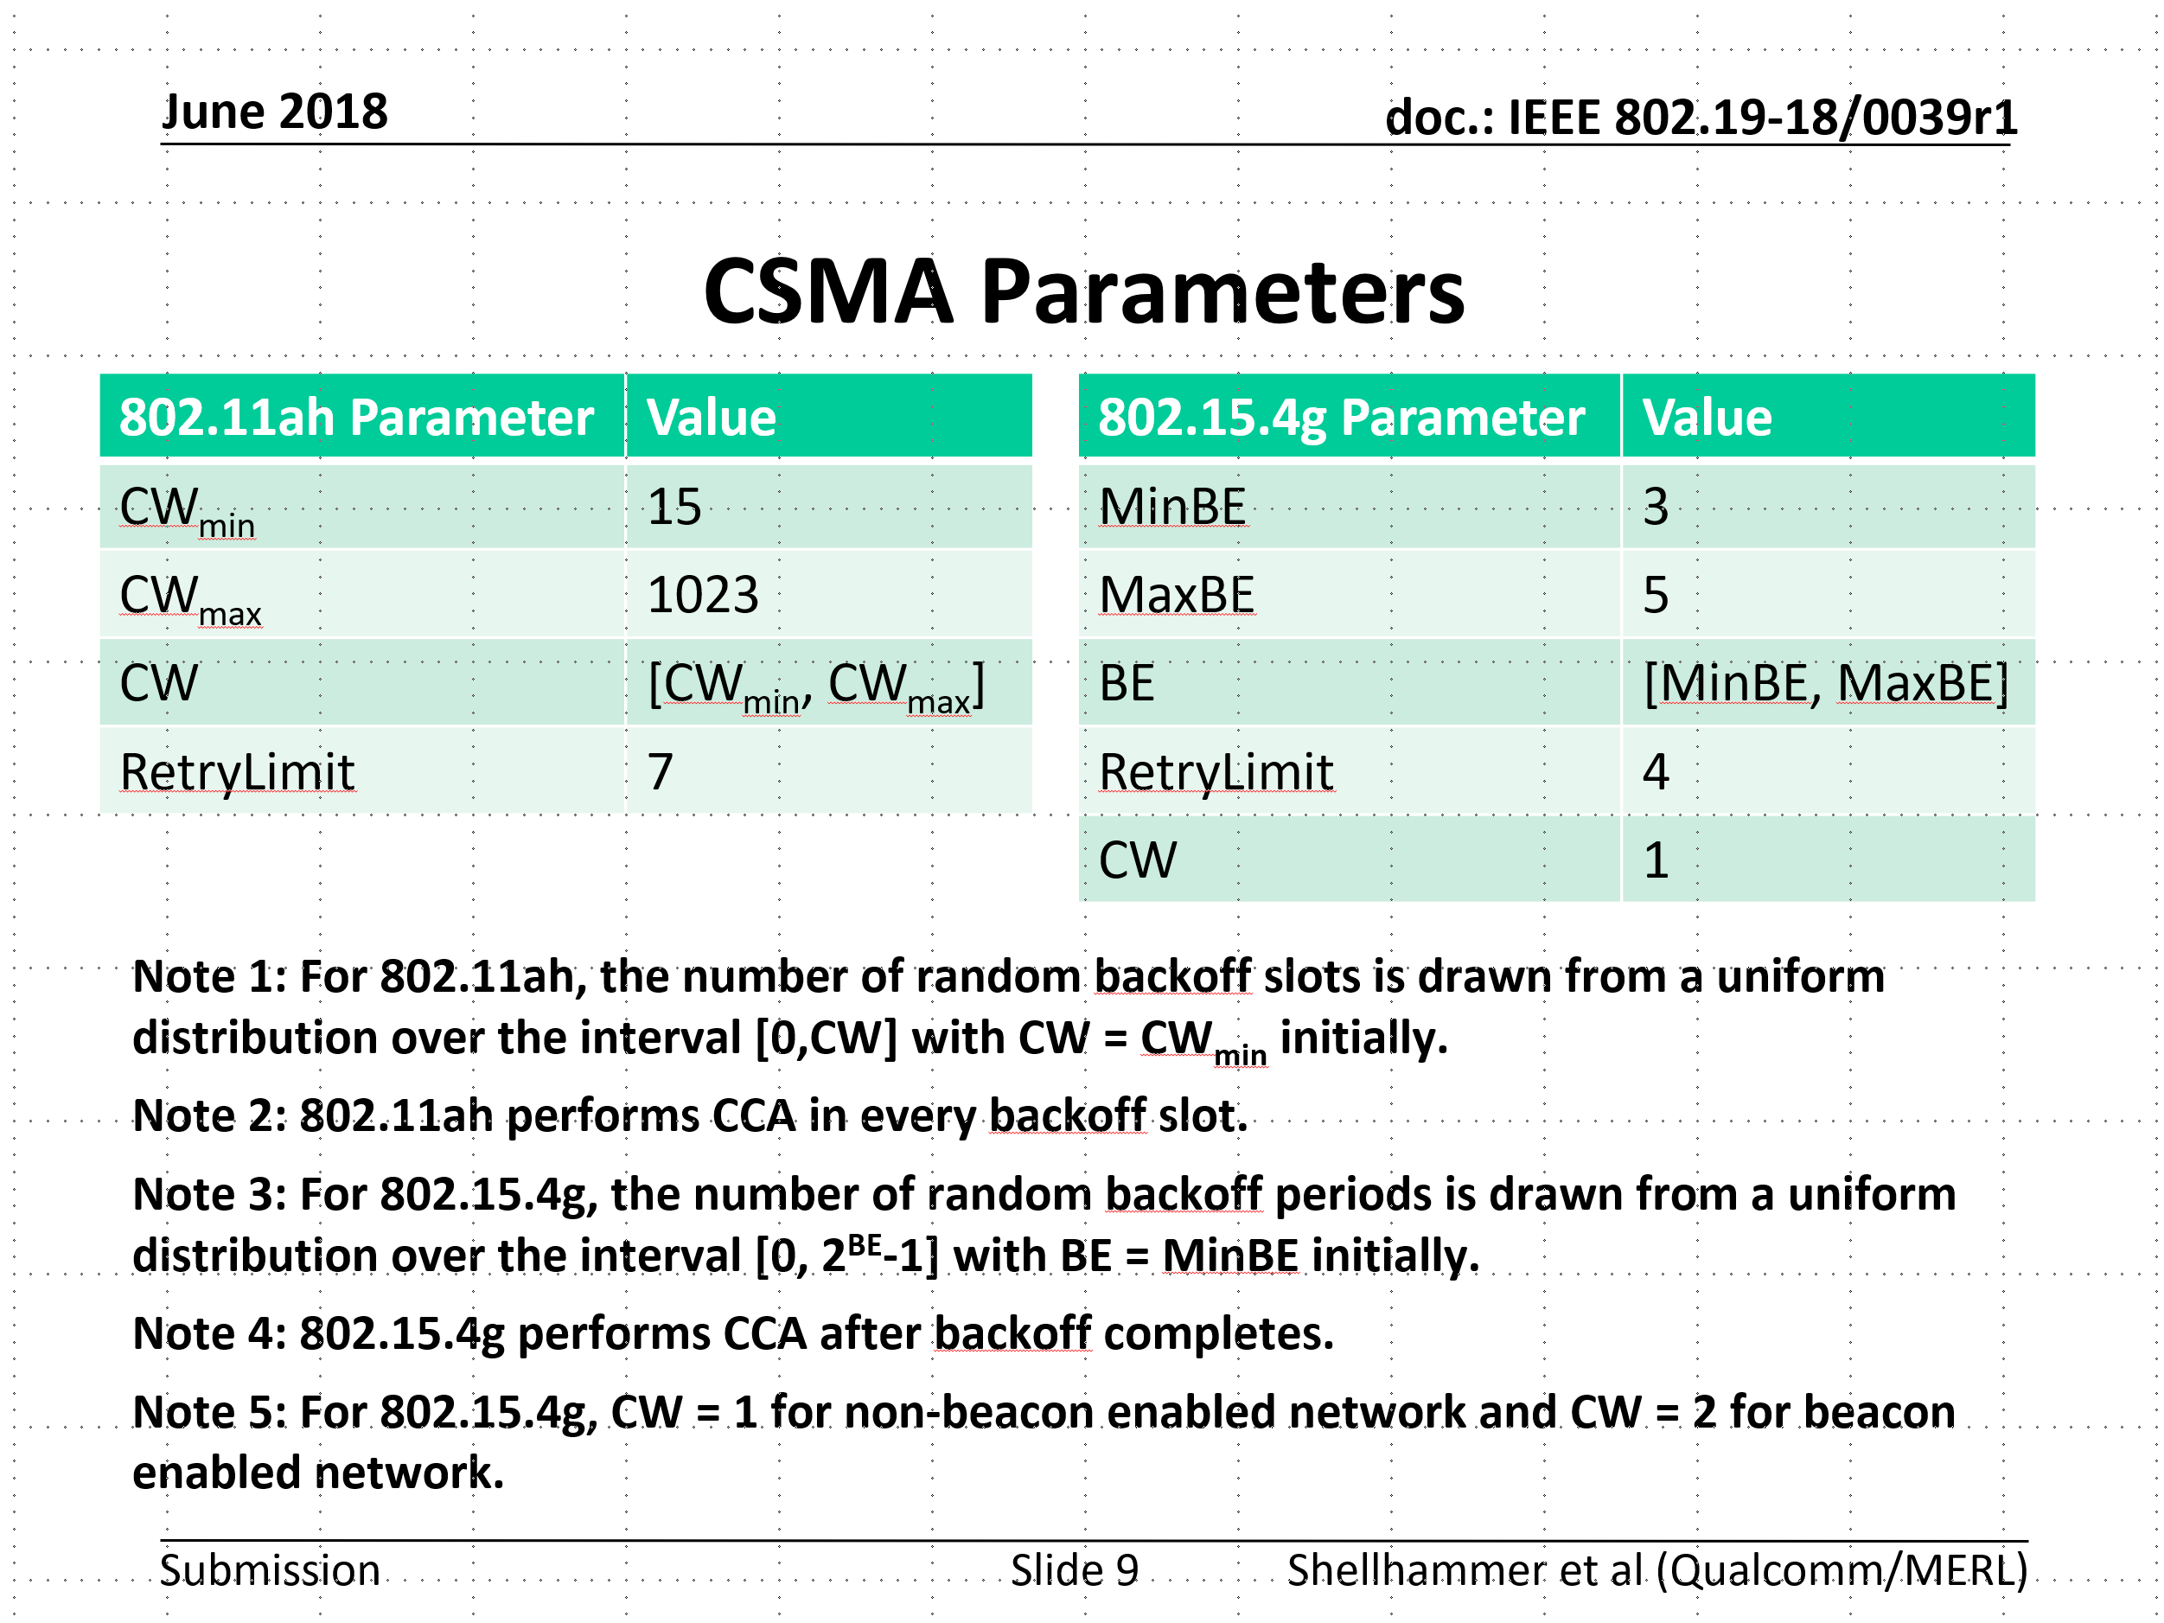
Simulation parameters discussed in TG3
Refer to 19-18/0039r1

Slide 6
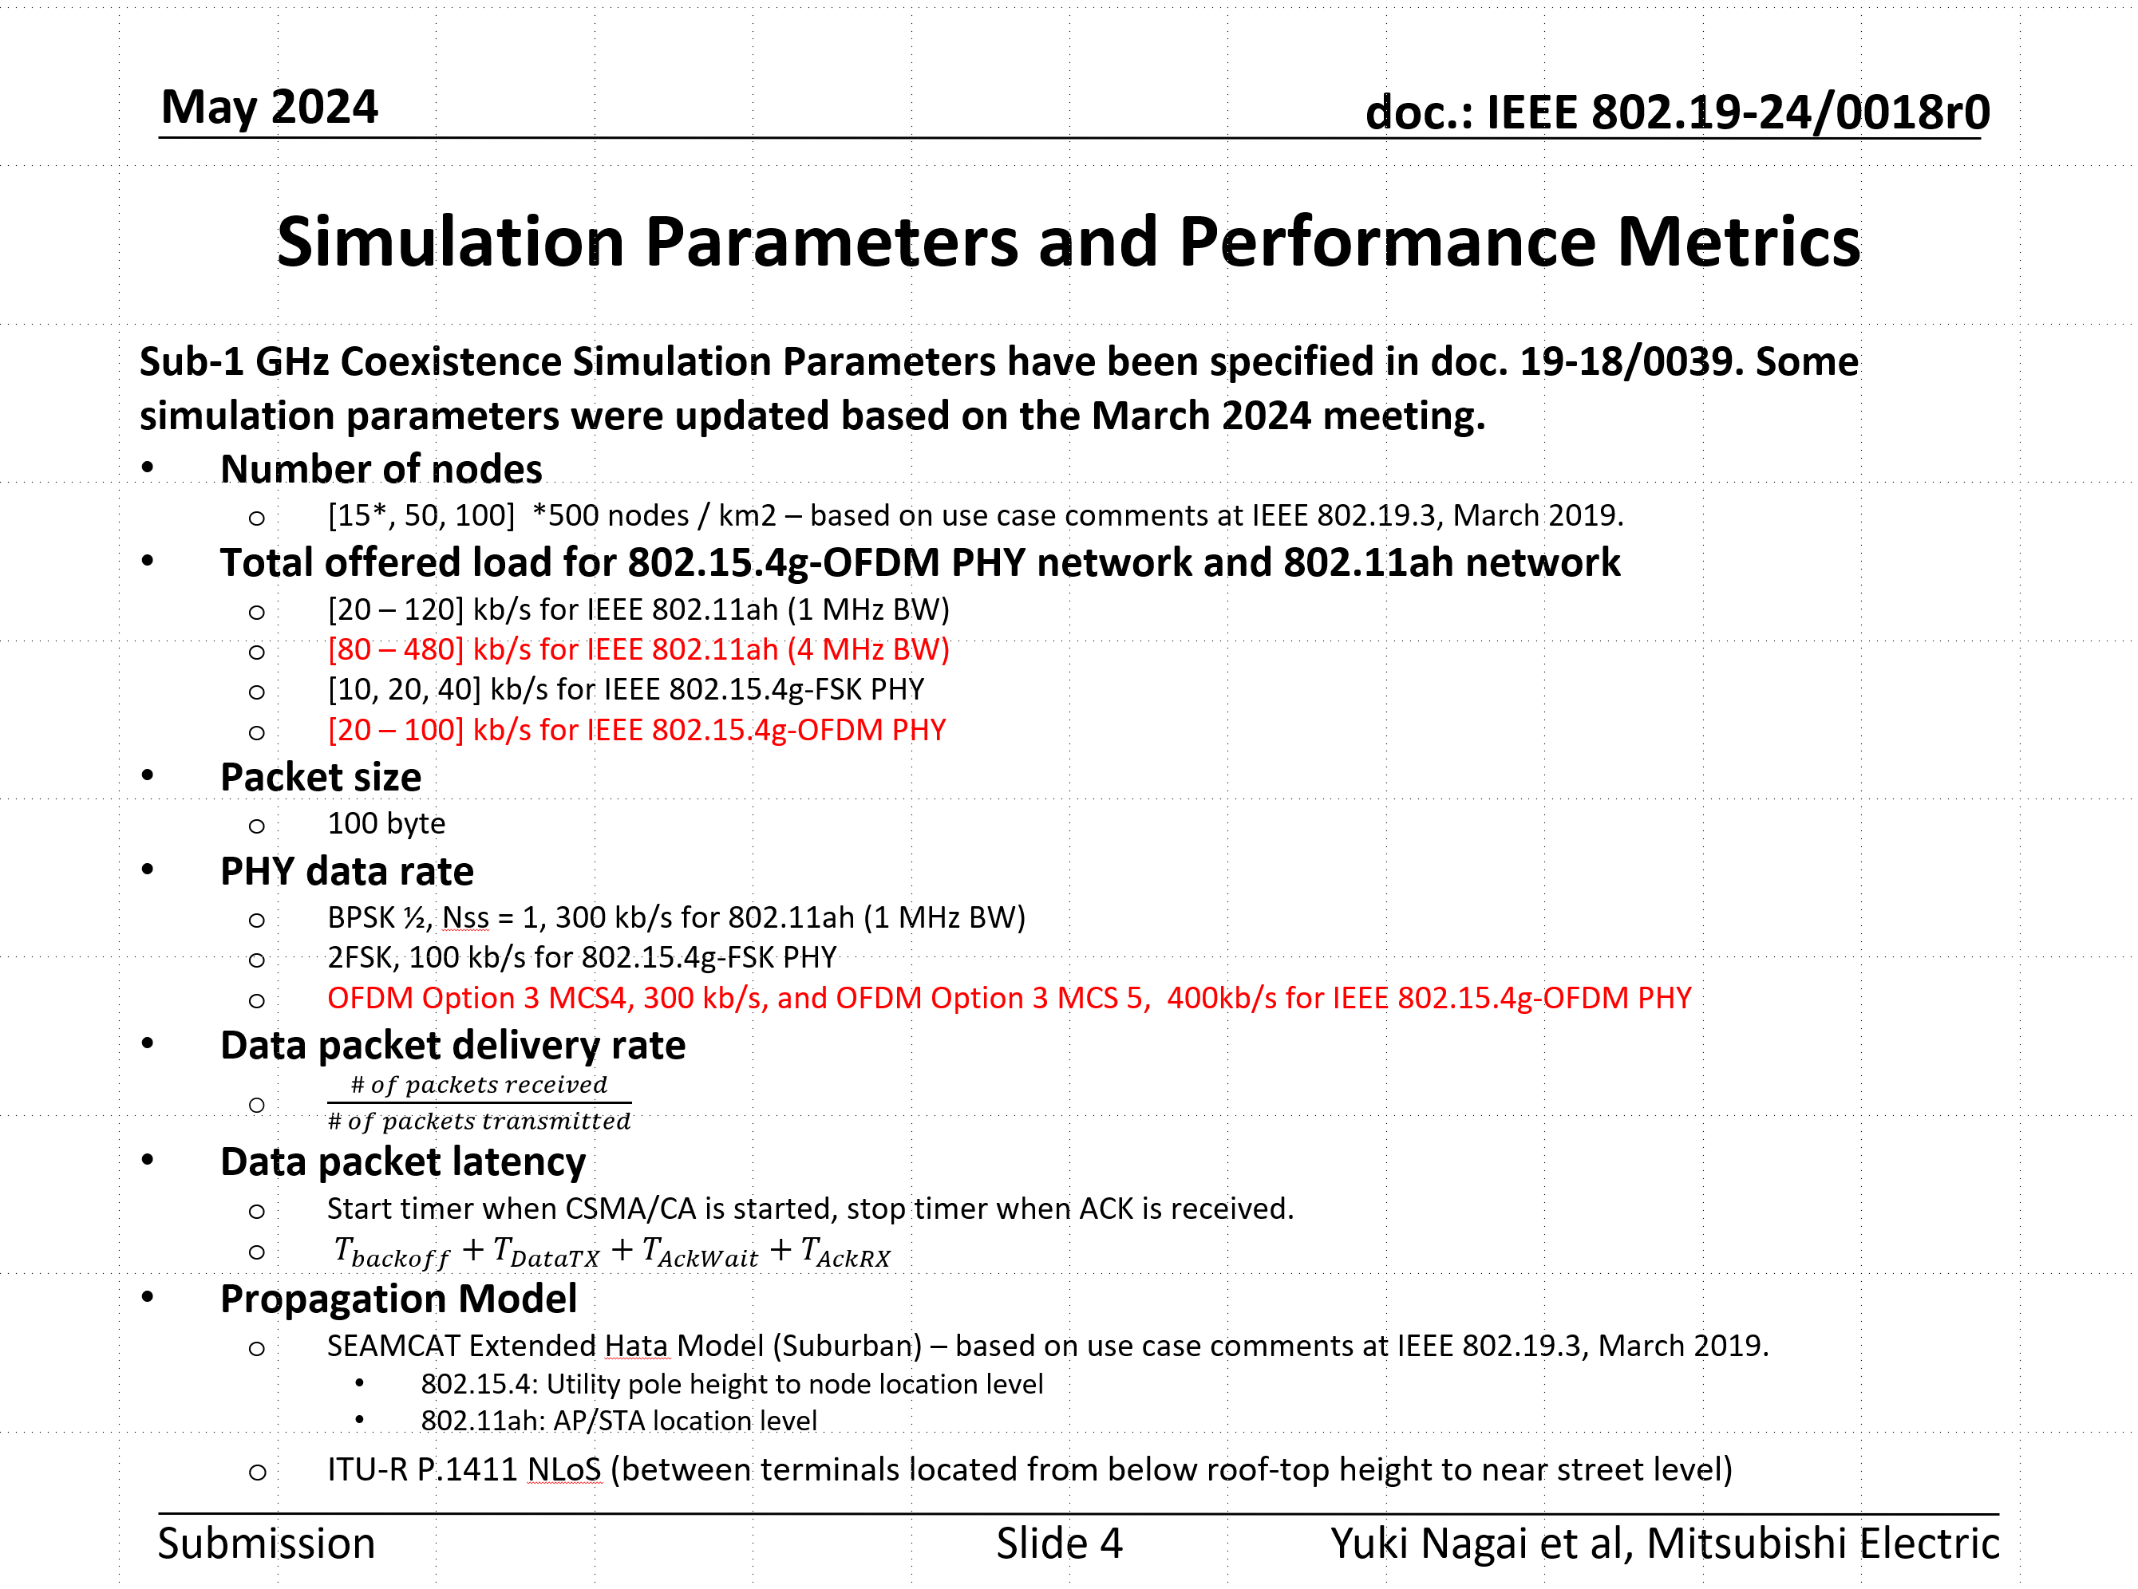
Simulation parameters were updated at the TG3a May 2024 meeting.
Refer to 19-24/0018r0

Slide 7
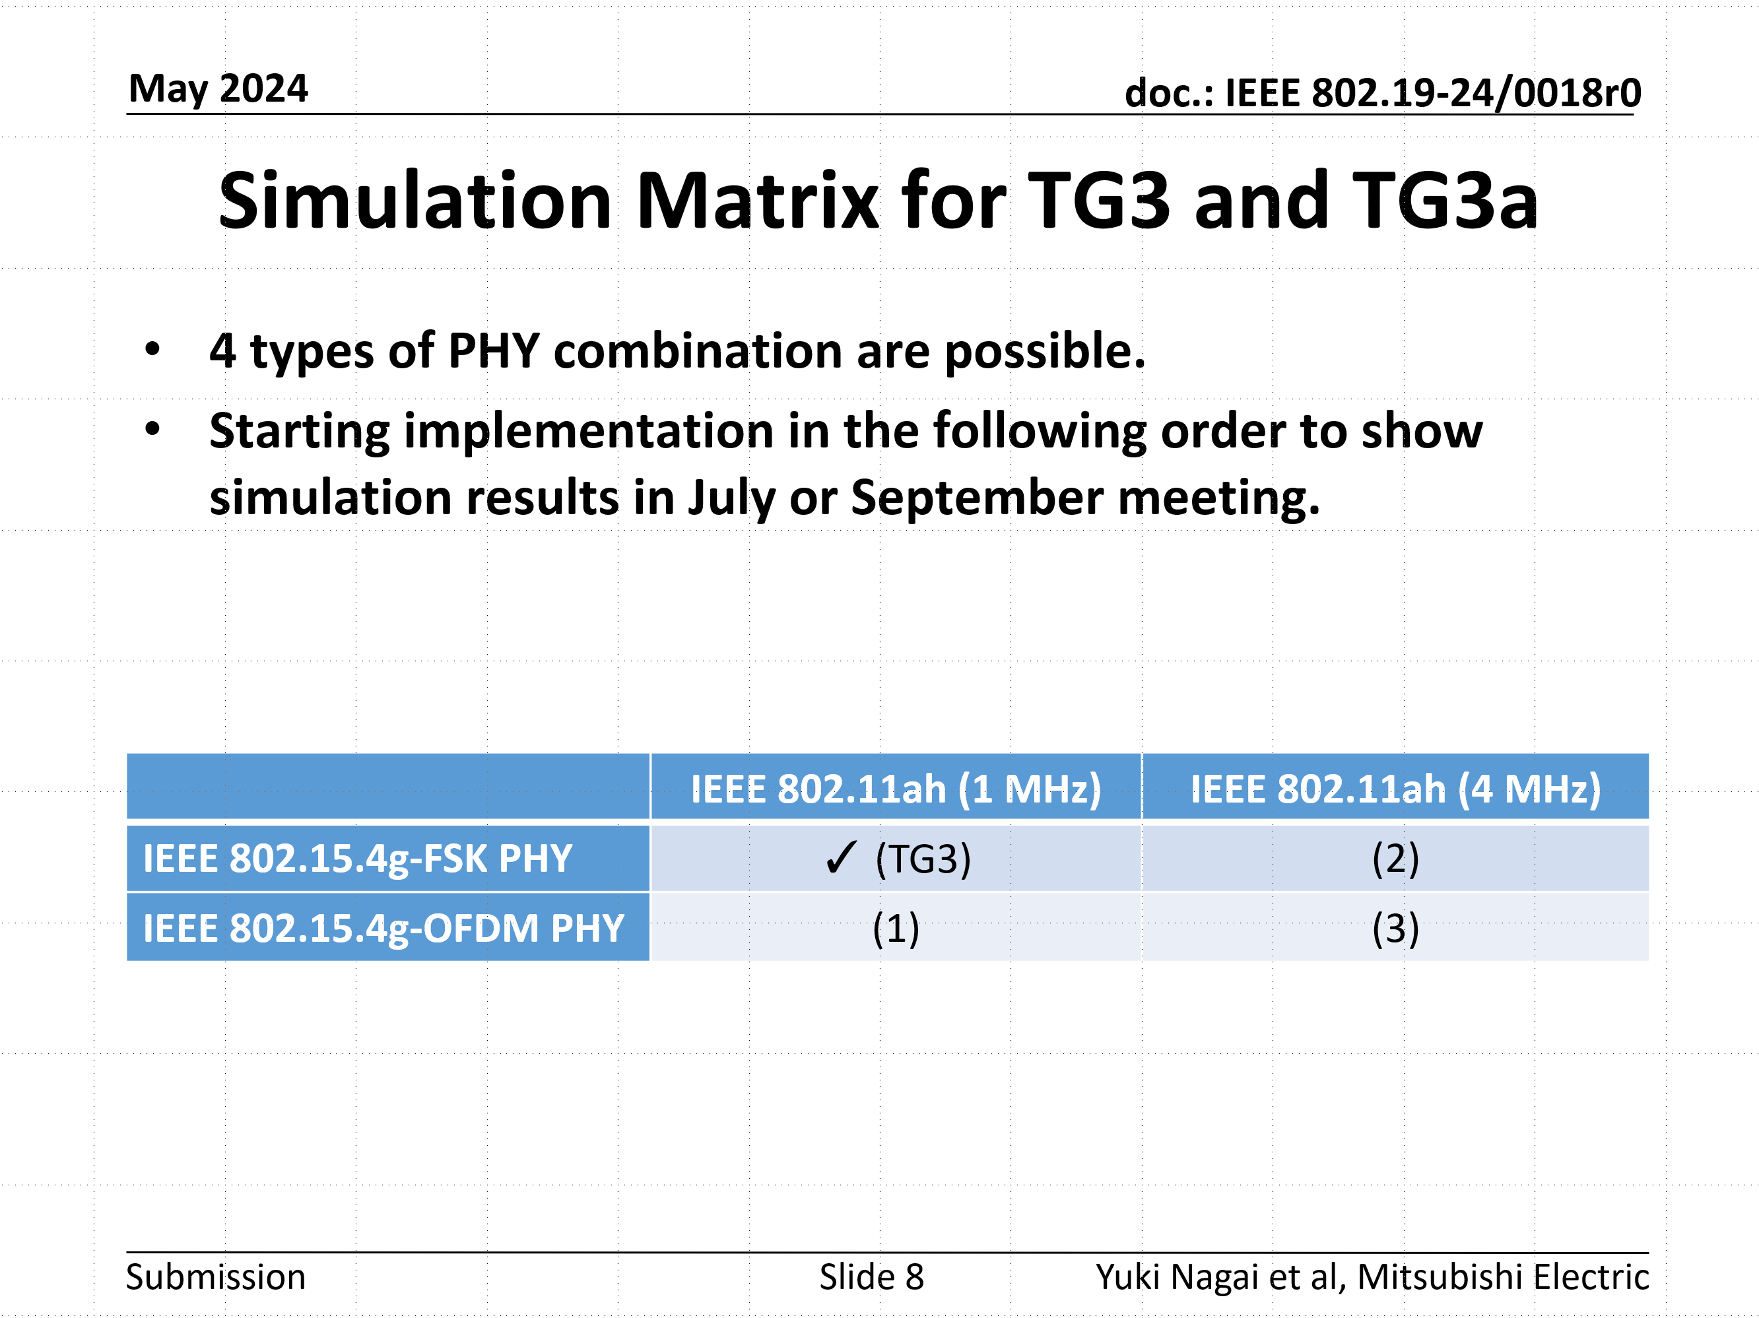
Simulation parameters were updated at the TG3a May 2024 meeting.
Refer to 19-24/0018r0

Slide 8
Simulation Result (Packet Delivery Rate)
802.15.4g offered load: 20 kbps
(TG3), Case (1): IEEE 802.11ah 1MHz
Case (2), (3): IEEE 802.11ah 4MHz
IEEE 802.11ah PDR Lines
IEEE 802.15.4g PDR Lines
When the offered load of 802.11ah increases, the PDR of 802.15.4g decreases.
802.11ah impacts not only 802.15.4g FSK PHY but also SUN OFDM PHY packet delivery.
Case (1), (3)
Case (1), (3)
(TG3), Case (2)
(TG3), Case (2)

Slide 9
Simulation Result (Latency)
802.15.4g offered load: 20 kbps
Latency
Latency
(TG3), Case (1): IEEE 802.11ah 1MHz
Case (2), (3): IEEE 802.11ah 4MHz
IEEE 802.11ah Delay Lines
IEEE 802.15.4g Delay Lines
802.15.4g FSK PHY and SUN OFDM PHY impact the packet latency of 802.11ah 1MHz, but have no much impact on 802.11ah 4MHz.
Case (1), (3)
Case (1), (3)
(TG3), Case (2)
(TG3), Case (2)

Slide 10
Simulation evaluation with Suspendable CAMA/CA on IEEE 802.15.4-2024
IEEE 802.15.4-2024 was published on Dec 12, 2024.
New feature “Suspendable CAMC/CA algorithm” was added to improve coexistence performance and efficiency for high density condition on Section 10.12 (P. 320).
Coexistence performance for Use Case 1-3
with “Suspendable CAMA/CA” is presented on the following slides.
Ref: Suspendable CAMA/CA
  802.15-23/0268r0、IEEE 802.15.4-2024
  Y. Nagai et al., "Improve IEEE 802.15.4 Network Reliability by Suspendable CSMA/CA," 2024 IEEE WCNC,2024, pp. 1-6, doi: 10.1109/WCNC57260.2024.10570554.

Slide 11
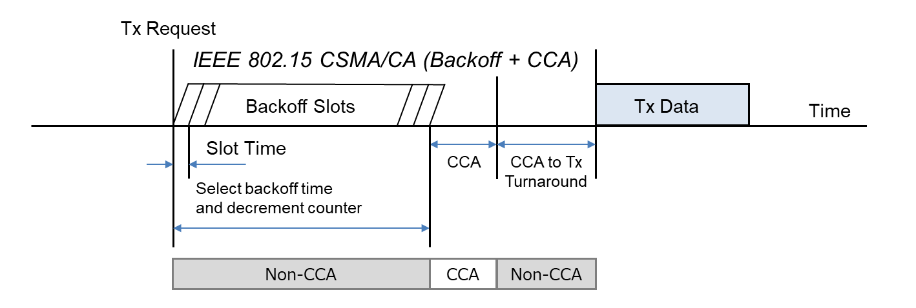
Abstract of Suspendable CAMA/CA
IEEE 802.15.4 CSMA/CA is originally designed for battery-powered devices and has features for reducing power consumption. Therefore, IEEE 802.15.4 CSMA/CA does not perform carrier sense to minimize power consumption except in CCA (Clear Channel Assessment) period before transmission.
This is a point where the IEEE 802.15.4 CSMA/CA differs significantly from IEEE 802.11 CSMA/CA and others.

Slide 12
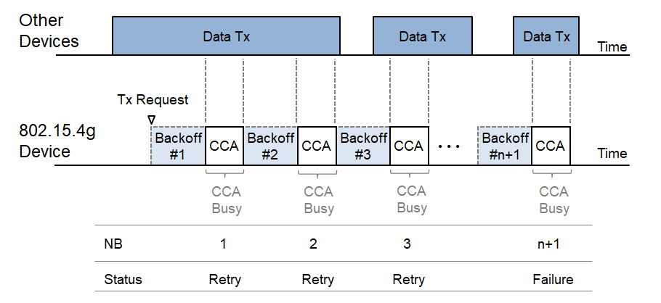
Abstract of Suspendable CAMA/CA
However, as the number of devices and communication frequency increase, packet loss becomes a serious problem caused by backoff failure.
To be more specific, when an IEEE 802.15.4 device detects busy channel during CCA period, the device increments Number of Backoffs (NB) by 1. When the NB exceeds the specified threshold macMaxCSMABackoffs, the device concludes a backoff failure.

Slide 13
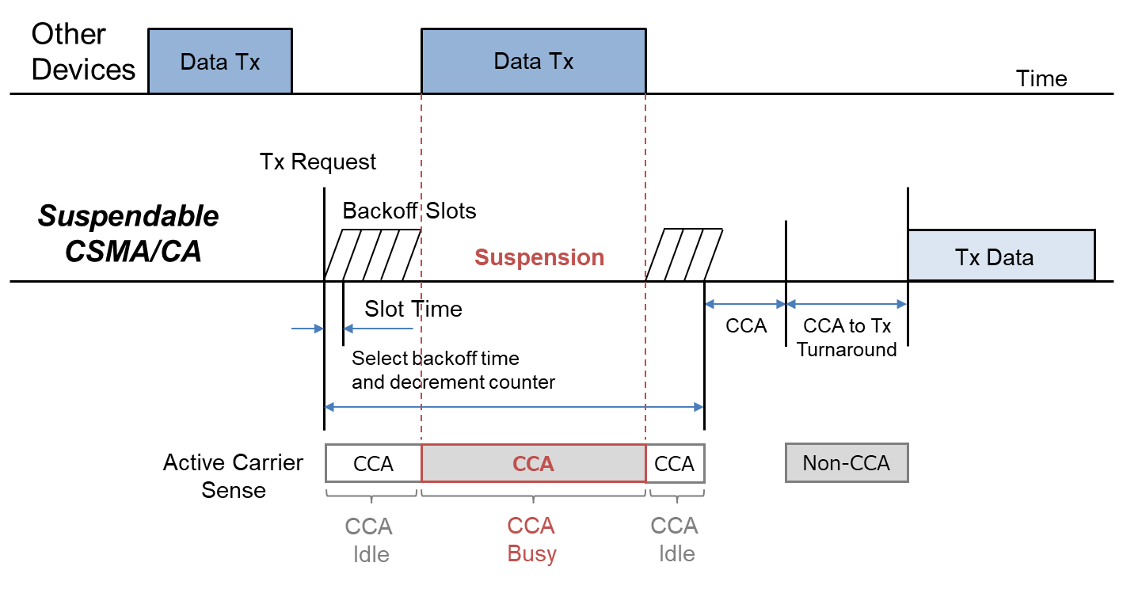
Abstract of Suspendable CAMA/CA
If CCA is busy during the backoff delay period, the backoff timer shall be suspended until sensing the channel indicates that the channel is clear or macSuspendedCsmaMaxTime is exceeded. Upon CCA detecting clear, the backoff time shall resume.
If macSuspendedCsmaMaxTime is exceed, backoff ends in ”Failure” and CSMA/CA algorithm terminates with a channel access failure.
The Suspendable CAMA/CA on IEEE802.15.4-2024 has the backward compatibility and interoperability with the legacy IEEE 802.15.4 CSMA/CA.

Slide 14
Simulation results using suspendable CSMA/CA
IEEE 802.15.4g: FSK, IEEE 802.11ah: 1 MHz (TG3)
802.15.4g offered load: 20 kbps
Packet Delivery Rate
Latency
The packet delivery rate of 802.15.4g increases by applying suspendable CSMA/CA.
The packet delivery rate of 802.11ah does not significantly decrease when the offered load of 802.11ah is below 60 kbps.
Latency increases for both 802.15.4g and 802.11ah.

Slide 15
Simulation results using suspendable CSMA/CA
IEEE 802.15.4g: OFDM MCS 4, IEEE 802.11ah: 1 MHz (Case (1))
802.15.4g offered load: 20 kbps
Packet Delivery Rate
Latency
The packet delivery rate of 802.15.4g increases by applying suspendable CSMA/CA.
The packet delivery rate of 802.11ah does not significantly decrease when the offered load of 802.11ah is below 90 kbps.
The latency increases when the offered load of 802.11ah is above 70 kbps. The latency of 802.11ah does not significantly increase.

Slide 16
Simulation results using suspendable CSMA/CA
IEEE 802.15.4g: OFDM MCS 5, IEEE 802.11ah: 1 MHz (Case (1))
802.15.4g offered load: 20 kbps
Packet Delivery Rate
Latency
The packet delivery rate of 802.15.4g increases by applying suspendable CSMA/CA.
The packet delivery rate of 802.11ah does not significantly decrease when the offered load of 802.11ah is below 100 kbps.
The latency increases when the offered load of 802.11ah is above 70 kbps. The latency of 802.11ah does not significantly increase.

Slide 17
Simulation results using suspendable CSMA/CA
IEEE 802.15.4g: FSK, IEEE 802.11ah: 4 MHz (Case (2))
802.15.4g offered load: 20 kbps
Packet Delivery Rate
Latency
The packet delivery rate of 802.15.4g increases by applying suspendable CSMA/CA.
The packet delivery rate of 802.11ah does not decrease.
The latency of 802.15.4g increases, but the increase is less compared to when the bandwidth of 802.11ah is 1 MHz.
The latency of 802.11ah does not significantly increase.

Slide 18
Simulation results using suspendable CSMA/CA
IEEE 802.15.4g: OFDM MCS 4, IEEE 802.11ah: 4 MHz (Case (3))
802.15.4g offered load: 20 kbps
Packet Delivery Rate
Latency
The packet delivery rate of 802.15.4g slightly increases by applying suspendable CSMA/CA.
The packet delivery rate of 802.11ah does not decrease.
The latency of both 802.15.4g and 802.11ah does not increase.

Slide 19
Simulation results using suspendable CSMA/CA
IEEE 802.15.4g: OFDM MCS 5, IEEE 802.11ah: 4 MHz (Case (3))
802.15.4g offered load: 20 kbps
Packet Delivery Rate
Latency
The packet delivery rate of 802.15.4g slightly increases by applying suspendable CSMA/CA.
The packet delivery rate of 802.11ah does not decrease.
The latency of both 802.15.4g and 802.11ah does not increase.

Slide 20
Summary
802.11ah impacts 802.15.4g SUN FSK and OFDM PHY packet delivery.
802.15.4g SUN FSK and OFDM PHY impacts packet latency of 802.11ah 1MHz, but no much impact for 802.11ah 4MHz.
New feature “Suspendable CAMA/CA” on IEEE 802.15.4-2024 improves the coexistence performance (packet delivery rate) of IEEE 802.15.4g and IEEE 802.11ah.
We would propose Suspendable CAMA/CA as the one of the update candidate for IEEE 802.19.3a Recommended Practice.

