Slide 1
Thoughts on managing coexistence between sensing and communication
Date: 2025-07-08
Authors:
Notice: This document has been prepared to assist IEEE 802.19. It is offered as a basis for discussion and is not binding on the contributing individual(s) or organization(s). The material in this document is subject to change in form and content after further study.

Slide 2
Abstract
UWB and Wi-Fi are key candidates to enable in-cabin sensing applications in automotive.
However, some of these applications are safety-critical applications, e.g., child presence detection (CPD) that need to meet certain safety requirements, e.g., Euro/China NCAP.
Therefore, ways of managing coexistence between sensing with communication operations need to be established.
  Examples: coexistence between Wi-Fi based radar and Wi-Fi based communication/ranging, coexistence between UWB-based radar and UWB-based ranging, etc.

Slide 3
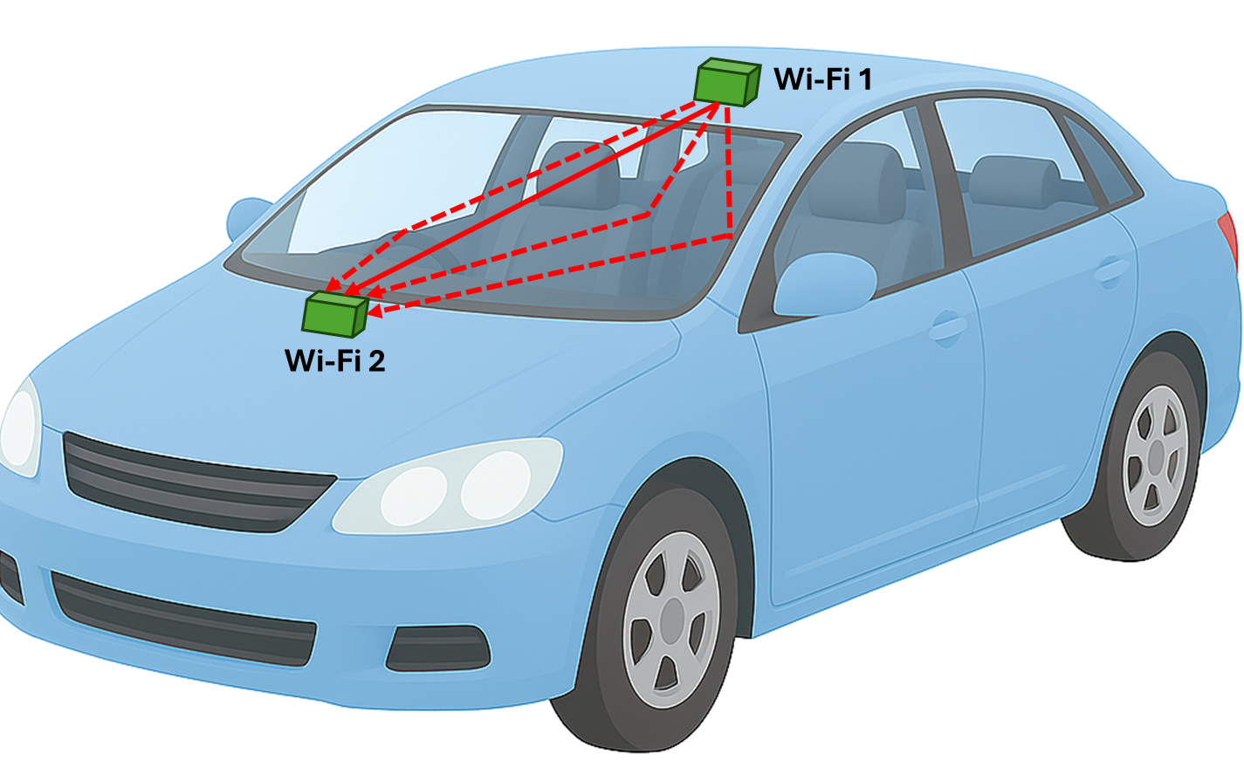
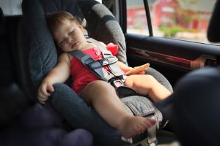
Safety critical application in automotive
Child presence detection (CPD): Detect a child left unattended in the vehicle cabin.
CPD can be done using Wi-Fi sensing.

Slide 4
Example scenario 1:
Impact of communication on Wi-Fi based CPD
Interference from vehicle network:
  It is possible that both phone and child are left inside the car. Phone may be streaming over Wi-Fi, which can keep the channel significantly occupied, forcing CPD to defer transmissions for seconds.
  It may be possible that vehicle’s Wi-Fi is being used outside the vehicle.
Interference from nearby networks:
  Vehicles often park near other Wi-Fi sources (neighbor cars, home hotspots, public APs). Co‑channel Wi-Fi (even on adjacent channels) causes additional busy airtime.
  In a dense parking lot or urban setting, overlapping transmissions and noise (e.g., Bluetooth) can push utilization even higher.
In practice, co-interference adds contention: CPD frames compete with these extraneous transmitters.
Existing IEEE 802.11bf places Wi-Fi sensing traffic in Voice category, which does not provide a guaranteed way to access the channel.

Slide 5
CPD requirements
Sensing for CPD must operate as soon as the doors are closed (Euro NCAP requirement: CPD must be performed within 10 seconds).
Sampling criteria for CPD: How often do we need to sample?
  Radar sampling frequency must be twice as fast as the frequency of the activity we need to track to meet the Nyquist sampling criteria.
  For breathing, sample criteria can be determined based on maximum possible breathing rate.
    Infants (birth to 1 year): 30-60 breaths per minute.
    Toddlers (1 to 3 years): 24-40 breaths per minute.
    Preschoolers (3 to 5 years): 22-34 breaths per minute.

Slide 6
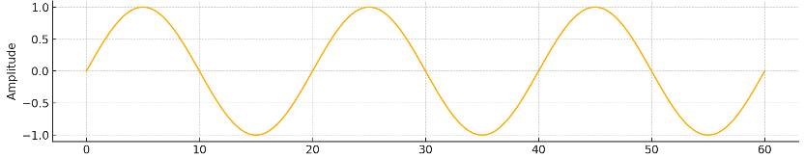
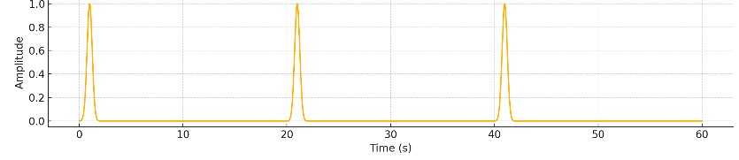

Sampling Criteria for CPD
Example calculations for breathing movements of a newborn:
During breathing, a newborn’s chest moves 0.5 - 3 mm and abdomen moves 1 - 5 mm or more. Assume breathing is sinusoidal with 2mm or 0.002m of peak-to-peak movement.
Velocity is the derivative of displacement:
$v\left(t\right)=A\frac{d }{dt}\left[\sin\left(2πft\right)\right]=A 2πf\cos{(2πft)}$ A = 1 mm
Maximum occurs when cosine is +1 or -1, so:
  $v_{max}=A 2πf$
Frequency of breathing can vary. Assume f = 5 Hz.
  $v_{max}=\left(0.001\right)\left(2π\right)\left(5\right)=0.031$ m/s
Example: Same breathing rate can have different breathing waveforms. Irregular breathing pattern raises the highest relevant frequency component.
Sampling here won’t help

Slide 7
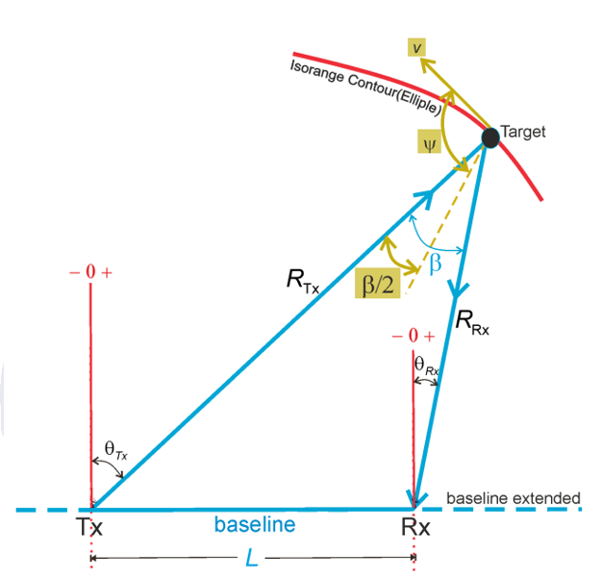

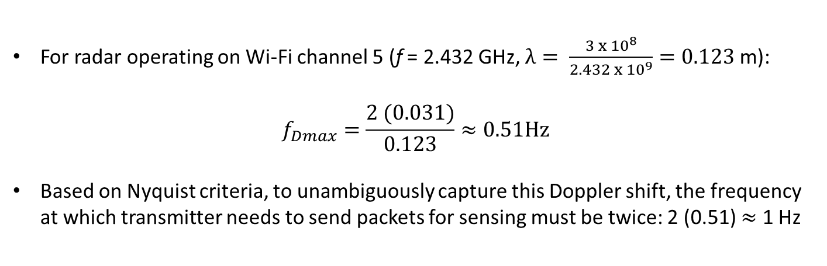


Sampling Criteria for CPD
This velocity translates to a maximum doppler frequency of:
$$f_{Dmax}=\frac{2v_{max}}{λ }$$
$$A=πr^{2}$$
$$f_{D}=\frac{2v}{λ}\cos{ψ\cos\left(\frac{β}{2}\right)}$$
For radar operating on Wi-Fi channel 5 (f = 2.432 GHz, $λ= \frac{{3 x 10}^{8}}{2.432{ x 10}^{9}}=0.123$ m):
$$f_{Dmax}=\frac{2 (0.031)}{0.123}≈0.51Hz$$
Based on Nyquist criteria, to unambiguously capture this Doppler shift, the frequency at which transmitter needs to send packets for sensing must be twice: 2 (0.51) $≈$ 1 Hz

Slide 8
Sampling Criteria for CPD
In practice, we need more margin so typically higher sampling rates are required.
  E.g., we need enough samples during radar’s coherent processing interval (CPI) or “dwell time” for velocity resolution
  More radar samples (N) during CPI lead to higher SNR gain (aka. “coherent processing gain”) of approximately 10 x log10(N) dB -> amplifies weak periodic signals [1].
  Need to take into account environmental disturbances, noise, etc.
Although the Nyquist rate for human breathing is low, systems sample at rates 20-200× above Nyquist (20–200 Hz) [2].
Simulations and empirical studies have shown the impact of interference on the attainable CSI frame rate. Example:
  Just a single extra device more than halved the attainable CSI frame rate [3]. In practice, if the car’s Wi-Fi AP is shared by multiple clients (videos, uploads, etc.), the CPD’s CSI updates could likewise drop by orders of magnitude.
  Even 10 seconds of heavy utilization triggers network throttling [4]. If CPD devices are starved of transmissions for those 10 seconds, the child remains “unseen” too long. This could force a CPD algorithm to exceed the Euro NCAP 10 s limit before confidently detecting a child.

Slide 9
Thoughts on managing co-existence for safety-critical Wi-Fi sensing applications
Move non-Wi-Fi sensing traffic to BK
Reprioritizing the QoS parameters of different types of Wi-Fi traffic:
  Normal mode: No Wi-Fi Sensing + regular QoS profile for other applications as specified in existing standard
  Sensing mode: Highest QoS profile for Wi-Fi sensing + all other traffic is assigned AC_BK (background).
Assign AC_VO (voice access category)’s QoS parameters to sensing traffic and flag all other access categories as “background”.

Slide 10
Thoughts on managing co-existence for safety-critical Wi-Fi sensing applications
2. Reduced QoS of other traffic
Reprioritizing the QoS parameters of different types of Wi-Fi traffic
  Normal mode: No Wi-Fi Sensing + regular QoS profile for other applications as specified in existing standard
  Sensing mode: Highest QoS profile for Wi-Fi sensing + adapted reduced QoS profile for other applications
Lower voice and video traffic channel access priority to best effort + longer backoff + reduced TXOP
Assign Wi-Fi sensing highest channel access priority + shortest backoff + increased TXOP

Slide 11
Thoughts on managing co-existence for safety-critical Wi-Fi sensing applications
Weigh according to number of devices and respective traffic type
AP can weigh parameters for different traffic differently, according to the amount of connection after incorporating the number of devices and traffic type
Example: Wi-Fi sensing traffic + x numbers of voice users present in the network. Increase aCWmin, aCWmax and AIFSN proportional to x

Slide 12
Safety critical application in automotive
Child presence detection (CPD): Detect a child left unattended in the vehicle cabin.
CPD can also be performed using UWB radar.

Slide 13
Example scenario 2:
​Impact of digital key ranging on UWB-based CPD
It is possible that an adult leaves their Digital Key (DK) + child in a vehicle​.
In this case, the car will keep using UWB ranging to detect the DK that’s left behind in the vehicle​.
For example, the minimum ranging interval is 96 ms and typically 3 ranging rounds are performed (Car Connectivity Consortium).
However, sensing for CPD must operate as soon as the doors are closed (Euro NCAP requirement: CPD must be performed within 10 seconds).
Existing IEEE 802.11bf places Wi-Fi sensing traffic in Voice category, which does not provide a guaranteed way to access the channel.

Slide 14
Conclusion
Wi-Fi sensing competes with communication, creating co-existence issues.
There is a need for application aware prioritization of safety-critical sensing traffic vs other data traffic to avoid conflict.
Possible approaches for safety-critical Wi-Fi based sensing applications can involve reprioritizing the standard QoS parameters of different types of Wi-Fi traffic to support safety-critical sensing traffic.
Safety-critical applications like CPD can also use UWB.
Therefore, potential impact of UWB ranging (e.g., digital key) on UWB-based sensing also needs to be analyzed.

Slide 15
References
[1] Richards, Mark A. Fundamentals of radar signal processing. Vol. 1. New York: Mcgraw-hill, 2005.
[2] X. Wang, C. Yang, and S. Mao, “On CSI-Based Vital Sign Monitoring Using Commodity Wi-Fi,” ACM Trans. Comput. Healthcare, vol. 1, no. 3, Art. 12, May 2020.
[3] Sharma, Aryan, Haoming Wang, Deepak Mishra, and Aruna Seneviratne. "Conservative Interference Injection to Minimize Wi-Fi Sensing Privacy Risks and Bandwidth Loss." Future Internet 17, no. 1, 2025.
[4] Huawei. Channel utilization. Huawei Support Encyclopedia.[Online: https://info.support.huawei.com/info-finder/encyclopedia/en/Channel+Utilization.html].

