Slide 1
IEEE 802.21 MEDIA INDEPENDENT HANDOVER
DCN: 21-10-0128-01-srho
Title: IEEE 802.21 MIH CS Applicability for WMF SRHO
Date Submitted: September 1, 2010
Presented at IEEE 802.21 session #40 in St. Petersburg
Authors or Source(s):
Junghoon Jee, Changmin Park (ETRI)
Abstract: This contribution discusses about the IEEE 802.21 defined Command Service’s application to Single Radio Handover Procedures of WiMAX Forum.
1
Notes:
1

Slide 2
  IEEE 802.21 presentation release statements
This document has been prepared to assist the IEEE 802.21 Working Group. It is offered as a basis for discussion and is not binding on the contributing individual(s) or organization(s). The material in this document is subject to change in form and content after further study. The contributor(s) reserve(s) the right to add, amend or withdraw material contained herein.
The contributor grants a free, irrevocable license to the IEEE to incorporate material contained in this contribution, and any modifications thereof, in the creation of an IEEE Standards publication; to copyright in the IEEE’s name any IEEE Standards publication even though it may include portions of this contribution; and at the IEEE’s sole discretion to permit others to reproduce in whole or in part the resulting IEEE Standards publication. The contributor also acknowledges and accepts that this contribution may be made public by IEEE 802.21.
The contributor is familiar with IEEE patent policy, as stated in Section 6 of the IEEE-SA Standards Board bylaws <http://standards.ieee.org/guides/bylaws/sect6-7.html#6> and in Understanding Patent Issues During IEEE Standards Development http://standards.ieee.org/board/pat/faq.pdf>
2
Notes:
2

Slide 3
Overview
Overall progress in WiMAX Forum (WMF)
  IEEE 802.21 MIH based ND&S is included in the WiFi-WiMAX IWK 1.6 specification.
  Only MIH IS is included, not CS and ES
  Still competitive with 3GPP ANDSF
    Adopted for WiMAX - 3GPP EPS Interworking in WMF
    Operators’ interests
IEEE 802.21 WG needs to show more value added features
  IS performance superiority over OMA-DM
  CS and ES aspects
This contribution presents a possible way to integrate IEEE 802.21 MIH CS with the WiMAX SRHO procedures
  To have a consensus in IEEE 802.21 WG and approach to WMF to facilitate the further collaboration model

Slide 4
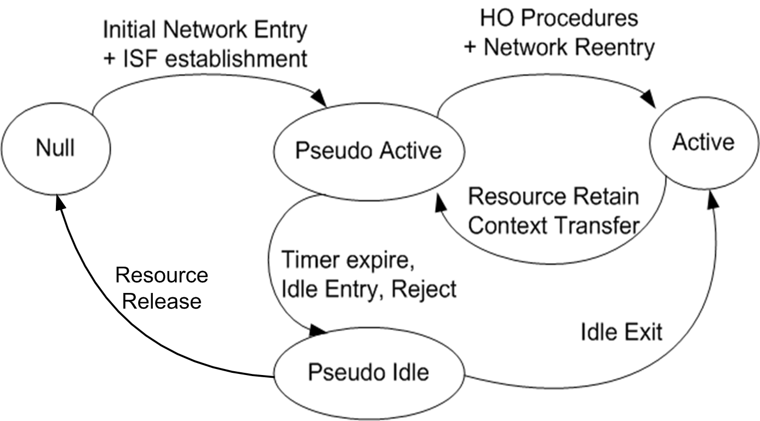
WMF SRHO Procedures Summary
Overall Steps
  NULL → Pseudo Active → (Pseudo Idle) → Active

Slide 5
WMF SRHO Procedures Summary (2)
NULL → Pseudo Active
  Initial Network Entry
  ISF establishment
  Pseudo Active mode timers starts
Before Pseudo Active mode timer expires,
  MS can initiate the transition to Active mode by sending MOB_MSHO-REQ to SFF
  MS may initiate the transition to Pseudo Idle mode
When Pseudo Active mode timer expires
  SFF can command the MS’s transition to Active mode by sending MOB_BSHO-REQ to MS
  SFF can command the MS’s transition to Pseudo Idle mode by triggering network initiated Idle mode entry procedure
  SFF can send a session release indication (e.g. DREG) to MS via SFF tunnel to release the pre-registration context

Slide 6
WMF SRHO Procedures Summary (3)
When MS is in the Pseudo Idle mode, MS can initiate the transition to Active mode by sending RNG_REQ over the air to Target BS.
When Pseudo-Idle mode timer expires,
  WiMAX SFF requests MS to complete Inter-RAT handover by initiating network-initiated Pseudo-Idle mode exit procedure
  WiMAX network sends a session release indication to MS via the SFF tunnel

Slide 7
Problem Statement
One particular example from the WMF SRHO procedure
  SFF sends MOB_BSHO-REQ to MS to execute Inter_RAT HO when Pseudo Active mode timer expires
  MS can reject or ignore that request with the following reason
    When other RATs (e.g., WiFi or 3G) provide better radio link quality
Issues
  Pre-requisite steps are required before commanding Inter-RAT HO
    Inter-RAT HO required?
      Multi-Radio link conditions need to be checked
        Only MS can identify the status not SFF
    Target Decision
      Target RAT, Target PoA

Slide 8
Problem Statements (2)
Issues (cont.)
  IEEE 802.16 handover execution message (i.e. MOB_BSHO-REQ) for different purpose?
    Originally defined to execute 802.16 Intra-HO at the time of HO decision is made

Slide 9
Proposed Approach
Separating Handover Preparation from Handover Execution, NOT mixing together
Refer the IEEE 802.21 design principle
Handover Initiation
Handover Preparation
Handover Execution
Scope of 802.21
Media independent / Uniform way!
Search New Lin
L2 HO Execution
L3 Mobility Signaling
Packet Rerouting
Link Status Monitoring
Neighbor Network Discovery
Target Link Selection

Slide 10
Proposed Approach (2)
Utilize the MIH CS facilities to prepare the Inter-RAT HO before commanding the Inter-RAT HO execution
  Enables to identify Multi-Radio link status
  Enables to select the target radio technology and target PoA
Applicable MIH CS facility
  MIH_Link_Get_Parameters
    Enables MIHF entity to identify the remote peer MIHF’s link status information
Advantages
  No need to change the 802.16 MAC for Inter-RAT HO
    No need to define additional parameters for 802.16 MAC messages (e.g., MOB_BSHO-REQ, MOB_MSHO-IND)
  Uniform way to check multi-radio link status in various IWK scenarios

Slide 11
Proposed Approach (3)
Complete operations
  Check first multi-radio link status
  Decide the target radio technology and target PoA
  Command the Inter-RAT handover toward that target PoA: Media Dependent

Slide 12
Transport of L2 Information for SRHO
L2 Information
  SIB (System Information Block)
  Initial Entry, Attach
  L2 Handover
  Network Reentry
Transport Options
  Generic MAC Container
  L3 Tunneling
  802.21c
Benefits of utilizing 802.21c
  Uniform way for various IWK cases
  Enables simplified L2 container

Slide 13
Conclusion
It’s time to suggest what additional value added services can be provided by IEEE 802.21
  Not only IS but also CS and ES!
IEEE 802.21 MIH can complement WMF SRHO procedures in an uniform manner
  Enables a network entity like SFF to acquire multi-radio link status information in an uniform manner
  MIH facilities are applicable for various IWK scenarios
    Between WiMAX and WiFi
    Between WiMAX and 3GPP
    Between WiMAX and 3GPP2
Need to observe other cases as well where IEEE 802.21 MIH can complement!

