Slide 1
Status on Coexistence proposals
Antonio de la Oliva
UC3M

Slide 2
Proposals
5 Proposals for different parts of the standard were presented:
  Amerisys (not related to system architecture)
  ETRI
  Interdigital
  NICT
  Nokia

Slide 3
ETRI Proposal

Slide 4
ETRI Proposal
Coexistence Manager:
  Responsible of decision making
  Generates request/commands and control information to Coexistence Enabler
  Maintains Context information for coexistence among CMs
  Helps on CM discovery

Slide 5
ETRI Proposal
Coexistence Enabler:
  Enables communication between CM and TVBD
  Request information from the TVBD
  Translating reconfiguration requests/commands and control information received from the coexistence manager into TVBD-specific reconfiguration requests/commands

Slide 6
ETRI Proposal
Interfaces State Machine
  It does not seem the same followed in .21, may affect if MIH protocol wants to be reused
CM to CE communication (example)
  Context.Info.Get
  Reconfiguration.Set
  Event.Set
  Event.Get
CM to CM communication based on Master to Slave communication

Slide 7
ETRI Proposal
Reference Model

Slide 8
ETRI Proposal
CX_DME_SAP (our LINK_SAP)
  It abstracts media dependent interface to communicate with TVBD management entities
  Transmit power level, sensing threshold, channel reconfiguration assignment..

Slide 9
ETRI Proposal
CX_NET_SAP
  Not really defined, just a primitive to move a PDU
  Same idea than other proposals
      CX_TP_Data.request (
      TransportType,
      SourceAddress,
      DestinationAddress,
      ReliableDeliveryFlag,
      CXProtocolPDU
      )

Slide 10
NICT Proposal
They use the standard system description model without proposing any modification
Everything related to two interfaces
  COEX_MEDIA_SAP (configuration of TVBD)
  COEX_TR_SAP (Transport)
Important: It seems there is no concept of Media Independence (although later they seem to define everything in a Media Independent way)

Slide 11
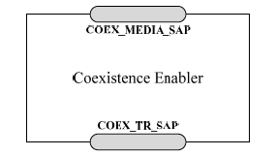
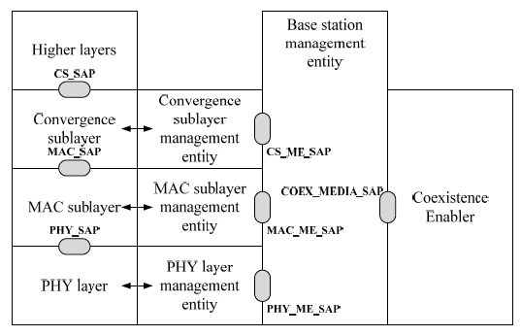
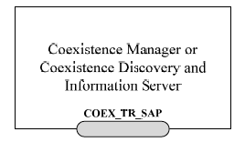
NICT Proposal

Slide 12
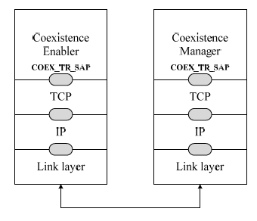
NICT Proposal
CE seems to be only located in AP
CM can only communicate to CE via Transport SAP (so seems not to be collocated)

Slide 13
NICT Proposal
Coexistence Media SAP
  Information Service
    Used by CE to obtain information from TVBD
    TVBD to get information from CE
    TVBD to share information with other TVBD
  Measurement Service
    CE to require measurements
  Reconfiguration Service
    CE to require reconfiguration to TVBD
  Event Service
    Bidirectional from CE to TVBD and viceversa

Slide 14
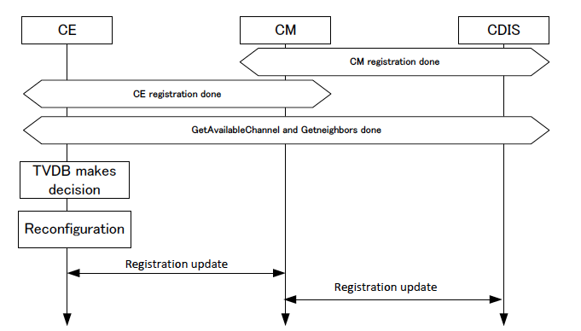
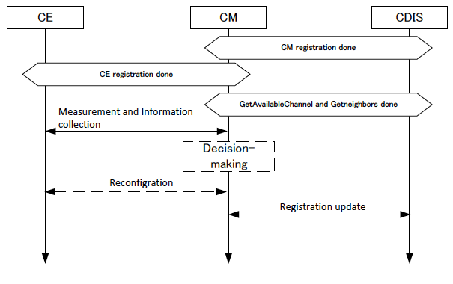
NICT Proposal
Procedures
  They have registration and authorization procedures
  There is a mix of decision making entities, sometimes the TVBD decides, other times the CM

Slide 15
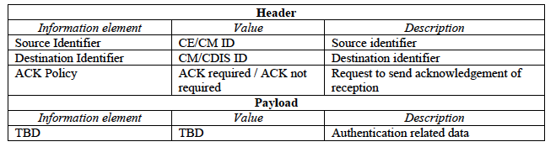
NICT Proposal
Transport SAP critical since CE and CM communicates always through it
CP_PACKET_SEND.(
  TransportPref,
    SourceID,
DestinationID,
CoexProtocolPDU
)
Not clear to me if it is defined the format of each field/compatible with .21?

Slide 16
NICT Proposal
Data types defined in (what I think) is ASN.1
Not sure if this determines the communication protocol format

Slide 17
Nokia Proposal
Coexistence Enabler
  TVBD interfaces the coexistence system with the CE.
  CE resides in a TVBD. A TVBD network is represented by only one CE. A CE is served by only one CM at a time.
  Requests information from TVBD
    Generates resource requests, channels state vectors, coexistence value, capabilities and characteristics information.
    Provides information to CM.
  Receives configuration commands and information requests from CM
    Configures the TVBD according the commands and requests.

Slide 18
Nokia Proposal
Coexistence Manager
  Facilitates the coexistence between TVBDs, and makes decisions on the spectrum resource sharing.
  Serves one or more registered CEs associated to TVBD.
  Neighbor management:
    Discovers and determines neighbor networks to its TVBD.
  Information collection:
    Collects TVBD information from the CE it serves, and channel availability information from TVWS database.
      Generates a spectrum map for the TVBD.
    Exchanges TVBD capabilities, characteristics, coexistence value, and spectrum map with CMs of the neighbor networks.
  Resource allocation:
    Allocates the resources to its TVBD and its neighbors upon receiving a resource request from CE or discovering change in spectrum availability.
    Sends/receives resource allocation commands to/from CMs of neighbors.
    Configures its TVBD according the resource allocation.

Slide 19
Nokia Proposal
CDIS
  Neighbor Discovery service to CMs
  Keep record of registered CMs and Information of TVBD
  Calculates candidate neighbor list

Slide 20
Nokia Proposal
They propose a service model for the system
  Neighbor discovery service
  Neighbor management service
  Spectrum information management service
  Resource management service

Slide 21
Nokia Proposal
Neighbor Discovery Service
  Provided by CDIS, used by CM
  CM provides the information, CDIS computes the list of neighbors and send it to the appropriate CMs

Slide 22
Nokia Proposal
Neighbor Management Service
  Provided by CM, used by CM
  Neighbors if they interfere between each other

Slide 23
Nokia Proposal
Spectrum Information Management Service
  Provide by CM used by CM
  CMs of neighbor networks share spectrum usage and availability information related to their TVBDs
  CMs also send resource allocation commands to CMs of neighbor networks

Slide 24
Resource Management Service
Resource Management Service
  Provided by CM used by CE
  CM performs decision then CE allocates the actual resources to TVBD
  Based on Query/Response between CE and CM

Slide 25
Nokia Proposal

Slide 26
Nokia Proposal
COEX_COMM_SAP: Media Independent Interface provides transport services for inter-entity communication
COEX_TVBD_SAP: abstract TVBD independent interface. Translation to specific TVBD primitives performed in the TVBD

Slide 27
Nokia Proposal
Final Remark:
“We’d like to see the reference model kept simple and we’d like to see it designed for the coexistence system purposes
  Own simple reference model with a TVBD interface to an imaginary TVBD system”

Slide 28
Interdigital Proposal
Please refer to past presentations in .21
Basically the proposal relies on services and media independence
  Event, Command and Information services

Slide 29
Summary
All proposals seem to handle heterogeneity
  Some kind of media independent SAP is provided even if it is not openly called this way
  Some of the proposals are based on services
    As opposed to .21, the services are more focused in functionality and not in events/commands/information
    Each service uses a combination of events/commands
  Much work to do in reference model, decision taking placement and mapping of entities to modules

Slide 30
Summary
How can we help them?
  Please do not reinvent the wheel
    It seems they are going either to form their own new protocol→at least 1 year delay
    I am worried about the layered architecture of the protocol→too much “send PDU” in the current proposals.
      This is not a L2 protocol, maintain the layered architecture of internet protocols
  Not clear to me if they understand the difficulty of making a Media Independent Layer and its mapping to media specific. There is currently no analysis of which SAPs must be opened and what functionality is missing.

