Slide 1
IEEE 802.21 MEDIA INDEPENDENT HANDOVER
DCN: 21-11-0045-00-0000
Title: Distributed Mobility Management using IEEE 802.21
Date Submitted: March 16, 2011
Presented at IEEE 802.21 session #43 in Singapore
Authors or Source(s):
Antonio de la Oliva, Fabio Giust, Carlos J. Bernardos
Abstract: Mechanism to support DMM through IEEE 802.21

Slide 2
  IEEE 802.21 presentation release statements
This document has been prepared to assist the IEEE 802.21 Working Group. It is offered as a basis for discussion and is not binding on the contributing individual(s) or organization(s). The material in this document is subject to change in form and content after further study. The contributor(s) reserve(s) the right to add, amend or withdraw material contained herein.
The contributor grants a free, irrevocable license to the IEEE to incorporate material contained in this contribution, and any modifications thereof, in the creation of an IEEE Standards publication; to copyright in the IEEE’s name any IEEE Standards publication even though it may include portions of this contribution; and at the IEEE’s sole discretion to permit others to reproduce in whole or in part the resulting IEEE Standards publication. The contributor also acknowledges and accepts that this contribution may be made public by IEEE 802.21.
The contributor is familiar with IEEE patent policy, as stated in Section 6 of the IEEE-SA Standards Board bylaws <http://standards.ieee.org/guides/bylaws/sect6-7.html#6> and in Understanding Patent Issues During IEEE Standards Development http://standards.ieee.org/board/pat/faq.pdf>

Slide 3
Motivation
Current Mobility Approaches rely on a central point, either HA or LMA
Issues:
  Sub-optimal Routing
  Reliability
  Scalabilities
  Lack of granularity
  Signaling Overhead

Slide 4
Multiple Domains scenario overview
The DMA domain (See last slide with refs):
  Is the “default” domain the MN attaches to
  Consists in a set of nodes (MARs) capable of playing at the same time roles similar to
    PMIPv6 LMA
    PMIPv6 MAG
The FAMA design (See last slide with refs):
  Applies when the MN attaches to a node outside the DMA domain
  Re-uses DMA nodes as Home Agents

Slide 5
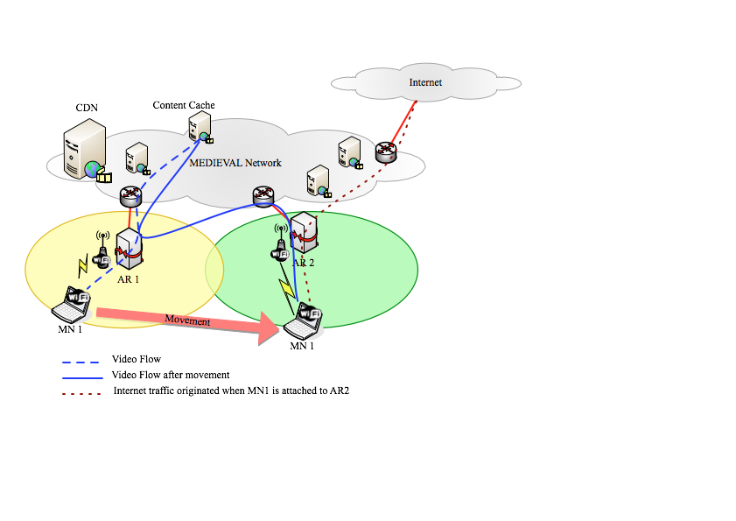
The DMA domain
The first node an MN attaches to (MAR₁) acts as a plain IPv6 router for the prefix advertised to MN (Pref1), no mobility support
After handover MN attaches to MAR₂ and gets Pref2. Mobility can be activated to keep ongoing connections:
  MAR1 plays as LMA
  MAR2 plays as MAG
  A tunnel is built between them
MN starts new communications using Pref2
Next handovers witness the same behavior:
  MARs playing LMA for flows established with their prefix
  The new MAR playing MAG

Slide 6
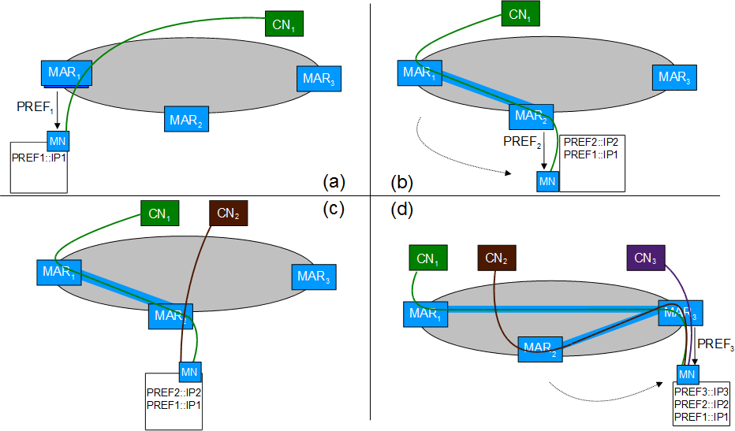
The DMA domain (ii)

Slide 7
FAMA design
When MN crosses DMA domain, it can keep the connections alive:
  MN activates MIPv6 client functionality (Binding updates/Binding Acknowledgment signaling authenticated with CGA instead of IPsec
  MAR anchoring flows (either acting as LMA or plain routers) become Home Agents
  Tunnels are built between MN and the HAs (i.e. the MARs anchoring the addresses)
This allows mobility to be always managed by nodes in the same domain
DMM principles are maintained:
  Mobility is activated only for those flows requiring it
  Multiple mobility managers are distributed at the edge of the network

Slide 8
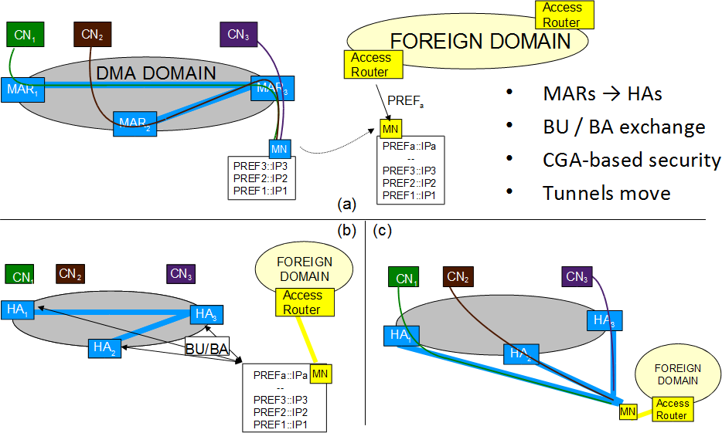
FAMA design (ii)

Slide 9
Intra-domain issues
Source address selection
  [Seite-DMA] suggests a custom source selection algorithm
Inter-MAR signaling
  How can a MAR know if a MN's old address should be maintained?
  How can a MAR know which was MN's former MAR?
[Bertin-DDMM] provides an approach for the MAR-to-MAR signaling

Slide 10
DMA in detail
When an MN changes point of attachment, the new MAR has to inform the old one about the MN’s movement
This is necessary to build a tunnel between them and create a binding entry in the old MAR storing the pair HoA-CoA for the MN
  We are assuming to use PMIPv6 signaling, i.e. PBU/PBA
How can the new MAR know the previous point of attachment?

Slide 11
DMA in detail
Use 802.21 MIH functions to advertise the new MAR
  MN’s PoS sends a message to the PoS located in the target MAR advertising the previous MAR’s address
  The address is sent when the serving PoS queries the candidates Target PoS for resource availabilty
    A Candidate Target PoS stores the address and eventually uses it when it is elected Target PoS with an HO commit message
  The procedure works in both cases of NIHO and MIHO

Slide 12
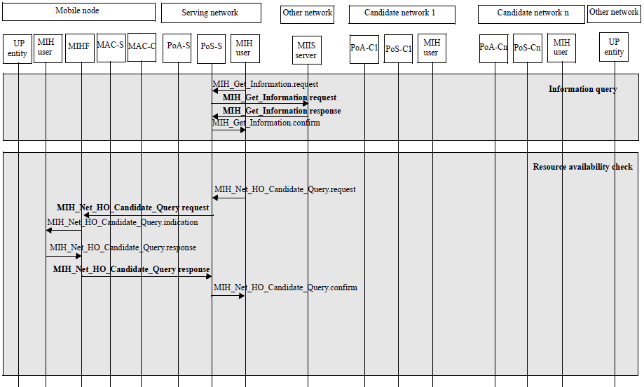
Network-initiated HO procedure

Slide 13
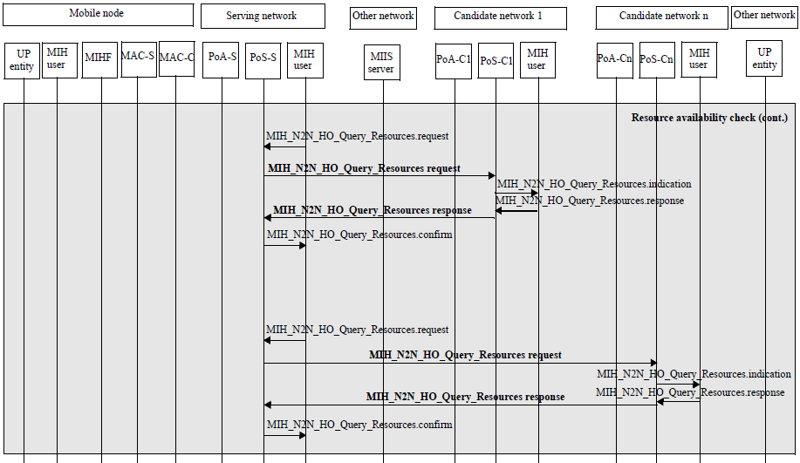
Network-initiated HO procedure
Here Serving PoS’s IP address is available at “user space”

Slide 14
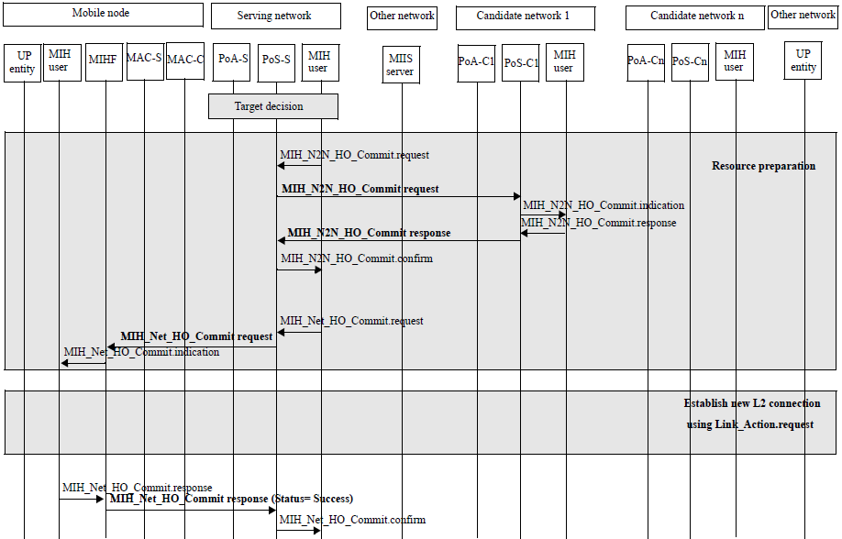
Network-initiated HO procedure
At this stage IP Mobility procedure can be prepared

Slide 15
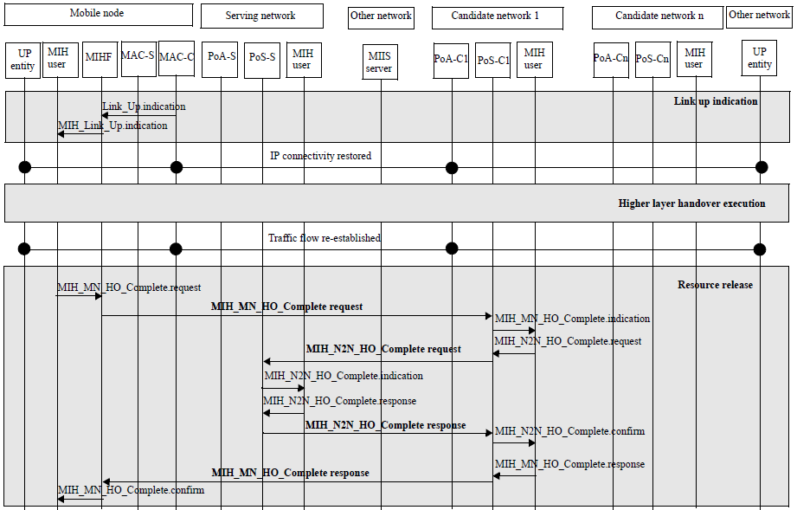
Network-initiated HO procedure
At this stage IP Mobility can be finalized with the signaling

Slide 16
IEEE 802.21 Optimizations
Ways of knowing if a flow requires mobility
  Include in the MIS a way of knowing flow profiles (Mobility requirements)
  Events?
Use of .21 to move the information regarding the serving PoS to target PoS
Use of 21a to authenticate all of this?

Slide 17
References
[Seite-DMA]
  P. Seite, “Dynamic Mobility anchoring”, IETF Draft, May 2010 draft-seite-netext-dma-00.txt
[Bertin-DDMM]
  P. Bertin, S. Bonjour, and J.-M. Bonnin,
  “A Distributed Dynamic Mobility Management Scheme Designed for Flat IP Architectures”, in New Technologies, Mobility and Security, 2008. NTMS ’08., Nov. 2008, pp. 1–5
[FAMA]
  F. Giust, A. de la Oliva, C. J. Bernardos,
  “Flat Access and Mobility Architecture: an IPv6 Distributed Client Mobility Management solution”, under submission

