Slide 1
IEEE 802.21 MEDIA INDEPENDENT HO SERVICES
DCN: 21-12-0025-00-0000
Title: 802.11/21 Network Discovery and Selection Architecture
Date Submitted: March 12, 2012
Authors or Source(s): Peretz Feder, Ajay Rajkumar and Dan Gal(ALU), Anthony Chan (Huawei), Antonio de la Oliva (UC3M), Farrokh Khatibi (QCOM), Charlie Perkins (Tellabs), Dapeng Liu (China Mobile), Christian Niephaus (Fraunhofer), Yoshihiro Ohba (Toshiba), Juan Carlos Zuniga (InterDigital), Junghoon Jee (ETRI), Subir Das(ACS)
Abstract: This document shows how 802.21 can complement 802.11 interworking features to provide a complete system architecture

Slide 2
  IEEE 802.21 presentation release statements
This document has been prepared to assist the IEEE 802.21 Working Group. It is offered as a basis for discussion and is not binding on the contributing individual(s) or organization(s). The material in this document is subject to change in form and content after further study. The contributor(s) reserve(s) the right to add, amend or withdraw material contained herein.
The contributor grants a free, irrevocable license to the IEEE to incorporate material contained in this contribution, and any modifications thereof, in the creation of an IEEE Standards publication; to copyright in the IEEE’s name any IEEE Standards publication even though it may include portions of this contribution; and at the IEEE’s sole discretion to permit others to reproduce in whole or in part the resulting IEEE Standards publication. The contributor also acknowledges and accepts that this contribution may be made public by IEEE 802.21.
The contributor is familiar with IEEE patent policy, as stated in Section 6 of the IEEE-SA Standards Board bylaws <http://standards.ieee.org/guides/bylaws/sect6-7.html#6> and in Understanding Patent Issues During IEEE Standards Development http://standards.ieee.org/board/pat/faq.pdf>

Slide 3
Outline
Overview of IEEE 802.21
Overview of IEEE 802.11u (GAS/ANQP)
Relationship between Internetworking features
802.11/21 System Architecture
Conclusion

Slide 4
IEEE 802.21 Overview

Slide 5



Handovers: Who makes the Decision ?
Measurements
Triggers
IEEE 802.21
Neighbor Maps
Service Information
Network
(Operators)
Mobile Device
(User)

Slide 6
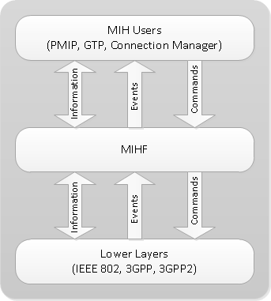
IEEE 802.21. Overview
IEEE 802.21-2008 aims at improving the user experience of mobile device users by facilitating handover between heterogeneous access networks
Media Independent Handover Function (MIHF)
  Mechanisms for network detection and selection
  Defined Services: Events, Commands, and Information
  The 802.21 layer belongs to the control plane
  Provides both L2 and L3 transports

Slide 7
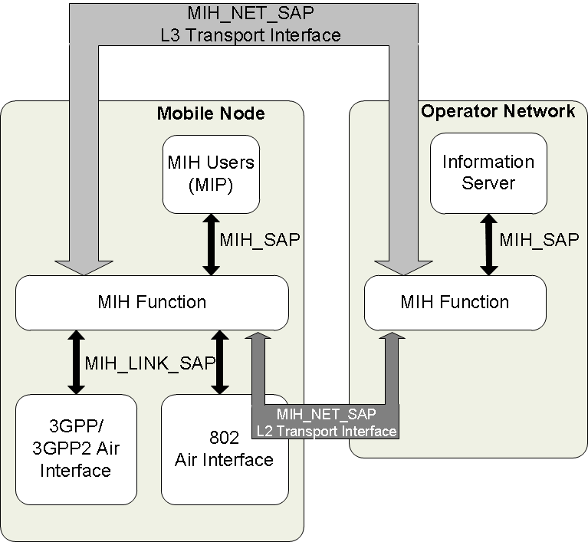
IEEE 802.21 Services
(Logical Diagram)
MIIS: Media Independent Information Service
  Acquire network information
  Information can be accessed from any technology
  Network selection
  Examples: neighbor maps, coverage zones, etc.

Slide 8
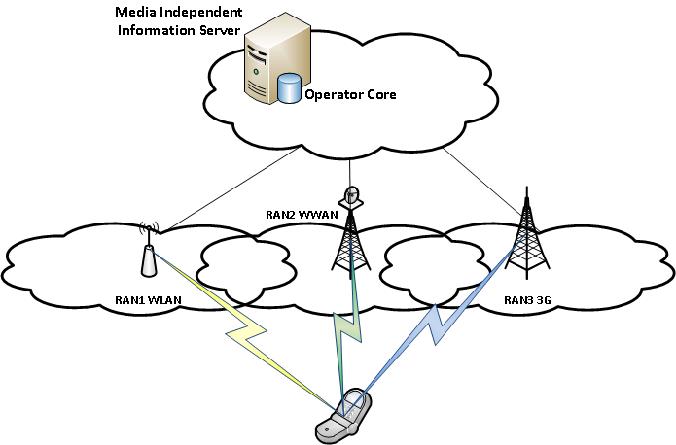
Media Independent Information Service
Stores Network Maps
List of Available Networks, e.g., 802.11/16, GSM, UMTS, LTE
Link Layer Information
  Neighbor Maps
Higher Layer Services (VoIP, Emergency (E911),VPN,..)
Network Type | SSID/ Cell ID | BSSID | Operator | Security | Channel | QoS | Higher layer Service | Data Rate
GSM/HSPA | 13989 | N/A | Oper-1 | UMTS/AKA | 1900 | N/A | E911 | 9.6 Kbps
LTE | 12345 | N/A | Oper-2 | UMTS/AKA | 700 | N/A | E911 | 40Mbps
802.11 | Enterprise | 00:00:… | Oper-3 | 802.11i | 6 | N/A | VPN | 54 Mbps
802.16e | 3456 | N/A | Oper-4 | PKM | 11 | Yes | VoIP | 40 Mbps

Slide 9
IEEE 802.11u Overview

Slide 10
802.11u Interworking Functions
• Network discovery and selection
  Allows for an architecture where external information server query is included
  Discovery of suitable networks through the advertisement of parameters via management frames, like access network type, roaming consortium, PLMN list, etc.
  Selection of a suitable IEEE 802.11 infrastructure using various services (e.g., Access Network Query Protocol (ANQP)) in the BSS
  Selection of an SSPN or external network with its corresponding IEEE 802.11 infrastructure

Slide 11
Complementary 802.11/21
System Architecture

Slide 12
802.21 Information Service Feature
802.21 Network Discovery and Selection function provides Information Service which is a MIH Information Server in the architecture
MIH protocol supports both L2 and L3 transports
    Ethertype is defined (IEEE Registry)
    UDP/TCP transport and ports are assigned by IANA (RFC 5677)
Similar to ANQP, MIH protocol defines a container to carry other messages
Information Service defines a number of Information Elements
  Vendor specific namespace is defined
  Provide both TLV and XML/RDF encodings

Slide 13
Similarities between 802.21 IS and 802.11
Attribute | 802.21 MIH IS | 802.11/ANQP
Inter-access (WLAN, 3G/4G) | Yes | 802.11 focused
AP Dependency | Yes | Yes
UE Dependency | Yes (Connection Mgr or client) | Yes (Connection Mgr)
AP Upgrade | Software upgrade | Software upgrade
UE Upgrade | Software upgrade | Software upgrade
Access selection based on Operator Policy (access characteristics, application requirements, subscriber profile, charging info., etc.) | Yes. WAN elements can be loaded through MIH exchange | Yes. WAN elements can be loaded through ANQP inquiry
Per APN Decision granularity | No | No
Standardization | IEEE-802.21-2009 | IEEE 802.11 -2011

Slide 14
System Architecture [802.11+802.21]

Slide 15
GAS/ANQP with MIH call Flow
STA
Provisioned Home Realm; FQDN
AP
Configured SSID
Information Server
MIH Information Server
Scan Request
Scan Response
Build the scan list;
Analyze SSIDs,
No AP to associate
Generated ANQP
GAS Init Req (bundled ANQP NAI + WAN…)
GAS Init Resp (Comeback Delay=1000TU …)
MIH [ANQP (IE) Request
MIH[ANQP(IE)] Response
GAS Comeback Req
GAS Comeback Resp
GAS Comeback Req
GAS Comeback Resp
Defrag ANQP;
Consolidate all inputs from all networks
Analyze ANQP;
Discover & select network
Association Req
802.11
802.21

Slide 16
Conclusion
A system architecture comprising 802.11 and 802.21 is straightforward
Industry requires such a capability
This an opportunity for IEEE 802 to provide a complete system solution
Some additional work may be required and it is an opportunity to work together
  802.21 is discussing a work item
  802.11 ISD SG work seems to be inline with 802.21 work item

