Slide 1
IEEE 802.21 MEDIA INDEPENDENT HANDOVER
DCN: 21-12-0028-03-0000
Title: P802.21d Group Management Framework
Date Submitted: March 14, 2012
To be Presented at IEEE802.15 WNG session #49 in Big Island
Authors or Source(s):
Yoshihiro Ohba and Toru Kambayashi (Toshiba), Antonio de la Oliva (UC3M), Stephen Chasko and Ruben Salazar (Landis+Gyr), Subir Das (ACS)
Abstract: This document describes a framework on group management in mesh networks in heterogeneous networks

Slide 2
  IEEE 802.21 presentation release statements
This document has been prepared to assist the IEEE 802.21 Working Group. It is offered as a basis for discussion and is not binding on the contributing individual(s) or organization(s). The material in this document is subject to change in form and content after further study. The contributor(s) reserve(s) the right to add, amend or withdraw material contained herein.
The contributor grants a free, irrevocable license to the IEEE to incorporate material contained in this contribution, and any modifications thereof, in the creation of an IEEE Standards publication; to copyright in the IEEE’s name any IEEE Standards publication even though it may include portions of this contribution; and at the IEEE’s sole discretion to permit others to reproduce in whole or in part the resulting IEEE Standards publication. The contributor also acknowledges and accepts that this contribution may be made public by IEEE 802.21.
The contributor is familiar with IEEE patent policy, as stated in Section 6 of the IEEE-SA Standards Board bylaws <http://standards.ieee.org/guides/bylaws/sect6-7.html#6> and in Understanding Patent Issues During IEEE Standards Development http://standards.ieee.org/board/pat/faq.pdf>

Slide 3
Background
In January 802.15 WNG/802.21 joint session, group management use cases in mesh network were presented
In this presentation we present following things:
  The proposed PAR ( P802.21d) and it’s objective
  Relationship with 802.15.5-2009 group management mechanisms

Slide 4
Group Management in Mesh Networks
(Presented Jan-2012, DCN 21-12-0009-01-0000)
Failover/Failback of an AMI network
  If the devices were no longer on one network, it is needed to perform failover or migrate/handover (or failback) devices to another network
  The takeout device (e.g., concentrator) is typically associated with a NAN (Neighborhood Area Network) segment
  If that device goes down, other devices will failover to a second NAN segment
Triggering configuration/maintenance to large number of mesh devices
  Use of group management signaling
AMI mesh network
segments
A segment (i.e., a group of devices) may be formed independently of physical locations of the devices

Slide 5
Proposed PAR

Slide 6
Purpose and Work Plan
The purpose of this proposed amendment is to define Group Management mechanisms within Media Independent Handover (MIH) Framework
Proposed Amendment (IEEE 802.21d) will extend the handover mechanisms for managing a large number of users as a group
  Using multicast mechanisms of the underlying technology
  Providing secure mechanisms to trigger configuration/ maintenance

Slide 7
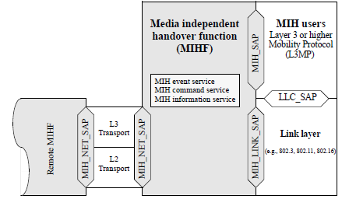
802.21 Existing Model

Slide 8
Relationship with 802.15.5-2009
Group Management Mechanisms

Slide 9
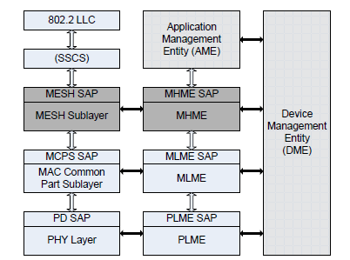
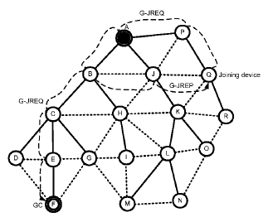
Group Mgmt in 802.15.5-2009
802.15.5 defines MHME (Mesh sublayer Management Entity) and its SAP over 802.15.4-2006, 802.15.3-2003 and 802.15.3b-2005 MAC
MHME SAP primitives for group management
  MHME-JOIN
  MHME-LEAVE
802.15.5 defines a protocol for general mesh service among MHMEs on different nodes
  G_JREQ/G_JREP message are exchanged to realize MHME-JOIN

Slide 10
Relationship with existing group management mechanisms
For link-layer group management mechanisms, mapping between MIH_Link SAP and media-specific SAP used for group management (e.g., 802.15.5 MHME SAP) will need to be defined
For IP group management mechanisms (IGMP, MLD), a modification of MIH_NET_SAP may be needed
Interface to
IP group management
Interface to
Media-specific
group management

Slide 11
Summary
If PAR is approved, 802.21d will define extensions to existing MIH services to perform group management, especially
  Define new primitives / attributes for group management
  Defining a mapping between MIH_LINK_SAP and existing media-specific SAPs for interface with L2 group management, and possibly modifying MIH_NET_SAP for interface with IP group management
  Multicast security mechanisms for group handover and group configuration/maintenance commands
Input and active participation from 802.15 members are encouraged

