Slide 1
IEEE 802.21 MEDIA INDEPENDENT HANDOVER
DCN: 21-12-0109-00-0000
Title: 8/29/2012 802.21c interim document discussion, IE requirements
Date Submitted: Aug. 29, 2012
Authors or Source(s): Charlie Perkins
Abstract:
This document proposes new IEs to support SPoS key distribution for optimized handovers, and raises some issues for discussion during the Aug. 29, 2012 802.21(c) teleconference.

Slide 2
Issues
Naming: Should “PoS” replace “MGW”?
Conformance to key hierarchy in 802.21a
New IE needed for key distribution formula
IE needed for MN to inform SPoS about desired RAT
Discussion around Figure N.6.1 and descriptions of steps

Slide 3
Should “PoS” replace “MGW”?
Name “MGW” was originally chosen to indicate that the SRHO document was relevant to a particular class of PoS
But this is obvious and implicit within the 802.21c document, and would likely remain obvious even if 802.21c is folded into the main document
The change would have to be propagated into the figures also, making for a bit more time-consuming editing.
Even though a nontrivial change, I think it is worthwhile to avoid creating additional terminology. Too much terminology is already an impediment to clarity of the documents, and leads to inconsistencies.

Slide 4
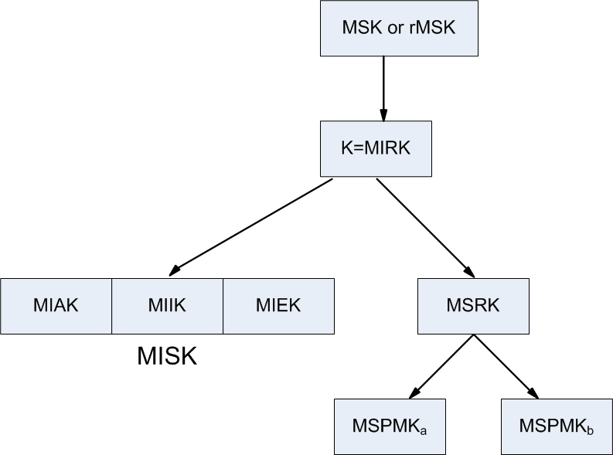
Conform to key 802.21a hierarchy
Need to make sure that key derivation in section 11.6.1 conforms to this key hierarchy

Slide 5
New IE needed for MIRK, etc
Here, define “MNID” to mean MNnetworkaccessid, and “TPoS_ID” to mean TPoS_Identifier. MIRK is K_{tmgw}
SPoS payload to TPoS must contain:
  MNID, Nonce, [K_{tmgw} ⊕ PNG_{stmgw} (MNID, Nonce)]
SPoS payload to MN must contain:
  TPoS_ID, Nonce, [K_{tmgw} ⊕ PNG_{smgw} (TPoS_ID, Nonce)]
New IE needed to provide [K_{tmgw} ⊕ PNG (ID, Nonce)]
Also, MN needs IE to enable SPoS to identify the proper TPoS
  Preferred RAT
  SSID
  BSID
  …

Slide 6
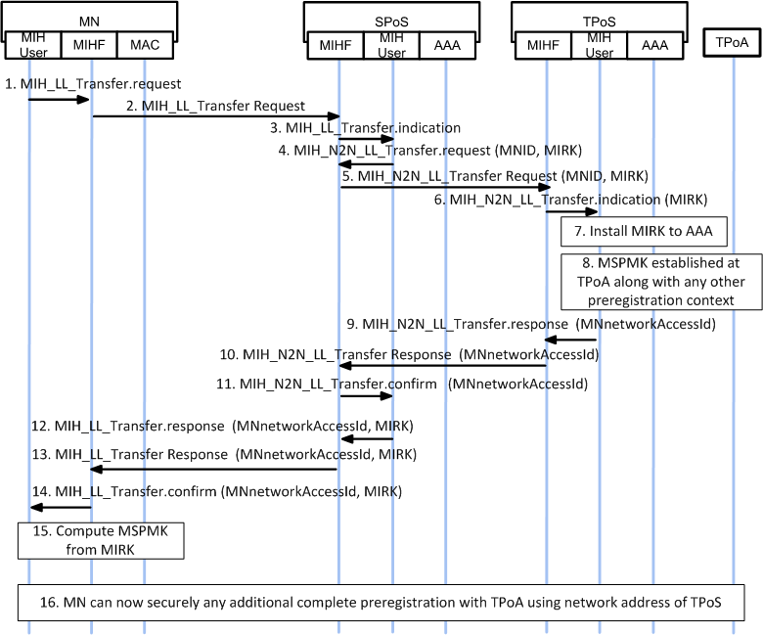
Figure N.6.1 discussion

