Slide 1
IEEE 802.21 MEDIA INDEPENDENT HANDOVER
DCN: 21-12-0125-00-srho
Title: Discussion of SRHO Draft Status
Date Submitted: September 18, 2012
Presented at IEEE 802.21c Meeting, Indian Wells Interim
Authors or Source(s): Charles Perkins
Abstract: Some problems have caused delays in the completion of the SRHO 802.21c draft document. This presentation lists some of the issues in order to find resolution

Slide 2
  IEEE 802.21 presentation release statements
This document has been prepared to assist the IEEE 802.21 Working Group. It is offered as a basis for discussion and is not binding on the contributing individual(s) or organization(s). The material in this document is subject to change in form and content after further study. The contributor(s) reserve(s) the right to add, amend or withdraw material contained herein.
The contributor grants a free, irrevocable license to the IEEE to incorporate material contained in this contribution, and any modifications thereof, in the creation of an IEEE Standards publication; to copyright in the IEEE’s name any IEEE Standards publication even though it may include portions of this contribution; and at the IEEE’s sole discretion to permit others to reproduce in whole or in part the resulting IEEE Standards publication. The contributor also acknowledges and accepts that this contribution may be made public by IEEE 802.21.
The contributor is familiar with IEEE patent policy, as stated in Section 6 of the IEEE-SA Standards Board bylaws <http://standards.ieee.org/guides/bylaws/sect6-7.html#6> and in Understanding Patent Issues During IEEE Standards Development http://standards.ieee.org/board/pat/faq.pdf>

Slide 3
Some issues to be resolved
My problem: unfamiliarity with some of the design
  And the design philosophy
  By now this problem is mostly resolved, but not completely
Updating figures is very slow
  Visio → PowerPoint is often irreversible!!
  PowerPoint figure drawing has many bugs!
  Help will be gratefully accepted
  Are my small reorganizations acceptable?
Language needed to insure independence of SRHO features from previous parts of 802.21 specification
  In particular, to enable use of PoS terminology without requiring implementation of specific MICS, MIES, or MIIS features
  Where should it go??

Slide 4
Target network control frame
C-GW forwards L2 frame to Target POA
 | MICF SRCF | TCP or UDP/ IP |  | TCP or UDP/ IP | MICF SRCF
L2(2) |  | L2(1) |  | L2 |  | L2
PHY(2) |  | PHY(1) |  | PHY |  | PHY
MN’s target interface |  | MN’s source interface |  | - | PoS
MICSAP
MICSAP
MICSAP
MiCLSAP
L2(2) control frame
MICF hdr |  | MICF hdr
TCP or UDP/ IP hdr |  | TCP or UDP/ IP hdr
L2(1) hdr |  | L2 hdr
PHY(1) hdr |  | PHY hdr
MN |  | PoS

Slide 5
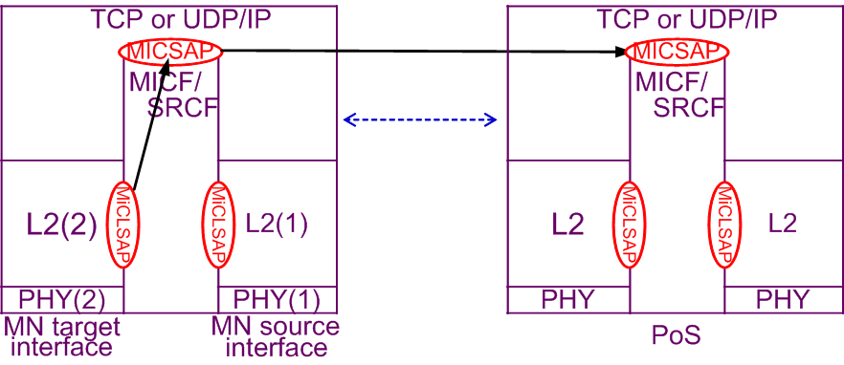
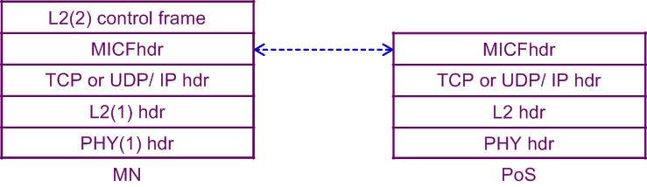
Target network control frame
PoS forwards L2 frame to Target PoA

Slide 6



PoS forwards MN’s Target L2 frame to Target PoA
MICF /SRCF
MICF /SRCF
TCP or UDP/ IP
TCP or UDP/ IP
L2(2)
L2(1)
L2
L2
PHY(2)
PHY(1)
PHY
PHY
MN target interface
MN source interface
PoS
L2(2) control frame
MICF hdr
MICF hdr
TCP or UDP/ IP hdr
TCP or UDP/ IP hdr
L2(1) hdr
L2 hdr
PHY(1) hdr
PHY hdr
MN
PoS

Slide 7
PoS forwards MN’s Target L2 frame to Target PoA
MICF /SRCF
MICF /SRCF
TCP or UDP/ IP
TCP or UDP/ IP
L2(2)
L2(1)
L2
L2
PHY(2)
PHY(1)
PHY
PHY
MN target interface
MN source interface
PoS
L2(2) control frame
MICF hdr
MICF hdr
TCP or UDP/ IP hdr
TCP or UDP/ IP hdr
L2(1) hdr
L2 hdr
PHY(1) hdr
PHY hdr
MN
PoS

Slide 8
Remaining questions on key dist.
Is the key K_{tpos} considered to be MSPMK or MISK?
Should MN and TPoS use algorithm in 10.2.1.2?
For fastest handover preparation with fewest round trips, channel allocation, tunnel setup, etc. should occur at same time as SA establishment. This can be done by including L2 frames along with the request for SA establishment, as long as that is permissible in the protocol.

