Slide 1
IEEE 802.21 MEDIA INDEPENDENT HANDOVER
DCN: 21-13-0043-00-0000
Title: New scenarios for 802.21.1, and some corrections
Date Submitted: March 11, 2013
To be presented at…
Authors or Source(s):
Daniel Corujo (ITAV)
Carlos Guimarães (ITAV)
Antonio de la Oliva (UC3M)
Abstract: This document contains a list of potential scenarios related to the utilization of MIH mechanisms en sensor environments.

Slide 2
  IEEE 802.21 presentation release statements
This document has been prepared to assist the IEEE 802.21 Working Group. It is offered as a basis for discussion and is not binding on the contributing individual(s) or organization(s). The material in this document is subject to change in form and content after further study. The contributor(s) reserve(s) the right to add, amend or withdraw material contained herein.
The contributor grants a free, irrevocable license to the IEEE to incorporate material contained in this contribution, and any modifications thereof, in the creation of an IEEE Standards publication; to copyright in the IEEE’s name any IEEE Standards publication even though it may include portions of this contribution; and at the IEEE’s sole discretion to permit others to reproduce in whole or in part the resulting IEEE Standards publication. The contributor also acknowledges and accepts that this contribution may be made public by IEEE 802.21.
The contributor is familiar with IEEE patent policy, as stated in Section 6 of the IEEE-SA Standards Board bylaws <http://standards.ieee.org/guides/bylaws/sect6-7.html#6> and in Understanding Patent Issues During IEEE Standards Development http://standards.ieee.org/board/pat/faq.pdf>

Slide 3
Topics
The Role of 802.21 in sensor/Internet-of-Things scenarios
  Possibility of Proxy MIH behavior
Data Type corrections needed on the base standard
Improving robustness of the MIH Protocol state machine
MIH Capability Discovery information enhancement per link
Hierarchical MIIS
High-level MIIS information
New network link events

Slide 4
Sensors?
Evolutions in electronic miniaturization and wireless technologies, are changing the sensor-related scenarios landscape
  Sensors with more than one radio device/technology
  Coupled with opportunistic connection management logic
  Beyond sensors → into the Internet of Things (IoT)
    Multitude of devices able to
      Send EVENTS
      And receive COMMANDS

Slide 5
Special Requirements
Sensors can now be found beyond single-purpose devices
  Home automation
  Even your smartphone has many sensors
However, typical sensor-related issues still plague these IoT Scenarios
  Battery consumption
  Low transmission power
  Low computation power
  Low memory
  …
As such, the way is open for supportive management protocols to assist in OPTIMIZING sensor linking and usage
  Such as the link commands from 802.21

Slide 6
Disclaimer
Sensor links? That is old news!!!
Not really… typically when one considers wireless links involving sensors, one starts to think about sensor networks
But, that might no longer be the case!
  Why?
Because IoT goes beyond sensor-devices into an interconnected heterogeneous-device environment
  E.g., Smart Environments
As such, typical sensor optimization mechanisms no longer fall into place (they just care for sensor mesh/ad-hoc routing)
Plus, current “trendy” high-level control/management mechanisms for IoT (e.g., REST, ETSI, OASIS, etc.), require the support of high-level network stack protocols
  Which, depending of the device, might not be supported

Slide 7
The role of MIH in Sensor Scenarios
Concretely, MIH can contribute to Sensor-related scenarios, by providing link layer commands and events
  Able to operate at Link Layer level
    E.g., transported in control frames
Moreover, the PoS can reside in Sensor Gateways, which is typically the interconnecting node between sensors and the remainder of the network
  E.g., collocated PoA/PoS scenarios are also supported

Slide 8
Scenario Examples
Scenario 1 – Registration and Capability Exchange
  Off-the-shelf sensor/devices can be purchased and connected to an wireless access network. Through MIH, the operator is able to receive information about multi-link capabilities of the device, empowering a PoS for link connection optimization
Scenario 2 – Link signal threshold configuration
  These devices can be configured with a signal threshold to report on the current link signal condition deterioration, enabling handover opportunities
Scenario 2 – Energy-efficient scenarios
  A Link_Going_Down event can be generated when the battery levels are down. This can motivate the notification to the network for some action, as well as prompting for a handover to another technology less energy consuming.

Slide 9
Evolutions
Typically, sensors have low capabilities, and thus need to connect to a Gateway node
This gateway node, in turn, is responsible for managing the controlling aspects of the sensors, and to manage their connection to the network
This can leverage some simple extended MIH behavior, such as Proxy-MIH
Sensors
MIIS
PoA
Proxy-PoS
PoS

Slide 10
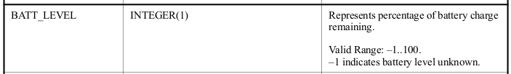
Data types inconsistencies
The following slides presents a set of inconsistencies discovered in the IEEE 802.21 data types base standard.
BATT_LEVEL is defined as a signed integer but “-1” is a valid value.
  Suggestion: change BATT_LEVEL from an INTEGER(1) to an UNSIGNED_INT(1)

Slide 11
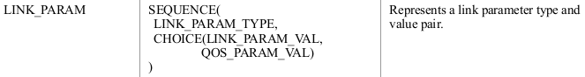
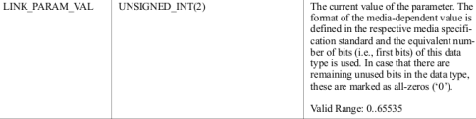
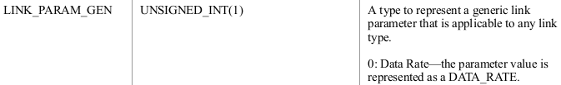
Data types inconsistencies
LINK_PARAM
If LINK_PARAM_TYPE is a LINK_PARAM_GEN with value “0” (data rate) “the parameter value is represented as a DATA_RATE”, which is an UNSIGNED_INT(4). However, LINK_PARAM_VAL (which is an UNSIGNED_INT(2) ) is not sufficient to accomodate the DATA_RATE value.
    Suggestion: change LINK_PARAM_VAL from an UNSIGNED_INT(2) to an UNSIGNED_INT(4)

Slide 12
Improving Robustness of
State Machines
Current state machines can be easily hacked
  Source and destination state machines do not verify the SID and AID of response the message.
    A response message with a different AID and SID will always be forwarded by the state machines an long as there is a previous request for the same TID.
  Source and destination state machines do not verify the OPCODE of response messages.
    Any type of message (request/response/indication) can be sent in response to a request message, an long as there is a previous request for the same TID.

Slide 13
MIH Capability Discover information limitation
Different link-layers can have different capabilities, which can be requested individually by the MIHF.
MIH_Capabilities_Discover messages and primitives allow an MIH-User to convey the locally supported MIH capabilities to the requestor MIH-User.
However, these messages and primitives only allow to specify a bitmap of the supported events and commands on the local MIHF by all link, not allowing to specify the capabilities of each link-layer individually.
Suggestion:
  Allow sending a separate list of capabilities, per link
    i.e., a list of bitmaps (one bitmap per link)
Example
  My WiFi card supports link_detected and link_action, but my 3G card only supports link_action

Slide 14
Hierarchical MIIS
Hierarchical Information
  Services replying to information requests about PoAs do not need to have information about the whole infra-structure of the operator/domain
  The hierarchical deployment of this information allows it to be deployed into servers by zone, or domain.
  Queries about detected PoAs, but belonging to another domain/zone, can be forwarded to a information server existing in a higher level of the hierarchy
Global MIIS
Local MIIS #1
Local MIIS #2
AP1
AP1
AP2
AP2

Slide 15
High-Level MIIS information
The MIIS could be coupled with high-level information
  Assisting PoA selection by the user
Examples of information
  Video-Services (i.e., better QoS/exclusive content)
  Emergency Services
This information could be normalized
  Using new developed I.E.
Or left open to be defined by the operator/deployed

Slide 16
New Network Link Layers
In our research, we often consider the possibilities from having events being generated by PoAs
Here, of high interest, would be Link_Parameters_Change events related to network aspects such as
  Load
  User attached/dettached
  …
These events could be used to trigger other management procedures on the network
However, requires common base of events throughout the different technologies

