Slide 1
IEEE 802.21
DCN: 21-17-0033-00-0000
Title: Bandwidth and Latency Requirements for Virtual Reality
Date Submitted: July 06, 2017
IEEE 802.21 session #81 in Berlin, Germany
Authors or Source(s):
Eun-Seok Ryu esryu@gachon.ac.kr (Gachon University)
Sangkwon Peter Jeong ceo@joyfun.kr (JoyFun Inc.,)
Dongil Dillon Seo dillon@volercreative.com (VoleRCreative)
Abstract: Determining bandwidth and latency requirements for Virtual Reality using the LAB data.

Slide 2
  IEEE 802.21 presentation release statements
This document has been prepared to assist the IEEE 802.21 Working Group. It is offered as a basis for discussion and is not binding on the contributing individual(s) or organization(s). The material in this document is subject to change in form and content after further study. The contributor(s) reserve(s) the right to add, amend or withdraw material contained herein.
The contributor grants a free, irrevocable license to the IEEE to incorporate material contained in this contribution, and any modifications thereof, in the creation of an IEEE Standards publication; to copyright in the IEEE’s name any IEEE Standards publication even though it may include portions of this contribution; and at the IEEE’s sole discretion to permit others to reproduce in whole or in part the resulting IEEE Standards publication. The contributor also acknowledges and accepts that this contribution may be made public by IEEE 802.21.
The contributor is familiar with IEEE patent policy, as stated in Section 6 of the IEEE-SA Standards Board bylaws <http://standards.ieee.org/guides/bylaws/sect6-7.html#6> and in Understanding Patent Issues During IEEE Standards Development http://standards.ieee.org/board/pat/faq.pdf>

Slide 3
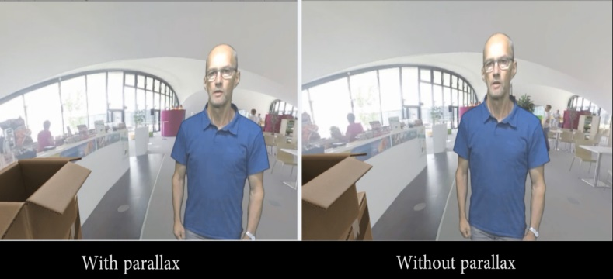
Quality Requirements for VR
Announced by Technicolor, Oct. 2016 (m39532, MPEG 116th Meeting)
Requirement | details
pixels/degree | - 40 pix/deg - no HMD is capable of displaying 40pix/deg today
video resolution | - 3 times 4K(3840x1920) vertical resolution = 11520x6480
framerate | - 90 fps - a 90fps framerate offers a latency low enough to prevent nausea
3D Audio | - support of scene-based and/or environmental audio - 360 surround sound, object-based audio, Ambisonics
motion-to-photon latency & motion-to-audio latency | - how much time there is between the user interacts and an image / audio - maximum 20ms
foreground & parallax | - objects in the foreground shall be far enough to prevent nausea - if objects are too close it is likely they can become an important cause of nausea - interactive parallax with background shall be present for such objects - pic1 shows how it is possible to look behind the figure in the foreground
Fig. 1. Importance of parallax.
3

Slide 4
16K(15360x7680) Bitrate
Producing 16K video data by merging 4K Test Sequence(3840x1920)
  AerialCity, DrivingInCity, DrivingInCountry, PoleVault (name of the sequence)
Using the HM 16.6 Reference Software
Encoded only 10 frames to measure the Bitrate at pilot
  Under our test environment 7 hours of encoding time was required to encode 10 frames of 16K video data.
  Due to this circumstance that 10 frames of bitrate was chosen arbitrarily.
Coding Structure | Quantization Parameter | 16K Bitrate | 12K Bitrate (approximate)
RA | 37 | 106 Mbps | 66 Mbps
 | 32 | 200 Mbps | 126 Mbps
 | 22 | 947 Mbps | 596 Mbps
LDB | 37 | 111 Mbps | 69 Mbps
 | 32 | 215 Mbps | 135 Mbps
 | 22 | 1,094 Mbps | 689 Mbps
※ RA: Random Access
※ LDB: Low Delay Big-picture
※ HM: HEVC test Model (reference software of the H.265 Standard)

