Slide 1
IEEE 802.21
DCN: 21-17-0034-00
Title: Presentation of ‘Network Requirement according to compression CODEC for 4K UHD Service’
Date Submitted: July 7, 2017
IEEE 802.21 session #81 in Berlin, Germany
Authors or Source(s):
JinHo Jeong jiniehee@gmail.com (Greencloud Co., Ltd.)
HyeonWoo Nam hwnam@dongduk.ac.kr (Dongduk Women’s University)
Sangkwon Peter Jeong ceo@joyfun.kr (JoyFun Inc.,)
Abstract: Network Requirement according to compression CODEC for 4K UHD Service

Slide 2
  IEEE 802.21 presentation release statements
This document has been prepared to assist the IEEE 802.21 Working Group. It is offered as a basis for discussion and is not binding on the contributing individual(s) or organization(s). The material in this document is subject to change in form and content after further study. The contributor(s) reserve(s) the right to add, amend or withdraw material contained herein.
The contributor grants a free, irrevocable license to the IEEE to incorporate material contained in this contribution, and any modifications thereof, in the creation of an IEEE Standards publication; to copyright in the IEEE’s name any IEEE Standards publication even though it may include portions of this contribution; and at the IEEE’s sole discretion to permit others to reproduce in whole or in part the resulting IEEE Standards publication. The contributor also acknowledges and accepts that this contribution may be made public by IEEE 802.21.
The contributor is familiar with IEEE patent policy, as stated in Section 6 of the IEEE-SA Standards Board bylaws <http://standards.ieee.org/guides/bylaws/sect6-7.html#6> and in Understanding Patent Issues During IEEE Standards Development http://standards.ieee.org/board/pat/faq.pdf>

Slide 3
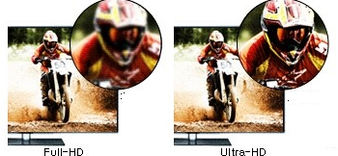
Definition
Table 1 Comparison of Pixel and Resolution
Method | Pixel | Resolution
HD | 1,036,800 | 1,366 x 768
Full-HD | 2,073,600 | 1,920 x 1,080
4K UHD | 8,294,400 | 3,840 x 2,160
3
Full-HD (Full High Definition): a set of HDTV high-definition video modes characterized by 1080 horizontal lines of vertical resolution for progressive scan.
4K UHD (4k Ultra High Definition): the digital video format which the International Telecommunication Union (ITU) approves as one among the next generation high definition video quality standard corresponding to standard of the aspect ratio 16:9 and number of pixels 8,294,400 and screen resolution 3840X2160. 4K UHD applies for the video having the number of pixels of the quadruple in comparison with the Full HD.

Slide 4
Definition(cont’d)
Table 1 Comparison of Pixel and Resolution
4
Bit Rate: the data size of the bit unit which has to handle per second. The bps (bit per second) is used as the unit.
CBR (Constant Bit Rate): the way that it compresses each frame comprising the video into the uniform capacity.
VBR (Variable Bit Rate): the way that it analyze the difference of each frames and stores as the relative low capacity in the part the movement writing and stores as the high-capacity in the part which there is a lot of the movement. i.e. the way that it compresses into the capacity which is not fixed according to the movement of the image inside.
Frame Rate: the size of the frame which it has to handle per second. It is the meaning like the fps (frame per second).

Slide 5
Comparison of Typical Smartphone
Table 1 Comparison of Pixel and Resolution
 | SAMSUNG |  |  | LG |  | APPLE
Product | Galaxy S8 | Galaxy S8+ | Galaxy Note 8 | G6 | G6+ | iphone 7 | iphone 7+
Resolution | 2960x1440 | 2960x1440 | 2560x1440 | 2880x1440 | 2880x1440 | 1920x1080 | 1920x1080
5
Table shows that resolution of the most of latest smart phones can apply for 4K UHD.

Slide 6
Computation of Bit Rate
Table 1 Comparison of Pixel and Resolution
6
Equation for computation of Bit Rate:
  Video Area Bit Rate=(Y Resolution+Cb Resolution+Cr Resolution)×# of Quantization Bit×fps
  Audio Area Bit Rate=Sampling Rate×Sampling Bit×# of Channel
  Video Bit Rate=Video Area Bit Rate+Audio Area Bit Rate
[Example] Computation of Bit Rate:
  Condition: non-compressed 4KU HD video made of (Stereo, 16bit, 48KHz) audio and (8bit, YCbCr 4:2:2 sampling, 29.97 fps) video
  Video Area Bit Rate: (3840×2160+1920×2160+1920×1080)×8×90=10,450,944,000≒10.451 Gbps
  Audio Area Bit Rate: 48000×16×2=1536000bps=1500Kbps≒1.46 Mbps
  Video Bit Rate: 10.451Gbps+1.46Mbps≒10.452 Gbps

Slide 7
Compression Codec
Table 1 Comparison of Pixel and Resolution
7
H.264 (MPEG-4 AVC (Advanced Video Coding)): the most widely used file format for the recording, compression and distribution of the video.
H.265 (HEVC, High Efficiency Video Coding): a video compression standard, one of several potential successors to the widely used AVC (H.264 or MPEG-4 Part 10). In comparison to H.264, H.265 offers about double the data compression ratio at the same level of video quality, or substantially improved video quality at the same bit rate. It supports resolutions up to 8192×4320, including 8K UHD.

Slide 8
Feature of H.264
Table 1 Comparison of Pixel and Resolution
Level | Maximum Bitrate for Profile (Kbps) |  |  | Maximum Resolution@Maximum Frame Rate
 | BS, Main, Extended | High | High 10
1.0 | 64 | 80 | 192 | 128×96@30.9, 176×144@15.0
1.1 | 192 | 240 | 576 | 176×144@30.3, 320×240@10.0, 352×288@7.5
1.2 | 384 | 480 | 1,152 | 320×240@20.0, 352×288@15.2
Omitted
5.0 | 135,000 | 168,750 | 405,000 | 1920×1080@72.3, 2048×1024@72.0, 2048×1080@67.8, 2560×1920@30.7, 3672×1536@26.7
5.1 | 240,000 | 300,000 | 720,000 | 1920×1080@120.5, 2560×1920@51.2, 3840×2160@31.7, 4096×2048@30.0, 4096×2160@28.5, 4096×2304@26.7
5.2 | 240,000 | 300,000 | 720,000 | 1920×1080@172.0, 2560×1920@108.0, 3840×2160@66.8, 4096×2048@63.3, 4096×2160@60.0, 4096×2304@56.3
8
Table shows that level-wise feature of the H.264.
When the Frame Rate of 5.1 and 5.2 level supporting 4K UHD from H.264 is 31.7 fps and 66.8 fps, the Bit Rate needs 240 Mbps, 300 Mbps, 720 Mbps. If the Frame Rate of the video used in VR contents service is 90 fps, the maximum bit rate, as to the 1.5~3 times gets to grow bigger than the value in Table.

Slide 9
Feature of H.265
Table 1 Comparison of Pixel and Resolution
Level | Maximum Bit Rate(Kbps) |  | Maximum Resolution@Maximum Frame Rate
 | Average VBR | Maximum VBR
1 | 128 | - | 128×96@33, 176×144@15.0
2 | 1,500 | - | 176×144@100.0, 352×288@30.0
Omitted
5 | 25,000 | 100,000 | 1920×1080@128.0, 3840×2160@32.0, 4096×2160@30.0
5.1 | 40,000 | 160,000 | 1920×1080@256.0, 3840×2160@64.0, 4096×2160@60.0
5.2 | 60,000 | 240,000 | 1920×1080@300.0, 3840×2160@128.0, 4096×2160@120.0
6 | 60,000 | 240,000 | 3840×2160@128.0, 7680×4320@32.0, 8192×4320@30.0
6.1 | 120,000 | 480,000 | 3840×2160@256.0, 7680×4320@64.0, 8192×4320@60.0
6.2 | 240,000 | 800,000 | 3840×2160@300.0, 7680×4320@128.0, 8192×4320@120.0
9
Table shows that level-wise feature of the H.265.
When the Frame Rate of 6, 6.1 and 6.2 level supporting 4K UHD from H.265 is 128 fps, 256 fps, 300 fps, the bit rate which is less than H.264 is needed.
However, when comparing with H.264, it is on the rise as the problem that operation capacity more than the 5 times and 2 times is required in the encoding and decoding process.

Slide 10
Need of Compression
Table 1 Comparison of Pixel and Resolution
10
The compression is needed so that the user can take advantage of VR contents smoothly.
The H.264 and H.265 can be considered in order to compress the high definition high-quality video.
  HD channel 2 streams can be transmitted from 6MHz bandwidth which generally H.264 uses for the broadcasting.
  H.265 can transmit the HD channel 4 streams from 6MHz bandwidth.
Moreover, the H.265/MVC for 3D broadcasting is ready.
The operation capacity additionally needed for codec is not issued on network.
However, it is needed for the transmission without any error of the video file on network to understand codec and compression file system.

Slide 11
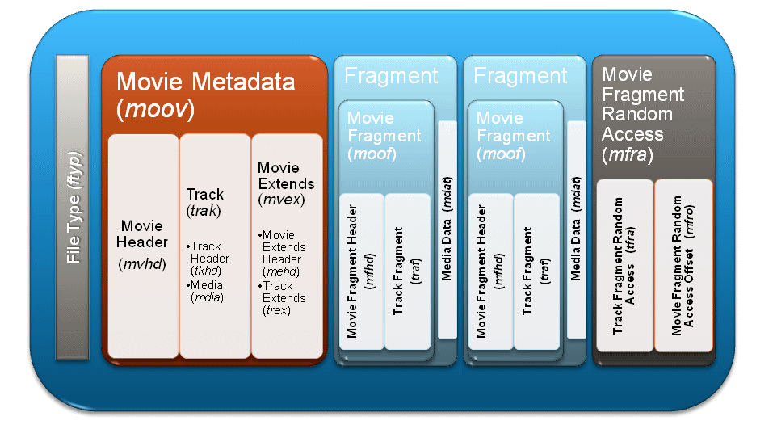
Architecture of Video File
Table 1 Comparison of Pixel and Resolution
11
Figure shows that Architecture of Video File.
When the data file is divided into the packet unit and it is transmitted, it has to be careful so that lost doesn't may come to the packet in which MVHD (Movie Header) is contained. But when file is transmitted from network, network doesn't have the way in which it can recognize the packet lost.
Therefore, it is the best way that it guarantees so that the total packet can be altogether normally transmitted.

Slide 12
Conclusion
Table 1 Comparison of Pixel and Resolution
12
The network of the good quality in which the contents can be steadily transmitted is needed in order to serve the stable QoE for the virtual reality service user.
It is the alternative would better securing the large-scale buffer for the stable mass file streaming. However, the memory Issue of the device has to be together considered.
Particularly, IEEE 802.21 is the committee dealing the Handover issue.
Therefore, the encoding problem and decoding problem that it can be generated in Handover is considered, it is necessary to suggest the solutions.
In the encoding problem and decoding problem that it can be generated in Handover, is there what?

