Slide 1
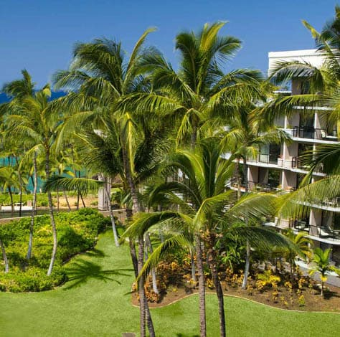
IEEE 802.21
Session #82
Big Island, HI, USA
WG Closing Plenary
Subir Das
sdas at vencorelabs dot com
Subir Das, Chair 802.21 WG

Slide 2
Meeting Updates
Working Group Update
Teleconferences
Motions
Future Locations
Subir Das, Chair, IEEE 802.21

Slide 3
WG Update
Presentation on Network requirements for IEEE P3079 and discussion on creating a white paper
  https://mentor.ieee.org/802.21/dcn/17/21-17-0045-00-0000-use-case-for-handover-occurrence-while-using-the-vr-service.docx
Met with ISO/JTC1/SC6
  https://mentor.ieee.org/802.11/dcn/17/11-17-1178-05-0jtc-jtc1-sc-agenda-for-hawaii-sep-2017.pptx
Discussed the IEEE-SA Press Release
Presentation on 802C
  https://mentor.ieee.org/802.11/dcn/17/11-17-1466-01-0000-local-mac-addresses-in-the-overview-and-architecture-based-on-ieee-std-802c.pptx
Presentation on EchoNet Lite
  https://mentor.ieee.org/802.21/dcn/17/21-17-0048-00-0000-report-on-echonet-lite-for-2017-09.ppt
Subir Das, Chair, IEEE 802.21

Slide 4
Teleconferences
October 16, 2017, 7:00-8:00 am, US EDT (8:00-9:00 pm, JST/KST)
Subir Das, Chair, IEEE 802.21

Slide 5
WG Motions

Slide 6
P802.21 WG Motion
Motion: Authorize the WG Chair to request the EC to forward IEEE P802.21-2017/cor1 to IEEE SA RevCom.
Moved by: Yoshikazu Hanatani
Seconded by : Hyeong Ho Lee
For: 06
Against: 00
Abstain: 00
Motion Passes
Slide 6

Slide 7
Future Sessions
Subir Das, Chair, IEEE 802.21

Slide 8
Future Session – 2017
Plenary: November 5-10, 2017, Caribe Hotel and Convention Center, Orlando, FL, USA
  Co-located with all 802 groups
Subir Das, Chair 802.21 WG

Slide 9
November Plenary Meeting Logistics
IEEE 802 Plenary Session, November 5-10, 2017 at the Caribe Royale in Orlando, Florida, USA.
Event Information: http://802world.org/plenary
Registration: https://www.regonline.com/ieee802plenarynovember17
REGISTRATION FEES & DEADLINES
  Early Registration
    $US 450.00 for attendees staying one or more nights at the Caribe Royale Orlando otherwise US $750.00
    Deadline: 6:00 PM Pacific Time, Friday, October 13, 2017
  Standard Registration
    $US 550.00 for attendees staying one or more nights at Caribe Royale Orlando otherwise $US 850.00 for all others
    Deadline: 6:00 PM Pacific Time, Friday, November 3, 2017
  Late/On-site Registration
  $US 750.00 for attendees staying one or more nights at Caribe Royale Orlando otherwise $US 1050.00
  After: 6:00 PM Pacific Time, Friday, November 3, 2017
Hotel Reservations
  https://reservations.travelclick.com/5636?groupID=1693692
IEEE 802 Room Rates
  Single/Double Occupancy*: $US 139.00 per night; 2 Bedroom Villa (4 Adult Occupancy)*: $US 285.00 per Night
IEEE 802 Group Rate Deadline: Friday, October 13, 2017, 8:00 PM Eastern Time
Subir Das, Chair 802.21 WG

Slide 10
Future Sessions – 2018
January 15-20, 2018, Hotel Irvine, Los Angeles, CA, USA
  Co-located with all 802 groups
Plenary: March 04-09, 2018, Hyatt Regency O’Hare, Rosemont, Illinois, USA
  Co-located with all 802 groups
Interim: May 06-11, 2018, Mariott, Warsaw, Poland
  Co-located with all wireless groups
Plenary: July 8-13, 2018, Manchester Grand Hyatt, San Diego, CA, USA
  Co-located with all 802 groups
Interim: September 09-14, 2018, Hilton Waikoloa Village, Kona, HI, USA, 802 Wireless Interim Session.
  Co-located with all 802 wireless groups
Plenary: November 11-16, 2017, Marriott Marquis Queen’s Park, Bangkok, Thailand
  Co-located with all 802 groups
Subir Das, Chair 802.21 WG

