Slide 1
IEEE 802.21 MEDIA INDEPENDENT HANDOVER SERVICES
DCN: 21-18-0033-00-0000
Title: Diagram for Network Enablers for seamless HMD based VR Content Service
Date Submitted: July 02, 2018
Presented at IEEE 802.21 session #86 – San Diego, California, USA
Authors or Source(s): Dongil Dillon Seo(VoleRCreative),
Peter Jeong(JoyFun), Minseok OH, Namgi KIM (Kyonggi U.)
Abstract: This document is distributed to help understand DCN 21-18-0029-01-0000.

Slide 2
  IEEE 802.21 presentation release statements
This document has been prepared to assist the IEEE 802.21 Working Group. It is offered as a basis for discussion and is not binding on the contributing individual(s) or organization(s). The material in this document is subject to change in form and content after further study. The contributor(s) reserve(s) the right to add, amend or withdraw material contained herein.
The contributor grants a free, irrevocable license to the IEEE to incorporate material contained in this contribution, and any modifications thereof, in the creation of an IEEE Standards publication; to copyright in the IEEE’s name any IEEE Standards publication even though it may include portions of this contribution; and at the IEEE’s sole discretion to permit others to reproduce in whole or in part the resulting IEEE Standards publication. The contributor also acknowledges and accepts that this contribution may be made public by IEEE 802.21.
The contributor is familiar with IEEE patent policy, as outlined in Section 6.3 of the IEEE-SA Standards Board Operations Manual <http://standards.ieee.org/guides/opman/sect6.html#6.3> and in Understanding Patent Issues During IEEE Standards Development http://standards.ieee.org/board/pat/guide.html>
  IEEE 802.21 presentation release statements
This document has been prepared to assist the IEEE 802.21 Working Group. It is offered as a basis for discussion and is not binding on the contributing individual(s) or organization(s). The material in this document is subject to change in form and content after further study. The contributor(s) reserve(s) the right to add, amend or withdraw material contained herein.
The contributor grants a free, irrevocable license to the IEEE to incorporate material contained in this contribution, and any modifications thereof, in the creation of an IEEE Standards publication; to copyright in the IEEE’s name any IEEE Standards publication even though it may include portions of this contribution; and at the IEEE’s sole discretion to permit others to reproduce in whole or in part the resulting IEEE Standards publication. The contributor also acknowledges and accepts that this contribution may be made public by IEEE 802.21.
The contributor is familiar with IEEE patent policy, as stated in Section 6 of the IEEE-SA Standards Board bylaws <http://standards.ieee.org/guides/bylaws/sect6-7.html#6> and in Understanding Patent Issues During IEEE Standards Development http://standards.ieee.org/board/pat/faq.pdf>

Slide 3
Abstract
The diagrams shown in this document are used in the document 'White Paper for Network Enablers for seamless HMD based VR Content Service'.
These diagrams should be used when you need more detail understanding or when you need to make modifications.

Slide 4
VR System
Total Motion-to-Photon Latency ≤20ms
HMD
Motion
Input
New Image
Output
①
1ms
⑦
Pixel
Switching
1ms
IMU
90Hz OLED Display 11ms
⑥
②
Write Display
Local Content Server
⑤
Data Processing Unit
2ms
Remote Content Server
③
④
Data Processing Unit
2ms

Slide 5
VR System
Total Motion-to-Photon Latency ≤20ms
HMD
Motion
Input
New Image
Output
1ms
Pixel
Switching
1ms
IMU
90Hz OLED Display
11ms
Write Display
Wired / Wireless Network
must be ≤ 5ms
Content Server
Data Processing Unit
2ms

Slide 6
Case | Status of each node |  |  |  |  |  |  | Remarks
 | ① | ② | ③ | ④ | ⑤ | ⑥ | ⑦
1 | direct | HDMI | Wired LAN | Wired LAN | HDMI | chip | display Panel | Wired Network
2 | direct | on Board | Wireless LAN | Wireless LAN | on Board | chip | display Panel | Wireless Network
3 | direct | on Board | Cellular network | Cellular network | on Board | chip | display Panel | Mobile Network
4 | direct | LAN | n/a | n/a | LAN | chip | display Panel | Local Network
5 | Sensor Network | HDMI | n/a | n/a | HDMI | chip | display Panel | Motion Sensing
6 | direct | on Board | Cellular network | Wireless LAN | on Board | chip | display Panel | Network Handover

Slide 7
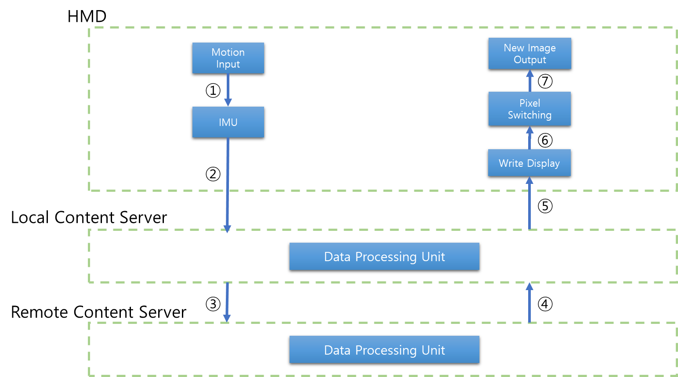
Case | Status of each node |  |  |  |  |  |  | Remarks
 | ① | ② | ③ | ④ | ⑤ | ⑥ | ⑦
1 | direct | HDMI | Wired LAN | Wired LAN | HDMI | chip | display Panel | Wired Network
2 | direct | on Board | Wireless LAN | Wireless LAN | on Board | chip | display Panel | Wireless Network
3 | direct | on Board | Cellular network | Cellular network | on Board | chip | display Panel | Mobile Network
4 | direct | LAN | n/a | n/a | LAN | chip | display Panel | Local Network
5 | Sensor Network | HDMI | n/a | n/a | HDMI | chip | display Panel | Motion Sensing
6 | direct | on Board | Cellular network | Wireless LAN | on Board | chip | display Panel | Network Handover

Slide 8
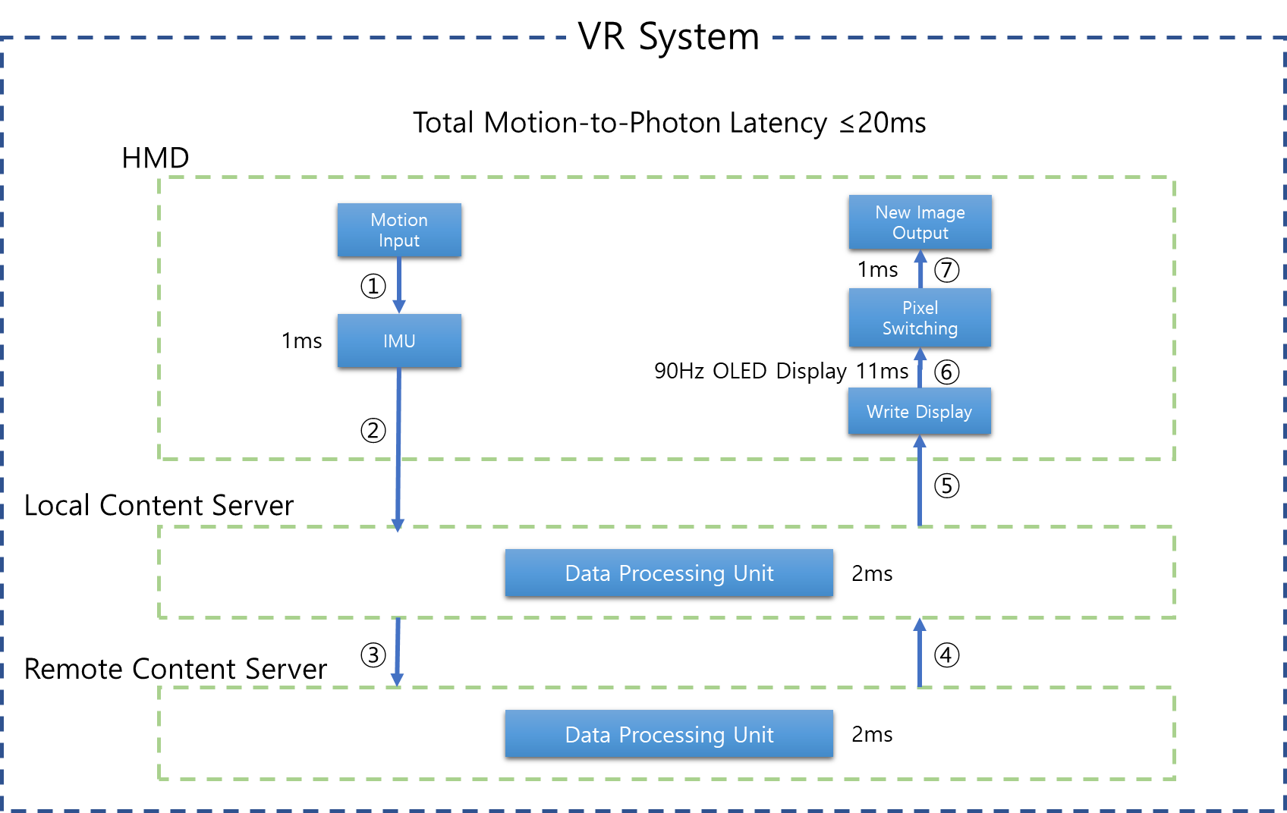
Case | Status of each node |  |  |  |  |  |  | Remarks
 | ① | ② | ③ | ④ | ⑤ | ⑥ | ⑦
1 | direct | HDMI | Wired LAN | Wired LAN | HDMI | chip | display Panel | Wired Network
2 | direct | on Board | Wireless LAN | Wireless LAN | on Board | chip | display Panel | Wireless Network
3 | direct | on Board | Cellular network | Cellular network | on Board | chip | display Panel | Mobile Network
4 | direct | LAN | n/a | n/a | LAN | chip | display Panel | Local Network
5 | Sensor Network | HDMI | n/a | n/a | HDMI | chip | display Panel | Motion Sensing
6 | direct | on Board | Cellular network | Wireless LAN | on Board | chip | display Panel | Network Handover

Slide 9

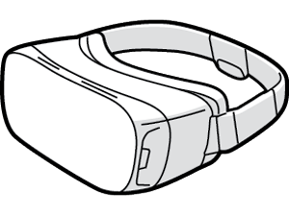
Local content server
Remote content server
VR HMD
wired
LAN
WAN
Local content server
Remote content server
VR HMD
wireless
LAN
WAN

Slide 10
VR HMD
Content server
cellular network
Content server
VR HMD
LAN

Slide 11
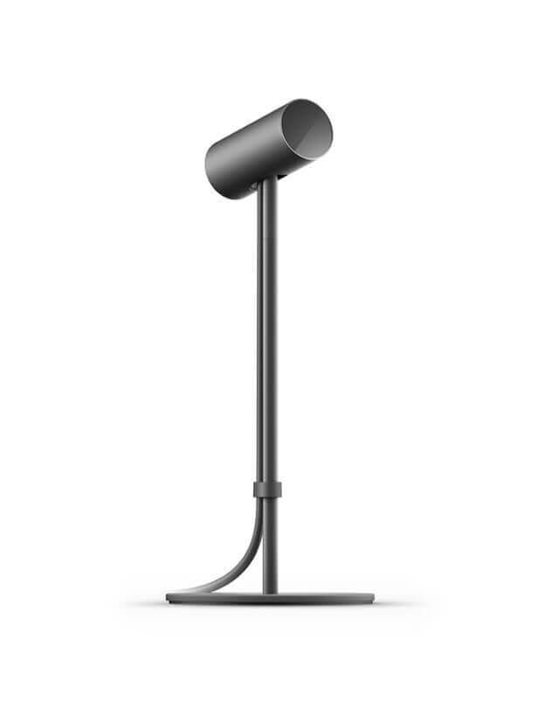
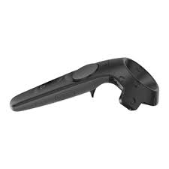
Motion detector
Content server
Controller
VR HMD

Slide 12
Case 1
Case 2
Case 3
Case 4
Case 5

Slide 13
References
[1] https://www.quora.com/What-causes-the-picture-delay-when-I-move-my-head-around-when-wearing-Oculus-or-Gear-VR

