Slide 1
IEEE 802.21 MEDIA INDEPENDENT HANDOVER
DCN: 21-1-0067-00-0000
Title: The Network Relevance in VR
Date Submitted: November 13, 2018
Presented at IEEE 802.21 session #88 Bangkok, Thailand
Authors or Source(s): Subir Das (Perspecta Labs)
Seo, Dong-Il Dillon (VoleR Creative)
Jeong, Sangkwon Peter (JoyFun)
Abstract: This document is to identify the industry problems for VR and to discuss the network relevance that will help to solve these problems.

Slide 2
  IEEE 802.21 presentation release statements
This document has been prepared to assist the IEEE 802.21 Working Group. It is offered as a basis for discussion and is not binding on the contributing individual(s) or organization(s). The material in this document is subject to change in form and content after further study. The contributor(s) reserve(s) the right to add, amend or withdraw material contained herein.
The contributor grants a free, irrevocable license to the IEEE to incorporate material contained in this contribution, and any modifications thereof, in the creation of an IEEE Standards publication; to copyright in the IEEE’s name any IEEE Standards publication even though it may include portions of this contribution; and at the IEEE’s sole discretion to permit others to reproduce in whole or in part the resulting IEEE Standards publication. The contributor also acknowledges and accepts that this contribution may be made public by IEEE 802.21.
The contributor is familiar with IEEE patent policy, as stated in Section 6 of the IEEE-SA Standards Board bylaws <http://standards.ieee.org/guides/bylaws/sect6-7.html#6> and in Understanding Patent Issues During IEEE Standards Development http://standards.ieee.org/board/pat/faq.pdf>
  IEEE 802.21 presentation release statements
This document has been prepared to assist the IEEE 802.21 Working Group. It is offered as a basis for discussion and is not binding on the contributing individual(s) or organization(s). The material in this document is subject to change in form and content after further study. The contributor(s) reserve(s) the right to add, amend or withdraw material contained herein.
The contributor grants a free, irrevocable license to the IEEE to incorporate material contained in this contribution, and any modifications thereof, in the creation of an IEEE Standards publication; to copyright in the IEEE’s name any IEEE Standards publication even though it may include portions of this contribution; and at the IEEE’s sole discretion to permit others to reproduce in whole or in part the resulting IEEE Standards publication. The contributor also acknowledges and accepts that this contribution may be made public by IEEE 802.21.
The contributor is familiar with IEEE patent policy, as outlined in Section 6.3 of the IEEE-SA Standards Board Operations Manual <http://standards.ieee.org/guides/opman/sect6.html#6.3> and in Understanding Patent Issues During IEEE Standards Development http://standards.ieee.org/board/pat/guide.html>

Slide 3
Table of Contents
Ⅰ
Industry Problems
Ⅱ
Industry Relevance
Ⅲ
Technical Challenges
Ⅳ
Goals & Objectives

Slide 4
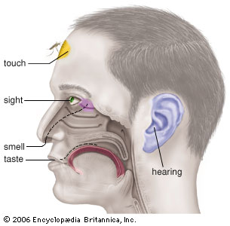
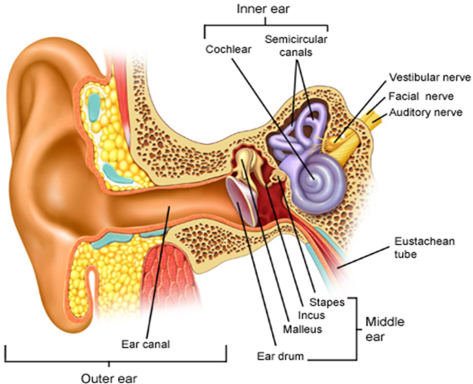
Industry Problems (VR Sickness)
Motion Sickness
Simulator Sickness
Sea Sickness
Cybersickness
Car Sickness
Air Sickness
VR Sickness
Space Sickness
Six Senses
VR sickness is a part of Motion Sickness and it is caused by the mismatch of information between the visually received information and the vestibular system.

Slide 5
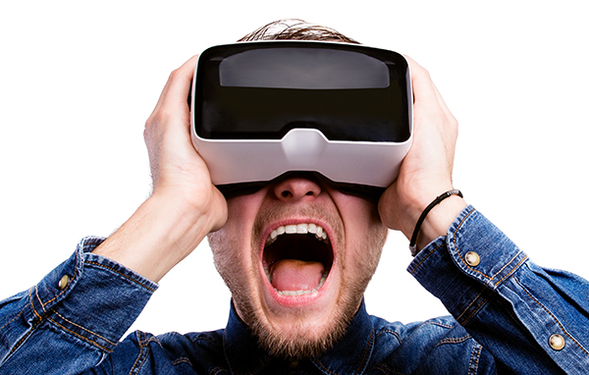



Industry Problems (QoE vs QoS)
VR HMD delivers S3D images directly to human eyes within 5 cm distance between the display and the eyes and this directly affects human sensory system.
VR content provides fully immersive experience where the user feels he/she is actually in the VR world, bad quality of experience can cause VR sickness easier than the normal flat screen (Hence, QoE is more important than QoS)
VS
Top-down Process
Bottom-up Process
Motion Sickness

Slide 6
Industry Relevance
Telecommunication Companies are exploring VR content to be the next killer app for 5G network
  VR Sickness and good QoE are necessary for the VR mass adoption
HMD manufacturers are creating stand-alone also known as all-in-one device to create a better QoE as it eliminates the cord that was attached to the device
  Added processor and batteries along with limited physical case space increase the weight and the heat
Content creators wish to create more compelling visual experience comparable to the modern PCs and gaming consoles for VR
  Powerful PCs that can run VR content with high visual fidelity are too expensive and the cord connecting the VR HMD and the PC limits the freedom of user movement
  Stand-alone device is not powerful enough to create high fidelity visuals which make the VR content less appealing compared to the PCs and gaming consoles
Platform holders want compelling VR content to grow their VR content ecosystem
  Lack of compelling VR content make people to not to reuse the VR HMD they purchased

Slide 7
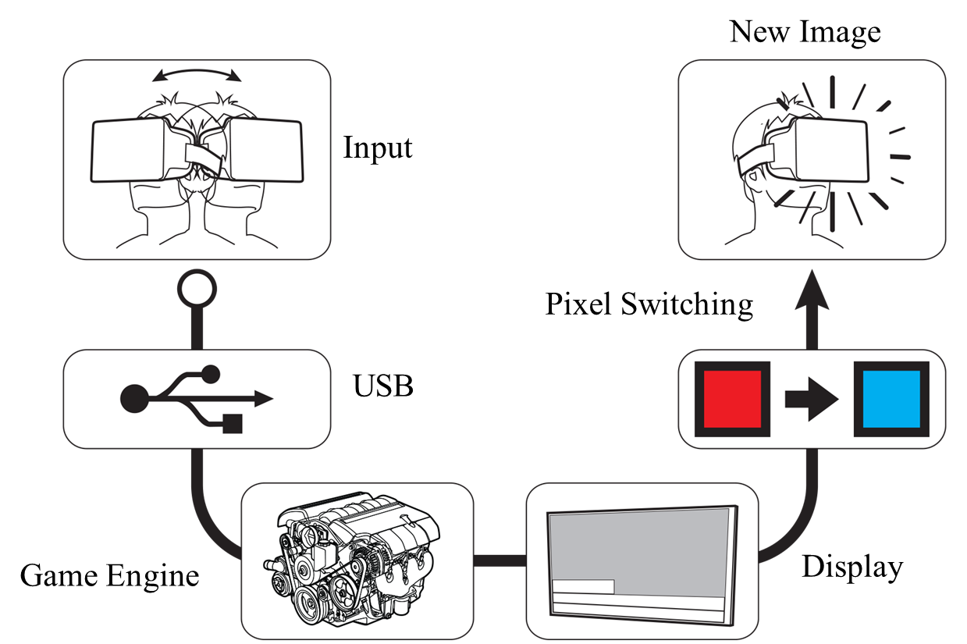


Technical Challenges
According to the paper published by Held, Efsathiou, & Greene in 1966,
if the MTP (motion-to-photon latency) is too high,
it makes people to feel motion sick.
The paper published by Sheridan & Ferrel in 1963 also states
that the high MTP also cause a poor manual performance of human being.
In 2003, Bernard D. Adelstein from NASA Ames Research Center mentioned in his paper, HEAD TRACKING LATENCY IN VIRTUAL ENVIRONMENTS: PSYCHOPHYSICS AND A MODEL, the MTP needs to be less than 17 ms.
According to John Carmack, the CTO of Oculus, the MTP must be lower than 20 ms to minimized the VR sickness.
Hence, the network latency needs to be satisfying this MTP latency condition.
Tracker
CPU
GPU
Display
Photons
Optics
Head motion
Under 20 milliseconds of latency for comfortability
User’s retina

Slide 8
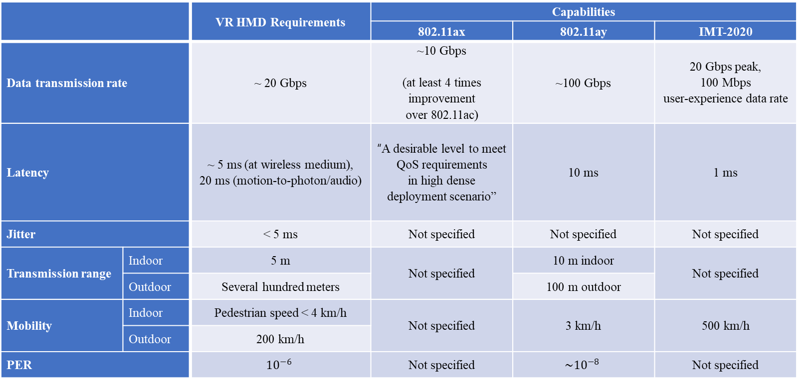
Goals & Objectives
 |  | VR HMD Requirements | Capabilities
 |  |  | 802.11ax | 802.11ay | IMT-2020
Data transmission rate |  | ~ 20 Gbps | ~10 Gbps (at least 4 times improvement over 802.11ac) | ~100 Gbps | 20 Gbps peak, 100 Mbps user-experience data rate
Latency |  | ~ 5 ms (at wireless medium), 20 ms (motion-to-photon/audio) | “A desirable level to meet QoS requirements in high dense deployment scenario” | 10 ms | 1 ms
Jitter |  | < 5 ms | Not specified | Not specified | Not specified
Transmission range | Indoor | 5 m | Not specified | 10 m indoor | Not specified
 | Outdoor | Several hundred meters |  | 100 m outdoor
Mobility | Indoor | Pedestrian speed < 4 km/h | Not specified | 3 km/h | 500 km/h
 | Outdoor | 200 km/h
PER |  | $${10}^{−6}$$ | Not specified | $$\sim {10}^{−8}$$ | Not specified

Slide 9
Conclusion
VR is a very important part of the future industries and many WGs in IEEE 802 are looking into development of standards for VR industrial needs.
Various Standard Organizations such as Khronos Group, ISO/IEC JTC1/SC24, SC29 WG11(MPEG), IEEE 3079, IEEE 2048 are developing technical standards for VR
One of the issues that is preventing the VR from the mass adoption is VR Sickness and Motion-to-Photon Latency is one of the major issues causing the VR sickness.
Motion-to-Photon Latency is directly related to the network issues that IEEE 802 should consider when developing network standards for VR.
To be more proactive to the VR industrial needs, we suggest to create a SG that will help us to create the PAR for future standard development.

