Slide 1
IEEE 802.21 MEDIA INDEPENDENT HANDOVER
DCN: 21-1-0071-00-0000
Title: HMD based Industrial(Shop/Street) Applications System AR/VR Content Visualization for AR/VR Commercialization
Date Submitted: November 14, 2018
Presented at IEEE 802.21 session #88 Bangkok, Thailand
Authors or Source(s): Jaesang Cha (SNUST), Vinayagam Mariappan (SNUST), MinwooLee (SNUST), Younggyu Kang, Daehyun Kim (Namuga Co., Ltd.), Juphil Cho (Kunsan Univ.), Byungjun Min, Jungjin Ra (Head IT Co., Ltd), Hyeong Ho Lee (Netvision Telecom Inc., Korea Univ.)
Abstract: This document is to describe the VR Commercialization for Industrial Training Application using HMD devices.

Slide 2
  IEEE 802.21 presentation release statements
This document has been prepared to assist the IEEE 802.21 Working Group. It is offered as a basis for discussion and is not binding on the contributing individual(s) or organization(s). The material in this document is subject to change in form and content after further study. The contributor(s) reserve(s) the right to add, amend or withdraw material contained herein.
The contributor grants a free, irrevocable license to the IEEE to incorporate material contained in this contribution, and any modifications thereof, in the creation of an IEEE Standards publication; to copyright in the IEEE’s name any IEEE Standards publication even though it may include portions of this contribution; and at the IEEE’s sole discretion to permit others to reproduce in whole or in part the resulting IEEE Standards publication. The contributor also acknowledges and accepts that this contribution may be made public by IEEE 802.21.
The contributor is familiar with IEEE patent policy, as stated in Section 6 of the IEEE-SA Standards Board bylaws <http://standards.ieee.org/guides/bylaws/sect6-7.html#6> and in Understanding Patent Issues During IEEE Standards Development http://standards.ieee.org/board/pat/faq.pdf>
  IEEE 802.21 presentation release statements
This document has been prepared to assist the IEEE 802.21 Working Group. It is offered as a basis for discussion and is not binding on the contributing individual(s) or organization(s). The material in this document is subject to change in form and content after further study. The contributor(s) reserve(s) the right to add, amend or withdraw material contained herein.
The contributor grants a free, irrevocable license to the IEEE to incorporate material contained in this contribution, and any modifications thereof, in the creation of an IEEE Standards publication; to copyright in the IEEE’s name any IEEE Standards publication even though it may include portions of this contribution; and at the IEEE’s sole discretion to permit others to reproduce in whole or in part the resulting IEEE Standards publication. The contributor also acknowledges and accepts that this contribution may be made public by IEEE 802.21.
The contributor is familiar with IEEE patent policy, as outlined in Section 6.3 of the IEEE-SA Standards Board Operations Manual <http://standards.ieee.org/guides/opman/sect6.html#6.3> and in Understanding Patent Issues During IEEE Standards Development http://standards.ieee.org/board/pat/guide.html>

Slide 3
Table of Contents
Ⅰ
Need of AR/VR in Industrial (Shop/Street) Application
Ⅱ
HMD-AR/VR in Industrial (Shop/Street) Application
Ⅲ
Conclusions

Slide 4
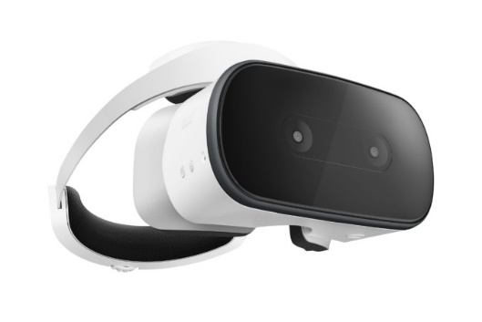
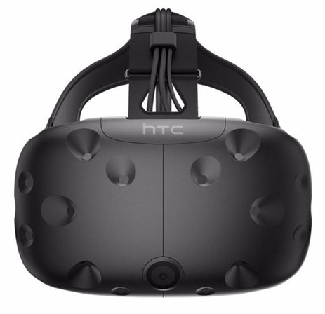
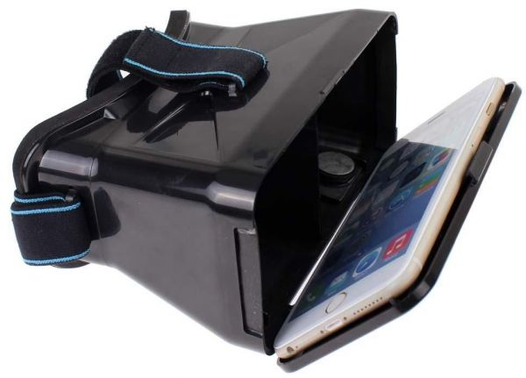
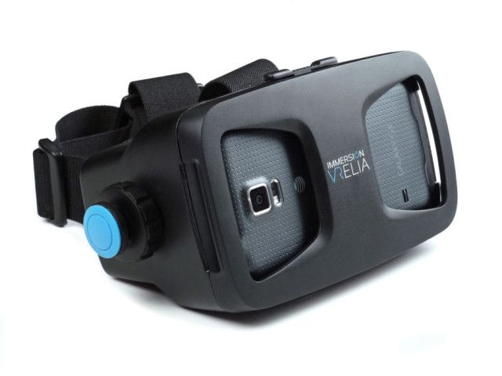
Need of AR/VR in Industrial(Shop/Street) Applications
Needs
  Need a new system to support teaching on behalf of teaching materials.
Basic Concept
  To Provide Training Information for Industrial Education Field
  Training System designed Using HMD-AR System that consists Display/Camera embedded HMD or Smart device Embedded HMD
  Provide additional information which education student related such as apparatus, how to use, manual, etc.
Display / Camera Embedded HMD
Smart Device Embedded HMD
  < Types of the HMD System >

Slide 5
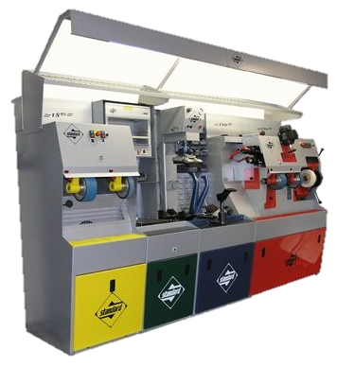
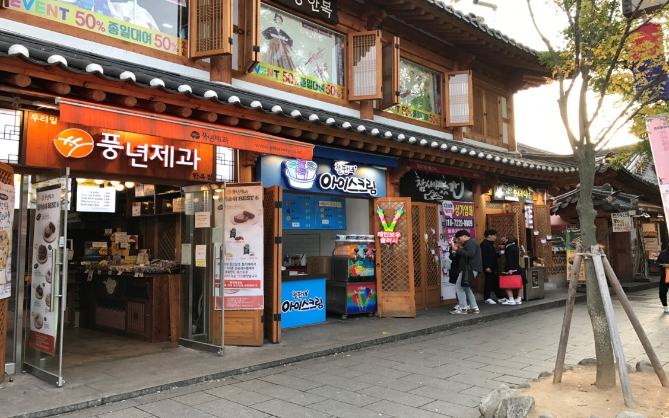
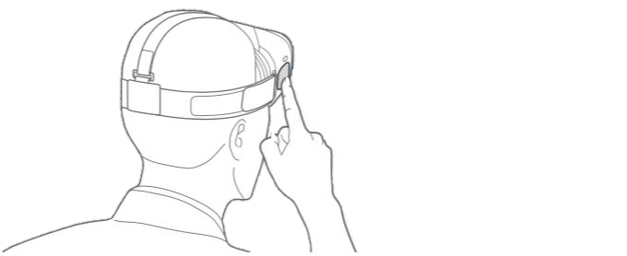

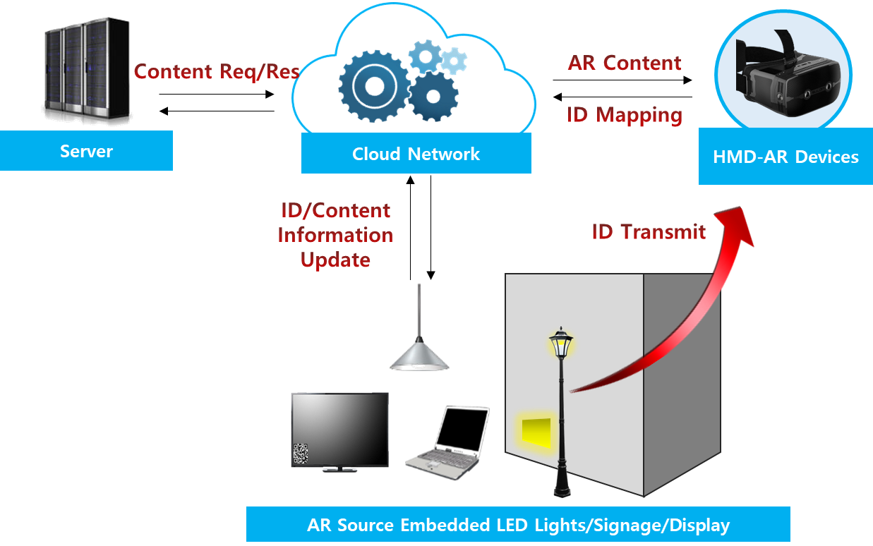
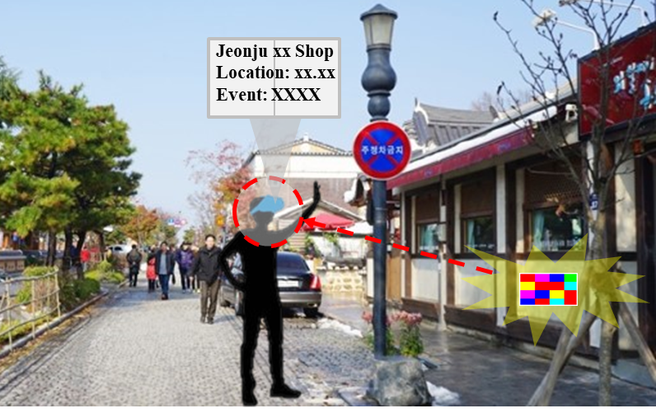

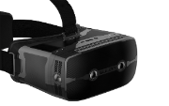
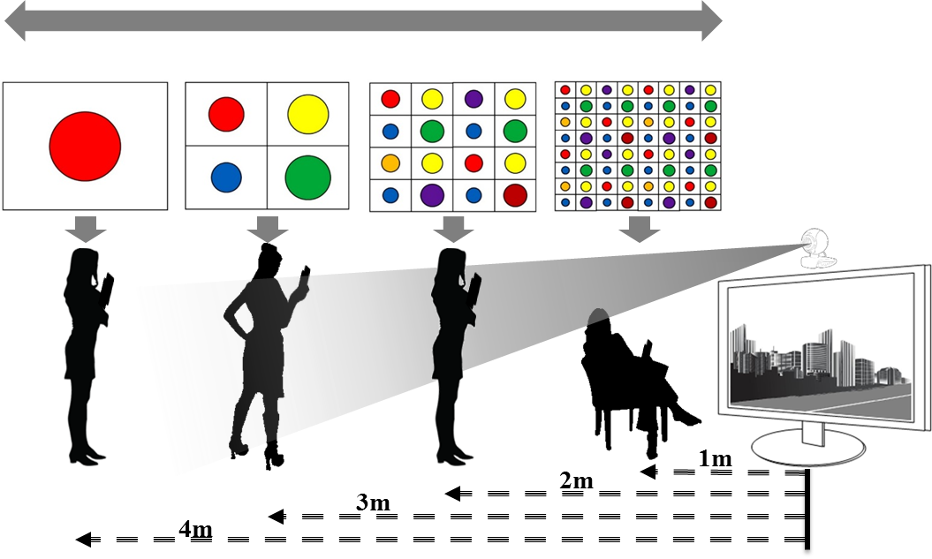

HMD-AR/VR in Industrial(Shop/Street) Applications
HMD-AR based Training(Shop/Street) applications for Commercialize in Industrial Education Field
  Proposed system helps education student to provide additional information such as apparatus, manual, etc.
  Can provide additional information using camera that embedded HMD.
  Image is acquired from a camera built in the HMD, and an object is analysed by extracting features of a apparatus or equipment located in the field of view.
Factory Operator / Shop visitor
Store in Downtown
Restaurant
  < HMD based AR/VR Use-case in Various Place>

Slide 6
Conclusions
Proposed the HMD based Industrial(Shop/Street) applications AR/VR Content Visualization for AR/VR Commercialization.
By using Display/Camera embedded HMD or Smart device Embedded HMD, we can construct training system in industrial(Shop/Street) application field.
Provide additional information which education student related such as apparatus, how to use, manual, etc. So, It will be useful for educators and students in actual industrial (Shop/Street) application field.

