Slide 1
IEEE 802.21 MEDIA INDEPENDENT HANDOVER
DCN: 21-1-0072-00-0000
Title: HMD-AR/VR based Smart Museum Content Visualization using Virtual Reality for AR/VR Commercialization
Date Submitted: November 14, 2018
Presented at IEEE 802.21 session #88 Bangkok, Thailand
Authors or Source(s): Jaesang Cha (SNUST), Vinayagam Mariappan (SNUST), Minwoo Lee (SNUST), Younggyu Kang, Daehyun Kim (Namuga Co., Ltd.), Juphil Cho (Kunsan Univ.), Byungjun Min, Jungjin Ra (Head IT Co., Ltd), Hyeong Ho Lee (Netvision Telecom Inc., Korea Univ.)
Abstract: This document is to describe the VR Commercialization for Smart Museum Application using HMD devices.

Slide 2
  IEEE 802.21 presentation release statements
This document has been prepared to assist the IEEE 802.21 Working Group. It is offered as a basis for discussion and is not binding on the contributing individual(s) or organization(s). The material in this document is subject to change in form and content after further study. The contributor(s) reserve(s) the right to add, amend or withdraw material contained herein.
The contributor grants a free, irrevocable license to the IEEE to incorporate material contained in this contribution, and any modifications thereof, in the creation of an IEEE Standards publication; to copyright in the IEEE’s name any IEEE Standards publication even though it may include portions of this contribution; and at the IEEE’s sole discretion to permit others to reproduce in whole or in part the resulting IEEE Standards publication. The contributor also acknowledges and accepts that this contribution may be made public by IEEE 802.21.
The contributor is familiar with IEEE patent policy, as stated in Section 6 of the IEEE-SA Standards Board bylaws <http://standards.ieee.org/guides/bylaws/sect6-7.html#6> and in Understanding Patent Issues During IEEE Standards Development http://standards.ieee.org/board/pat/faq.pdf>
  IEEE 802.21 presentation release statements
This document has been prepared to assist the IEEE 802.21 Working Group. It is offered as a basis for discussion and is not binding on the contributing individual(s) or organization(s). The material in this document is subject to change in form and content after further study. The contributor(s) reserve(s) the right to add, amend or withdraw material contained herein.
The contributor grants a free, irrevocable license to the IEEE to incorporate material contained in this contribution, and any modifications thereof, in the creation of an IEEE Standards publication; to copyright in the IEEE’s name any IEEE Standards publication even though it may include portions of this contribution; and at the IEEE’s sole discretion to permit others to reproduce in whole or in part the resulting IEEE Standards publication. The contributor also acknowledges and accepts that this contribution may be made public by IEEE 802.21.
The contributor is familiar with IEEE patent policy, as outlined in Section 6.3 of the IEEE-SA Standards Board Operations Manual <http://standards.ieee.org/guides/opman/sect6.html#6.3> and in Understanding Patent Issues During IEEE Standards Development http://standards.ieee.org/board/pat/guide.html>

Slide 3
Table of Contents
Ⅰ
Need of HMD-AR/VR in Smart Museums
Ⅱ
HMD-AR/VR in Smart Museum
Ⅲ
Conclusions

Slide 4
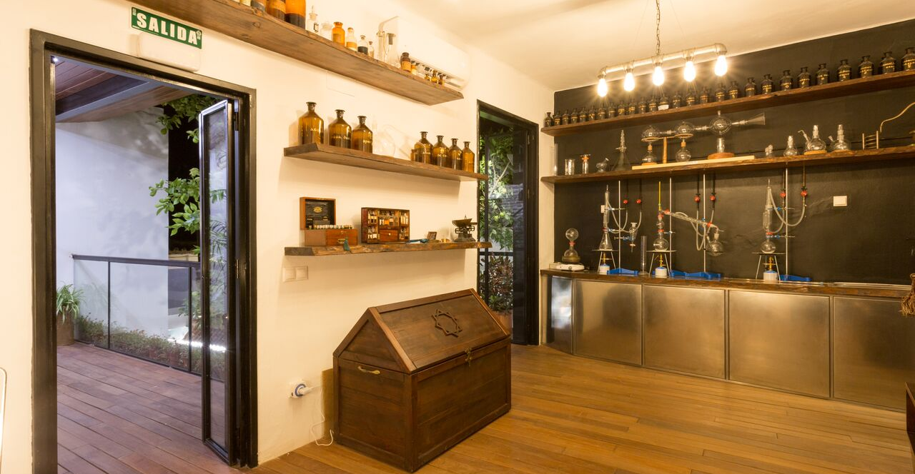
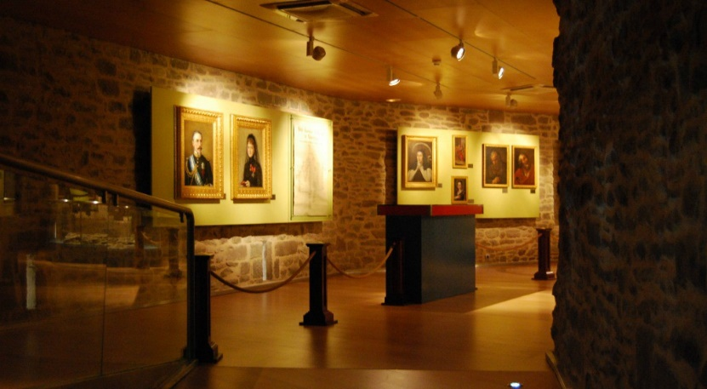
Need of HMD-AR/VR in Smart Museums
Needs
  Museum exhibitor should be close to the item to obtain detailed information about the exhibits in the museum..
  In addition, since the user has to stop after obtaining the desired information and receive the service, it may cause inconvenience.
Basic Concept
  The user wears an HMD with a built-in smartphone, and then receives AR contents that rendering with real image.
  When coordinate information on an exhibit is obtained, detailed information is displayed to the user.
  The content can be provided both in the suspended state and in the moving state.
  < Modern Museums >

Slide 5
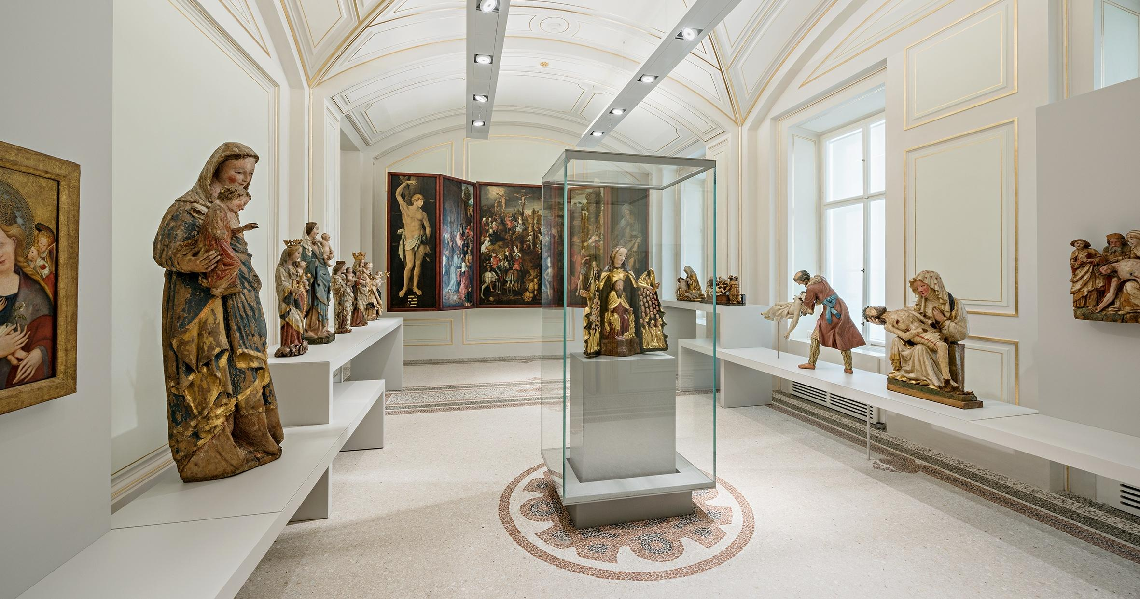
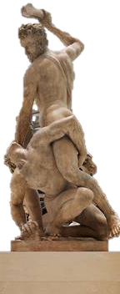
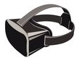

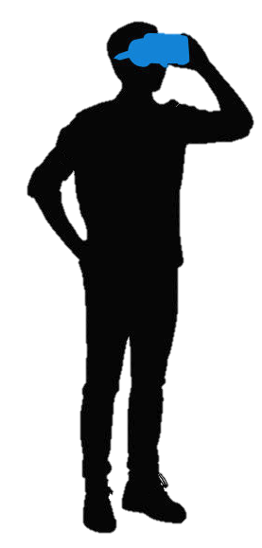
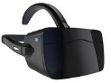

HMD-AR/VR in Smart Museum
Exhibitor need to present interactive and immersive visual experience for visitors
Exhibition Things to be realized in AR/VR environment to give immersive view experience
Functional Requirement for AR/VR Commercialization for Museum Information Display Service Scenario
  Object Feature Tracking
  Head Position / Orientation
  Obtain Coordinate Data
  Graphical Image Processing
  Rendering Frame Buffer
  AR/VR Contents Display
Real Image (Museum)
Virtual Image (Additional Info.) - 3D
Name :
Origin :
History :
More Info. :
HMD & Camera
Real World Video Image
Virtual Image Inset into video of Real world
  < HMD-AR/VR Museum Service Scenario >

Slide 6
Conclusions
Proposed the HMD-AR/VR based Smart Museum Content Visualization using Virtual Reality for AR/VR Commercialization.
Proposed technology is an solution that allows users to easily obtain information about exhibits in a dynamic environment.
The user can obtain the data without any additional operation by the application of the technology, thereby providing convenience. In addition, this technology can be extended to various application technologies such as actual experiential contents and 3-sensible contents.

