Slide 1

IEEE 802.21
Session #89
WG Opening Plenary
Subir Das
sdas at perspectalabs dot com
Subir Das, Chair 802.21 WG

Slide 2
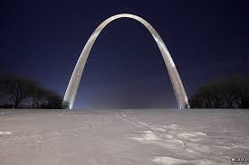
St. Louis, Missouri, USA
January, 2019
Subir Das
sdas at perspectalabs dot com
January, 2019
Subir Das, Chair 802.21 WG

Slide 3
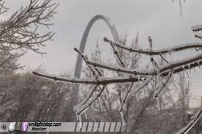
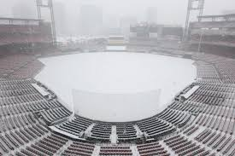
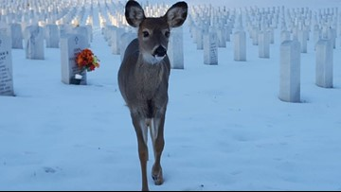
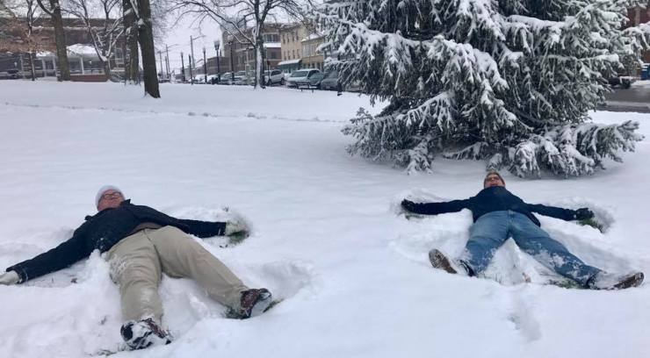

Slide 4
Session Time and Location
 | Monday (Jan 14, 2019) | Tuesday (Jan 15, 2019) | Wednesday (Jan 16, 2019) | Thursday (Jan 17, 2019)
AM-1 8:00-9:00a | IEEE 802 Wireless EC Opening Plenary | Presentation in 802.11 WNG | N/A | SG Session
AM-2 10:30-12:30 | N/A | SG Session | Presentation in 802.15 WNG | WG Closing Plenary
PM-1 1:30 – 3:30p | WG Opening Plenary | SG Session | SG Session | N/A
PM-2 4:00 – 6:00p | SG Session and presentation in 802.19 WG | SG Session and presentation in 802.19 TAG | Presentation in 802.24 TAG | NA
Eve 6:00-10:30p | N/A | N/A | Networking Social (6:30 – 9:00p) | NA
802.21 Default Location: Grand Suite #1; 802.19 TAG: Gateway 4; 802.11 WNG: Archview Ballroom; 802.15 WNG: Ballpark 2/3; 802.24 TAG: Grand Suite #1
The WG has 14 voting members and two aspirant member as of this meeting
Subir Das, Chair 802.21 WG

Slide 5
IEEE 802.21
Meeting Server Details
http://mentor.ieee.org/802.21/documents
Slide 5
Subir Das, Chair 802.21 WG

Slide 6
Attendance
Electronic Attendance ONLY
Electronic Attendance
  IMAT System
    https://imat.ieee.org/attendance
  Via local server
    http://ieee802.linespeed.io/ and click ATTENDANCE
  Mark attendance during every session
Total number of 802.21 WG sessions: 08
06 sessions for 75% attendance to be counted towards WG voting membership
All attendance records are reported on the meeting minutes
  Please check the attendance records for any errors
Subir Das, Chair 802.21 WG

Slide 7
Voting Membership
802.21 Voting Membership described in
  DCN#: 21-06-0075-02-0000
Maintenance of Voting Membership
  Two Plenary sessions out of four consecutive Plenary sessions on a moving window basis
  One out of the two Plenary session requirement, could be substituted by an Interim session
WG Letter Ballots
  WG members are expected to vote on WG LBs
  Failure to vote on 2 out of last 3 WG LBs could result in loss of voting rights
Subir Das, Chair 802.21 WG

Slide 8
Miscellaneous Meeting Logistics
Schedule website: http://schedule.802world.com/
WG Documents: http://ieee802.linespeed.io/
Meeting Map: http://802world.org/wireless/meeting-map/
Guest Room Internet is complimentary and available upon check in
Meeting Place Network: IEEE802 ; Access code: ieeeieee
Network help desk: Ballroom Foyer
Food and Beverages Service:
  Breakfast: 7:30-8:30 AM Grand Foyer (2nd Floor)
  Morning and afternoon Coffee/Tea/snacks
    10:00AM –11:00 AM, and 3:00-4:00 PM
  Lunch (M-Th): 12:00-1:30p; Grand Salon C/D (2nd Floor)
Social Event:
  Wednesday January 16th, 6:00 PM – 9:00 PM
  Biergarten at Anheuser-Busch
  Shuttle Bus: Leave hotel (6:00-6:45pm); Leave Social (8:00-9:00pm)
Subir Das, Chair 802.21 WG

Slide 9
Registration and Media Recording
Each Attendee must provide contact information and pay conference fee
Conference fee has to be paid through the registration desk at the hotel or through sponsor
Failure to pay conference fee results in loss of credit for voting rights
Photography not permitted unless approved by WG Chair
Audio taping of IEEE 802.21 meetings is NOT allowed
Media – Press and Analyst briefings
  Only the 802.21 WG Chair and WG Vice-Chair are allowed to give verbal statements/interviews to the media on behalf of the IEEE 802.21 working group
Subir Das, Chair 802.21 WG
Notes:
17

Slide 10
Membership & Anti-Trust
Individual membership
  In all IEEE standards meetings, membership is by individual, hence you do not represent a company or organization.
Anti-Trust laws
  The Anti-Trust laws forbid the discussion of prices within our meetings.
Subir Das, Chair 802.21 WG
Notes:
26

Slide 11
(Optional to be shown)
The IEEE-SA strongly recommends that at each WG meeting the chair or a designee:
  Show slides #1 through #4 of this presentation
  Advise the WG attendees that:
    The IEEE’s patent policy is consistent with the ANSI patent policy and is described in Clause 6 of the IEEE-SA Standards Board Bylaws;
    Early identification of patent claims which may be essential for the use of standards under development is strongly encouraged;
    There may be Essential Patent Claims of which the IEEE is not aware. Additionally, neither the IEEE, the WG, nor the WG chair can ensure the accuracy or completeness of any assurance or whether any such assurance is, in fact, of a Patent Claim that is essential for the use of the standard under development.
  Instruct the WG Secretary to record in the minutes of the relevant WG meeting:
    That the foregoing information was provided and that slides 1 through 4 (and this slide 0, if applicable) were shown;
    That the chair or designee provided an opportunity for participants to identify patent claim(s)/patent application claim(s) and/or the holder of patent claim(s)/patent application claim(s) of which the participant is personally aware and that may be essential for the use of that standard
    Any responses that were given, specifically the patent claim(s)/patent application claim(s) and/or the holder of the patent claim(s)/patent application claim(s) that were identified (if any) and by whom.
  The WG Chair shall ensure that a request is made to any identified holders of potential essential patent claim(s) to complete and submit a Letter of Assurance.
  It is recommended that the WG chair review the guidance in IEEE-SA Standards Board Operations Manual 6.3.5 and in FAQs 12 and 12a on inclusion of potential Essential Patent Claims by incorporation or by reference.
  Note: WG includes Working Groups, Task Groups, and other standards-developing committees with a PAR approved by the IEEE-SA Standards Board.
Subir Das, Chair 802.21 WG

Slide 12
Participants, Patents, and Duty to Inform
Slide #1
All participants in this meeting have certain obligations under the IEEE-SA Patent Policy. Participants:
  “Shall inform the IEEE (or cause the IEEE to be informed)” of the identity of each “holder of any potential Essential Patent Claims of which they are personally aware” if the claims are owned or controlled by the participant or the entity the participant is from, employed by, or otherwise represents
    “Personal awareness” means that the participant “is personally aware that the holder may have a potential Essential Patent Claim,” even if the participant is not personally aware of the specific patents or patent claims
  “Should inform the IEEE (or cause the IEEE to be informed)” of the identity of “any other holders of such potential Essential Patent Claims” (that is, third parties that are not affiliated with the participant, with the participant’s employer, or with anyone else that the participant is from or otherwise represents)
  The above does not apply if the patent claim is already the subject of an Accepted Letter of Assurance that applies to the proposed standard(s) under consideration by this group
Quoted text excerpted from IEEE-SA Standards Board Bylaws subclause 6.2
Early identification of holders of potential Essential Patent Claims is strongly encouraged
No duty to perform a patent search
Subir Das, Chair 802.21 WG

Slide 13
Call for Potentially Essential Patents
Slide #3
If anyone in this meeting is personally aware of the holder of any patent claims that are potentially essential to implementation of the proposed standard(s) under consideration by this group and that are not already the subject of an Accepted Letter of Assurance:
  Either speak up now or
  Provide the chair of this group with the identity of the holder(s) of any and all such claims as soon as possible or
  Cause an LOA to be submitted
Subir Das, Chair 802.21 WG

Slide 14
Participation in IEEE 802 Meetings
All participation in IEEE 802 Working Group meetings is on an individual basis
• Participants in the IEEE standards development individual process shall act based on their qualifications and experience. (https://standards.ieee.org/develop/policies/bylaws/sb_bylaws.pdfsection 5.2.1)
• IEEE 802 Working Group membership is by individual; “Working Group members shall participate in the consensus process in a manner consistent with their professional expert opinion as individuals, and not as organizational representatives”. (subclause 4.2.1 “Establishment”, of the IEEE 802 LMSC Working Group Policies and Procedures)
Participants have an obligation to act and vote as an individual and not under the direction of any other individual or group. A Participant’s obligation to act and vote as an individual applies in all cases, regardless of any external commitments, agreements, contracts, or orders.
Participants shall not direct the actions or votes of any other member of an IEEE 802 Working Group or retaliate against any other member for their actions or votes within IEEE 802 Working Group meetings, see https://standards.ieee.org/develop/policies/bylaws/sb_bylaws.pdf section 5.2.1.3 and the IEEE 802 LMSC Working Group Policies and Procedures, subclause 3.4.1 “Chair”, list item x.
By participating in IEEE 802 meetings, you accept these requirements. If you do not agree to these policies then you shall not participate.
(Latest revision of IEEE 802 LMSC Working Group Policies and Procedures: http://www.ieee802.org/devdocs.shtml and Participation slide: https://mentor.ieee.org/802-ec/dcn/16/ec-16-0180-03-00EC-ieee-802-participation-slide.ppt )
Slide 14
Notes:
doc.: ec-16-0149-00-00EC
November 2016
Dorothy Stanley, HP Enterprise
Page 14

Slide 15
Other Guidelines for IEEE WG Meetings
Slide #4
All IEEE-SA standards meetings shall be conducted in compliance with all applicable laws, including antitrust and competition laws.
  Don’t discuss the interpretation, validity, or essentiality of patents/patent claims.
  Don’t discuss specific license rates, terms, or conditions.
    Relative costs, including licensing costs of essential patent claims, of different technical approaches may be discussed in standards development meetings.
      Technical considerations remain primary focus
  Don’t discuss or engage in the fixing of product prices, allocation of customers, or division of sales markets.
  Don’t discuss the status or substance of ongoing or threatened litigation.
  Don’t be silent if inappropriate topics are discussed … do formally object.
---------------------------------------------------------------
See IEEE-SA Standards Board Operations Manual, clause 5.3.10 and “Promoting Competition and Innovation: What You Need to Know about the IEEE Standards Association's Antitrust and Competition Policy” for more details.
Subir Das, Chair 802.21 WG

Slide 16
2.7 LMSC Chair’s Guidelines on Commercialism at meetings
http://www.ieee802.org/misc-docs/802_chair_guidelines_rev1.9.6.pdf
IEEE 802 Plenary Sessions are held to develop standards. Commercial activity in conjunction with these meetings is discouraged. The Executive Committee of IEEE 802 has expressed a clear desire to avoid product promotions, or anything that can be construed as a product promotion, at the IEEE 802 meetings. We do not want IEEE standards meetings to turn into trade shows, where vendors avail themselves of the opportunity to show their wares to a captive audience. Any discussion of pricing information in the IEEE 802 meeting can bring our body under suspicion of anti-trust violations and therefore cannot be allowed.
IEEE 802 meetings make no provision for hospitality suites, product demos, and receptions (collectively referred to as "vendor events"). However, if any vendor embarks on such an activity they are asked to adhere to the following guidelines:
A) No announcements or notifications regarding vendor events should be made inside the IEEE 802 meeting rooms or in the vicinity of the IEEE 802 meeting rooms or IEEE 802 registration office.
B) No brochures or other collateral material should be distributed inside the IEEE 802 meeting rooms, or in the adjacent areas that constitute the IEEE 802 meeting area. An exception is made for brochures and collateral related to current and upcoming meeting venues, such as travel brochures, and for IEEE publications.
C) No posters outside IEEE 802 meeting rooms.
D) No notification using IEEE WG EMAIL reflectors.
E) No commercial mailing notification using the address lists obtained from IEEE or IEEE 802.
Subir Das, Chair 802.21 WG

Slide 17
Copyright
Under the current US copyright law — the author of information is deemed to own the copyright from the moment of creation
The IEEE Bylaws require copyright of all material to be held by the IEEE
  Must consult with IEEE for re-use of copyright material
The IEEE Standards accomplishes transfer of copyright ownership through the Project Authorization Request (PAR) process
Subir Das, Chair 802.21 WG

Slide 18
WG Status
IEEE 802.21/Cor1 Standard was published in 2018
ISO/IEC/JTC1 SC6 published three IEEE 802.21 Standards in 2018
Study Group on ‘Network Enablers for Seamless HMD based VR Content Service’ was approved in November, 2018
  Dillon Seo will Chair the SG
Subir Das, Chair 802.21 WG

Slide 19
Objectives for the January Meeting
Study Group Sessions
Presentations to other WGs and TAGs
PAR/CSD Discussion
Subir Das, Chair 802.21 WG

Slide 20
Future Sessions – 2019
Plenary: March 10-15, 2019, Hyatt Regency Vancouver and Fairmont Hotel Vancouver, Vancouver, Canada
  Co-located with all 802 groups
Interim: May 12-17, 2019, Grand Hyatt Atlanta in Buckhead , Atlanta, Georgia, USA
  Co-located with all wireless groups
Plenary: July 14-19, 2019, Austria Congress Centre, Vienna, Austria
  Co-located with all 802 groups
Interim: September 15-20, 2019 - Marriott Hanoi, Hanoi Vietnam (TBC)
  Co-located with all 802 wireless groups
Plenary: November 10-15, 2019, Hilton Waikoloa Village, Kona, HI, USA,
  Co-located with all 802 groups
Subir Das, Chair 802.21 WG

