Slide 1
IEEE 802.21 MEDIA INDEPENDENT HANDOVER
DCN: 21-19-0012-00-0000
Title: Mirror Signage Connected OWC Technology for Virtual Dressing Room using AR / VR System
Date Submitted: January 17, 2019
Presented at IEEE 802.21 session #89 in Saint Louis, USA
Authors or Source(s): Jaesang Cha (SNUST), Vinayagam Mariappan (SNUST), Minwoo Lee (SNUST), Hyeong Ho Lee (Netvision Telecom Inc., Korea Univ.), Soo Young Chang (SYCA)
Abstract: This document is to describe the AR/VR Commercialization for Virtual Dressing Room.

Slide 2
  IEEE 802.21 presentation release statements
This document has been prepared to assist the IEEE 802.21 Working Group. It is offered as a basis for discussion and is not binding on the contributing individual(s) or organization(s). The material in this document is subject to change in form and content after further study. The contributor(s) reserve(s) the right to add, amend or withdraw material contained herein.
The contributor grants a free, irrevocable license to the IEEE to incorporate material contained in this contribution, and any modifications thereof, in the creation of an IEEE Standards publication; to copyright in the IEEE’s name any IEEE Standards publication even though it may include portions of this contribution; and at the IEEE’s sole discretion to permit others to reproduce in whole or in part the resulting IEEE Standards publication. The contributor also acknowledges and accepts that this contribution may be made public by IEEE 802.21.
The contributor is familiar with IEEE patent policy, as stated in Section 6 of the IEEE-SA Standards Board bylaws <http://standards.ieee.org/guides/bylaws/sect6-7.html#6> and in Understanding Patent Issues During IEEE Standards Development http://standards.ieee.org/board/pat/faq.pdf>
  IEEE 802.21 presentation release statements
This document has been prepared to assist the IEEE 802.21 Working Group. It is offered as a basis for discussion and is not binding on the contributing individual(s) or organization(s). The material in this document is subject to change in form and content after further study. The contributor(s) reserve(s) the right to add, amend or withdraw material contained herein.
The contributor grants a free, irrevocable license to the IEEE to incorporate material contained in this contribution, and any modifications thereof, in the creation of an IEEE Standards publication; to copyright in the IEEE’s name any IEEE Standards publication even though it may include portions of this contribution; and at the IEEE’s sole discretion to permit others to reproduce in whole or in part the resulting IEEE Standards publication. The contributor also acknowledges and accepts that this contribution may be made public by IEEE 802.21.
The contributor is familiar with IEEE patent policy, as outlined in Section 6.3 of the IEEE-SA Standards Board Operations Manual <http://standards.ieee.org/guides/opman/sect6.html#6.3> and in Understanding Patent Issues During IEEE Standards Development http://standards.ieee.org/board/pat/guide.html>

Slide 3
Table of Contents
Ⅰ
Need of Mirror Signage Connected OWC Technology
Ⅱ
OWC Based Virtual Dressing Room
Ⅲ
Conclusions

Slide 4
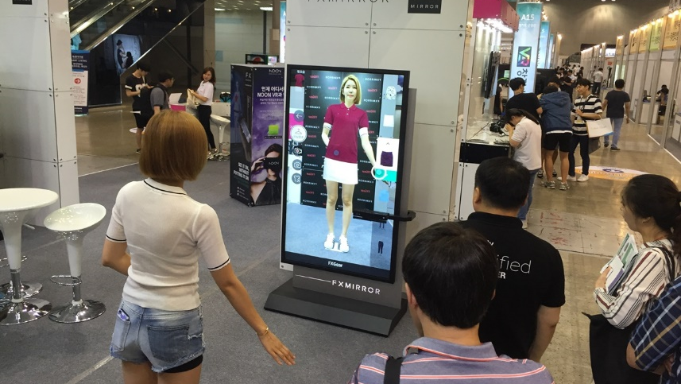
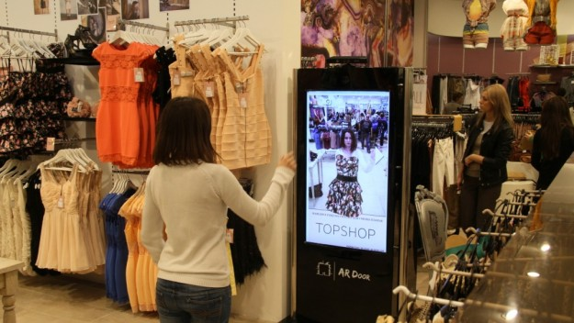
Need of Mirror Signage Connected OWC Technology
Needs
  Currently, AR / VR technology is constantly being developed and applied to large-sized stores and department stores.
  Kinnect or Camera-based AR services are now being offered in conjunction with kiosks or displays for Interactive Virtual Fitting.
  However, there is a need to improve virtual fitting technology to give realistic immersive view experience to the end users.
Basic Concept
  Optical wireless communication technology that can display AR / VR content in head mounted mirror signage from local server
  AR/VR contents are transferred through OWC link between LED linked with clothes stand and Camera / PD built in HMD
  User can get selected clothes specific AR/VR content and experience the realistic immersive view.
  < Clothing Store >

Slide 5

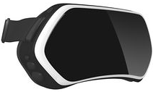

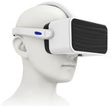


OWC Based Virtual Dressing Room
Camera
Mirror Signage
Mirror Signage
LED Tag
Clothing Information
HMD
Virtual Silhouette
OWC link used between the LED attached to the clothing cradle and the PD/Camera connected with mirror signage based HMD devices.
HMD mirror signage render received the clothes specific AR/VR contents from the store local Content server.
User can experience with immersive view experience with selected clothes interactive and can get details about the dimension information of the clothes, cost, etc. in addition to the virtual dressing experience through the HMD.

Slide 6
Conclusions
Mirror Signage Connected OWC Technology for Virtual Dressing Room using AR / VR System.
To provide immersive wear and view experience to the user before select the clothes and provides various detailed information about clothes in a clothes shopping area.’
Proposed technology able to expand the current AR / VR technology in virtual dressing room to provide immersive user experiences on this market.

