Slide 1
Review of 802.11 & Comparison with 802.22 RA Smart Grid and Critical Infrastructure Monitoring
IEEE P802.22 Wireless RANs Date: 2011-06-20
Authors:
Notice: This document has been prepared to assist IEEE 802.22. It is offered as a basis for discussion and is not binding on the contributing individual(s) or organization(s). The material in this document is subject to change in form and content after further study. The contributor(s) reserve(s) the right to add, amend or withdraw material contained herein.
Release: The contributor grants a free, irrevocable license to the IEEE to incorporate material contained in this contribution, and any modifications thereof, in the creation of an IEEE Standards publication; to copyright in the IEEE’s name any IEEE Standards publication even though it may include portions of this contribution; and at the IEEE’s sole discretion to permit others to reproduce in whole or in part the resulting IEEE Standards publication. The contributor also acknowledges and accepts that this contribution may be made public by IEEE 802.22.
Patent Policy and Procedures: The contributor is familiar with the IEEE 802 Patent Policy and Procedures http://standards.ieee.org/guides/bylaws/sb-bylaws.pdf including the statement "IEEE standards may include the known use of patent(s), including patent applications, provided the IEEE receives assurance from the patent holder or applicant with respect to patents essential for compliance with both mandatory and optional portions of the standard." Early disclosure to the Working Group of patent information that might be relevant to the standard is essential to reduce the possibility for delays in the development process and increase the likelihood that the draft publication will be approved for publication. Please notify the Chair
Wendong Hu as early as possible, in written or electronic form, if patented technology (or technology under patent application) might be incorporated into a draft standard being developed within the IEEE 802.22 Working Group. If you have questions, contact the IEEE Patent Committee Administrator at patcom@iee.org.

Slide 2
Abstract
This document provides an overview of P802.11ah and P802.11af standards on PAR, 5C, usage models and technical aspects, which may have some relevance with 802.22 Regional Area Smart Grid and Critical Infrastructure Monitoring.
Also, this document provides comparison between P802.11ah, P802.11af and 802.22 RA smart grid and critical infrastructure monitoring.

Slide 3
Title
P802.11ah (Task Group) | Standard for Information Technology - Telecommunications and Information Exchange Between Systems - Local and Metropolitan Area Networks - Specific Requirements - Part 11: Wireless LAN Medium Access Control (MAC) and Physical Layer (PHY) Specifications: Amendment- Sub 1 GHz License-Exempt Operation
P802.11af (Task Group) | IEEE Standard for Information Technology - Telecommunications and Information Exchange Between Systems - Local and Metropolitan Area Networks - Specific Requirements - Part 11: Wireless LAN Medium Access Control (MAC) and Physical Layer (PHY) Specifications - Amendment: TV White Spaces Operation

Slide 4
PAR Scope
P802.11ah | This amendment defines an Orthogonal Frequency Division Multiplexing (OFDM) Physical layer (PHY) operating in the license-exempt bands below 1 GHz, e.g., 868-868.6 MHz (Europe), 950 MHz - 958 MHz (Japan), 314-316 MHz, 430-434 MHz, 470-510 MHz, and 779-787 MHz (China), 917 - 923.5 MHz (Korea) and 902-928 MHz (USA), and enhancements to the IEEE 802.11Medium Access Control (MAC) to support this PHY, and provides mechanisms that enable coexistence with other systems in the bands including IEEE 802.15.4 and IEEE P802.15.4g. The data rates defined in this amendment optimize the rate vs range performance of the specific channelization in a given band. This amendment also adds support for: transmission range up to 1 km data rates > 100 kbit/s while maintaining the IEEE 802.11 WLAN user experience for fixed, outdoor, point to multi point applications.
P802.11af | An amendment that defines standardized modifications to both the 802.11 physical layers (PHY) and the 802.11 Medium Access Control Layer (MAC), to enable operation in the TV White Spaces (the unused channels in the TV bands).

Slide 5
5C and Functional Requirement
 | P802.11ah | P802.11af
Distinct Identity | operation of license-exempt 802.11 wireless networks in frequency bands below 1 GHz excluding the TV White Space bands. | operation in the TV White Space bands, which are below 1 GHz. There are no other IEEE 802 projects specifically addressing personal/ portable operation under FCC Part 15 Subpart H.

Slide 6
Usage Models
P802.11ah | P802.11af | 802.22 New SG
Sensors and Meters Smart Grid - Meter to Pole Environmental/Agricultural Monitoring industrial process sensors Healthcare Home/Building Automation Home sensors Backhaul Sensor/Meter data Backhaul aggregation of sensors Backhaul aggregation of industry sensors Extended range Wi-Fi Outdoor extended range hotspot Wi-Fi for cellular traffic offloading | WLAN use cases extended to TV White Space | (a) Regional Area Smart Grid/Metering: support Low Complexity CPEs (b) Critical Infrastructure/Hazard Monitoring: Support very large number of monitoring CPEs (c) Smart Traffic Management and Communication Real time monitoring, low latency (d) Rural farm house and agricultural monitoring Support remote monitoring with relaxed latency requirement, supports interface with sensors monitoring environmental factors, live stock behavior etc, (e) Emergency Temporary Broadband Infrastructure : Ad hoc connecting among portable CPEs (f) Remote Medical Service: Support remote medical service with high QoS in a rural residence area (g) Combined Smart Grid and Broadband Service Support CPEs with multiple operation modes [eg. low and high capabilities]

Slide 7
Summary – Review, Differences and Similarities
 |  | P802.11ah | P802.11af | P802.22 New SG
1 | Amendment | OFDM PHY and enhanced MAC | PHY and MAC Amendment ( …use of TGac with changes for TGaf is their focus.) | PHY and MAC Amendment
2 | Operating Frequency | the license-exempt bands below 1 GHz | TVWS frequency | TVWS frequency
3 | Operating bandwidth | under discussion (2.5, 5, 10, 20 MHz) | under discussion (2,4,8, 16 MHz or 5,10,20, 40MHz) | 6,7 or 8 MHz
4 | Coverage | up to 1 km | several hundreds of meters | WRAN (Several tens of Km, 20~30Km)
5 | Transmission Power | Under discussion (100mW) | Fixed high power (4W) in US, Portable/Mobile Power (100mW, 40mW) in US. | Fixed high power (4W) in US, Portable/Mobile Power (100mW, 40mW) in US. Base station (500W) in Canada, user terminal (4W) in Canada.
6 | Transmission Rate (bit/s) | > 100 k | 1M~54 M (below 1M is also under discussion) | From several kbps (one stream) to several Mbps (multi-streams)
7 | Network topology | Infrastructure Mode, Ad hoc mode | Infrastructure Mode, Ad hoc mode | Infrastructure Mode, Point-to-Multipoints, Support peer-to-peer connection
8 | Available Devices | up to 6000 (for smart grid use case) | Up to 2007 | More than 512
9 | Coexistence | 802.15.4 and P802.15.4g | .22 | 11af, .15 4TV coexistence

Slide 8
Summary - Technical Comparison
 | 802.11-2007 |  |  | 802.22 (802.22D3-redline) |  |  | Comment on the comparison from the perspective of 802.22 New SG
Frequency range | 2.4 GHz, 5 GHz, infrared (ongoing sub GHz and TV channel) |  |  | 54-862 MHz for unused TV channel |  |  | TVWS band and compliances to regulation for its usage are the key differences
Multiple Access | CSMA (channel access: DSSS and OFDM) |  |  | OFDMA |  |  | OFDMA guarantees efficient management of large number of device than CSMA
FFT Size | 64 |  |  | 2048 |  |  | 802.22 has higher data throughput for comparable bandwidth
Bandwidth(MHz) | 5 | 10 | 20 | 6 | 7 | 8
Maximum Data Throughput (Mbit/s) | 13.5 | 27 | 54 | 22.69
Subcarrier frequency spacing (KHz) | 78.125 | 156.25 | 312.5 | 3.3 | 3.9 | 4.5 | 802.22 is more robust to frequency selective fading
Cyclic Prefix Duration (μsec) | 3.2 | 1.6 | 0.8 | Up to 75 |  |  | -802.22 is more robust to spread delay. - It is optimized to support long range
Coexistence | -CSMA-based -Database access (RLQP) -MAC messages for measurement |  |  | -Spectrum sensing, database access and geolocation (Interface) -Self-coexistence window -Quiet period -Coexistence beacon protocol -On-demand frame contention -MAC messages for measurement and channel measurement -Embedded channel management |  |  | 802.22 has enhanced coexistence techniques

Slide 9
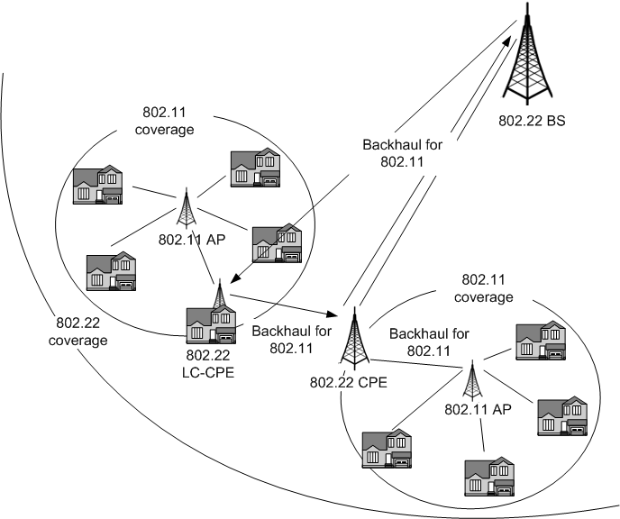
Example Application Scenario
802.22 RA smart grid and critical infrastructure monitoring application will be complimentary to other short range applications at the users’ end
We may have different types of CPEs in 802.22 new SG
Currently CPEs can not communicate to each other

Slide 10
Conclusion
Comparing to 802.11, uniqueness of 802.22 New SG
  is able to provide services related to smart grid and critical Infrastructure Monitoring applications for a larger coverage area.
  is able to support a huge number of devices in TV whitespace for smart grid and critical Infrastructure Monitoring.
  is able to provide enhanced robustness in dealing with delay spread as well as frequency selective fading.
  is able to provide enhanced coexistence.

Slide 11
References
802.11ah PAR and 5C
802.11af PAR and 5C
802.11-2007
802.22-2011

Slide 12
Appendix
As amendment for 802.22, 802.22 New SG
  consider to support low energy consumption and complexity CPEs
  considers to support ad hoc connection (such as peer-to-peer connection, multi-hop connection) among portable CPEs for emergency broadband infrastructure
  considers to support very large number of CPEs with low energy and complexity for monitoring a regional area
  considers to support high reliability and QoS for critical applications such as medical service, hazard monitoring, etc
  considers to support real time monitoring system with low latency.
  considers CPEs with multiple operation modes [eg. low and high capabilities]
  considers supporting interface with various sensors

