Slide 1
Advanced Beaconing to Expand Protection of Licensed Services
IEEE P802.22 Wireless RANs Date: 2012-09-18
Authors:
Notice: This document has been prepared to assist IEEE 802.22. It is offered as a basis for discussion and is not binding on the contributing individual(s) or organization(s). The material in this document is subject to change in form and content after further study. The contributor(s) reserve(s) the right to add, amend or withdraw material contained herein.
Release: The contributor grants a free, irrevocable license to the IEEE to incorporate material contained in this contribution, and any modifications thereof, in the creation of an IEEE Standards publication; to copyright in the IEEE’s name any IEEE Standards publication even though it may include portions of this contribution; and at the IEEE’s sole discretion to permit others to reproduce in whole or in part the resulting IEEE Standards publication. The contributor also acknowledges and accepts that this contribution may be made public by IEEE 802.22.
Patent Policy and Procedures: The contributor is familiar with the IEEE 802 Patent Policy and Procedures http://standards.ieee.org/guides/bylaws/sb-bylaws.pdf including the statement "IEEE standards may include the known use of patent(s), including patent applications, provided the IEEE receives assurance from the patent holder or applicant with respect to patents essential for compliance with both mandatory and optional portions of the standard." Early disclosure to the Working Group of patent information that might be relevant to the standard is essential to reduce the possibility for delays in the development process and increase the likelihood that the draft publication will be approved for publication. Please notify the Chair
Apurva N. Mody < apurva.mody@ieee.org > as early as possible, in written or electronic form, if patented technology (or technology under patent application) might be incorporated into a draft standard being developed within the IEEE 802.22 Working Group. If you have questions, contact the IEEE Patent Committee Administrator at patcom@iee.org.
>

Slide 2
Executive Summary

Slide 3
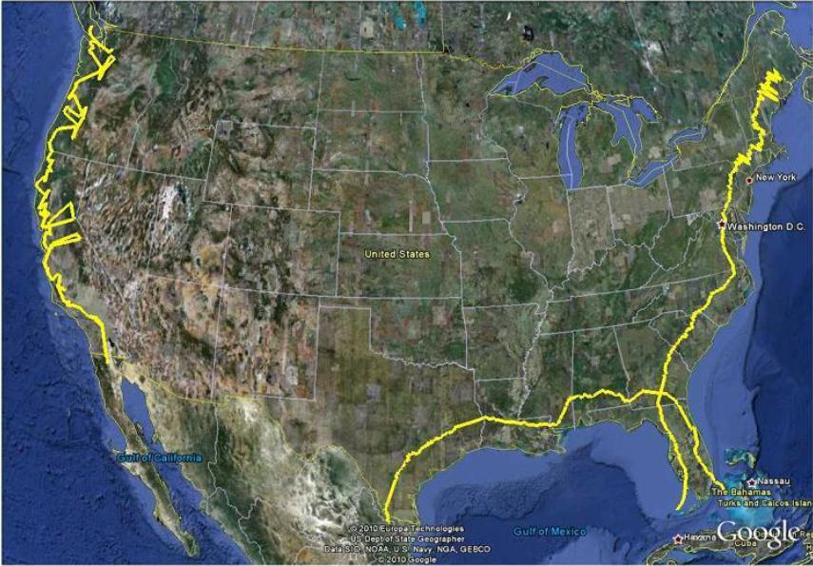
Radar, Commercial Comms Co-existence in 3550-3650 Bands in the US Using IEEE 802.22.1 Advanced Beaconing
3550 – 3650 MHz Band: As per the Presidential
Memorandum, one of the portions
of the spectrum identified to achieve the goal of
freeing up 500MHz of spectrum, is the
3550-3650 MHz where maritime radars have
been deployed.
Current Plan: The current plan is to use
exclusion zones to protect U.S. Navy coastal
operations and other Department of Defense test
and training areas. This means that major part of
the US population will not be able to use these bands.
Alternatives: However, there may be some other approaches which will make 100 MHz of spectrum available nation-wide, and especially in the coastal areas where significant US population resides.
Co-existence Techniques: In general, three techniques have been widely accepted to enable spectrum sharing (1) Spectrum sensing based detection and avoidance, (2) Database driven approaches (e. g. in the Television Band WhiteSpaces) and (3) Beaconing approaches (e. g. the IEEE Standard 802.22.1-2010).
Use of Advanced Beaconing Approach: Neither spectrum sensing nor database driven approaches are suitable for radar, comms co-existence. However, advanced beaconing approaches, such as the one developed in the IEEE Standard 802.22.1-2011 for co-existence between the primary signals and incumbent signals may be used for the 3550-3650 band.
US Exclusion Zones for 3550-3650 Band
Will exclude majority of large cities

Slide 4
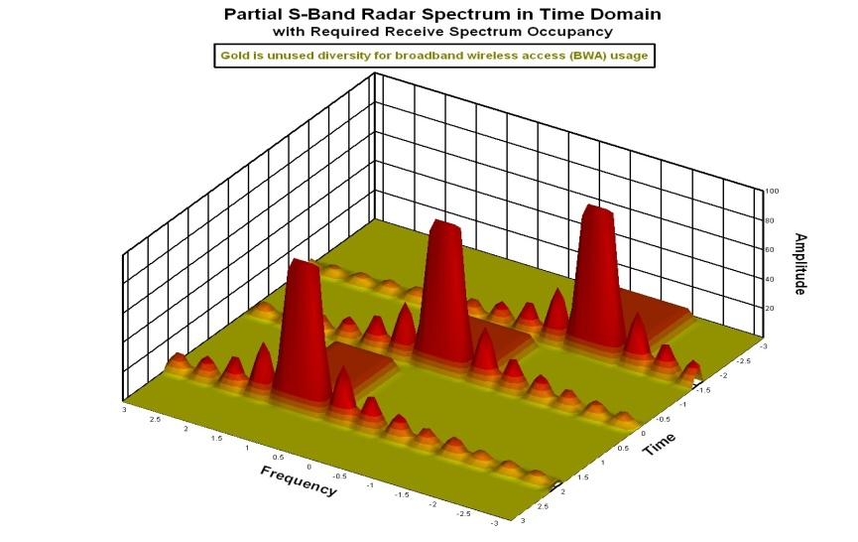

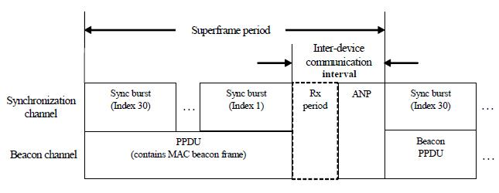
Radar, Commercial Comms Co-existence in 3550-3650 Bands in the US Using IEEE 802.22.1 Advanced Beaconing
How will it Work: The designed beacon will contain Peace Time temporal patterns of the radars which when combined with some universal time clock such as GPS can help commercial communications systems to use the empty time slots for their operation. During Emergency Scenarios, the beacon will send Urgent Co-existence request, to ask all the commercial systems to shut down immediately. If the beacon cannot be heard or decoded, commercial comms will cease operation by default. Security features for such beacons are very important. IEEE Std, 802.22.1-2010 has incorporated many such security mechanisms that may be applied to the 3550-3650 band relatively readily.
IEEE 802.22.1 Like Beacon
Current IEEE 802.22.1 beacon protocol contains many security Features already
We are proposing a Commercial (FCC) Interoperability enabling standard for co-existence with DoD Radars (NTIA), a paradigm shift for spectrum sharing

Slide 5
Further Details

Slide 6
Proposal for Radar, Commercial Comms Co-existence in 3550-3650 Bands in the US Using Advanced Beaconing
US Exclusion Zones for 3550-3650 Band
will exclude majority of large cities
3550 – 3650 MHz Band: As per the Presidential Memorandum, one of the portions of the spectrum identified to achieve the goal of freeing up 500MHz of spectrum, is the 3550-3650 MHz where maritime radars have been deployed.
Current Plan: The current plan is to use of exclusion zones to protect U.S. Navy coastal operations and other Department of Defense test and training areas. This means that major part of the US population will not be able to use these bands.

Slide 7
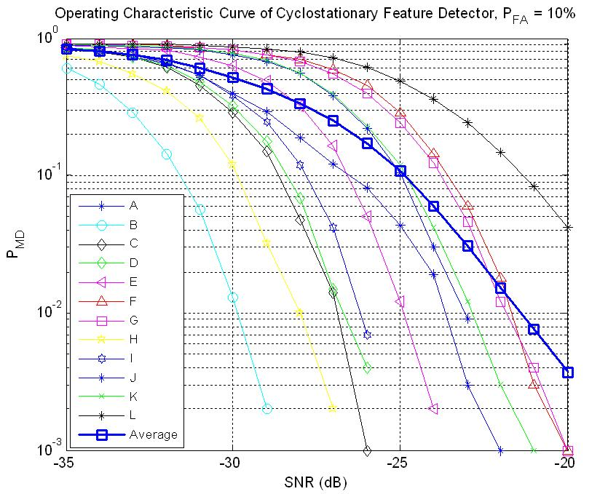
Alternate Co-existence Enablers
Alternatives: There may be some other, approaches which will make 100 MHz of spectrum available nation-wide, and especially in the coastal areas where significant US population resides.
Co-existence Techniques: In general, the three techniques that are widely accepted to enable spectrum sharing are:
  Spectrum sensing based detection and avoidance,
  Database driven approaches (e. g. in the Television Band WhiteSpaces) and
  Beaconing approaches (e. g. the IEEE Standard 802.22.1-2010).
Spectrum sensing and database driven approaches will not work for this application

Slide 8

IEEE 802.22 WG on Cognitive Radio Based Wireless Regional Area Networks
IEEE 802.22 WG is the recipient of the IEEE SA Emerging Technology Award
IEEE 802.22 Standard – Wireless Regional Area Networks: Cognitive Radio based Access in TVWS:
Published in July 2011
802.22.1 – Std for Enhanced Interference Protection in TVWS: Published in Nov. 2010
802.22.2 – Std for Recommended Practice for Deployment of 802.22 Systems: Expected completion - Dec 2012
802.22a – Enhanced Management Information Base and Management Plane Procedures: Expected Completion - Dec. 2013
802.22b Enhancement for Broadband Services and Monitoring Applications
Further amendments will be made to this standard
www.ieee802.org/22

Slide 9
Use of Advanced Beaconing
Use of Advanced Beaconing Approach: Neither Spectrum sensing nor database driven approaches are suitable for radar and commercial comms co-existence.
However, advanced beaconing approaches, such as the one developed in the IEEE Standard 802.22.1-2011 for co-existence between the primary signals and incumbent signals may be used for the 3550-3650 band.

Slide 10
IEEE 802.22.1 Beaconing Protocol – History
Initial Difficulties in Detecting Wireless Microphone Signals
Many studies have suggested that FCC R&O target for wireless microphones sensing is not sufficient to protect wearable microphones (where body attenuation of as much as 27dB is possible according to the manufacturers)
IEEE 802.22.1 Standard Using Beaconing to Protect
The IEEE 802.22 Working Group has designed a beacon signal which can be transmitted with 25 times higher power than the microphones in the clear. If higher power, antenna characteristics and body attenuation are counted then this results in a 53 dB gain [Chouinard]
These beacon signals consist of repeated pseudo-noise (PN) sequences and occupy a bandwidth of 78 kHz.
Many security features are provided
  PN header sequences used to ensure that any attempts to replay/ relay the beacon will be detected
  Each beacon transmitted contains an Elliptic Curve Cryptography (ECC) based digital signature, as well as certificate/public key associated with the signature. If a receiver of the beacon chooses, it can authenticate the beacon by using the certificate/public key to verify the signature. Doing so gives the receiver assurance that the beacon was transmitted by a valid source

Slide 11
IEEE 802.22.1 Beaconing Protocol
-114 dBm
Wireless Microphone Beacon Sensing Results

Slide 12
How will it Work?
How will it Work: The designed beacon will contain Peace Time temporal patterns of the radars which when combined with some universal time clock such as GPS will help commercial communications systems to use the empty time slots for their operation. During Emergency Scenarios, the beacon will send Urgent Co-existence request, to ask all the commercial systems to shut down immediately. If the beacon cannot be heard or decoded, commercial comms will cease operation by default. Security features for such beacons are very important. IEEE Std, 802.22.1-2010 has incorporated many such security mechanisms that may be applied to the 3550-3650 band relatively readily.
We are proposing a Commercial (FCC) Interoperability enabling standard for co-existence with DoD Radars (NTIA), a paradigm shift for spectrum sharing

Slide 13
Radar, Commercial Comms Co-existence in 3550-3650 Bands in the US Using IEEE 802.22.1 Advanced Beaconing
IEEE 802.22.1 Like Beacon
Current IEEE 802.22.1 beacon protocol contains many security Features already

Slide 14
Proposed: IEEE 802.22.1 Beaconing for Commercial Comms Radar Interoperability
Paradigm Shift in Sharing Spectrum with differing waveforms (FCC & NTIA) in time domain
Non Dynamic Frequency Selection ; Separate Cognitive comm coordination encrypted beacon channel (IEEE802.22.1)
Radar PRI requests to BWA for [20%] Time slots
Commercial BWA: 80% to 100% time/duty
Underutilized S-band turns into highly Spectrum Efficient 'without Interference'
5 years standard development, for 500MHz 10 year BBP
IEEE 802.22 brings university, commercial developments
Products certified by FCC and NTIA before adoption
Standard would involve DoD, but does not require classified radar waveforms

Slide 15
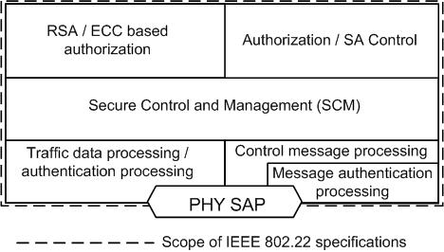
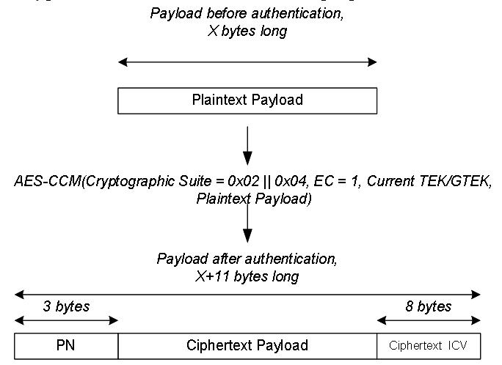
IEEE 802.22 – Security Sub-layer 1 (Non-Cognitive)
Confidentiality and Privacy – AES (128) GCM is used for encryption and authentication
Network Authorization – RSA and ECC based X.509 certificates are used for mutual authentication / network entry authorization.
Integrity – AES-GCM is used to compute Integrity Check Vector (ICV). PN sequence numbers are appended to each packet.
Authentication – Signals such as wireless microphone beacon and CBP are authenticated using ECC based digital signatures. No encryption is provided for these packets.
Key Management – Secure Control and Management Protocol is used for key management.
Management Messages – All management messages except for the broadcast, initial ranging and basic CID are protected.
  Device Security – Trusted Computing Group, Trusted Platform Module specifications are recommended to enable tamper-proof capability for hardware and software.
Security Sub-layer 1

Slide 16
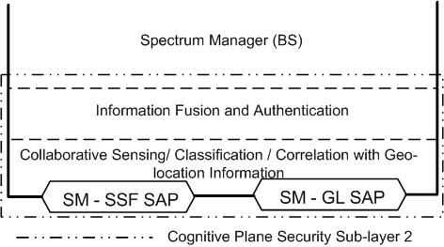
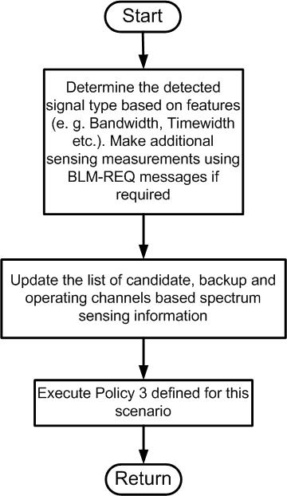
IEEE 802.22 – Security Sub-layer 2 (Cognitive)
Spectrum Availability -
  Spectrum Sensing used to ensure spectrum availability for primary users.
  Various types of signal specific and feature based sensing algorithms have been included into the standard
  Standard recommends sensing algorithms to determine the signal type (Signal Classification)
  Collaborative Sensing - The group in general thinks that collaborative sensing will be useful. FCC R&O requires ‘OR’ rule based collaborative sensing.
  Correlation with Geo-location Information – Closely tied to collaborative sensing. It tries to cross check the spectral footprint of the detected signal based on location of the sensor
Spectrum Access Authorization –
  BS is capable of de-authorizing a subscriber at any time. Sensing and incumbent database service used for spectrum access authorization
  Capability Check – The Spectrum Manager (SM) is capable of prohibiting a subscriber from registering if it does not have adequate sensing capabilities.
Radio Behavior Control
  IEEE 802.22 is policy driven. Policies are rule-based.
Security Sub-layer 2
Signal classification
and policy based
behavior control of the
802.22 devices

Slide 17
Conclusions
We have proposed a Commercial (FCC) Interoperability enabling standard for co-existence with DoD Radars (NTIA), a paradigm shift for spectrum sharing
We are proposing an Advanced Beaconing Approach: Advanced beaconing approaches, such as the one developed in the IEEE Standard 802.22.1-2011 for co-existence between the primary signals and incumbent signals may be used for the 3550-3650 band.
More than 60 people from nearly 30 different organizations participated in the development of this international standard
IEEE 802.22.1 already contains many security features that will be useful for this application.
IEEE 802.22 Emerging Breakthrough Technology: IEEE 802.22 Working Group is the recipient of the IEEE SA Emerging Technology Award
IEEE 802.22 and IEEE 802.22.1 technologies could prove very crucial in meeting the goals of the President’ s Memo to free up 500 MHz of spectrum.

Slide 18
References
IEEE 802.22.1-2010™ Commercial Standard
IEEE 802.22-2011TM Commercial Standard
NTIA, Department of Commerce Report, “An Assessment of the Near-Term Viability of Accommodating Wireless Broadband Systems in the 1675-1710 MHz, 1755-1780 MHz, 3500-3650 MHz, and 4200-4220 MHz, 4380-4400 MHz Bands” http://www.ntia.doc.gov/files/ntia/publications/fasttrackevaluation_11152010.pdf
K. Carrigan, “The Defense Case for the C Band,” http://www.satellitetoday.com/webexclusives/The-Defense-Case-for-C-Band_18658.html
R. Ames, A. Edwards, K. Carrigan “Field Test Report WiMAX Frequency Sharing with FSS Earth Stations February 2008,” http://www.apt.int/sites/default/files/Rep-5_6E1WiMAX_Field_Test_Report_by_SUIRG.pdf
G. Chouinard, “RF Sensing in TV WhiteSpace” Presented at the 8th Conference on Communications Networks and Services Research (CNSR2010) held at McGill University, Montreal, Canada, 12-14 May 2010.
802.22 July Plenary WG Motions: https://mentor.ieee.org/802.22/dcn/12/22-12-0072-00-0000-july-plenary-motions.doc
White House PCAST report “Realizing the Full Potential of Government –held Spectrum to Spur Economic Growth,” - http://www.whitehouse.gov/sites/default/files/spectrum.pdf

