Slide 1
IEEE 802.22 November Plenary EC Closing Motions
Date: 2012-11-15
Authors:

Slide 2
Motion to Forward the IEEE 802.22.1 Revision PAR to the NESCOM
Slide 2

Slide 3
Motion to Approve the P802.22.1a PAR on Advanced Beaconing
November 2011
Working Group Motions – September 2012 Palm Springs
Move to approve the contents of the document 22-12-83r3 (https://mentor.ieee.org/802.22/dcn/12/22-12-0083-03-0001-advanced-beaconing-par.docx) as the contents for the P802.22.1a amendment PAR form and the contents of the document 22-12-84r3(https://mentor.ieee.org/802.22/dcn/12/22-12-0084-03-0001-advanced-beaconing-5c.docx) as 5C for the Advanced Beaconing study group and forward the same to the 802 Executive Committee before October 5th to meet the 30 day rule for consideration during the November plenary for the EC approval. Move to upload the PAR to the IEEE SA NESCOM before October 5th pending approval from the Sponsor Chair, so that it can be on the agenda for the December meeting of the NESCOM. Allow the Chair to make changes to the PAR and 5C as he sees fit, based on the comments from other EC members or the members of the IEEE SA NESCOM
Move: Changwoo Pyo
Second: Shigenobu Sasaki
Yes: 10
No: 0
Abstain: 0
Motion passes

Slide 4
P802.22.1a Comments and Resolutions
November 2011
Subsequently 802.22 Working Group received comments from 802.19 and 802.11 Working Groups.
These comments were addressed and resolved.
The comments and resolutions can be found in the backups of this presentation as well as the following presentation: 22-12-0102-00. https://mentor.ieee.org/802.22/dcn/12/22-12-0102-00-0001-802-22-responses-to-comments-on-the-802-22-1-par.pptx
The contents of the revised PAR and 5C documents can be found in the following documents:
PAR - 22-12-0083 Rev5 (0001) https://mentor.ieee.org/802.22/dcn/12/22-12-0083-05-0001-advanced-beaconing-par.docx
5C – 22-12-0084 Rev5 (0001) https://mentor.ieee.org/802.22/dcn/12/22-12-0084-05-0001-advanced-beaconing-5c.docx

Slide 5
Motion to Approve the P802.22.1 Revision PAR on Advanced Beaconing
November 2011
Working Group Motions – November 2012 San Antonio
Move to allow the Chair to submit the Document 22-12-0083 Rev5 (https://mentor.ieee.org/802.22/dcn/12/22-12-0083-05-0001-advanced-beaconing-par.docx) as the IEEE 802.22.1 Revision PAR and Document 22-12-0084 Rev 5 (https://mentor.ieee.org/802.22/dcn/12/22-12-0084-05-0001-advanced-beaconing-5c.docx) as the 5C for the IEEE 802.22.1 Advanced Beaconing Revision for the IEEE 802.22.1 Standard to the EC. The WG approves the comment response as contained in document 22-12-0102 Rev0 (https://mentor.ieee.org/802.22/dcn/12/22-12-0102-00-0001-802-22-responses-to-comments-on-the-802-22-1-par.pptx) The 802.22 WG further request the chair to seek approval from the EC to forward this PAR to the IEEE SA NESCOM. 802.22 WG allows the chair to make modifications to the PAR or the 5C as he sees fit to address the comments from the EC or the NESCOM members.
Move: Peter Flynn
Second: Sunghyun Hwang
For: 9
Against: 0
Abstain: 0
Motion Passes

Slide 6
November 2011
EC Motion – To Forward P802.22.1 Revision PAR and 5C to NESCOM
Move that the EC approves the P802.22.1 Revision PAR :22-12-0083Rev5 (0001): https://mentor.ieee.org/802.22/dcn/12/22-12-0083-05-0001-advanced-beaconing-par.docx
and 5C: 22-12-0084Rev5(0001): https://mentor.ieee.org/802.22/dcn/12/22-12-0084-05-0001-advanced-beaconing-5c.docx
and allows the 802.22 WG to forward the PAR to NESCOM
Move: Apurva Mody
Second: Subir Das
For:
Against:
Abstain:
Motion Passes / Fails

Slide 7
Backups
Slide 7

Slide 8
Current IEEE 802.22.1 Standard
The IEEE 802.22.1-2010 Standard was published in 2010. This standard defines a beaconing specification that enables spectrum sharing between licensed Part 74 (e. g. licensed wireless microphone) systems and the unlicensed Television Band (VHF/ UHF Band) White Space Devices.
In June 2010, the President of the United States signed a Memorandum calling for the National Telecommunications and Information Administration (NTIA), in collaboration with the Federal Communications Commission (FCC), to make 500 megahertz of spectrum available for fixed and mobile wireless broadband.
Please See the reference for the PCAST report.

Slide 9
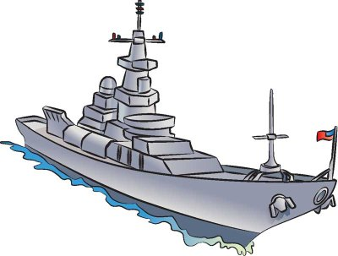
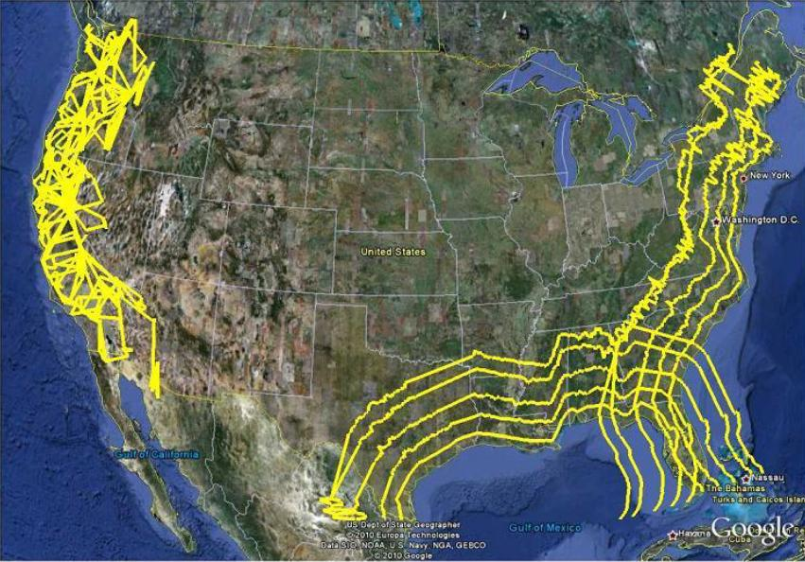
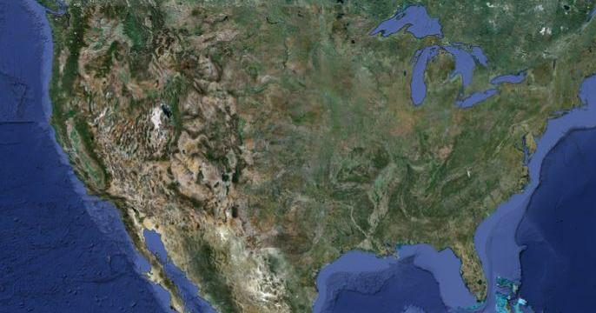
Spectrum sharing with radar using IEEE 802.22.1 Beaconing Standard – Enables spectrum sharing in the 3550 – 3650 MHz Bands
To Create NATIONAWIDE availability of the 3550-3650 MHz Band using IEEE 802.22.1 advanced beaconing approach
Beacon signal
On-shore commercial systems decode the beacon and adjust their transmissions
Current Plan: The current plan is the use of exclusion zones to protect U.S. Navy coastal operations and other Department of Defense test and training areas. This means that major part of the US population will not be able to use these bands.
Alternatives: However, there may be some other approaches which will make 100 MHz of spectrum available nation-wide, and especially in the coastal areas where significant US population resides.
Approach
Use of Advanced Beaconing Approach: Neither spectrum sensing or database driven approaches are suitable for this type of spectrum sharing. However, advanced beaconing approaches, such as the one developed in the IEEE Standard 802.22.1 for spectrum sharing between the primary signals and incumbent signals may be used for the 3550-3650 band.
US Exclusion Zones for 3550-3650 Band
Will exclude majority of large cities
IEEE 802.22.1 Advanced Beaconing will make 3550-3650 MHz band available nationwide
Background
Deployment Strategy
3550 – 3650 MHz Band: One of the portions of the spectrum identified to achieve the goal of freeing up 500MHz of spectrum, is the 3550-3650 MHz where maritime radars have been deployed.
Regulators have realized that beaconing is a viable option for spectrum sharing. The IEEE 802.22.1-2010™ standard has been completed and can be revised to add protection of radars and satellite earth stations
Approved for Public Release
Distribution Unlimited

Slide 10
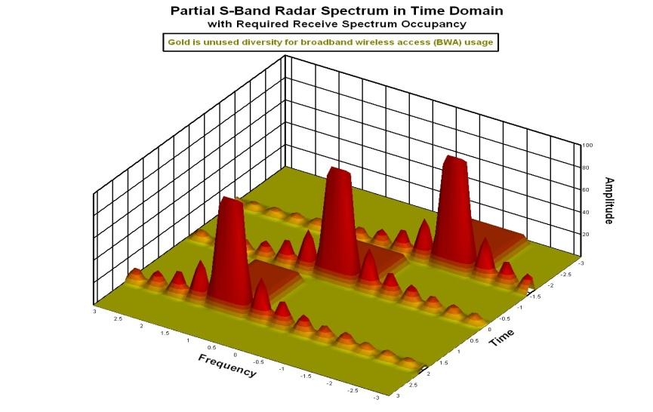

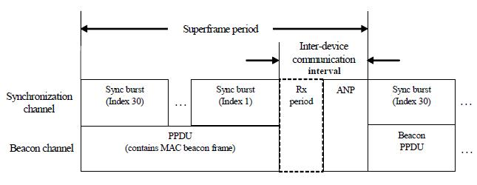
Spectrum sharing with radar using IEEE 802.22.1 Beaconing Standard
How will it Work: The designed beacon will contain Peace Time temporal patterns of the radars (e. g. PW, PRI), which when combined with some universal time clock such as GPS can help commercial communications systems to use the empty time slots for their operation.
During Emergency Scenarios, the beacon will send Urgent Co-existence request, to ask all the commercial systems to shut down immediately. Security features for such beacons are very important. IEEE Std, 802.22.1-2010™ has incorporated many such security mechanisms that may be applied to the 3550-3650 band relatively readily.
Current IEEE 802.22.1 beacon protocol contains many security Features already
IEEE 802.22.1 Like Beacon
Presenter: Mr. Ken Carrigan,
Kenneth.carrigan@navy.mil
Presenter: Dr. Apurva N. Mody,
apurva.mody@ieee.org,+1-404-819-0314
Approved for Public Release
Distribution Unlimited

Slide 11
Comments from the 802.11 WG
In the current form, we cannot support the approval of the proposed PAR.
The Title 2.1 and Scope 5.2b does not communicate clearly the substance of the project.
802.22 Response:
We agree with this comment. 802.19 provided similar comment.
The 802.22 WG Chair talked to 802.11 (Jon Rosdahl and Bruce Kraemer). Since an amendment to an existing Standard does not allow changes to the title, we have taken the following action – Our proposed PAR will no longer be an Amendment, but it will be a Revision to the IEEE 802.22.1-2010 Standard. This will allow us to make changes to the Title, Scope and Purpose.
Accordingly we have made changes to the Title, Scope and Purpose. We have also provided the Need for this revision to the standard. The updated PAR and 5C with modifications can be found here:
The new Title is as follows: Standard for Information Technology--Telecommunications and information exchange between systems--Local and metropolitan area networks--Specific requirements Part 22.1: Standard to Enable Spectrum Sharing using Advanced Beaconing
(continued)

Slide 12
Comments from the 802.11 WG
(continued)
The new Scope is as follows:
This standard specifies methods for spectrum sharing using advanced beaconing. The beacon specifies a format that facilitates its detection at low Signal to Noise Ratios. It contains information about a system that requires interference protection and is willing to share the spectrum with other systems.
The Standard defines Physical Layer (PHY) and Medium Access Control Layer (MAC) for advanced beacon operation in High Frequency (HF), Very High Frequency (VHF), Ultra High Frequency (UHF) (3MHz to 862 MHz) and the S-Band (2 GHz - 4 GHz). Enhanced security features, spectrum management, self organizing network and relay capabilities are included in the beacon specification.
The beacon supports spectrum sharing with licensed wireless microphones, radars, fixed and transportable space to earth receiver stations and other services. The beacon may also be used for applications such as search and rescue amongst others.
This standard supports mechanisms to enable coexistence with other 802 systems in the same band.

Slide 13
Comments from the 802.11 WG
(continued)
The New Purpose is as follows:
This standard proposes an advanced beaconing specification to facilitate spectrum sharing. The beacon contains information about the system that is willing to share the spectrum but needs interference protection. Any new system that wants to operate in the same bands will decode this information from the beacon and adjust its parameters accordingly to not cause the interference. with that system.

Slide 14
Comments from the 802.11 WG
Unable to differentiate what alternate systems you will be actually communicating with.
802.22 Response: We have tried to clarify this in the PAR scope and purpose. Beacon contains information about the system that is willing to share the spectrum but needs interference protection. Any system that wants to operate in the designated bands will have to decode this information and adjust its parameters accordingly to not cause the interference. (E. g. system that is willing to share the spectrum could be radar, or satellite to earth station receiver etc.)

Slide 15
Comments from the 802.11 WG
Which of the communication devices are 802.22, and which are some other 3rd party device operating in the frequency band mentioned.
802.22 Response: The beacon is an 802.22.1 device and uses a different modulation from 802.22 [See the note below]. Any new system that wants to share the spectrum with an existing holder of the spectrum is the 3rd party system.
E. g. a licensed exempt device operating in the TV Band WhiteSpaces wanting to share the spectrum with a Licensed Part 74 wireless microphone is a third party system.
Or a communications system operating in the 3550 – 3650 Band trying to share the spectrum with radar is a 3rd party system
[Note: 802.22 base standard defines an OFDMA based PHY that is used primarily for broadband (6 MHz) communications in VHF/ UHF Bands. On the other hand 802.22.1 defines a separate waveform (PHY and MAC) that consists of a signal that occupies 76 kHz bandwidth that is used to protect primary and secondary users such as licensed Part 74 microphones.]

Slide 16
Comments from the 802.11 WG
What types (quantities) of information will you convey in the proposed beaconing scheme?
802.22 Response: The proposed beaconing scheme contains small quantities of information such as location of the system willing to share the spectrum, the frequency, pulse width and pulse repetition interval in case of radars, beacon identification, authentication and beacon grouping information. During emergency situations it may contain messages asking all the other systems sharing the spectrum to cease the operation.
Are the Beacons adhering to the existing 802.22 definitions?
802.22 Response: No the beacons will not adhere to 802.22 WRAN definitions but will adhere to the 802.22.1 beacon definitions.

Slide 17
Comments from the 802.11 WG
Why is there a new PHY? What is new and different that you need in the PHY world?
802.22 Response: The current PHY of 802.22.1 is expected to be used with some enhancements to increase the range and detectability. But this is yet to be decided.
Is this a complementary Radio communicating with some other existing non-802 device, then that communication is already defined by the other device
802.22 Response: The main purpose of the 802.22.1 is to take information from a system that is willing to share the spectrum and broadcast it to others using a standardized format for efficient spectrum utilization and interference minimization.
5.4, the purpose is supposed to be what is in the final Standard, not the Amendment, so you should either not change the purpose statement, or the new statement should address what is in the final resultant standard. The proposed Purpose Statement seems to try to address the amendment only.
802.22 Response: We agree, and this has been changed.

Slide 18
Comments from the 802.19 WG
802.22.1a PAR
2.1 Title
The scope states that the advanced beacon protects devices in the 2-4 GHz band (in addition to the TV band); however, the title states that the beacon protects “… Low-Power Licensed Devices Operating in TV Broadcast Bands.” Please make the title and the scope consistent. If the advanced beacon intends to protect devices in the 2-4 GHz band, then please update the title so that it is not restricted to the TV bands.
802.22 Response:
We agree with this comment
The 802.22 WG Chair talked to 802.11 (Jon Rosdahl and Bruce Kraemer). Since an amendment to an existing Standard does not allow changes to the title, we have taken the following action – Our proposed PAR will no longer be an Amendment, but it will be a Revision to the IEEE 802.22.1-2010 Standard. This will allow us to make changes to the Title, Scope and Purpose.
Accordingly we have made changes to the Title, Scope and Purpose. We have also specified the need for this revision to the standard. The updated PAR and 5C with modifications can be found here:

Slide 19
Comments from the 802.19 WG
802.22.1a PAR
5.2.b. Scope
Please break the Scope into several paragraphs to improve readability.
802.22 Response: We agree with this comment. Changes have been made to improve the readability of the Scope.
5.5. Need
The Need states that “The President signed a Memorandum …” Please clarify the president of what Nation since IEEE is an international standards organization.
802.22 Response: We agree with this comment. We have made changes to the Need as requested.

Slide 20
References
2012 September Plenary Working Group Motions - https://mentor.ieee.org/802.22/dcn/12/22-12-0103-00-0000-september-interim-working-group-meeting-minutes.doc
2012 November Plenary Working Group Motions - https://mentor.ieee.org/802.22/dcn/12/22-12-0106-00-0000-802-22-november-plenary-wg-motions.doc
PCAST Report – Report to the President – Realizing Full Potential of the Govt. held Spectrum to Spur Economic Growth http://www.whitehouse.gov/sites/default/files/microsites/ostp/pcast_spectrum_report_final_july_20_2012.pdf
IEEE 802.22 Working Group Website – www.ieee802.org/22
Apurva Mody, Gerald Chouinard, “Overview of the IEEE 802.22 Standard on Wireless Regional Area Networks (WRAN) and Core Technologies” http://www.ieee802.org/22/Technology/22-10-0073-03-0000-802-22-overview-and-core-technologies.pdf
IEEE 802.22.1-2010™ Standard
IEEE 802.22-2011™ Standard

