Slide 1
IEEE P802.22b Teleconferences
IEEE P802.22 Wireless RANs Date: 2012-12-20
Authors:
Notice: This document has been prepared to assist IEEE 802.22. It is offered as a basis for discussion and is not binding on the contributing individual(s) or organization(s). The material in this document is subject to change in form and content after further study. The contributor(s) reserve(s) the right to add, amend or withdraw material contained herein.
Release: The contributor grants a free, irrevocable license to the IEEE to incorporate material contained in this contribution, and any modifications thereof, in the creation of an IEEE Standards publication; to copyright in the IEEE’s name any IEEE Standards publication even though it may include portions of this contribution; and at the IEEE’s sole discretion to permit others to reproduce in whole or in part the resulting IEEE Standards publication. The contributor also acknowledges and accepts that this contribution may be made public by IEEE 802.22.
Patent Policy and Procedures: The contributor is familiar with the IEEE 802 Patent Policy and Procedures
<http://standards.ieee.org/guides/bylaws/sb-bylaws.pdf>, including the statement "IEEE standards may include the known use of patent(s), including patent applications, provided the IEEE receives assurance from the patent holder or applicant with respect to patents essential for compliance with both mandatory and optional portions of the standard." Early disclosure to the Working Group of patent information that might be relevant to the standard is essential to reduce the possibility for delays in the development process and increase the likelihood that the draft publication will be approved for publication. Please notify the Chair Apurva Mody <apurva.mody@ieee.org> as early as possible, in written or electronic form, if patented technology (or technology under patent application) might be incorporated into a draft standard being developed within the IEEE 802.22 Working Group. If you have questions, contact the IEEE Patent Committee Administrator at <patcom@ieee.org>.

Slide 2
Abstract
This presentation is the agenda and meeting plan for the Dec. 20, 2012 IEEE 802.22b teleconference.

Slide 3
Agenda: Teleconference
Dec. 20, 7:00 PM-8:00 PM EDT
Introduction (1min)
IEEE patent policy (1min)
Issues to discuss
  IEEE P802.22b Nov. Meeting Report - 22-12-0096-02-000b-ieee-p802-22b-nov-2012-report
  IEEE P802.22b Future Plan
  IEEE P802.22b Jan. Meeting Plan
Any other business
Adjourn (1min)

Slide 4
Introduction
Welcome to the IEEE P802.22b June 26, 2012 teleconference
Chairs and secretary
  Chair: Chang-woo Pyo (NICT)
  Vice-chair :
  Recording Secretary: Zhang Xin(NICT)
Recording your attendance
  Send email to: zhang@ieee.org

Slide 5
IEEE Patent Policy
http://standards.ieee.org/board/pat/pat-slideset.pdf

Slide 6
Review Nov. F2F Meeting
22-12-0096-02-000b-ieee-p802-22b-nov-2012-report

Slide 7
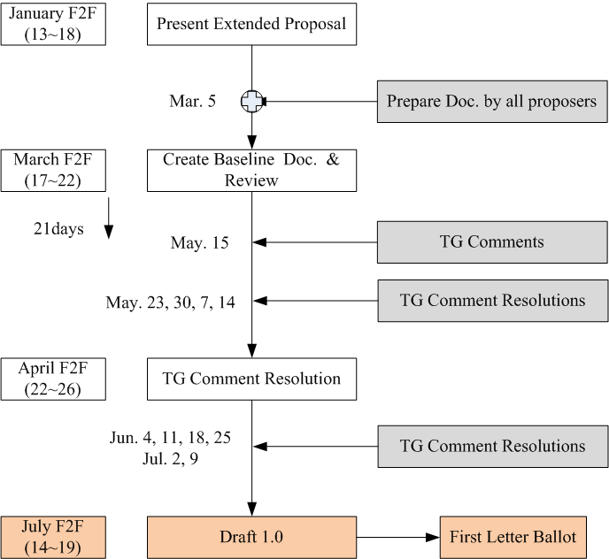
  IEEE P802.22b Tentative Future Plan
Combine Doc. prepared by proposals,
and Create Baseline Doc.

Slide 8
Jan. F2F Meeting Plan
Meeting Plan
  Present extend proposals
    Proposers can present extended version of proposal
  Fix future plan
    Document submission for creating a baseline document
  Assign Editor
    Any volunteer ?
  Discuss Baseline Document Creation method
    E.g., Combine all documents

Slide 9
Appendix: 802.22b Task Group Updated Timeline
 | 2012 |  |  |  |  |  | 2013 |  |  |  |  |  | 2014
 | 1 | 3 | 5 | 7 | 9 | 11 | 1 | 3 | 5 | 7 | 9 | 11 | 1 | 3 | 5 | 7 | 9 | 11
Task Group formed | x
Process document | x | x
Functional Requirements | x | x
Call for Proposals issued |  | x
Selection Criteria |  | x | x | x
Technical/Informative Contributions |  |  | x | x | x
Proposal presentations |  |  |  |  |  | x
Baseline proposal selected |  |  |  |  |  |  | x
Draft for 1st letter ballot |  |  |  |  |  |  |  | x | x
1st letter ballot completed |  |  |  |  |  |  |  |  |  | x
Comment Resolution |  |  |  |  |  |  |  |  |  |  | x
2nd letter ballot completed |  |  |  |  |  |  |  |  |  |  |  | x
Comment Resolution and recirculation |  |  |  |  |  |  |  |  |  |  |  |  | x
Sponsor ballot |  |  |  |  |  |  |  |  |  |  |  |  |  | x
Comment Resolution and recirculation |  |  |  |  |  |  |  |  |  |  |  |  |  |  | x | x
RevCom/NesCom Approval |  |  |  |  |  |  |  |  |  |  |  |  |  |  |  |  | x | x

