Slide 1
PHY Performance Comparison between 802.22 PHY and Proposed PHY
IEEE P802.22 Wireless RANs Date: 2013-01-16
Authors:
Notice: This document has been prepared to assist IEEE 802.22. It is offered as a basis for discussion and is not binding on the contributing individual(s) or organization(s). The material in this document is subject to change in form and content after further study. The contributor(s) reserve(s) the right to add, amend or withdraw material contained herein.
Release: The contributor grants a free, irrevocable license to the IEEE to incorporate material contained in this contribution, and any modifications thereof, in the creation of an IEEE Standards publication; to copyright in the IEEE’s name any IEEE Standards publication even though it may include portions of this contribution; and at the IEEE’s sole discretion to permit others to reproduce in whole or in part the resulting IEEE Standards publication. The contributor also acknowledges and accepts that this contribution may be made public by IEEE 802.22.
Patent Policy and Procedures: The contributor is familiar with the IEEE 802 Patent Policy and Procedures
<http://standards.ieee.org/guides/bylaws/sb-bylaws.pdf>, including the statement "IEEE standards may include the known use of patent(s), including patent applications, provided the IEEE receives assurance from the patent holder or applicant with respect to patents essential for compliance with both mandatory and optional portions of the standard." Early disclosure to the Working Group of patent information that might be relevant to the standard is essential to reduce the possibility for delays in the development process and increase the likelihood that the draft publication will be approved for publication. Please notify the Chair Apurva Mody <apurva.mody@baesystems.com> as early as possible, in written or electronic form, if patented technology (or technology under patent application) might be incorporated into a draft standard being developed within the IEEE 802.22 Working Group. If you have questions, contact the IEEE Patent Committee Administrator at patcom@ieee.org.

Slide 2
Contents
Simulation Parameters
Simulation Results
- BER vs CNR performance
- PHY throughput vs CNR performance

Slide 3
Simulation Parameters

Slide 4
Simulation Parameters
Items | Specification
Modulation and Coding Scheme | QPSK-CC1/2, QPSK-CC2/3 16QAM-CC1/2, 16QAM-CC2/3 64QAM-CC2/3, 64QAM-CC2/3
Cyclic Prefix Mode | 1/8
Convolution Coding | Constraint length:7, Generator Polynomials: [133 171]
Decoding | Soft-decision Viterbi decoding
FDE | MMSE
Channel Model | IEEE802.22 Profile A , Profile B [1]
Reference BER | 2x10⁻⁴ *
*According to the following reference, this BER corresponds to the DVB-T standard defined quasi error free (QEF). QEF means “less than one uncorrelated error event per hour”, corresponding to BER=10-11 after the RS decoder.
[Reference]
Chan-Joo Kim, Myung-Sun Song, Gwang-Zeen Ko, Sung-Hyun Hwang, Jung-Sun Um, Simulation Results to Determine the Normalized C/N in TPC Equation, IEEE802.22-08-0181r1, Jul. 2008

Slide 5
Channel Models
  Profile A and Profile B shown below are used for this simulation.
Profile A | Path1 | Path2 | Path3 | Path4 | Path5 | Path6
Excess delay[usec] | 0 | 3 | 8 | 11 | 13 | 21
Relative amplitude[dB] | 0 | -7 | -15 | -22 | -24 | -19
Profile B | Path1 | Path2 | Path3 | Path4 | Path5 | Path6
Excess delay[usec] | -3 | 0 | 2 | 4 | 7 | 11
Relative amplitude[dB] | -6 | 0 | -7 | -22 | -16 | -20
[Reference]
Eli Sofer and Gerald Chouinard, WRAN channel modelling, IEEE 802.22-05/0055r7, Aug. 2005.
  Each delayed wave has the amplitude with Rayleigh distribution and the phase with the uniform distribution

Slide 6
Simulation Results

Slide 7
Channel Model: Profile A
Code Rate: 1/2
3.2dB
2.6dB
0.6dB
Proposed PHY has different specifications between DS and US. → two curves(○,x)
Legacy 802.22 PHY has the same specifications between DS and US. →one curve(♢)
Reference BER:
2x10⁻⁴
At the reference BER point, proposed PHY improves BER performance by 3.2dB for QPSK-CC2/3, 2.6 dB for 16QAM-CC2/3, 0.6 dB for 64QAM-CC2/3.

Slide 8
Channel Model: Profile A
Code Rate: 2/3
3.7dB
2.5dB
Reference BER:
2x10⁻⁴
At the reference BER point, proposed PHY improves BER performance by 3.7dB for QPSK-CC2/3, 2.4 dB for 16QAM-CC2/3. For 64QAM-CC2/3, 802.22 PHY has better performance over 32 dB CNR.

Slide 9
Channel Model: Profile B
Code Rate: 1/2
3.3dB
3.9dB
4.5dB
Reference BER:
2x10⁻⁴
At the reference BER point, proposed PHY improves BER performance by 3.3dB for QPSK-CC2/3, 3.9 dB for 16QAM-CC2/3, 4.5 dB for 64QAM-CC2/3.

Slide 10
Channel Model: Profile B
Code Rate: 2/3
3.5dB
5.8dB
6.4 dB
Reference BER:
2x10⁻⁴
At the reference BER point, proposed PHY improves BER performance by 3.5 dB for QPSK-CC2/3, 5.8 dB for 16QAM-CC2/3, 6.4 dB for 64QAM-CC2/3.

Slide 11
Difference between Pilot Pattern
OFDM symbol
Subcarrier
Data Subcarrier
Pilot Subcarrier
802.22 Pilot Pattern
Proposed Pilot Pattern(US)
In the proposed pilot pattern, more accurate channel state estimation is available by the linear interpolation between the pilot subcarrier

Slide 12
According to the simulation results shown in slides 7 to 10
required CNR to meet the reference BER(2x10⁻⁴) are as follows.
 | Channel Model: Profile A |  | Channel Model: Profile B
 | 802.22 PHY | Proposed PHY | 802.22 PHY | Proposed PHY
QPSK-CC1/2 | 21.0 [dB] | 17.8 [dB] | 19.2 [dB] | 15.9 [dB]
QPSK-CC2/3 | 24.9 [dB] | 21.2 [dB] | 23.9 [dB] | 20.4 [dB]
16QAM-CC1/2 | 26.8 [dB] | 24.2 [dB] | 25.9 [dB] | 22.0 [dB]
16QAM-CC2/3 | 32.3 [dB] | 29.8 [dB] | 32.0 [dB] | 26.2 [dB]
64QAM-CC1/2 | 32.3 [dB] | 31.7 [dB] | 32.3 [dB] | 27.8 [dB]
64QAM-CC2/3 | 38.7 [dB] | N/A | 38.9 [dB] | 32.5 [dB]
Profile B
For most cases, proposed PHY has better BER performance than 802.22 PHY.
Over 30 dB CNR is not realistic for Profile A channel environment.

Slide 13
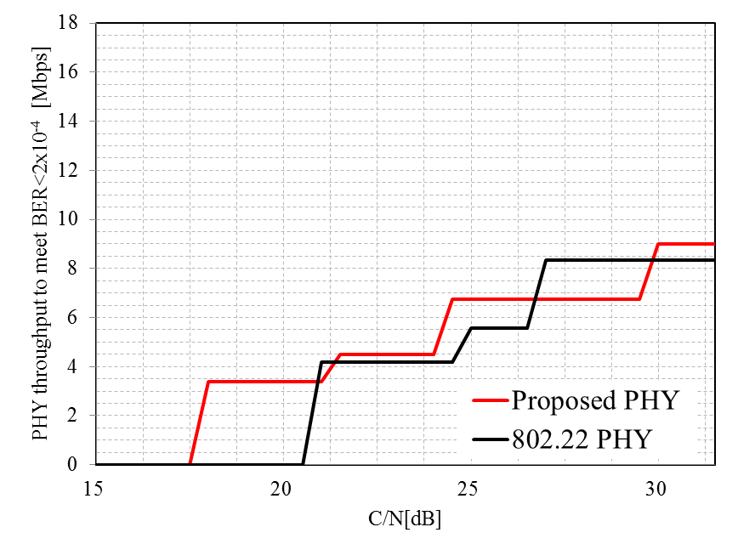
PHY throughput under the condition to meet the reference BER(2x10⁻⁴)
Channel Model: Profile A
QPSK-
CC1/2
QPSK-
CC2/3
16QAM-
CC1/2
Available MCS
in 802.22 PHY
QPSK-
CC1/2
QPSK-
CC2/3
16QAM-
CC1/2
16QAM-
CC2/3
Available MCS
in proposed PHY
Proposed PHY has better throughput than 802.22 PHY for many cases.

Slide 14
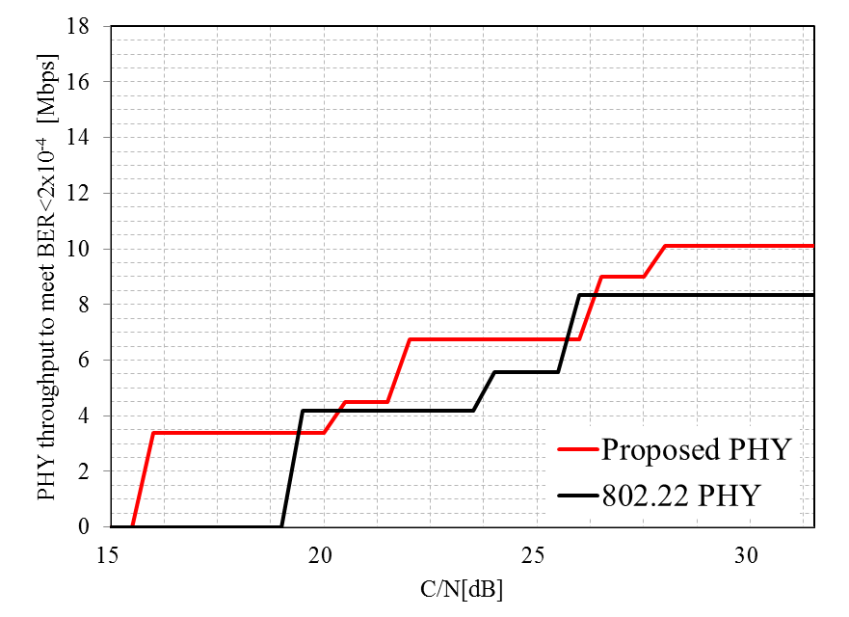
PHY throughput under the condition to meet the reference BER(2x10⁻⁴)
Channel Model: Profile B
QPSK-
CC1/2
QPSK-
CC2/3
16QAM-
CC1/2
Available MCS
in 802.22 PHY
QPSK-
CC1/2
QPSK-
CC2/3
16QAM-
CC1/2
16QAM-
CC2/3
64QAM-
CC1/2
Available MCS
in proposed PHY
Proposed PHY has better throughput than 802.22 PHY for most cases.

Slide 15
Summary
BER Performance and PHY throughput were compared between the legacy 22 PHY and proposed PHY using the Channel Models Profile A and B.
At the reference BER(2x10⁻⁴), proposed PHY improved the BER performance up to 6 dB compared to the legacy 802.22 PHY
Due to this better BER performance of proposed PHY, higher throughput can be supported by the proposed PHY for realistic environment.

