Slide 1
IEEE ITU Joint Meeting
Spectrum Sharing and White Space Standardization to Bridge Digital Divide
Dr. Apurva N. Mody,
Chair, IEEE 802.22 Working Group
apurva.mody@ieee.org,
+1-404-819-0314
https://mentor.ieee.org/802.22/dcn/13/22-13-0114-00-0000-ieee-itu-joint-meeting-spectrum-sharing-and-white-space-standardization-to-bridge-the-digital-divide.pptx

Slide 2
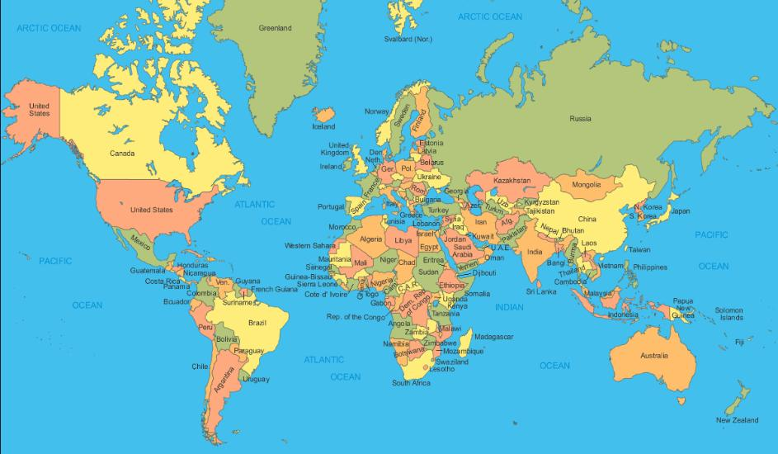
TVWS Regulations Around the World
Canada Regulations completed – Total 300 MHz (Ch. 2-51) being considered for license-exempt operation, of which 180 MHz (ch. 21-51) have already been open for light-licensing for remote rural broadband access since June 2009
UK Initial Rules Released (July 5th, 2012) – License-exempt database driven approach, different classes of devices, sensing optional
EU (CEPT) Discussions on-going – license-exempt, collaborative sensing, database approaches considered. Variable transmit power based on device capabilities, microphone protection beacon
Japan (MIC) Discussions on-going Final rules before 2015. 10 WS projects under way – WS Test Area to be allocated
Brazil – DTV transition on-going. Realizes the importance of broadband for rural (e. g. Res. 558, Operation in 450 – 470 MHz)
Egypt – interested and participating in IEEE 802
Singapore Testing devices on-going (IDA)– Final rules before 2015. 12 channels for testing. May allow bonding of up to 8 channels. Sensing , database required
USA Regulations completed – Total 288 MHz freed up (Sept 2010) for license-exempt operation. Geolocation database, sensing optional – Incentive auctions could change this.
ITU – Several study groups are discussing cognitive radio based operation. TVWS may be a discussion topic in 2015 WRC. IEEE 802 is providing inputs
India Discussions on-going – 368 – 380 MHz for rural. 470 MHz – 470 - 585 MHz for WhiteSpaces. Further discussions in 2015 time-frame

Slide 3

United States Tomorrow: shared-use Spectrum Superhighways
Courtesy: Mark Gorenberg, Hummer Winbald Venture Partners
PCAST recommends the President issue a new memorandum that:
states the policy of the U.S. government is to share underutilized Federal spectrum; and
identifies immediately 1,000 MHz of Federal spectrum for sharing with the private sector; and
The New Spectrum Superhighway:
  Divides spectrum into substantial blocks with common characteristics
  Makes sharing by Federal users with commercial users the norm
  Measures spectrum effectiveness using a new metrics
  Increases capacity and spectrum re-use by 1,000’s of times.
Cognitive radio
Non-cognitive radio

Slide 4
Agenda
Title | Speaker | Time
IEEE ITU Welcome | Paul Nikolich (Chair, IEEE 802) | 10 min
ITU Studies on Cognitive Radios and White Spaces | Philippe Aubineau (Counsellor, ITU-R Study Groups) | 15 min
White Spaces: Managing the Spaces or Better Managing Spectrum Efficiency | Christian Gomez, (ITU-R) Spectrum Regulation and Policy Officer ) | 15 min
IEEE 802.11 (WLAN) Standards on Spectrum Sharing | Rich Kennedy (IEEE 802.11 WG) | 20 min
IEEE 802.15.4m (WPAN) Standard for TVWS | Clint Powell (IEEE 802.15 WG) | 15 min
IEEE 802.19.1 (Co-existence) Standard | Stanislav Filin (IEEE 802.19.1 WG) | 15 min
IEEE 802.22: White Space Enabled Rural Broadband to Cognitive M2M | Apurva N. Mody (IEEE 802.22 WG) | 15 min
IETF Protocol to Access White Spaces | Subir Das (IETF PAWS) | 15 min

