Slide 1
802.15 TG4m Briefing to ITU-R Staff
Clint Powell (PWC, LLC)

Slide 2
P802.15.4m
Title
  IEEE Standard for Local and Metropolitan Area Networks Part 15.4: Low Rate Wireless Personal Area Networks (LR-WPANs) Amendment 6: TV White Space Between 54 MHz and 862 MHz Physical Layer
  Abstract
  In this amendment to IEEE Std. 802.15.4-2011, outdoor low-data-rate, wireless, TV White Space network requirements are addressed. Alternate PHYs are defined as well as only those MAC modifications needed to support their implementation.

Slide 3
P802.15.4m
Scope
  This amendment specifies a physical layer for 802.15.4 meeting TV white space regulatory requirements in as many regulatory domains as practical and also any necessary Media Access Control (MAC) changes needed to support this physical layer. The amendment enables operation in the VHF/UHF TV broadcast bands between 54 MHz and 862 MHz, supporting typical data rates in the 40 kbits per second to 2000 kbits per second range, to realize optimal and power efficient device command and control applications.
Purpose
  The purpose of this amendment is to allow 802.15.4 wireless networks to take advantage of the TV white space spectrum for use in large scale device command and control applications.

Slide 4
P802.15.4m
Intro of Draft
  This amendment specifies alternate PHYs in addition to those of IEEE Std 802.15.4-2011. In addition to the new PHYs, the amendment also defines those MAC modifications needed to support their implementation.
  The alternate PHYs support principally outdoor, low-data-rate, wireless, TV White Space network (TVWS) applications under multiple regulatory domains. The TVWS PHYs are as follows:
    — Frequency shift keying (TVWS-FSK) PHY
    — Orthogonal frequency division multiplexing (TVWS-OFDM) PHY
    — Narrow Band Orthogonal frequency division multiplexing
    (TVWS-NB-OFDM) PHY
  The TVWS PHYs support multiple data rates in bands ranging from
  54 MHz to 862 MHz.

Slide 5
P802.15.4m
PHY - Features
  3 PHYs: multi-rate and multi-regional - operating multiple over-the-air data rates in support of various applications in the TVWS
  Devices must support at least one of the 3 PHYs
PHY | Modulation | Data Rates
FSK | 2 level FSK 4 level FSK | 50 or 100 or 200 or 300 kbps 400 kbps
OR
OFDM | BPSK QPSK 16-QAM | 390.625 or 1562.5 kbps 781.250 or 3125 kbps 1562.5 or 6250 kbps
OR
NB-OFDM | BPSK QAM 16-QAM 64-QAM | 156 or 234 kbps 312 or 468 kbps 624 or 936 kbps 936 or 1404 or 1638 kbps

Slide 6
P802.15.4m
PHY - Features
  17 Bands Currently Supported
Band |  | Band
TVWS Band USA |  | 896-901 MHz
TVWS Band UK |  | 901-902 MHz
TVWS Band Japan |  | 902-928 MHz
TVWS Band Canada |  | 917-923.5 MHz
TVWS Band Korea |  | 928-960 MHz
450-470 MHz |  | 920-928 MHz
470-510 MHz |  | 950-958 MHz
779-787 MHz |  | 2400-2483.5 MHz
863-870 MHz |  | future expansion

Slide 7
P802.15.4m
MAC - Features
  TVWS multichannel cluster tree PAN (TMCTP)
  with a Super PAN coordinator (SPC)
  The SPC:
    Communicates with other PAN coordinators on their dedicated channels during the beacon only period (BOP)
    Provides access to geolocation database (GDB) server, providing TVWS channel availability information to all PAN coordinators in TMCTP
    Allocates use of a different channel for each PAN coordinator in TMCTP

Slide 8
P802.15.4m
MAC - Features
  Direct device-to-device data transfer
  via. 4-modes:
    Probe-mode direct data transfer
    Polling-mode direct data transfer
    Broadcast-mode direct data transfer
    Multicast-mode direct data transfer
  Low-energy mechanisms
  via. TVWS power saving (TVWSPS) Information Element (IE)
    TVWSPS IE is used to initiate a TVWSPS transaction and contains the: PS Control, Periodic Listening Interval, Periodic Listening Duration, Rendezvous Time, and Data Transaction Duration entities

Slide 9
P802.15.4m
MAC - Features
  Location, GDB and channel access/usage
  supported by use of multiple IE’s:
    TVWS device category IE
    TVWS device identification IE
    TVWS device location IE
    TVWS channel information query request/response IE
    TVWS channel information source description IE
    Channel timing management IE
    Channel list verification IE

Slide 10
P802.15.4m
MAC - Features
  Transfer of ranging measurements between devices
  supported by use of multiple IE’s:
    Ranging request IE
    Ranging response IE
  Ranging determination (to generate geo-location info)
  support covered in informative annex:
    FSK PHY - Use of symbol transition timing (STT)
    OFDM PHYs - ToA estimation using conventional autocorrelation-based schemes

Slide 11
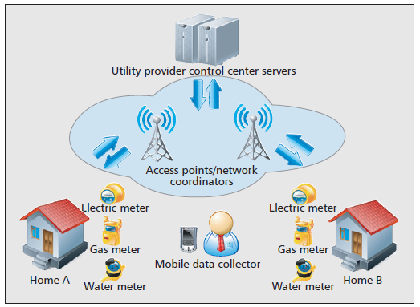
P802.15.4m
Depiction of Smart Utility Usage Model Utilizing TVWS*
  *figure from “Cognitive Communication in TV White Spaces:
  An Overview of Regulations, Standards, and Technology”,
  IEEE Communications Magazine, July 2013.

Slide 12
P802.15.4m - Summary
P802.15.4m:
  Enables 802.15 low-rate WPAN technologies in the TVWS for targeted applications using low-power low complexity devices including sensors for smart grid/utility, and machine-to-machine networks
  Provides Multiple PHY, Multiple Data Rate, Multiple Region Capability
  Is well suited for large scale device command and control applications, such as Smart Utility and Field Area Sensor Networks

