Slide 1
IEEE P802.22b September 2013 Plan & Report
IEEE P802.22 Wireless RANs Date: 2013-9-14
Authors:
Notice: This document has been prepared to assist IEEE 802.22. It is offered as a basis for discussion and is not binding on the contributing individual(s) or organization(s). The material in this document is subject to change in form and content after further study. The contributor(s) reserve(s) the right to add, amend or withdraw material contained herein.
Release: The contributor grants a free, irrevocable license to the IEEE to incorporate material contained in this contribution, and any modifications thereof, in the creation of an IEEE Standards publication; to copyright in the IEEE’s name any IEEE Standards publication even though it July include portions of this contribution; and at the IEEE’s sole discretion to permit others to reproduce in whole or in part the resulting IEEE Standards publication. The contributor also acknowledges and accepts that this contribution July be made public by IEEE 802.22.
Patent Policy and Procedures: The contributor is familiar with the IEEE 802 Patent Policy and Procedures
<http://standards.ieee.org/guides/bylaws/sb-bylaws.pdf>, including the statement "IEEE standards July include the known use of patent(s), including patent applications, provided the IEEE receives assurance from the patent holder or applicant with respect to patents essential for compliance with both mandatory and optional portions of the standard." Early disclosure to the Working Group of patent information that might be relevant to the standard is essential to reduce the possibility for delays in the development process and increase the likelihood that the draft publication will be approved for publication. Please notify the Chair Apurva Mody <apurva.mody@ieee.org> as early as possible, in written or electronic form, if patented technology (or technology under patent application) might be incorporated into a draft standard being developed within the IEEE 802.22 Working Group. If you have questions, contact the IEEE Patent Committee Administrator at <patcom@ieee.org>.

Slide 2
Meeting Protocol
Please announce your affiliation when you first address the group during a meeting slot

Slide 3
Attendee
https://imat.ieee.org/attendance
Register
Indicate attendance

Slide 4
Introduction
Welcome to the IEEE P802.22b September, Interim Meeting in Nanjing
TG Chairs and secretary
  Chair: Chang-woo Pyo (NICT)
  Vice-chair : Sunghyun Hwang (ETRI)
  Recording Secretary: Zhang Xin(NICT)
Recording your attendance
  Send email to: zhang@ieee.org

Slide 5
New Member
Welcome to 802.22b TG
Introduction

Slide 6
802.22b Title, PAR Scope and Purpose
Title
  Enhancement for Broadband Services and Monitoring Applications
PAR
  This amendment specifies alternate Physical Layer (PHY) and necessary Medium Access Control Layer (MAC) enhancements to IEEE std. 802.22-2011 for operation in Very High Frequency (VHF)/ Ultra High Frequency (UHF) TV broadcast bands between 54 MHz and 862 MHz to support enhanced broadband services and monitoring applications. The standard supports aggregate data rates greater than the maximum data rate supported by the IEEE Std. 802.22-2011. This standard defines new classes of 802.22 devices to address these applications and supports more than 512 devices in a network. This standard also specifies techniques to enhance communications among the devices and makes necessary amendments to the cognitive, security & parameters and connection management clauses. This amendment supports mechanisms to enable coexistence with other 802 systems in the same band.
Purpose
  The purpose of this amendment is to enhance the MAC and define an alternate PHY to accommodate broadband extensions and monitoring use cases for IEEE 802.22 devices operating is VHF/UHF TV broadcast bands between 54 MHz and 862 MHz.

Slide 7
Tentative TG 802.22b Agenda for the Week
Agenda
Motion to approve September 802.22b agenda as contained in 22-13-0144-00-000b
Move: Chang-woo Pyo
Second: Jerry Kalke
No objection. Motion passes

Slide 8
TGb Slot 1
Time: Tuesday Sep. 17th AM2
Review from July
Approve minutes from July
Discussion Items
Time slot for Presentation

Slide 9
Review of July Meeting
Contributions
Date | Contributions | Doc. # | Presenter
Slot #2 (Tue. PM1) | 802.22b general | 22-13-0089-00-000b | Pyo
Slot #3 (Wed. AM1) | PHY | 22-13-0091-00-000 | Oodo
Slot #4 (Wed. AM2) | 802.22b General Frame | 22-13-0074-02-000b | Pyo
Slot #5 (Thur. AM1) | Initialization and Associations | 22-13-0060-01-000b | Pyo
Slot #6 (Thur. AM2) | 802.22b Ranging | 22-13-0069-01-000b | Pyo
Date | Contributions | Doc. # | Presenter
Slot #3 (Wed. AM1) | Management messages for group resource allocation |  | Dr. Hwang
Slot #4 (Wed. AM2) | Proposed PHY text for 22b |  | Dr. Zhao
Slot #5 (Thur. AM1) | Proposed MIMO topics for 22b |  | Dr. Gabriel
Slot #6 (Thur. AM2) | Multi-Channel operation |  | Dr. Toh

Slide 10
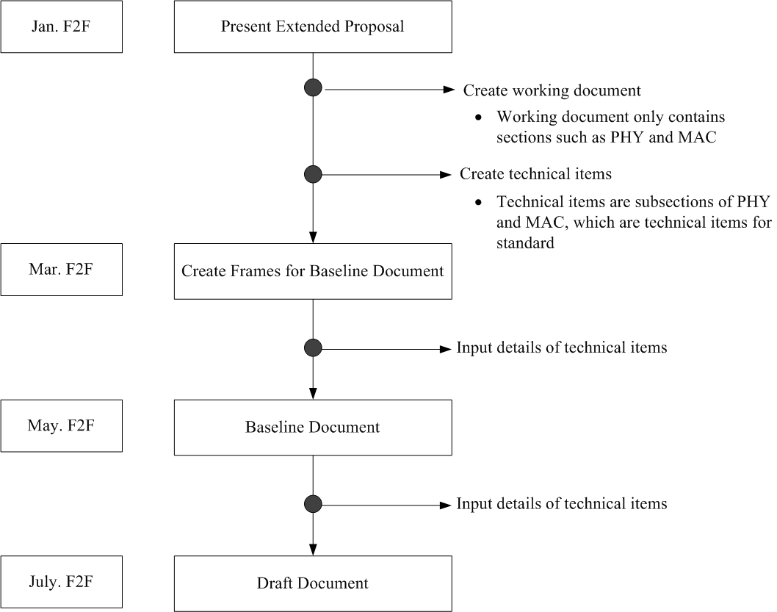
TGb Plan
July F2F
Sep. F2F

Slide 11
July Minutes
Motion to approve July 802.22b minutes as contained in 22-13-146-00-000b
Move: Chang-woo Pyo
Second: Gwang zeen Ko
No objection, Motion passes.

Slide 12
Review of Conference Calls
Teleconf. | Date | Discussion Items | Doc.
#1 | 2013-Aug-1 | Draft document-r0.1
#2 | 2013-Aug-8 | 802.22b MAC other functions | 22-13-0129-00-000b
#3 | 2013-Aug-15 | PHY Details MIMO | 22-13-0091-02-000b-0000 22-13-0131-00-000b-0000
#4
#5
#6

Slide 13
Conference Call Minutes
Motion to approve 802.22b conference call minutes as contained in
  22-13-148-00-000b
  22-13-149-00-000b
  22-13-150-01-000b
Move: Chang-woo Pyo
Second: Keat beng Toh
No objection. Motion passes

Slide 14
Discussion Items
Review Documents of Technical Items
Date | Contributions | Doc. # | Presenter
 | 802.22b Draft 1.0 | 151/r0 | Pyo

Slide 15
Contributions
Date | Contributions | Doc. # | Presenter
17th AM2 | Frame structure modification | 141/r2 | Dr. Ko
18th PM1 , 19th AM1 | TX diversity with array interference gain | 132/r3 | Dr. Gabriel
 | MIMO text: maximum ratio combining for the standard 802.22b | 140/r0
 | MIMO text: for the standard 802.22b | 131/r1
19th AM1 | Proposed PHY text for 802.22b | 122/r1 | Dr. Zhao
19th AM1 | MD-TCM Text for 802.22b
18th AM2 | Proposed Text of MAC technical items related to 7.7.11.3.X Multi-channel operation supported | 135/r0 | Dr. Toh
 | Proposed Text of MAC technical items related to 7.6.X MAC headers (Multi-channel operation mode) | 134/r0
 | Proposed Text of MAC technical items related to 7.7.X Channel Allocation Manager management messages | 133/r0

Slide 16
TGb Slot 2
Time: Tuesday July 17th PM1
Discuss Items
  Review Draft1.0 (151/r0)

Slide 17
TGb Slot 3
Time: Tuesday July 18th AM2
Discuss Items
  Review Draft1.0 (151/r0)
  Multi-channel operation supported (135/r0, 134/r0, 133/r0)

Slide 18
TGb Slot 4
Time: Wednesday July 18th PM1
Discuss Items
  Review Draft1.0 (151/r0)
  MIMO (132/r3, 140/r0, 131/r1)

Slide 19
TGb Slot 5
Time: Thursday July 19th AM1
Discuss Item

Slide 20
TGb Slot 6
Time: Thursday July 19th AM2
Discuss Items
Closing

Slide 21
Teleconference Plan
 | Mod | Tue | Wed | Thu | Fri | Sat | Sun
Sep | 23 | 24 | 25 | 26 | 27 | 28 | 29
Oct | 30 | 1 | 2 | 3 | 4 | 5 | 6
 | 7 | 8 | 9 | 10 | 11 | 12 | 13
 | 14 | 15 | 16 | 17 | 18 | 19 | 20
 | 21 | 22 | 23 | 24 | 25 | 26 | 27
 | 28 | 29 | 30 | 31 | 1 | 2 | 3
Nov | 4 | 5 | 6 | 7 | 8 | 9 | 10
Eastern Time 9pm
(Japan/Korean Time 10am)

Slide 22
802.22b Task Group Updated Timeline
 | 2012 |  |  |  |  |  | 2013 |  |  |  |  |  | 2014 |  |  |  |  |  | 2015
 | 1 | 3 | 5 | 7 | 9 | 11 | 1 | 3 | 5 | 7 | 9 | 11 | 1 | 3 | 5 | 7 | 9 | 11 | 1 | 3 | 5 | 7 | 9 | 11
Task Group formed | x
Process document | x | x
Functional Requirements | x | x
Call for Proposals issued |  | x
Selection Criteria |  | x | x | x
Technical/Informative Contributions |  |  | x | x | x
Proposal presentations |  |  |  |  |  | x
Processing to create a working document |  |  |  |  |  |  | x | x | x | x | x
Draft for 1st letter ballot |  |  |  |  |  |  |  |  |  |  | x
1st letter ballot completed |  |  |  |  |  |  |  |  |  |  | x | x
Comment Resolution |  |  |  |  |  |  |  |  |  |  |  | x
2nd letter ballot completed |  |  |  |  |  |  |  |  |  |  |  |  | x
Comment Resolution and recirculation |  |  |  |  |  |  |  |  |  |  |  |  |  | x
Sponsor ballot |  |  |  |  |  |  |  |  |  |  |  |  |  |  | x
Comment Resolution and recirculation |  |  |  |  |  |  |  |  |  |  |  |  |  |  |  | x | x
RevCom/NesCom Approval |  |  |  |  |  |  |  |  |  |  |  |  |  |  |  |  |  | x | x

