Slide 1
Comment Resolution related to
MAC Frame (CID 225, 226)
IEEE P802.22 Wireless RANs Date: 2013-11-21
Authors:
Notice: This document has been prepared to assist IEEE 802.22. It is offered as a basis for discussion and is not binding on the contributing individual(s) or organization(s). The material in this document is subject to change in form and content after further study. The contributor(s) reserve(s) the right to add, amend or withdraw material contained herein.
Release: The contributor grants a free, irrevocable license to the IEEE to incorporate material contained in this contribution, and any modifications thereof, in the creation of an IEEE Standards publication; to copyright in the IEEE’s name any IEEE Standards publication even though it may include portions of this contribution; and at the IEEE’s sole discretion to permit others to reproduce in whole or in part the resulting IEEE Standards publication. The contributor also acknowledges and accepts that this contribution may be made public by IEEE 802.22.
Patent Policy and Procedures: The contributor is familiar with the IEEE 802 Patent Policy and Procedures
<http://standards.ieee.org/guides/bylaws/sb-bylaws.pdf>, including the statement "IEEE standards may include the known use of patent(s), including patent applications, provided the IEEE receives assurance from the patent holder or applicant with respect to patents essential for compliance with both mandatory and optional portions of the standard." Early disclosure to the Working Group of patent information that might be relevant to the standard is essential to reduce the possibility for delays in the development process and increase the likelihood that the draft publication will be approved for publication. Please notify the Chair Apurva Mody <apurva.mody@ieee.org> as early as possible, in written or electronic form, if patented technology (or technology under patent application) might be incorporated into a draft standard being developed within the IEEE 802.22 Working Group. If you have questions, contact the IEEE Patent Committee Administrator at <patcom@ieee.org>.

Slide 2
Comment Resolution related to MAC Frame (CID 225, 226)
ID | Comment | Suggested Remedy
225 | Why is a new AZ DS-MAP IE defined (see Table G1). How is different than the DS-MAP IE as defined in 7.7.2.1 of IEEE Std. 802.22-2011 | If there is no real funcitonal need for defining a new IE for the DS access zone, then change all references of AZDS-MAP IE to DS-MAP IE and remove section 7.7.2.2. Make appropriate changes to MAP IE usage for US AZ.
226 | Why is a new DRZ DS-MAP IE defined (see Table I1). How is different than the DS-MAP IE as defined in 7.7.2.1 of IEEE Std. 802.22-2011 | If there is no real funcitonal need for defining a new IE for the DS Distributed relay zone, then change all references of DRZDS-MAP IE to DS-MAP IE and remove section 7.7.2.4. Make appropriate changes to US DRZ
Proposed Resolution
: Accept in principle

Slide 3
802.22b Frame Configuration
Overlapping by R-CPEs
No overlapping
Overlapping by R-CPEs
DRZDS-MAP IE
Same as DS-MAP IE,
but no need Multi-zone configuration
DS-MAP IE
- Multi-zone configuration
CRZDS-MAP IE
- Overlapping information
Access Zone (AZ)
Centralized Relay Zone (CRZ)
Distributed Relay Zone (CRZ)

Slide 4
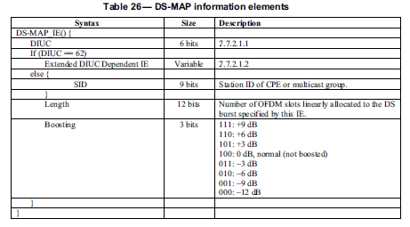
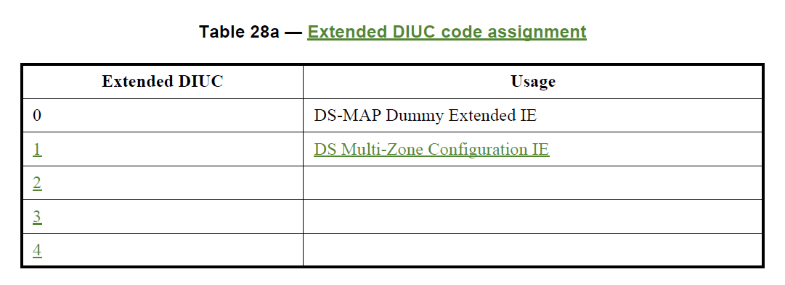
DS-MAP IE, AZDS-MAP IE, CRZDS-MAP IE and DRZDS-MAP IE
DS-MAP IE of IEEE 802.22 Std.
Multi-Zone Configuration

Slide 5
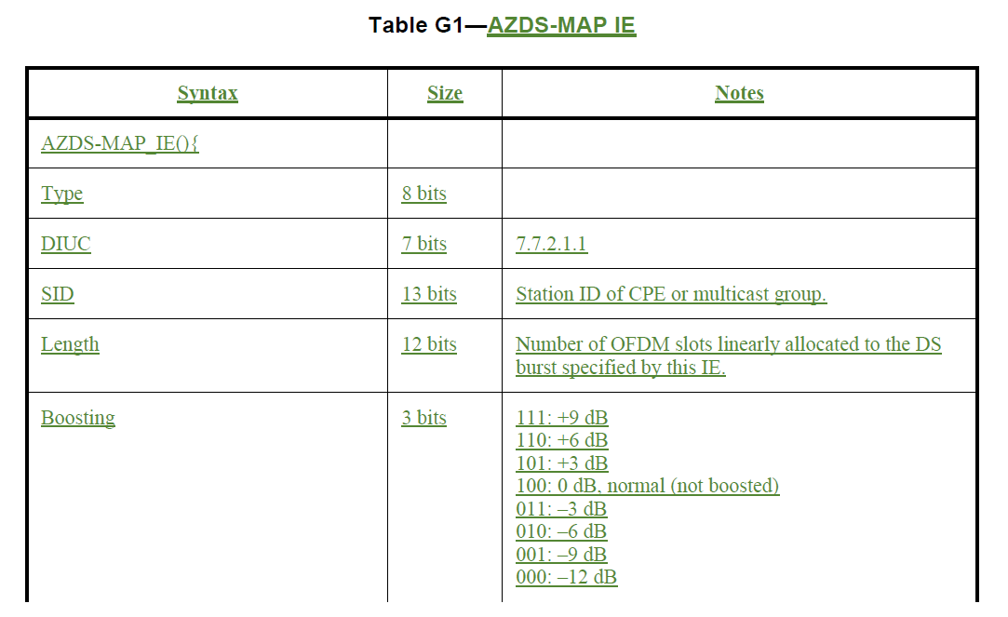
AZDS-MAP IE
  No Extended DIUC IE

Slide 6
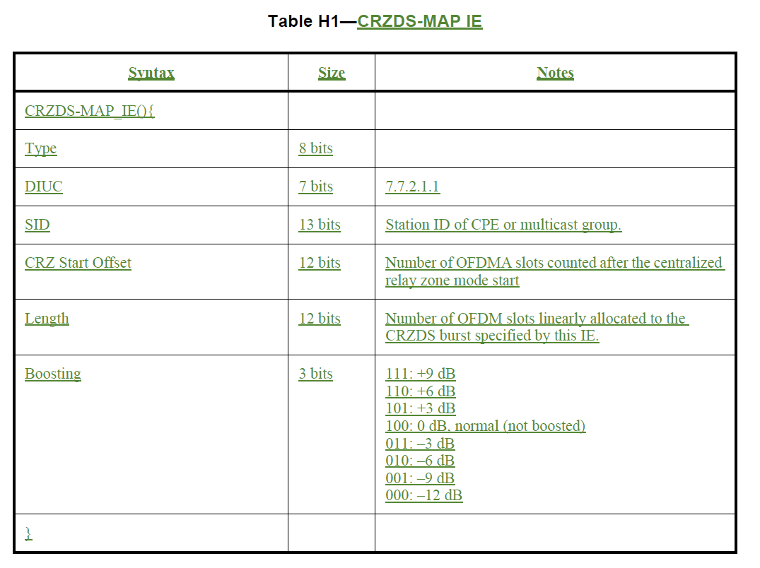
CRZDS-MAP IE
  No Extended DIUC IE
  Add “ CRZ Start Offset”
Overlapping
information

Slide 7
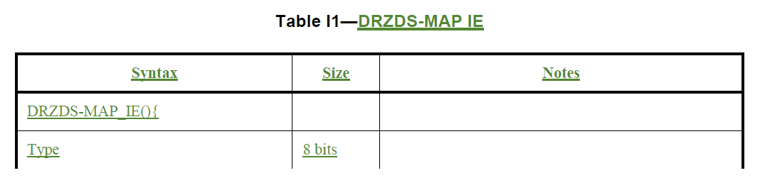
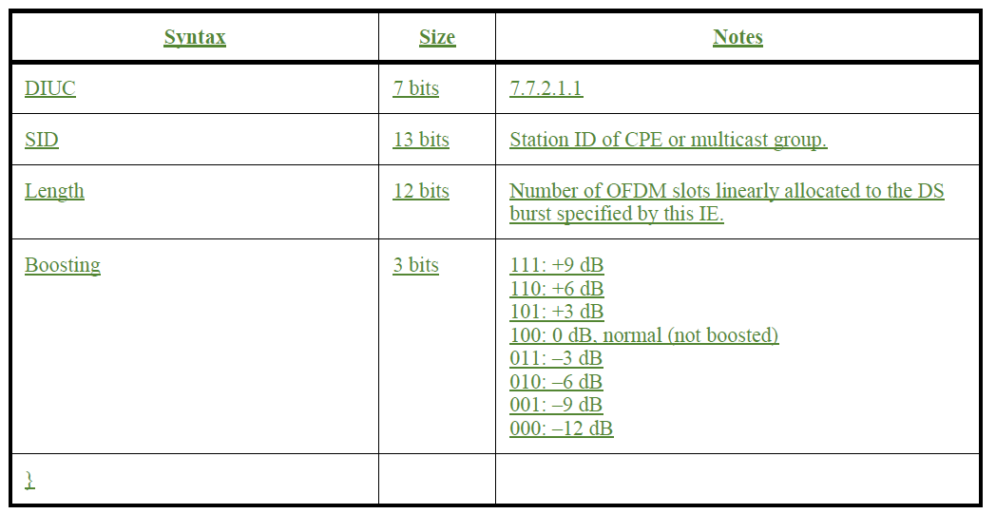
DRZDS-MAP IE
  No Extended DIUC IE

Slide 8
Current Usage of MAP allocation
802.22 Frame
802.22b Frame
DS-MAP IE
DS-MAP IE (DIUC=62)
US-MAP IE
AZDS-MAP IE
CRZDS-MAP IE
DRZDS-MAP IE

Slide 9
Proposed Resolution
802.22b Frame
Proposed 802.22b Frame
DS-MAP IE (DIUC=62)
DS-MAP IE (DIUC=62)
AZDS-MAP IE
Extended DS-MAP IE
CRZDS-MAP IE
DRZDS-MAP IE

Slide 10
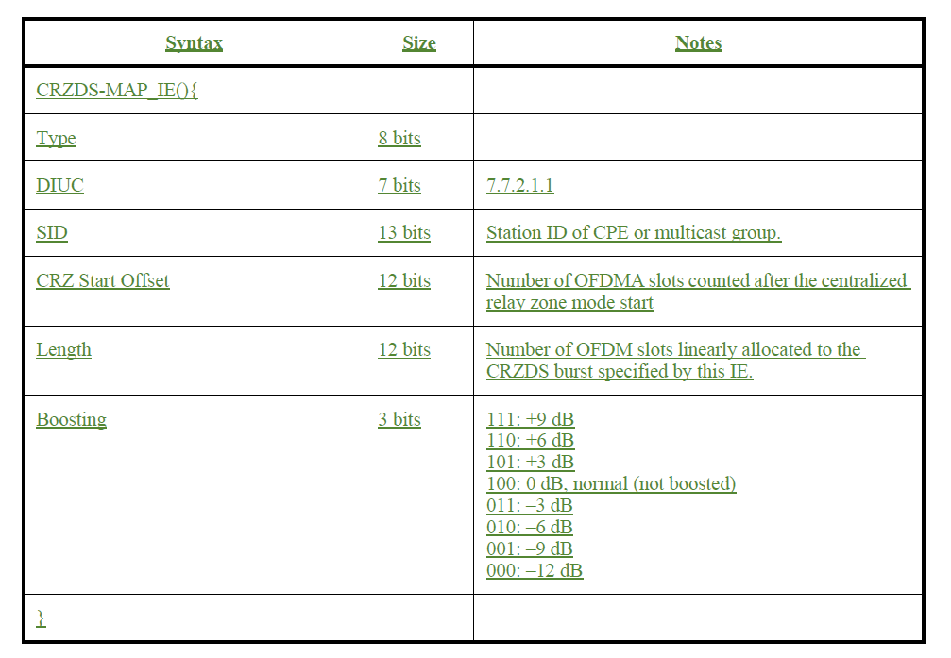
Extended DS MAP IE
Extended DS MAP IE
This field is only used when centralized relay zone is available, if not it shall be ignored

