Slide 1
Comment Resolution related to
Data Rate on PHY Mode 2 (CID 162)
IEEE P802.22 Wireless RANs Date: 2014-03-18
Authors:
Notice: This document has been prepared to assist IEEE 802.22. It is offered as a basis for discussion and is not binding on the contributing individual(s) or organization(s). The material in this document is subject to change in form and content after further study. The contributor(s) reserve(s) the right to add, amend or withdraw material contained herein.
Release: The contributor grants a free, irrevocable license to the IEEE to incorporate material contained in this contribution, and any modifications thereof, in the creation of an IEEE Standards publication; to copyright in the IEEE’s name any IEEE Standards publication even though it may include portions of this contribution; and at the IEEE’s sole discretion to permit others to reproduce in whole or in part the resulting IEEE Standards publication. The contributor also acknowledges and accepts that this contribution may be made public by IEEE 802.22.
Patent Policy and Procedures: The contributor is familiar with the IEEE 802 Patent Policy and Procedures
<http://standards.ieee.org/guides/bylaws/sb-bylaws.pdf>, including the statement "IEEE standards may include the known use of patent(s), including patent applications, provided the IEEE receives assurance from the patent holder or applicant with respect to patents essential for compliance with both mandatory and optional portions of the standard." Early disclosure to the Working Group of patent information that might be relevant to the standard is essential to reduce the possibility for delays in the development process and increase the likelihood that the draft publication will be approved for publication. Please notify the Chair Apurva Mody <apurva.mody@ieee.org> as early as possible, in written or electronic form, if patented technology (or technology under patent application) might be incorporated into a draft standard being developed within the IEEE 802.22 Working Group. If you have questions, contact the IEEE Patent Committee Administrator at <patcom@ieee.org>.

Slide 2
Comment Resolution related to Data Rate on PHY Mode2 (CID 162)
ID | Comment | Suggested Remedy
162 | In the Table AV1, the data rate and spectral efficiency is under the SISO and single channel operation. | Update the data rate and spectral efficiency considering the MIMO and multi-channel operation.
Proposed Resolution:
Proposed Tables AV1 and AZ1 are shown in the following 2 slides.

Slide 3
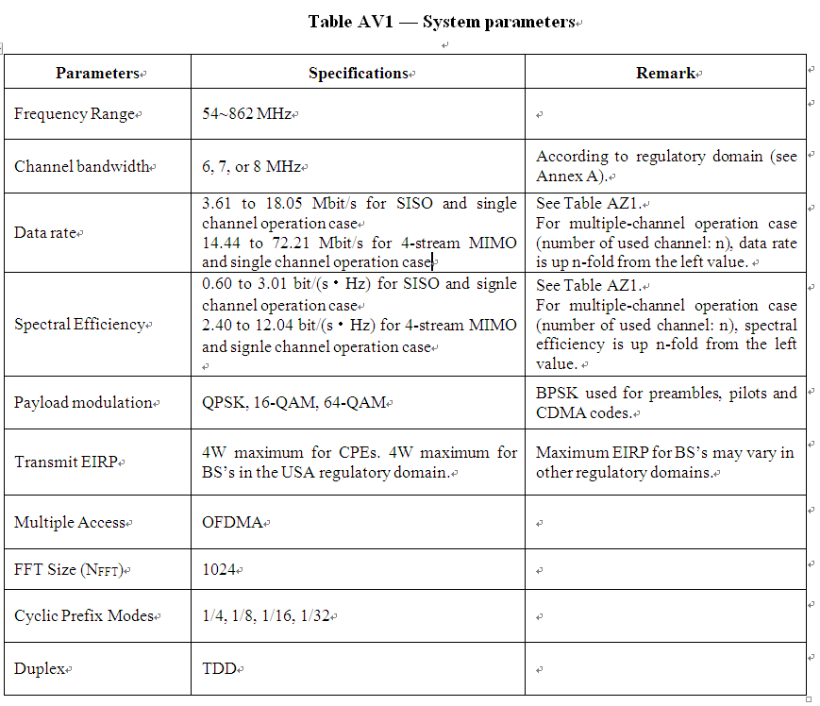

Slide 4
