Slide 1
Comment Resolution related to
Coexistence
IEEE P802.22 Wireless RANs Date: 2014-3-14
Authors:
Notice: This document has been prepared to assist IEEE 802.22. It is offered as a basis for discussion and is not binding on the contributing individual(s) or organization(s). The material in this document is subject to change in form and content after further study. The contributor(s) reserve(s) the right to add, amend or withdraw material contained herein.
Release: The contributor grants a free, irrevocable license to the IEEE to incorporate material contained in this contribution, and any modifications thereof, in the creation of an IEEE Standards publication; to copyright in the IEEE’s name any IEEE Standards publication even though it may include portions of this contribution; and at the IEEE’s sole discretion to permit others to reproduce in whole or in part the resulting IEEE Standards publication. The contributor also acknowledges and accepts that this contribution may be made public by IEEE 802.22.
Patent Policy and Procedures: The contributor is familiar with the IEEE 802 Patent Policy and Procedures
<http://standards.ieee.org/guides/bylaws/sb-bylaws.pdf>, including the statement "IEEE standards may include the known use of patent(s), including patent applications, provided the IEEE receives assurance from the patent holder or applicant with respect to patents essential for compliance with both mandatory and optional portions of the standard." Early disclosure to the Working Group of patent information that might be relevant to the standard is essential to reduce the possibility for delays in the development process and increase the likelihood that the draft publication will be approved for publication. Please notify the Chair Apurva Mody <apurva.mody@ieee.org> as early as possible, in written or electronic form, if patented technology (or technology under patent application) might be incorporated into a draft standard being developed within the IEEE 802.22 Working Group. If you have questions, contact the IEEE Patent Committee Administrator at <patcom@ieee.org>.

Slide 2
Comment Resolution related to MAC Frame (CID 87)
ID | Comment | Suggested Remedy
3 | less explanation for self-coexistence mechanism between Mode 1 and Mode 2, at this paragraph needs more clear explanation what is difference of self-coexistence mechanism between Mode 1 and Mode2 | Problem explaned in contribution 22-13-0142/r0

Slide 3
        Discussion on 802.22-13-0142r0
Agree with the advantage and disadvantage discussion between SCH and Extended FCH
The 802.22b Draft is not intended to remove SCH
  SCH still exists in PHY Mode 1, this provides compatibility of the legacy 802.22 standard
  Extended FCH is only used in PHY Mode 2, this provides much flexibility of coexistence operations

Slide 4
Coexistence in 802.22b
Coexistence in PHY Mode 1
  No change from 802.22 Standard, then it worked based on Legacy 802.22 Standard.
  SCH and CBP
Coexistence in PHY Mode 2
  Instead of using SCH, Extended FCH (Ex-FCH) is defined for coexistence
  Extended FCH includes all items of coexistence defined in SCH
The 802.22b Draft does not support coexistence between the different PHY modes of 1 and 2 due to no compatibility between the PHY modes

Slide 5
Structure comparison
Frame Structure – PHY Mode 1
Parameters are held during super-frame duration
Robust preamble
Frame Structure – PHY Mode 2
Parameters can change during super-frame duration

Slide 6
Coexistence Operations
Coexistence Operations
  PHY Mode 1
    SCH : Fixed in Superframe Duration
    CBP : Includes SCH and transmit in Self-Coexistence Window
  PHY Mode 2
    Extended FCH (Ex-FCH) : On-demand in Frame by Frame
    CBP : includes Ex-FCH and transmit in Self-Coexistence window

Slide 7
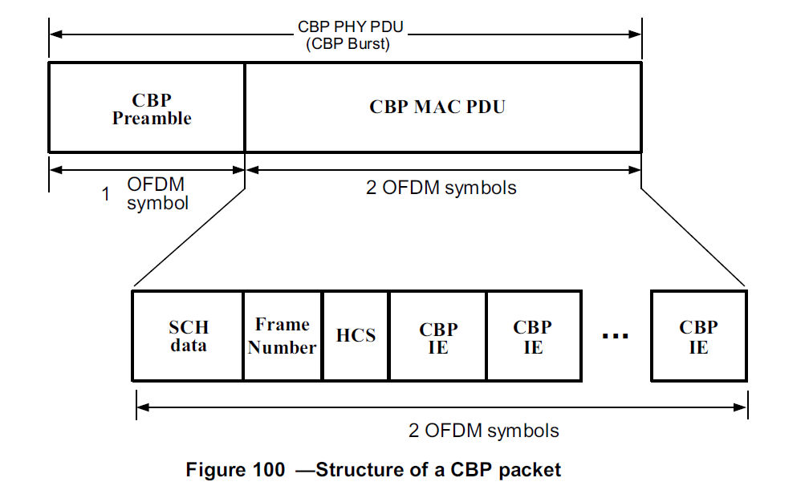
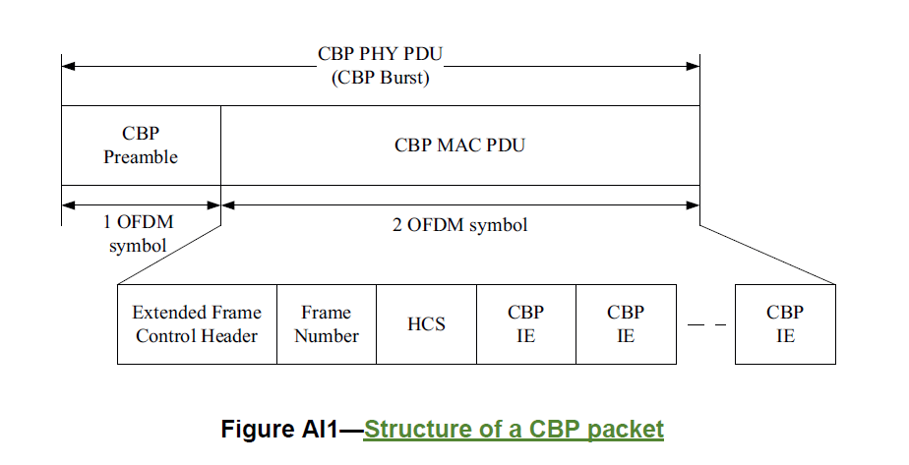
CBP Frame Format
PHY Mode 1
PHY Mode 2
CBP Frame Format is the most same between PHY Mode 1 and Mode 2 except for transmitting SCH in PHY Mode 1 and Ex-FCH in PHY Mode 2

Slide 8
Proposed Resolution
Add the following sentence in 7.20 Self-Coexistence
  On PHY Mode 1, an MR-WRAN runs in normal mode by default and transits to self-coexistence mode when the MR-WRAN can detect and decode an SCH or a CBP burst (Figure 100) from an adjacent MR-WRAN cell.
  On PHY Mode 2, an MR-WRAN runs in normal mode by default and transits to self-coexistence mode when the MR-WRAN can detect and decode an Extended Frame Control Header (Ex-FCH) or a CBP burst (Figure AI1) from an adjacent MR-WRAN cell.

