Slide 1


22-14-0070-00-0000
IEEE 802.22 WG on Cognitive Radio Based Spectrum Sharing and Wireless Regional Area Networks
IEEE 802.22 WG is the recipient of the IEEE SA Emerging Technology Award
IEEE 802.22 Standard – Wireless Regional Area Networks: Cognitive Radio based Access in TVWS
IEEE SA awards ceremony
802.22 Revision Project for Bands where Spectrum Sharing is Allowed
WG Letter Ballot
802.22.1 – Std for Enhanced Interference Protection using beaconing
802.22.2 – Std for Recommended Practice for Deployment of 802.22 Systems
802.22a – Enhanced Management Information Base and Management Plane Procedures
802.22b Enhancement for Broadband Services and Monitoring Applications
802.22.1 Revision – Advanced Beaconing
NEW!! Spectrum Occupancy Sensing (SOS) Study Group
32 Voting Members
11 Ex-officio, 2 Aspirants

Slide 2
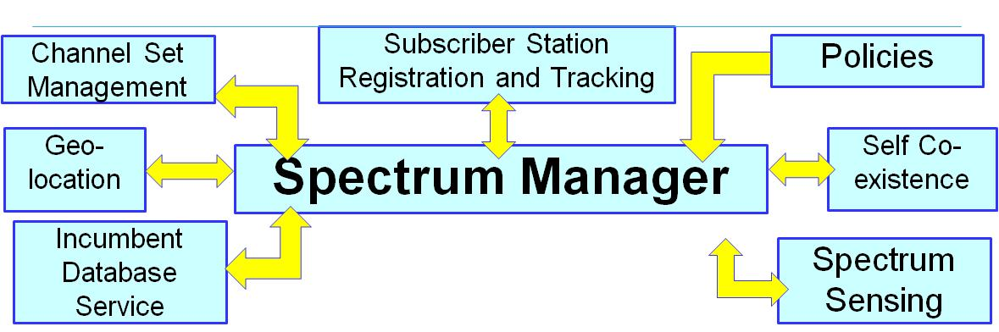
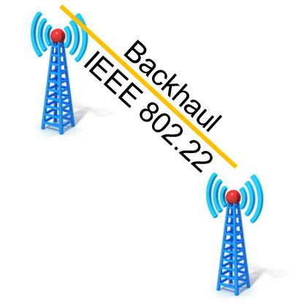
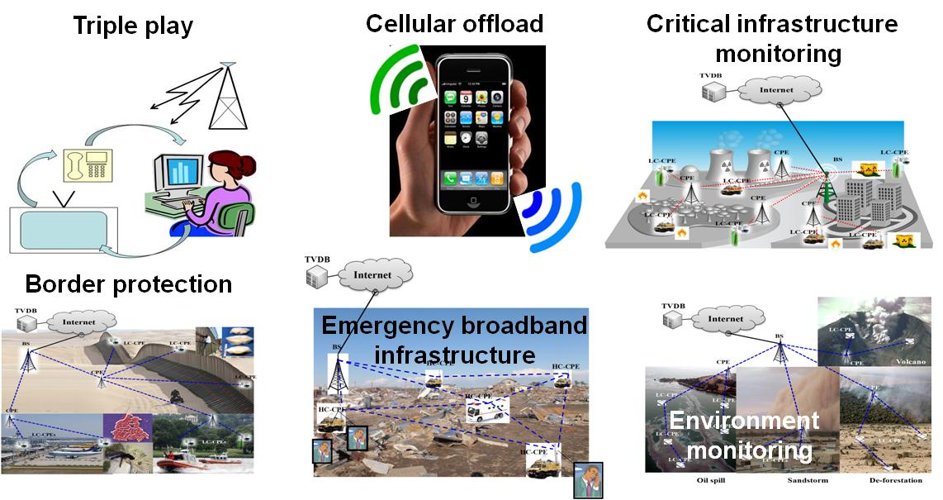
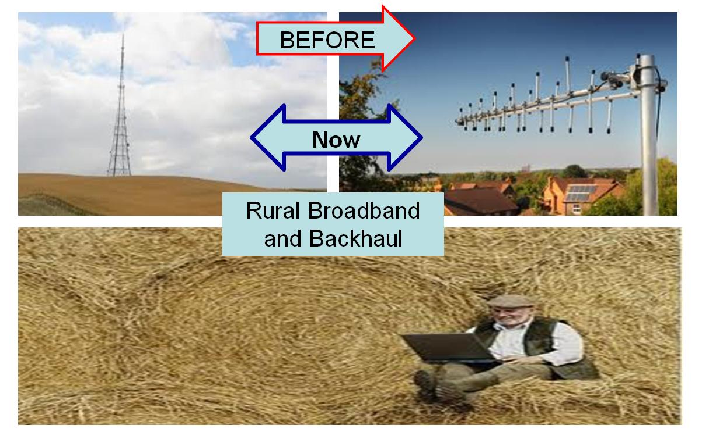
IEEE 802.22 (Wi-FAR™) Operation and Applications
Cognitive Radio Operation
Rural Broadband and Backhaul
IEEE 802.22 can support many other applications such as smart grid, wireless access to oil rigs as well as remote medical services
Source: WhiteSpace Alliance. www.WhiteSpaceAlliance.org

Slide 3
IEEE 802.22 WG Agenda for the May 2014 Interim Meeting

