Slide 1
A distributed spectrum monitoring system
Authors:
Name | Company | Address | Phone | email
Roger Hislop | Internet Solutions | 57 Sloane St Bryanston | +27115751000 | roger.hislop@is.co.za
Notice: This document has been prepared to assist IEEE 802.22. It is offered as a basis for discussion and is not binding on the contributing individual(s) or organization(s). The material in this document is subject to change in form and content after further study. The contributor(s) reserve(s) the right to add, amend or withdraw material contained herein.
Release: The contributor grants a free, irrevocable license to the IEEE to incorporate material contained in this contribution, and any modifications thereof, in the creation of an IEEE Standards publication; to copyright in the IEEE’s name any IEEE Standards publication even though it may include portions of this contribution; and at the IEEE’s sole discretion to permit others to reproduce in whole or in part the resulting IEEE Standards publication. The contributor also acknowledges and accepts that this contribution may be made public by IEEE 802.22.
Patent Policy and Procedures: The contributor is familiar with the IEEE 802 Patent Policy and Procedures http://standards.ieee.org/guides/bylaws/sb-bylaws.pdf including the statement "IEEE standards may include the known use of patent(s), including patent applications, provided the IEEE receives assurance from the patent holder or applicant with respect to patents essential for compliance with both mandatory and optional portions of the standard." Early disclosure to the Working Group of patent information that might be relevant to the standard is essential to reduce the possibility for delays in the development process and increase the likelihood that the draft publication will be approved for publication. Please notify the Chair
Apurva Mody <apurva.mody@ieee.org> as early as possible, in written or electronic form, if patented technology (or technology under patent application) might be incorporated into a draft standard being developed within the IEEE 802.22 Working Group. If you have questions, contact the IEEE Patent Committee Administrator at patcom@iee.org.

Slide 2
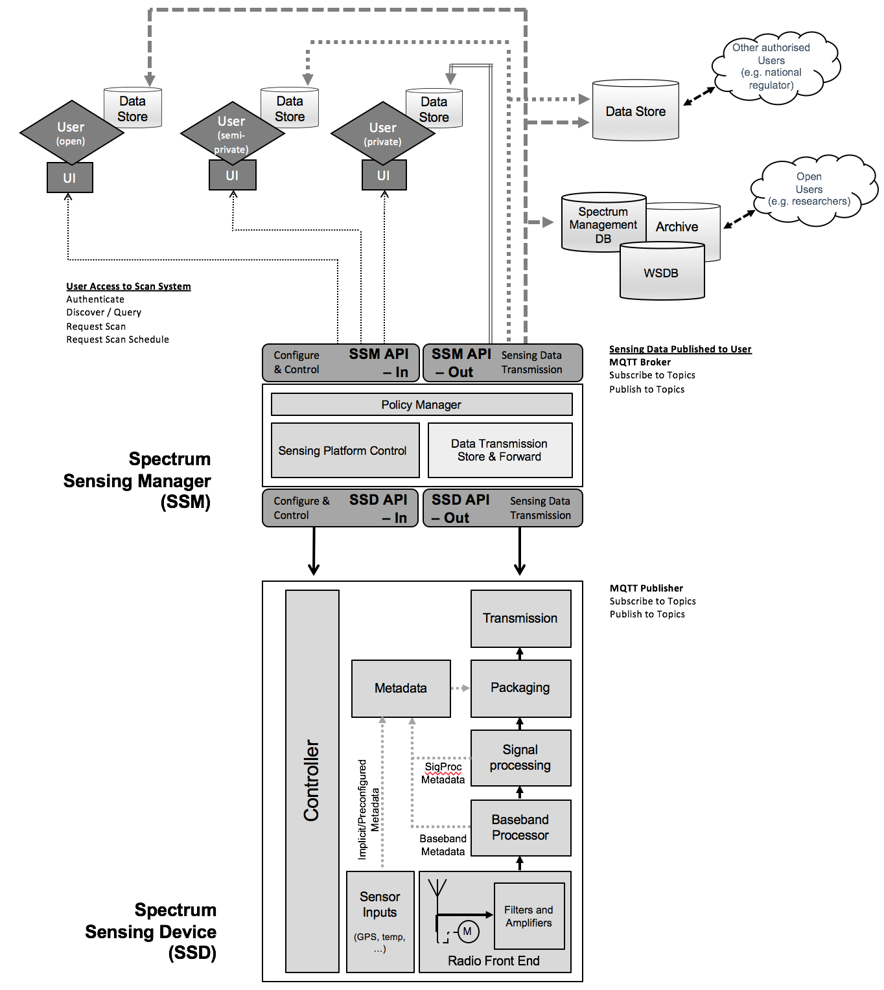
SCOS Architecture

Slide 3
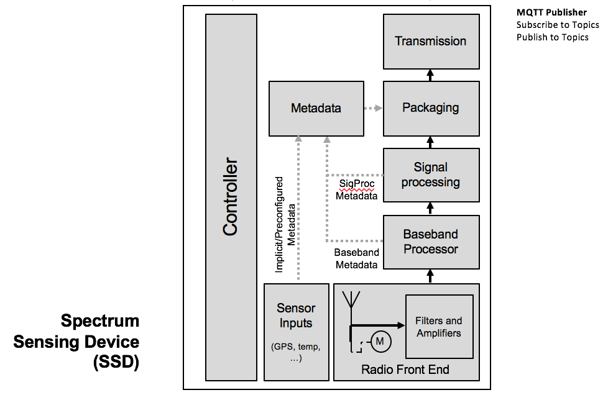
Detail of SSD

Slide 4
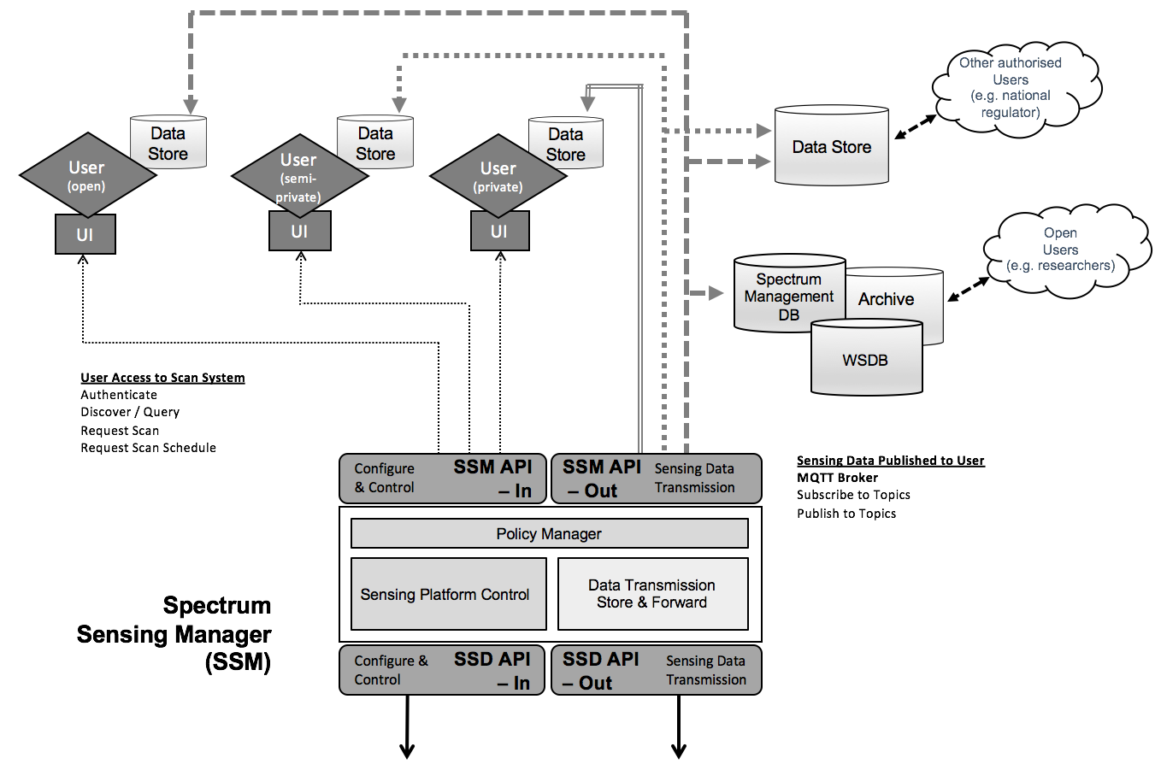
Detail of SSM and Users

Slide 5
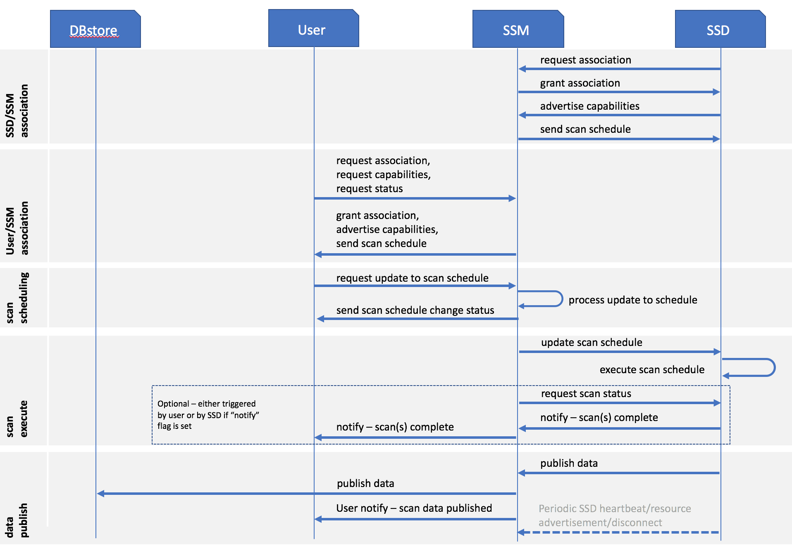
Message Flow

Slide 6
Fundamental Design Considerations
The main area of focus is how we abstract the layers between user, sensor management, sensor device, and sensed data.
The intention is to make it very flexible, and use as much of the tech that’s already well developed:
Distributed/Cloud-based data storage and processing
Ubiquitous public shared networks (Internet, GSM)
Low cost open computer platforms
Low cost RF receivers and SDRs

Slide 7
Put as much in the Cloud as possible
Every part of the architecture can be hosted on a VM or even Code-as-a-Service – apart from the sensing front end itself.
The sensor could be a simple embedded device that meets basic requirement of standard...
…or better, it should contain a computing platform (e.g. Linux-based computer board) that allows on-the-fly changes in sensor capabilities (e.g. pushing a processing algorithm to it) and autonomous activity

Slide 8
Design Thinking
We have no idea how the hardware tech will develop –SDRs, antenna, processing power of devices… or the use cases and user requirements.
The intent of the standard is to not enforce sensing hardware capabilities.
Collect data as to when and how sensing was done, the user must interpret it.
All scans have associated metadata describing the requestor, device capabilities, current configuration, environment, etc.
Sensing hardware capabilities reported in discovery process` to user. User decides on scan type/schedule, and requests it to be done.
This “package” of scan data + metadata is sent to a data store(s) – where user retrieves it and interprets.

Slide 9
Purpose
Regulation/enforcement activities
Interference detection, classification, location
Drive low cost sensing into White Space radio/CR
Spectrum planning

Slide 10
Where P1900.6 group can help
There are people in this group that could bring a lot to the table in this new IEEE 802 standard:
Distributed, future proof: Defining APIs, making the architecture Cloud-centric
Mass deployment: Understanding parameterising the tech of low cost sensor hardware
Consistency in metrics: Ensure the data collected allows users to compare apples and apples, and what kind of apples they’re getting.

Slide 11
Thank you roger.hislop@is.co.za

