Slide 1
Utility Applications of TSN
Tim Godfrey (EPRI)

Slide 2
802.24 Overview
802.24 Vertical Applications TAG
802.24.1 Smart Grid TG
802.24.2 IoT TG
802.24.1 Smart Grid Task Group
  Internal / external coordination in matters related application of IEEE 802 standards for Smart Grid
  802.24.1 TG meets at Plenaries and Wireless Interims
802.24.2 IoT Task Group
  Internal / external coordination in matters related application of IEEE 802 standards for Internet of Things (IoT)
  802.24.2 TG meets at Plenaries and 802 Interims

Slide 3
Presentation Objectives
To introduce 802.24 structure and activities
To identify utility applications that could potentially benefit from TSN
To discuss whether an 802.24 white paper on the topic would be
  A) Useful
  B) Supported by participation from 802.1 TSN members

Slide 4
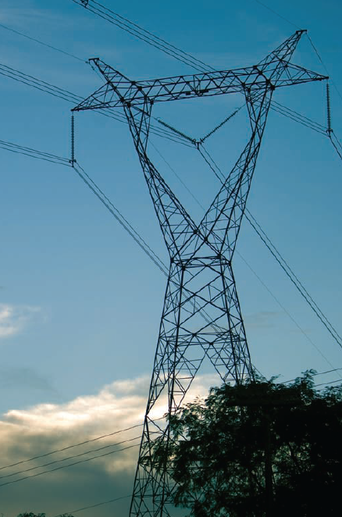
Transmission: Protection
Telecom Requirements
Reliability: Highest
  Essential for line current differential protection
  Redundancy may be used
Latency: Very low – a few mS typically
  Some systems can compensate for delay if delay is constant.

Slide 5

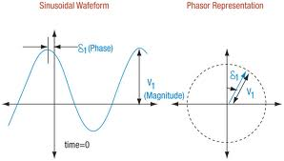
Transmission: Synchrophasors
Telecom Requirements
Reliability: Medium-High
  Each PMU is part of a network and provides data for a specific location.
Bandwidth: High
  Depends on repetition rate of measurements – can be Mbps
Latency: Sub-cycle time precision required. Limited delay compensation by time stamping packets

Slide 6
One researcher finds a need for TSN
Effects of Bursty Event Traffic on Synchrophasor Delays in IEEE C37.118, IEC61850, and IEC60870
  Wu, Nordstrom, Bakken
  IEEE SmartGridComm 2015
OpNet simulation of substation network environment combining protection event messages (IEC 61850 GOOSE), control center SCADA (IEC60870-5-104), and Synchrophasor data (IEEE C37.118)
Summary conclusion – Although the average data load can easily be accommodated with 100 Mbps Ethernet, under certain event conditions, application requirements are not met
Notes:
file:///C:/Data/Docs/EPRI/Technology%20Scouting/2015-11-02%20IEEE%20SmartGridComm/Proceedings/ieeesmartgridcomm15/papers/p483-wu.pdf

Slide 7
Discussion
Current status is lack of awareness of TSN in utility market
In cases where any deterministic solutions are employed, they are proprietary.
Would 802.1 TSN be interested in contributing to the development of an 802.24 white paper on how TSN can address utility application requirements for
  Substations LANs
  Protection
  Synchrophasors
  Others?

