Slide 1
802.24 Vertical Applications TAG
IEEE 802 Workshop Program
May 12, 2017
Daejeon, Korea

Slide 2
Scope of the 802.24 TAG
The IEEE 802.24 Vertical Applications TAG focuses on application categories that use IEEE 802 technology and are of interest to multiple IEEE 802 WGs and have been assigned to IEEE 802.24 by the IEEE Executive Committee.

Slide 3
802.24 Overview
802.24 Vertical Applications TAG
802.24.1 Smart Grid TG
802.24.2 IoT TG
802.24.1 Smart Grid Task Group
  Internal / external coordination in matters related application of IEEE 802 standards for Smart Grid
  802.24.1 TG meets at Plenaries and Wireless Interims
802.24.2 IoT Task Group
  Internal / external coordination in matters related application of IEEE 802 standards for the
  Internet of Things (IoT)
  802.24.2 TG meets at Plenaries and all-802 Interims

Slide 4
802.24 Membership
Technical Advisory Group Officers
  TAG Chair: Tim Godfrey
  Secretary & TAG Vice Chair: Ben Rolfe
Task Groups and chairs
  802.24.1 Smart Grid TG Tim Godfrey
  802.24.2 IoT TG Chris DiMinico
34 Voting Members

Slide 5
802.24 History
Formed in 2012 as the Smart Grid TAG
In 2014 the scope was expanded to “Vertical Applications TAG”, and a process was defined to initiate new Task Groups (TG)
  A Vertical Application is one that involves standards developed by multiple IEEE 802 working groups
The Smart Grid topic was designated TG 24.1
A new Task Group was started for the Internet of Things (IoT) in March 2015, and designated TG 24.2

Slide 6
Smart Grid Task Group Activities
Key Focus
  Develops white papers, presentations and other documents that do not require a PAR that describe the application of IEEE 802 standards to Smart Grid applications
  Acts as a point of contact for industry organizations and alliances for questions regarding the use of IEEE 802 standards in Smart Grid applications.
  Acts as a resource and knowledge base on IEEE 802 standards for certification efforts by industry bodies that require more than one IEEE 802 WG’s input.
  Identify technology gaps in Smart Grid communications and recommend standardization tasks to the appropriate IEEE 802 WG.
Liaisons
  IEEE P2030.5 Smart Energy Profile WG
  IEEE Power Engineering Society Power System Communications and Cyber Security (PSCC) committee
  Wi-SUN
  ZigBee Alliance

Slide 7

Smart Grid Task Group Activities
White Paper (2014)
  IEEE 802 Standards for Smart Grid
Companion Presentation (2016)
  802.24 Smart Grid White Paper Companion Presentation

Slide 8
Smart Grid Task Group Activities
Response to REPORT ITU-R SM.2351-0 “Smart grid utility management systems”
  Initial report did not represent IEEE 802 standards as actually used in industry
  Response was developed in 802.24, and forwarded back to ITU-R through 802.18 Radio Regulatory TAG, where it was accepted.

Slide 9
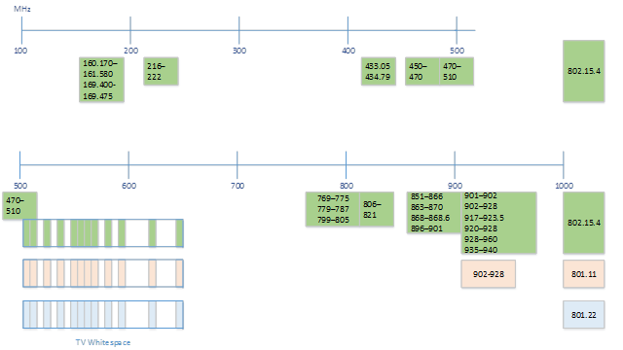
Smart Grid Task Group Activities
IEEE 802 Standards for operation in sub-1GHz bands
  Sub-1GHz White Paper (2016)

Slide 10
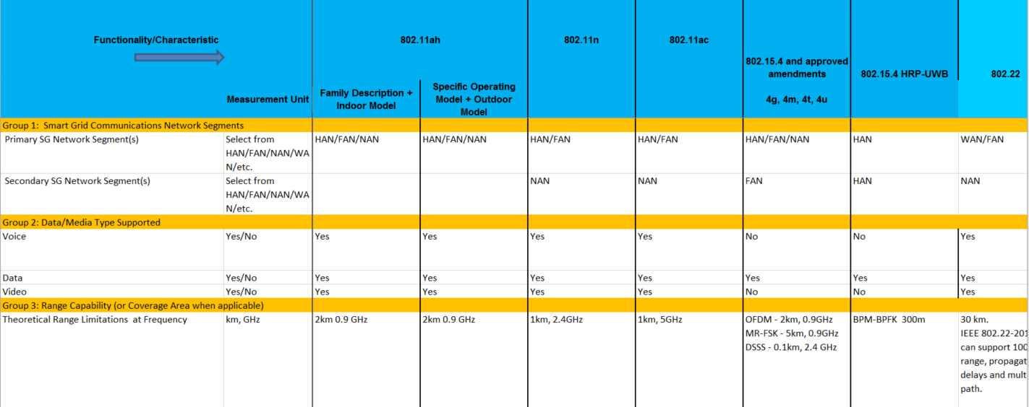
Smart Grid Task Group Activities
Updating of Wireless Characteristics Matrix
  Annex to NISTIR 7761 rev 1

Slide 11
IoT Task Group Activities
Key Focus
  Develops white papers, presentations and other documents that do not require a PAR that describe the application of IEEE 802 standards to identified IoT vertical applications.
  Identify technology gaps in selected IoT vertical applications and recommend standardization tasks to the appropriate IEEE 802 Working Group.
  Provide forum for liaison activities with industry organizations, other SDOs, government agencies, IEEE societies, etc. in identified IoT vertical applications.
  Maintain consistency with IoT architecture framework in development in IEEE P2413.
Liaisons Established
  IEEE P2413 IoT Architecture
  Industrial Internet Consortium (IIC)
  OPC (OLE for Process Control) Foundation - data interchange for manufacturing and process control

Slide 12
IoT Task Group Activities
Identified IoT vertical applications have broad applicability across numerous users and multiple vendors.
  Industrial Automation
  Data Center Management
  Security/Video Networks: Wireless & Wired
  Building Automation
  Automotive
  Sensors/Monitoring

Slide 13
IoT Task Group Activities
White Paper Outline
  24-15-0036-01-IoTg
  (Fig. 1 - IoT landscape)

Slide 14
IoT Task Group Activities
IEC SG 9 Communication Technologies
  Relationship to IEEE 802 standards
    from 24-15-0036-01-IoTg
Area | IEC | IEEE 802 Standards
Time Sensitive Networking | TC 9, TC 57, TC 65, TC 100 | 802.1, 802.3
LP-WAN technologies |  | 802.15.4
Wireless Coexistence | IEC 62675-2 | 802.19
5G Technologies |  | 802.11
Smart Manufacturing | IEC SG8 I4.0 | 802.11, 802.15.4
Smart Cities | SEG1 | 802.11, 802.15.4
Wearable Smart Devices | SG10 | 802.15

