Slide 1
802.24 Vertical Applications TAG
Internet Practice and IoT, and position and vision of IEEE activities
January 2018 Meeting
Irvine, CA, USA

Slide 2
Scope
Intent is to review in 802.24 TAG, current internet practices, its applicability on IoT, and, think about need to make proposal to review vision of IEEE technologies, their objectives and targets to efficiently join Internet value chain.

Slide 3
Internet and IoT definition
Internet definition (dictionary.com)
a vast computer network linking smaller computer networks worldwide (usually preceded by the). The Internet includes commercial, educational, governmental, and other networks, all of which use the same set of communications protocols.
Iot definition (dictionary.com)
a network of everyday devices, appliances, and other objects equipped with computer chips and sensors that can collect and transmit data through the Internet.
But, is it true for common people understanding?
In this presentation, to be compliant with thoughts of common people I am adding definition of Great Internet
It is collection of all communication, services and values what user get when is connected.

Slide 4

(Great) Internet
Applications & Data
API (Application Interface) & platforms
Services, (payment, medical, administration, ...)
Cloud/Fog Computing, Big Data/Data mng & storage,
High level protocols: HTTP/HTTPS/COAP/COAPS,
TLS/DTLS, TCP/IP, IPSEC,...
Communication: Ethernet, Wifi, Bluetooth, Fiber,
Mobile & Satellite communications, ...
Servers/Server farms, Routers, Base stations, Satelites
SDN, NFV,
...

Slide 5
(Great) Internet treasure
Communications provide reliable, efficient and secure transport of data
Data technologies (Cloud, Big Data, ...) are in application area
Powerful established service background ( FaaS, BaaS, PaaS, NaaS, ... )
Security by design
Connectivity by design
Native simplicity
Possibility to scale, update and upgrade
Interoperability by design
Vertical compatibility
Applications are separated from devices and from communications
Users get value from data collection, storage, manipulation and delivery
Cost optimized
Compatibility with well accepted standards
Artificial intelligence solutions
Scalable feature extensions
Numerous drivers for future developments using treasure of Internet solutions
...

Slide 6
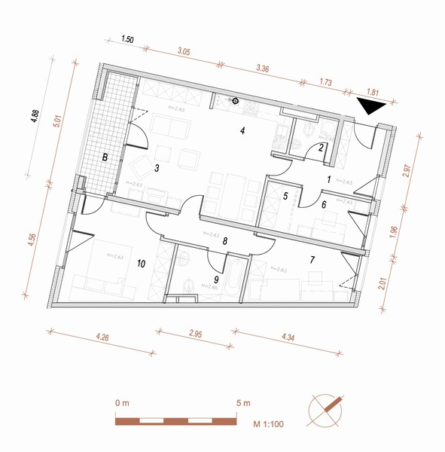
Connected Devices –
Traditional IoT vs Application Oriented Internet approach
– use case: heating, illumination, alarm and extension option
traditional | scope | REST
30 | Sensors | 10
3 | Gateways | 0
0 | Possible Extensions | No limit
3 | Possible Apps | No limit
- | Experience | +
no | Value chain | yes
out | App Developers | in
n.a. | Infrastructure | yes
long | Time to market | short
 | ...
Illumination sensor
Alarm sensor
thermometer
Universal sensor – presence, luminosity, temperature
Controller and gateway for illumination
Just simple router (Ethernet – 1.4 )
Controller and gateway for alarm
Controller and gateway for heating

Slide 7
Internet headings
Concerns about internet
Future of Internet
  Centralization vs decentralization
  Speed is enormous
  Ethics
  Areas of development
  Opening for other technologies
When future will come
Internet thoughts as engineers and citizens
Enabling blue ocean business possibilities and models
Trust and Feeling of final users of internet services
.......

Slide 8
Discussion

