Slide 1
IEEE 802.24 Vertical Applications Technical Advisory Group
DCN: 24-19-0016-00-0000
Title: VR Display Specs & Video Bandwidth Requirements
Date Submitted: July 03, 2019
Presented at IEEE 802.24 in Vienna, Austria
Authors or Source(s):
BeomRyeol Lee (ETRI, lbr@etri.re.kr)
Dong Il Dillon Seo (JoyFun, dillon@joyfun.kr)
Sangkwon Peter Jeong (JoyFun, ceo@joyfun.kr)
Abstract: This contribution document explains why VR industry receives a lot of attention and why IEEE 3079 is required to take the industry to the next level

Slide 2
  IEEE 802.21 presentation release statements
This document has been prepared to assist the IEEE 802.21 Working Group. It is offered as a basis for discussion and is not binding on the contributing individual(s) or organization(s). The material in this document is subject to change in form and content after further study. The contributor(s) reserve(s) the right to add, amend or withdraw material contained herein.
The contributor grants a free, irrevocable license to the IEEE to incorporate material contained in this contribution, and any modifications thereof, in the creation of an IEEE Standards publication; to copyright in the IEEE’s name any IEEE Standards publication even though it may include portions of this contribution; and at the IEEE’s sole discretion to permit others to reproduce in whole or in part the resulting IEEE Standards publication. The contributor also acknowledges and accepts that this contribution may be made public by IEEE 802.21.
The contributor is familiar with IEEE patent policy, as outlined in Section 6.3 of the IEEE-SA Standards Board Operations Manual <http://standards.ieee.org/guides/opman/sect6.html#6.3> and in Understanding Patent Issues During IEEE Standards Development http://standards.ieee.org/board/pat/guide.html>
  IEEE 802.24 presentation release statements
This document has been prepared to assist the IEEE 802.24 Working Group. It is offered as a basis for discussion and is not binding on the contributing individual(s) or organization(s). The material in this document is subject to change in form and content after further study. The contributor(s) reserve(s) the right to add, amend or withdraw material contained herein.
The contributor grants a free, irrevocable license to the IEEE to incorporate material contained in this contribution, and any modifications thereof, in the creation of an IEEE Standards publication; to copyright in the IEEE’s name any IEEE Standards publication even though it may include portions of this contribution; and at the IEEE’s sole discretion to permit others to reproduce in whole or in part the resulting IEEE Standards publication. The contributor also acknowledges and accepts that this contribution may be made public by IEEE 802.24.
The contributor is familiar with IEEE patent policy, as stated in Section 6 of the IEEE-SA Standards Board bylaws <http://standards.ieee.org/guides/bylaws/sect6-7.html#6> and in Understanding Patent Issues During IEEE Standards Development http://standards.ieee.org/board/pat/faq.pdf>

Slide 3
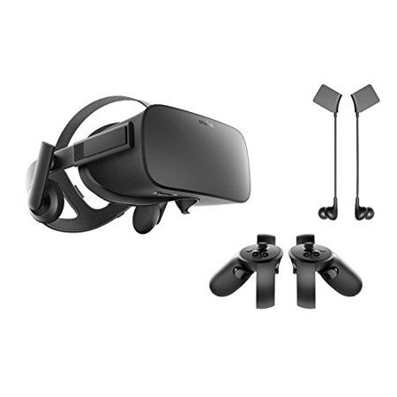
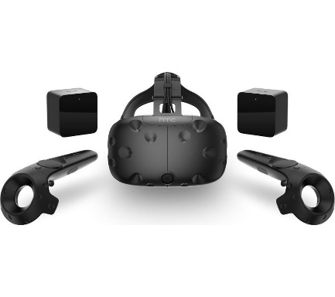
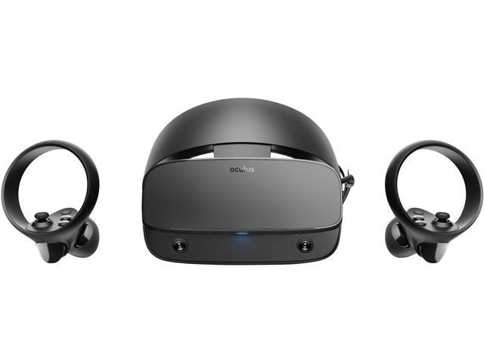
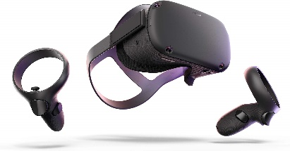
VR HMD Display Specifications
 |  | 1st Generation |  | 1.5 Generation | 2nd Generation
VR HMD |  | Oculus Rift | HTC Vive | Oculus Rift S | Oculus Quest
Resolution | Per Eye | 1080x1200 | 1080x1200 | 1280x1440 | 1440x1600
Resolution | Both | 2160x1200 | 2160x1200 | 2560x1440 | 2880x1600
Refresh Rate |  | 90 Hz | 90 Hz | 80 Hz | 72 Hz

Slide 4
VR HMD Display Considerations
Type: OLED vs LCD
  Pixel Change Time & Motion Blur
Pixel Structure: Pentile vs RGB
  Subpixels & Screen Door Effect
Resolution: Video Bandwidth Requirements
  Network Requirements
Refresh Rate: Flickering Effect
  Network Requirements
VR Sickness

Slide 5
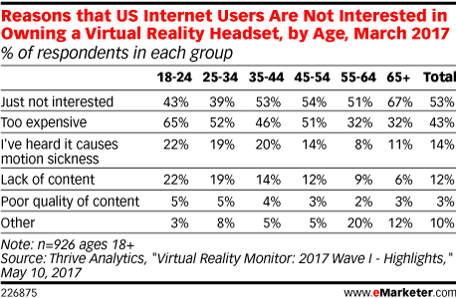
Reason to Reduce VR Sickness
Main VR consumers (age between 18 and 44 takes 59%) are reluctant to own a VR HMD because of VR Sickness

Slide 6
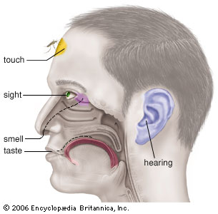
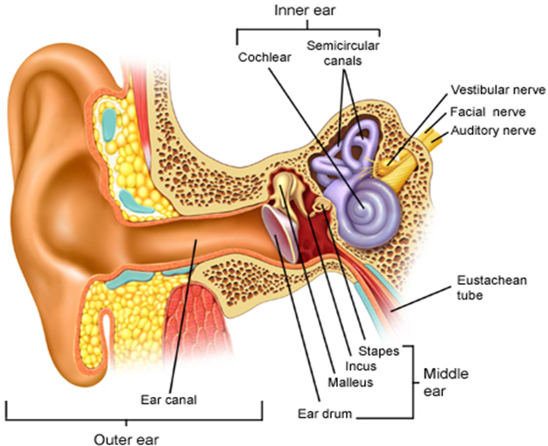
VR Sickness = Sensory Conflict
Current VR HMD focuses on Visual & Audio Sensory System
Mismatch of information in vestibular system

Slide 7
Suggested VR Sickness Solution
Technicolor, Oct. 2016 (m39532, MPEG 116th Meeting)
Requirement | Details
pixels/degree | - 40 pix/deg - no HMD is capable of displaying 40pix/deg today
video resolution | - 3 times 4K(3840x1920) vertical resolution = 11,520x6,480
framerate | - 90 FPS - a 90 FPS framerate offers a latency low enough to prevent nausea
3D Audio | - support of scene-based and/or environmental audio - 360 surround sound, object-based audio, Ambisonics
motion-to-photon latency & motion-to-audio latency | - how much time there is between the user interacts and an image / audio - maximum 20 ms
foreground & parallax | - objects in the foreground shall be far enough to prevent nausea - if objects are too close it is likely they can become an important cause of nausea - interactive parallax with background shall be present for such objects

Slide 8
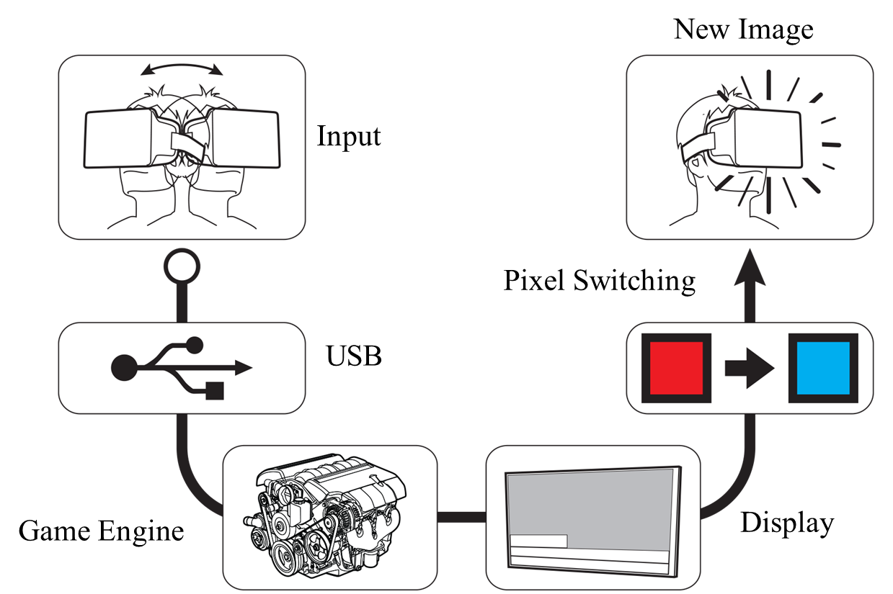


Motion to Photon Latency
90Hz OLED Display 11ms
※ MTP: Motion to Photon
1ms
Tracker
CPU
GPU
Display
Photons
Optics
Head motion
Under 20 milliseconds of latency for comfortability
User’s retina

Slide 9
MTP Latency Components
VR System
Total Motion-to-Photon Latency ≤20ms
HMD
Motion
Input
New Image
Output
①
1ms
⑦
Pixel
Switching
1ms
IMU
90Hz OLED Display 11ms
⑥
②
Write Display
⑤
Local Content Server
Data Processing Unit
2ms
Remote Content Server
③
④
Data Processing Unit
2ms

Slide 10
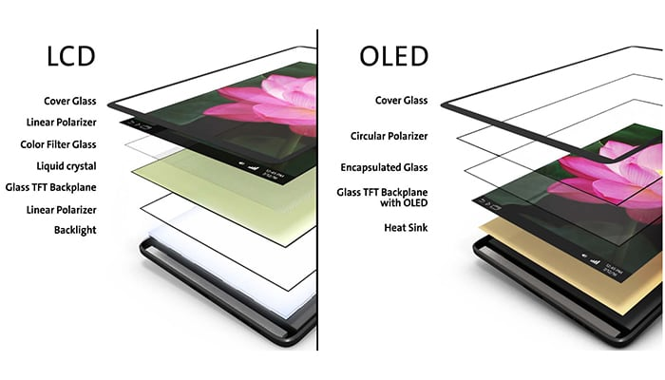

VR Display Types
OLED response time is faster
→ Lower MTP
Motion blur is more evident in LCD

Slide 11
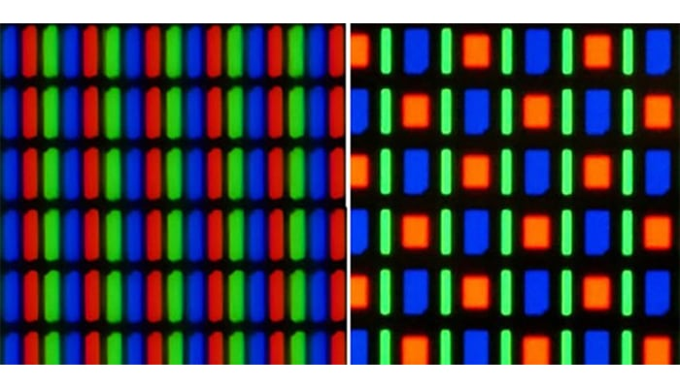

Pixel Structures
LCD (RGB)
OLED (RGBG) Pentile
Fish Eye Lens enlarges the screen size
Greater Subpixel space makes the screen door effect to be more evident

Slide 12






Resolution: Video Bandwidth
How to calculate Video Bandwidth from Display Resolution & Fresh Rate
Bandwidth = Resolution x Frame Rate x Color Depth
Pixel/Frame
Frame/Second
Bit
Bandwidth = $\frac{Pixel}{Frame}$ x $\frac{Frame}{Second}$x $\frac{Bit}{Pixel}$ = Bit/Second
Color Depth = 1 Bit = $2^{1} colors$
1 bit = 2 colors
2 bit = 4 color
4 bit = 16 colors
8 bit = 256 colors
24 bit = 16,777,216

Slide 13
Resolution: Bandwidth Requirements
<Uncompressed Video Data>
 |  | 1st Generation |  | 1.5 Generation | 2nd Generation
VR HMD |  | Oculus Rift | HTC Vive | Oculus Rift S | Oculus Quest
Resolution | Per Eye | 1080x1200 | 1080x1200 | 1280x1440 | 1440x1600
Resolution | Both | 2160x1200 | 2160x1200 | 2560x1440 | 2880x1600
Refresh Rate |  | 90 Hz | 90 Hz | 80 Hz | 72 Hz
Bandwidth |  | ~5.6Gb/s or ~700MB/s | ~5.6Gb/s or ~700MB/s | ~7.1Gb/s or ~885MB/s | ~8.0Gb/s or ~995MB/s
Display Cable |  | HDMI 1.3 | HDMI 1.3 | Mini Display Port 1.2 | N/A
HDMI 1.3 = Maximum Video Bandwidth is 8.16 Gb/s
HDMI 2.0 = Maximum Video Bandwidth is 18.0 Gb/s
HDMI 2.1 = Maximum Video Bandwidth is 48.0 Gb/s
Mini Display Port 1.2 = Maximum Video Bandwidth is 21.60 Gb/s

Slide 14
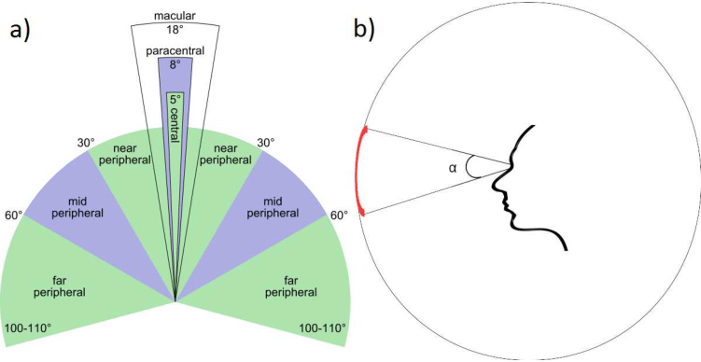

Refresh Rate: Flickering Effect
When using a low refresh rate display,
flickering effect around the peripheral vision becomes more evident

Slide 15
Summary
VR Display is selected based on the concept of reducing the MTP Latency
  For better UX, high resolution and high frame rate are required
  High resolution & high frame rate are required to reduce VR Sickness
  High resolution & high frame rate require high rendering capacity
  High rendering capacity, high resolution & high frame rate increase the VR HMD price
  VR HMD price needs to be cheaper in order to massively adopted
  Higher performance and lower price are inversely related
  Faster and more stable network can help the VR HMD price to decrease

