Slide 1
Licensed Narrowband Amendment
P802.16t PAR Presentation
Date: 2019-11-13
Author:

Slide 2
Goals of Amendment Project
A group of industry stakeholders have come together to support amending IEEE 802.16-2017 to:
  Provide support for narrower channels of operation
  Aggregate discontinuous narrowband spectrum.
This is needed to address operations in the smaller spectrum allocations that electric utilities and other critical infrastructure industries have access to
  The 802.16s amendment defined operation between 1.25 MHz and 100 kHz.
  This amendment will define operation to as narrow as 5 kHz channels
  The amendment will also define mechanisms to aggregate these smaller channels

Slide 3
Identified Task Group Participants
Tim Godfrey (EPRI)
Doug Gray (TCS)
Craig Tedrow (GE MDS)
Kathy Nelson (Ondas)
Menashe Shahar (Ondas)
Guy Simpson (Ondas)
Scott Schoepel (Motorola)
Anders Rendahl (Siemens)
Bob Saffari (Telewave)
Leonhard Korowajczuk (CelPlan)
Eugene Crozier (PowerTech Labs)
Bob Finch (Select Spectrum)
Klaus Bender (UTC)
Jerry Roberts (ENTELEC (Oil & Gas))
Tom Peters (WCC of AAR - Rail)
Robin Cohen (EWA two way users)
Mark Crosby (EWA)
Zach Smith (BNSF)
Rick Smith (Chevron)
Daoud Serang (CML Micro)
Lon Renner (Nebraska Public Power District)
Rich Hawkins (WiMAX Forum)

Slide 4
Supporters of IEEE P802.16t Amendment
BNSF
Great River Energy
Arizona Public Service
Tri-State G&T
Central Lincoln PUD
Cleco
Bay Electronics
NV Energy
Enterprise Products
Idaho Power
UTC (Utilities)
ENTELEC (Oil & Gas)
WCC of AAR (Rail)
EWA (two way users)
Chevron
Nebraska Public Power District
Connexus Energy
Herzog Technologies
Collins Aerospace
Centerpoint Energy

Slide 5
Supporters of IEEE P802.16t Amendment
Apache
Jagged Peak Energy
East River Electric
BC Hydro
Nashville Electric Service
Lee County Electric Cooperative
Dairyland Electric Cooperative
Puget Sound Energy
Others

Slide 6
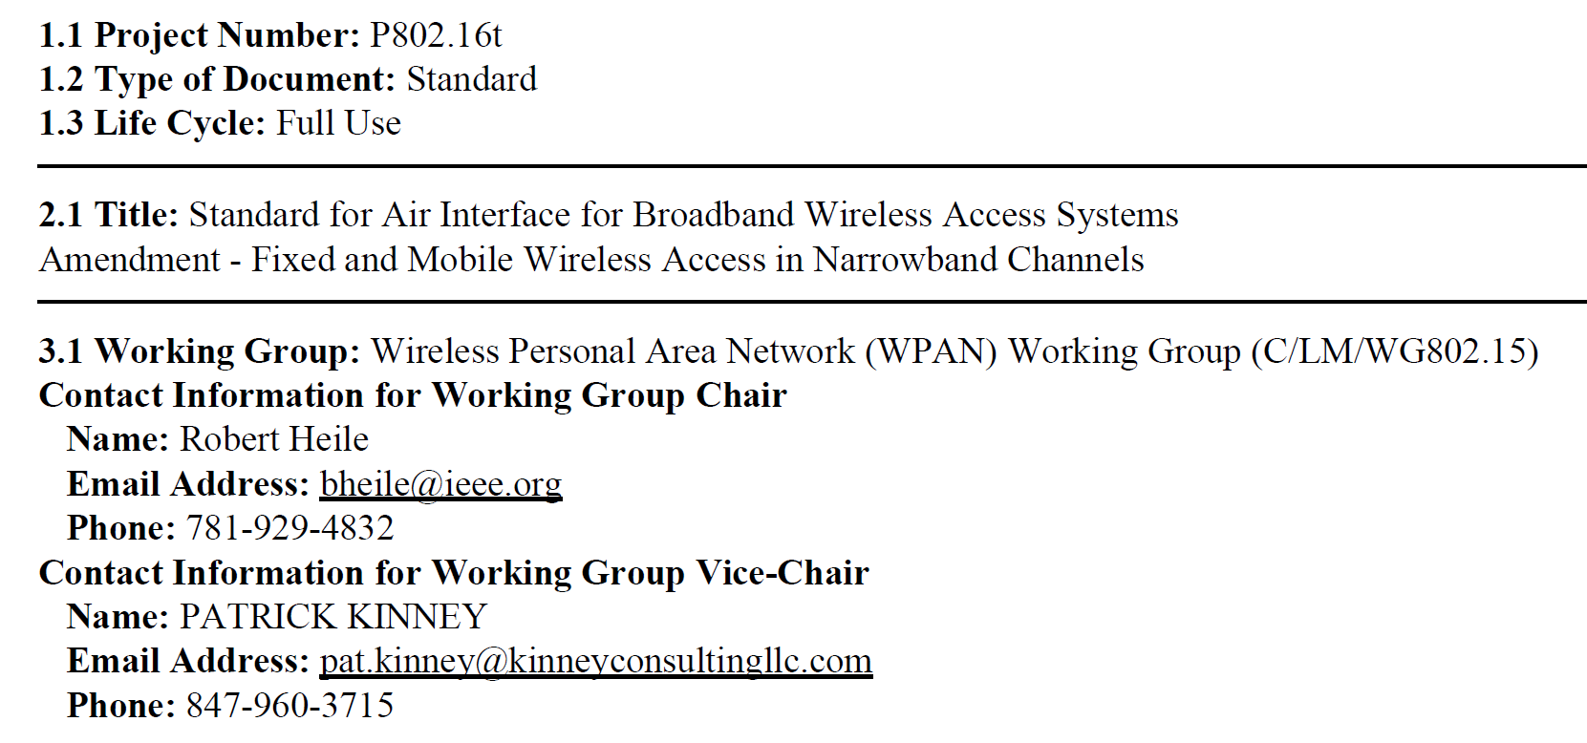
PAR Assignment of project to 802.15 WG
The PAR has been updated to show the assignment to 802.15

Slide 7
Scope Statement from Draft PAR
24-19-0029-06-0000-P802_16t_PAR.pdf
  Standard for Air Interface for Broadband Wireless Access Systems
  Amendment - Fixed and Mobile Wireless Access in Narrowband Channels
5.2.b. Scope of the project:
  This project specifies Time Division Duplexing (TDD) operation in licensed spectrum with channel bandwidths greater than or equal to 5 kHz and less than 100 kHz. The project will specify a new PHY, and changes to the MAC as necessary to support the PHY. The amendment is frequency independent but focuses on spectrum less than 2 GHz. The range and data rate supported by the narrower channels are commensurate with those of the base standard, as scaled by the reduced channel bandwidth. The project also amends IEEE Std 802.16 as required to support aggregated operation in adjacent and non-adjacent channels.

Slide 8
Need Statement from Draft PAR
5.5 Need for the Project:
  Mission critical entities have a strong preference for private, licensed networks for their data communications needs.Licensed channels from 5 kHz to 1 MHz may be available from the FCC and other regulators, or may be purchased in secondary markets at alower cost than commercial channels. Examples of operating frequencies include 160 MHz, 450 MHz, 700 MHz, and 900 MHz. Furthermore,VHF/UHF channels have superior propagation characteristics requiring less infrastructure and are capable of meeting capacity needs of privatenetworks. The amendment facilitates the development of innovative, cost-effective, and interoperable multivendor products for private licensed wireless access systems for mission critical networks. Applications include smart grids supporting generation, transmission, and distribution;field area networks; smart fields and smart pipes for oil and gas; intelligent transportation for rail systems; and federal, state and local uses forhomeland security, environmental and seismic monitoring and military communications.

Slide 9
Uniqueness
How are the desired use cases different than 802.15.4 SUN?
  Operation in Licensed Spectrum
  Point to Multi-point with handover between base stations. Relaying, but no mesh
  Fully Scheduled MAC supporting low, bounded latency
How are the desired use cases different than 802.15.4 LMR RCC?
  More flexibility in frequency bands and channel sizes
  Higher data rates than RCC LMR PHY
  Fully Scheduled MAC supporting low, bounded latency

Slide 10
PAR Development Process
As directed by IEEE 802 chair at July Plenary, 802.24 conducted teleconferences to develop a PAR and CSD, submitted for EC consideration at the November Plenary
PAR: 802.24-19-0029r4
CSD: 802.24-19-0030r0
As a result of the PAR Review Process during the November Plenary, the final versions of the PAR and CSD are as follows
PAR: 802.24-19-0029r6
CSD: 802.24-19-0030r1

Slide 11
PAR Development Plan and Milestones
Sept 18: Presentation of project overview to 802.15 WNG 802.15-19-0412r3
October 1st EC Teleconference
  EC was briefed on plan for PAR submittal and project assignment to 802.15 in November
802.24 teleconference October 1 – 1pm PDT
  Further discussion on PAR and CSD
PAR submitted to EC reflector Oct 8th for agenda at November plenary
  Per IEEE 802 LMSC O&M Section 9.2
  Including links to PAR, CSD, and presentation describing PAR development process
802.24 provides the forum in November for addressing PAR comments
  Tuesday Nov 12 PM2 and Wednesday Nov 13 PM2
PAR and CSD to be presented for approval Friday Nov 15 at EC meeting
The PAR shows the project is assigned to WG 802.15
  802.15 approves the assignment of this project to them
  The 802.16 standard will not be renamed or renumbered by this amendment project

Slide 12
PAR Comment Responses at November Plenary
Comments on the PAR from individuals and working groups have been compiled with responses from 802.24 in document 802.24-19-0035r0

Slide 13
Motion to recommend 802.15 approve PAR/CSD Comment Responses
Move to recommend that 802.15 approve the PAR and CSD comment responses in document 802.24-19-0035r0, and the resulting changes to the P802.16t PAR and CSD (as updated in 802.24-19-0029r6 and 802.24-19-0030r1 respectively).
  Moved: Ann Krieger
  Second: Allan Jones
  Vote: 7 / 0 / 1

Slide 14
802.24 Motion to approve P802.16t PAR and CSD
Approve the PAR and CSD contained in 802.24-19-0029r6 and 802.24-19-0030r1, respectively, and request the EC to forward the PAR to NesCom.
  Moved: Ben Rolfe
  Second: Allan Jones
  Vote: 7 / 0 / 1

Slide 15
802.24 Motion to recommend 802.15 approval of P802.16t PAR and CSD
Recommend that the PAR and CSD contained in 802.24-19-0029r6 and 802.24-19-0030r1, respectively, be approved by the IEEE 802.15 WG, and that the EC be requested to forward the PAR to NesCom.
  Moved: Ben Rolfe
  Second: Ann Krieger
  Vote: 7 / 0 / 1

Slide 16
802.15 motion to approve 802.16t PAR/CSD Comment Responses
Move to approve the PAR and CSD comment responses in document 802.24-19-0035r0, and the resulting changes to the P802.16t PAR and CSD (as updated in 802.24-19-0029r6 and 802.24-19-0030r1 respectively).
  Moved: Tim Godfrey
  Second:
  Vote: y / n / a

Slide 17
802.15 Motion to approve P802.16t PAR and CSD
Request that the PAR and CSD contained in 802.24-19-0029r6 and 802.24-19-0030r1, respectively, be approved by the IEEE 802.15 WG, and that the EC be requested to forward the PAR to NesCom. The 802.15 WG Chair and technical editor are authorized to make additional modifications to the PAR and CSD as needed to reflect EC discussion at its closing meeting.
  Moved: Tim Godfrey
  Second:
  Vote: Y/N/A

Slide 18
802.15 WG Motion to accept project (November)
Pending approval of the P802.16t PAR in document 802.24-19/0029r6 (or later version), 802.15 agrees to take on the project.
Moved: Tim Godfrey
Second:
Vote: Y/N/A

Slide 19
802.15 Motion to form 16T Study Group
Motion: that the 802.15 Working Group seeks approval from the 802 EC to form a study group in 802.15 to develop the PAR and CSD documents for Licensed Narrowband Amendment to 802.16 and additionally authorize the 802.15 WG Chair to make any necessary changes to these docs required to support the submission.
Moved: Tim Godfrey
Second:
Vote y/n/a
Note: This is in case comments are received from NesCom the Study Group is able to deal with them

Slide 20
P802.16t PAR and CSD - EC Motion
Approve forwarding P802.16t PAR documentation in https://mentor.ieee.org/802.24/dcn/19/24-19-0029-06-0000-licensed-narrowband-amendment-par.pdf to NesCom
Approve CSD documentation in https://mentor.ieee.org/802.24/dcn/19/24-19-0030-01-0000-licensed-narrowband-amendment-csd.docx
See 802.24-19-0033r5 for supporting documentation
Vote in the 802.24 TAG, PAR (y/n/a): <7>,<0>,<1>; CSD (y/n/a): <7>,<0>,<1>
Vote in the 802.15 WG, PAR (y/n/a): <y>,<n>,<a>; CSD (y/n/a): <y>,<n>,<a>
Moved: T Godfrey
Second: R Alfvin

Slide 21
EC Motion to form 802.15 Study Group
Approve the formation of 802.15 Licensed Narrowband Amendment Study Group to consider development of a Project Authorization Request (PAR) and Criteria for Standards Development (CSD) responses amending 802.16 for operation in narrower spectrum channels.
Vote in the WG: <y>,<n>,<a>
Moved: Rick Alfvin
Second: Tim Godfrey
Vote y/n/a
Note: This is in case comments are received from NesCom the Study Group is able to deal with them

Slide 22

Seen by Kathy Nelson in Fargo, North Dakota
Who’s car is it?

