Slide 1
802.24 Vertical Applications TAG
Closing Report
July 15, 2020
Electronic Meeting

Slide 2
802.24 Overview
Officers
  TAG Chair: Tim Godfrey
  Secretary & TAG Vice Chair: Ben Rolfe
Task Groups
  802.24.1 Smart Grid TG Tim Godfrey
  802.24.2 IoT TG Chris DiMinico
30 Voting Members as of March 2020
  Agenda for this meeting: 24-20-0009-00

Slide 3
802.24 Agenda - July 2020 Electronic Meeting |  | 24-20-0009-00-0000
1 | Wednesday, July 15, 2020 - 16:00 EDT
1.1 | Call session to order, present “Guidelines for IEEE SA meetings”, Quorum | Godfrey | 5 | 4:00 PM
1.2 | Review of Agenda / Approval of Agenda | Godfrey | 5 | 4:05 PM
1.3 | Approve minutes from prior TAG meeting | Godfrey | 5 | 4:10 PM
1.4 | Introduction/meeting objectives / Review action items from previous meeting | Godfrey | 5 | 4:15 PM
1.5 | Election of Officers | Godfrey / Rolfe | 15 | 4:20 PM
1.6 | ITU and regulatory items | Godfrey/Holcomb | 10 | 4:35 PM
1.7 | Low Latency White Paper | Holland | 20 | 4:45 PM
1.8 | Review of IoT white paper development, expanding scope and participation | DiMinico | 20 | 5:05 PM
1.9 | "IEEE 802 Solutions for Vertical Applications" White Paper | Godfrey/Reigel | 20 | 5:25 PM
1.10 | 802.24 New Action Items, New Activities, AOB | Godfrey | 10 | 5:45 PM
1.11 | Adjourn | Godfrey | 0 | 5:55 PM

Slide 4
802.24 TAG
Approve March TAG teleconference minutes
  802.24-30-0008r0
  Approved with unanimous consent
TAG Action Items :
  none

Slide 5
802.24 TAG: Election of Officers
Procedure in 802.24 Operations Manual document 24-14-0007-00-0000
Announced Candidates
  Tim Godfrey (Chair)
  Ben Rolfe (Vice Chair)
Election of Chair
  Vote: 7/0/0
Election of Vice Chair
  Vote: 7/0/0

Slide 6
Radio Regulatory Items
Update from 802.18 – Jay Holcomb
  WRC-19 any outcomes
    Will review Thursday, and look forward to WRC23.
  6 June – 70/80/90 GHz NPRM (5G) – relevant to 802.11ay.
  FCC – R&O and FNPRM on 6 GHz – any IEEE 802.18 actions?
      Multi-stakeholder Group – for dealing with 6 GHz implications.
      3GPP released NR-U channelization for 6 Ghz.
      WFA participation for MSG
      802.15.4a/z UWB community
      Pre-MSG formation/planning Kickoff meeting 7/31 (WFA / Winnforum)
      Unknown if FCC will sanction a the group, or is it independent
      FCC will be a “participant”
      STAs and Petition for Reconsideration have been filed on the R&O
      Train Control Applications.
      FNPRM introduces VLP operation – no AFC, ad-hoc band operation, outdoors and mobile

Slide 7
Liaison Review
P2413 Ludwig Winkel
ATIS TOPS Farrokh Khatibi
Wi-Fi Alliance (Informal) Alan Berkema
ZigBee Alliance (Informal) Ruben Salazar
IEEE PSCC TF S6 Marc Lacroix (completed)
Industrial Internet Consortium Wael Diab (not active - assign to Chris D)

Slide 8
“Low latency” White Paper
Achieving low latency with IEEE 802 standards
  Including wired and wireless communications
  An alternative (or complement) to 5G URLLC
A set of vertical applications enabled by low latency
The challenges of reliable low latency in unlicensed spectrum.
  Adapting TSN’s “FRER” feature
  Adapting 802 wireless to licensed spectrum?
  Operating over multiple bands or channels?
Special cases for high data rates for immersive video
Latest Draft is 802.24-19-0003r5.

Slide 9
Next Steps
Need volunteers to pare down AR/VR section to limit scope to Low Latency networking concepts.
A topic to explore is the relationship between high throughput and low latency. Can you have low latency without high bandwidth?
  Can we follow the example of 5G URLLC? This can be seen as alternative to 5G approaches, but standards-based and lower cost to use.
  Show how Wi-Fi technology can provide an equally good or better result and performance (bandwidth and low jitter and low latency) What are specific capabilities introduced in 802.11be?
Map identified uses cases on to various IEEE 802 standards.
Tie low latency to 802.1 TSN – how can 802.1 TSN functionality be carried into other MAC/PHY standards.
  Follow collaboration of 802.11be with 802.1 TSN – there are gaps in expectations from 802.11 and TSN.
  Discuss how FRER could compensate for lack of reliability/predictability of unlicensed spectrum
Trim down section 6 from RTA TIG.
  Tim will incorporate Allens document and upload as Revision 6
Max could review section on relation of TSN to 802.11

Slide 10
802.24.2 White Paper
Status and development of IoT White paper
  802.24-17-0036r2
  Ludwig is developing some related materials.
  Can we pull new developments from P2413 into this white paper?
  Single Pair Ethernet and PODL
    Chris will update now that the 802.3 projects have matured.
    Separate white paper on PODL
  These will be included in the overall IoT White Paper
Update on P2413 and IEC topics (Ludwig)
  We will continue to re-structure and advance with more wireless WG materials.
  New PAR for 2413.1
  New PAR 2413.2 Power Distribution IoT.

Slide 11
Next Steps to progress work in TG2 IoT
Discussion on plan and new activities for IoT task group and broader engagement
What are the IoT activities in IEEE 802?
  802.15.4 – Wi-SUN is going after IoT in addition to Smart Grid
  802.15.4w – LPWA another IoT focus
  802.11ah (Halow), 802.11ba (WUR)
Can we find volunteers to contribute to IoT white paper?
  Content from WFA HaLow white paper?
Incorporate activities in 802.19.3 related to preceding standards for IoT (Ben will ask for volunteers)
Chris D: Intelligent Sensor at end of cable model – include this is the overall white paper?

Slide 12
"IEEE 802 Solutions for Vertical Applications"
Previously called “Network Integration”
Draft White Paper is posted as IEEE802-24/19-0017r4
Input from Max Riegel
  802.24-19-0034r1
Discussion
  802.11 AANI, report talking about using 802.1CF model for how an 802 radio technology could be integrated with 5G Core.
  Review for applicability to this white paper, and invite the author(s) to attend next session.
  11-20-0013-00-AANI-draft-technical-report-on-interworking-between-3gpp-5g-network-wlan
    Author - hsoh5@etri.re.kr
    May not attend July 2020 meeting due to COVID-19
  This is on integration of 802 into 3GPP, rather than using IEEE 802 as an alternative to, but could be a worthwhile “counterpoint” concept for the paper.
Next Steps: further text contributions:
    Ask AANI (Joe Levy) to provide a contribution to expand on this concept.
    3GPP 5G LAN in Release 16 (network for URLLC) Introduced TSN mode called Time Sensitive Communication. Emulating Ethernet.according to TSN. Have to provide Ethernet, not just IP. Introduced connectivity service – emulating TSN. Resampling data paths of IEEE 802. Get all of 5G network complexity too.
    Should mention this in white paper as a reference.
  Max will provide a paragraph on “TSC”.

Slide 13
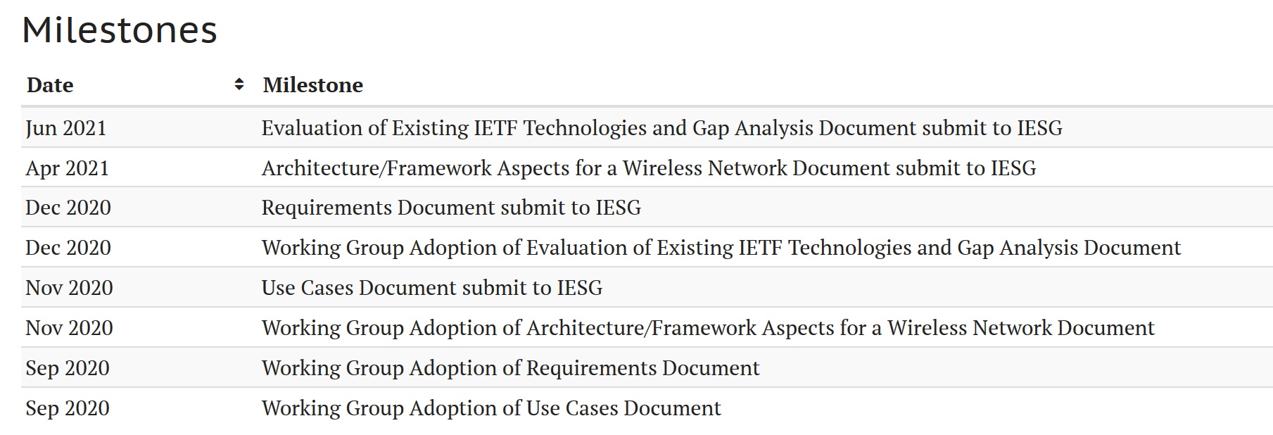
New Topic: IETF Reliable and Available Wireless
https://datatracker.ietf.org/wg/raw/about/
Opportunity for coordination between 802.24, 802.1 TSN, 802.11be, 802.15 IG DEP?
  Nobody is following this currently, table for now

Slide 14
2020 Future TAG Activity Planning
A whitepaper/document for application-specific use cases of Sub 1GHz standards 802.15.4g and 802.11ah. Identifying where each standard is most suitable, and how to make best use of mechanisms proposed in 802.19.3 TG.
  Can this also include applying 802.15.4s in sub-1GHz spectrum?
  Revisit in 2021 when meetings resume
Other topics to consider for 2021
  802.24 white paper on IoT and P2413
    Need to study what the new P2413 projects are about.
  Update of first Smart Grid white paper to address latest amendments of 802.15.4 u, v, w, x, y, Revmd.
    With completion of 802.15.4revMD, those people may be available to participate again?

Slide 15
802.24 TAG closing
Action Items from this meeting
  Update and revise Low Latency white paper, incorporate Allen’s text.
  Update 802 Solutions white paper, Max can provide paragraphs on TSC from 3GPP.
  Liaison with IETF? Ann K will look into it. Put on Agenda for Nov.
  Chris D will update and forward Single Pair Ethernet white paper
Any New Business?
  Plan on call during November Electronic plenary week.
Adjourn

