Slide 1
802.24 Vertical Applications TAG
Closing Report
November 2024 Plenary Meeting
Vancouver, BC, Canada

Slide 2
802.24 Overview
802.24 Vertical Applications TAG
802.24.1 Smart Grid TG
802.24.2 IoT TG
Officers
  TAG Chair: Tim Godfrey
  Secretary & TAG Vice Chair: Ben Rolfe
Task Groups
  802.24.1 Smart Grid TG Tim Godfrey
  802.24.2 IoT TG Chris DiMinico
25 Voting Members

Slide 3
Agenda
Call session to order / “Guidelines for IEEE SA meetings”
Review of Agenda / Approval of Agenda / Approve Minutes
Liaison Updates / Regulatory
Publication of “Low Latency White Paper”
IoT white paper Development and Contributions
Development of update to Smart Grid White paper.
AFV Infrastructure communications white paper: Review contributions and white paper draft

Slide 4
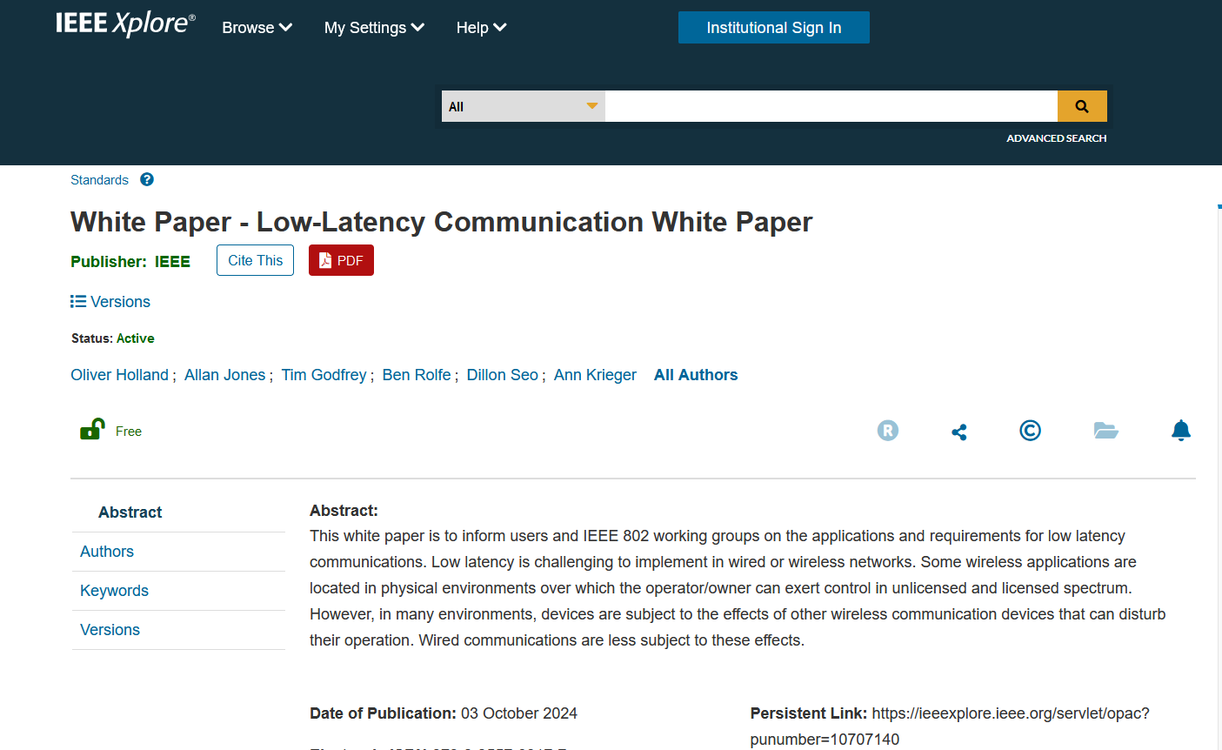
Low Latency White Paper
Published October 3rd.
https://ieeexplore.ieee.org/document/10707142

Slide 5
IoT White Paper Discussion
Discussions Notes
  Disambiguate the general poor state of available information on IoT,and highlight the IEEE 802 solutions that address them.
  Need to distinguish “Internet” public vs private. OT network for highly secure, isolated networks.
  Embedded comments need text contributions
  How to incorporate wired IoT – specifically Single Pair Ethernet.
    Add section 5 for Connectivity Technologies
    Revise closing section
  Nov 2024
    Smart Home section – Ben will seek Wi-Sun text for this.
    New section needs text: “7.Looking back at the Hype, and what has actually been delivered.” (Ben will find a volunteer)
    Fill in section on IoT with high reliability (Tim)
    Closing statement (Ann)
Latest Version Internet of Things White Paper 24-22-0011-07-IoTg-internet-of-things-white-paper

Slide 6
Smart Grid White Paper Revision Plan
Update of first Smart Grid white paper to address latest amendments of 802.15.4 u, v, w, x, y, Rev-me, and new organization of documents to clarify UWB vs Narrowband
New Standards
  Amendments of 802.15.4 (SUN) u, v, x, y, ac, ad/NG, (4me revision) Phil Beecher, Gary Stuebing, Don Sturek, Jeorg
  LECIM/LPWAN 802.15.4w Jeorg
  802.15.9 Tero
  802.1 TSN Reference to the TSN White Paper (Janos)
  802.11ah and 11ax (Dave Halasz)
  802.16s, 16t (Tim, Harry)
  802.19.3 sub-1 GHz coexistence (Ben)
New topics
  Integration of Gas/Water into electric metering
  Battery leaf nodes for low power
  Sensors
  Situational Awareness
  Physical Security
  Wildfire detection and prevention
  Any others identified by contributors.
Complementary role of IEEE 802 with cellular technologies

Slide 7
Areas discussed and Edited Nov 2024
Companion document update - 24-24-0029-00-sgtg-2025-update-package-of-802-smart-grid-standards.docx
Version at end of November meeting: 802.24-24-0014r4

Slide 8
AFV Communications - White Paper
Types of AFV sites: residential, commercial vehicle depot, public transport site, long haul freight transportation. (Public parking facilities)
Communications requirements: data volume, resilience, reliability.
  Ancillary communication to vehicles (maps, firmware and software updates for vehicles, inventory tracking, logistics, media, etc)
Relate to the use of IEEE 802 technologies as the solution

Slide 9
Contributions related to AFV White Paper
12-Nov-2024 ET | 2024 | 28 | 0 | TAG documents | Fresh AFV WP outline | Craig Rodine (Sandia) | 12-Nov-2024 19:49:14 ET | Download, Revise, Correct, Delete
27-Oct-2024 ET | 2024 | 27 | 0 | TAG documents | Proposed an extended outline for adding use cases of 'Integrated Charging Infrastructure with Distributed Energy Resources, Building and Grid-Level Energy Management Systems' in Clause 3 of the AFV draft outline (Doc. 24-24-0025-00-0000) | Jin Seek Choi (Hanyang University), Hyeong Ho Lee (Seoul National University of Science & Technology/NetvisionTelecom Inc.) | 27-Oct-2024 20:16:45 ET | Download, Revise, Correct, Delete

Slide 10
AFV Next Steps
Output document of combined outline:
  24-24-0027-01-0000-proposed-an-extended-outline-for-adding-use-cases-of-integrated-charging-infrastructure-with-distributed-energy-resources-building-and-grid-level-energy-management-systems-in-clause-3—1
Possible topic follow up on AFV.
  Future state of integrated networks for Energy Management Systems across electric vehicle, home, building, and grid.

Slide 11
802.24 TAG closing
Action Items
  Text contributions for SG white paper update, IoT White Paper. (AI’s inside document)
Any New Business?
Next Meeting
    January 2025 – Kobe, Japan (Ben Rolfe will Chair)
    March 2025 – Atlanta, GA, USA
Adjourn

