Slide 1
IEEE 802 Networks for Last mile Energy Orchestration Framework
Jin Seek CHOI, Hanyang University and
Hyeong Ho LEE, Netvision Telecom Inc.
May 2025 IEEE 802 Interim Session
Warsaw, Poland

Slide 2
Introduction
Related Documents of IEEE 802.24 TAG
  Proposed an extended outline for adding use cases of ‘Integrated Charging Infrastructure with Distributed Energy Resources, Building and Grid-Level Energy Management Systems’ in Clause 3 of the AFV draft outline (Doc. 24-24-0025-00-0000): 24-24-0027-01-0000 (Nov. 2024)
  IEEE 802.24 AFV WP revised (final) outline: 24-24-0025-00-0000 (Sept. 2024)
  White Paper: IEEE 802 Networks for next-generation Electric Vehicle Charging Infrastructure and use cases: 24-23-0007-06-0000 (July 2023)
  Cross-cutting vertical opportunity for EV Charging AFV (EV and H2V) Fueling: 24-22-0020-01-0000 (Nov. 2022)
  Cross-cutting vertical opportunity for EV Charging: 24-22-0016-01-0000 (Sept. 2022)
Propose: Supplementary White paper:
  “IEEE 802 Networks for Last mile Energy Orchestration Framework” as follows:

Slide 3
IEEE 802 Networks for Last mile Energy Orchestration Framework White Paper
1 Introduction
2 Energy Management Systems
3 Last-mile Energy Orchestration Framework
4 Security and Privacy for the Last-Mile Energy Orchestration Frameworks
5 IEEE 802 Standards and Protocol Guidance
6 Conclusions

Slide 4
1. Introduction - Why Energy Orchestration at grid edge?
The increasing complexity and decentralization of modern energy systems—driven by widespread electrification, renewable energy integration, and electric vehicle (EV) adoption—necessitates more intelligent and interoperable energy management frameworks. Energy Orchestration Frameworks (EOFs) aim to optimize the coordination between Distributed Energy Resources (DERs), Electric Vehicle Supply Equipment (EVSE), Energy Storage Systems (ESSs), and grid infrastructure.
This white paper introduces the concept of Last-Mile Energy Orchestration Frameworks, connecting distributed consumers, producers, and prosumers—including electric vehicles, solar rooftops, home batteries, and smart appliances—to larger energy systems via interoperable communication networks.
IEEE 802 protocols, widely deployed across home, industrial, and urban networks, offer a robust platform for enabling real-time data exchange, control, secure, and interoperable energy management across residential, commercial, and grid-level systems.
This white paper includes the IEEE 802 Protocol Guidance that ensure seamless interoperability across independent energy systems, which provides specific recommendations for the communication protocols necessary for implementing Last mile Energy Orchestration Framework.

Slide 5
    2. Energy Management Systems
Energy Management Systems are largely fragmented and domain-specific, focusing separately on electric vehicles (EVs), distributed energy resources (DERs), energy storage systems (ESSs), grid dispatch, or residential energy management systems. The evolution of DERs and the proliferation of EVs, ESSs, and residential energy systems demand seamless orchestration across homes, buildings, and grids.
  EV charging Systems are often vendor-specific, lacking interoperability and dynamic scheduling capabilities.
  DER Management Platforms primarily address utility-side grid support, with limited bi-directional integration with customer energy assets.
  Virtual Power Plants (VPPs) offer market participation through aggregated DERs but face standardization and latency challenges.
  Home and Building Energy Management Systems (HEMS/BEMS) focus on local optimization without deeper coordination with grid signals or DERs.
This fragmented landscape necessitates a unified orchestration framework built on open standards to support seamless coordination among all stakeholders in the energy ecosystem. The orchestration framework has evolved from isolated asset controllers to integrated, real-time intelligent systems.
  Distribution Grid Orchestration (-Grid Integration, EV-Grid Integration, EV-DER orchestration)
Ref: Integrating Electric Vehicles into the Grid, Brennan Borlaug, National Renewable Energy Laboratory, December 3, 2024
Yu, R. & Martini, P. (2024). Flexible DER & EV Connections, 2024

Slide 6
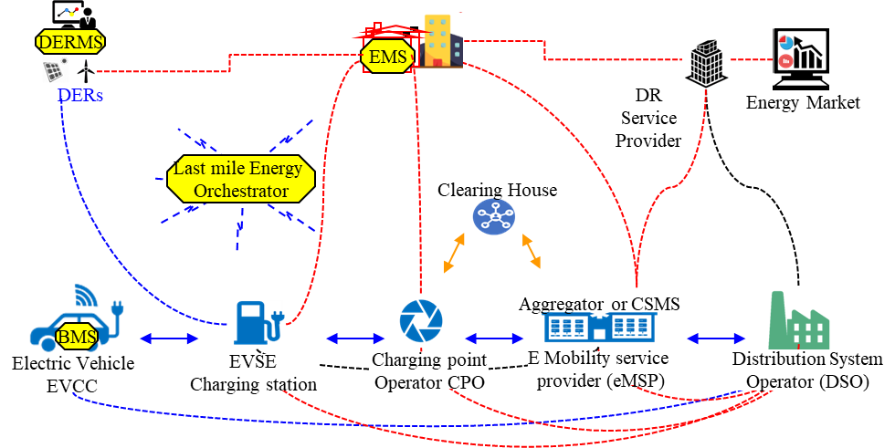
    3. Last-Mile Energy Orchestration Framework
Energy orchestration refers to the harmonized coordination of energy resources at the point of consumption or production—primarily involving homes, buildings, DERs, EVs, and prosumers. It serves as the critical interface between distributed energy consumers/producers and grid operators, typically involving:
  Dynamic load balancing between grid and consumer assets
  Bi-directional EV charging (V2G, V2H)
  Local DER optimization under grid constraints
  Participation in demand response and ancillary services
Last-mile energy orchestration Framework bridges
centralized utility operations with decentralized
energy assets, forming the foundation
for energy-resilient smart communities.

Slide 7
    3. Last-Mile Energy Orchestration Framework (Continue)
The success of Last-Mile Energy Orchestration Framework necessitates selecting and implementing appropriate communication protocols that ensure seamless interoperability, real-time data exchange, and system reliability across EVs, DERs, homes, buildings, and the grid. Here’s a protocol guidance for key aspects of integration as shown in Fig. Y:
  Physical Layer (ISO 15118, IEC 61851, SAEJ1772, IEC 62196)
  Communication Layer (ISO 15118, IEEE 2030.5, OCPP, IEC 63584)
  Application Layer (ISO 15118, IEC 61850, IEC 62746-10-1, IEEE 1547, IEC 63110, IEC 63380, IEC 63460, OSCP, Matter, CoaP)
  Security Layer (IEC 62351, 802.1X, 802E)
Figure Y Protocol guidance for EV Orchestration Framework.

Slide 8
    4. Security and Privacy for the Last-Mile Energy Orchestration Frameworks
As last-mile energy orchestration frameworks increasingly interconnect Electric Vehicles (EVs), Distributed Energy Resources (DERs), Energy Storage Systems (ESSs), Home/Building Energy Management Systems (HEMS/BEMS), and Grid operators, privacy risks become a critical concern. The orchestration process inherently involves the collection, transmission, and processing of sensitive personal and operational data, including:
  EV charging behavior and driving patterns
  Household energy consumption profiles
  DER production schedules (e.g., rooftop solar)
  Dynamic occupancy and appliance usage information
  Location tracking for mobile assets (e.g., EVs)
Without proper privacy-preserving mechanisms, this data could be exploited, leading to personal profiling, energy theft, or system manipulation.

Slide 9
    5. IEEE 802 Communications and Protocol Guidance
The IEEE 802 family of standards provides foundational Layer 2 networking protocols essential for building interoperable, scalable, and secure energy orchestration framework.
Here’s a IEEE 802 protocol guidance for key aspects of integration as shown in Fig. Y.
These protocols, when coordinated with higher-layer energy protocols (e.g., IEC 61850, ISO 15118, OCPP), enable real-time orchestration of heterogeneous energy resources in the last mile.
IEEE Standard | Application | Relevance to Orchestration
IEEE 802.3 (Ethernet) | Wired backbone | High-reliability DERMS/GEMS connections
IEEE 802.11 (Wi-Fi 6/6E/7) | Wireless access | Smart home/BEMS, EVSE communication, privacy-enhanced handshakes
IEEE 802.15.4 | Low-power mesh | IoT devices, sensors, home automation
IEEE 802.1X, 802.11i | Authentication | Secure access for EVSE, DER, and users
IEEE 802.1Qbv (TSN) | Time-Sensitive Networking | Deterministic scheduling for grid events
IEEE 802.11bd | V2X Communications | High-speed, low-latency V2G and V2I data exchange
IEEE 802.21 | Media-independent handover | Seamless network transitions for mobile EVs

Slide 10
6. Conclusion
Currently, Energy systems use IEEE 802 communications interfaces in a limited way without collaboration, and depend on the device vendor (or service provider).
IEEE 802 communications interfaces and protocols facilitate seamless communication, ensuring interoperability and efficient energy management across various levels of the independent infrastructures.
Future advancements in IEEE 802 communication protocols and energy orchestration technologies will likely further streamline these integrations, paving the way for more resilient and flexible energy systems that can accommodate the growing demands of electrification in smart cities and beyond.
The standard IEEE 802 communications (e.g., Wi-Fi) and use cases promise to expand opportunities for cooperative Energy Orchestration Framework to participate in comprehensive, dynamic energy management across EV, DERs, Homes, Building and Grids.
Security and privacy frameworks (e.g., IEEE 802.1X, ITU-T Y.3055, and 802.1AR) should be extended to support multi-tenant and multi-vendor ecosystems in Last-Mile Energy Orchestration Framework.

Slide 11
References
J. S. Choi, "Energy management agent frameworks: Scalable, flexible, and efficient architectures for 5G vertical industries," IEEE Industrial Electronics Magazine, vol. 15, no. 1, pp. 62-73, March 2021
J. S. Choi, "A hierarchical distributed energy management agent framework for smart homes, grids, and cities," IEEE Communications Magazine, Vol. 57, No. 7, pp. 113-119, 2019
Integrating Electric Vehicles into the Grid, Brennan Borlaug, National Renewable Energy Laboratory, December 3, 2024
Yu, R. & Martini, P. (2024). Flexible DER & EV Connections.

Slide 12
Thank you very much!
jinseek@hanyang.ac.kr

