Slide 1
IEEE Standards Association
Attendance Tool
Manager Access

Slide 2
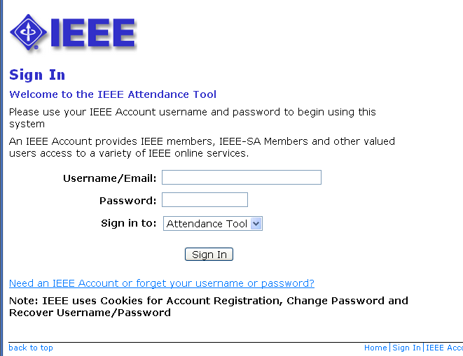
Sign in to Attendance Tool
http://imat.ieee.org
Enter your IEEE Account username/email and password

Slide 3
Terms
Event or Session – The overall meeting event that contains one or many sub-meetings (Breakouts).
Timeslot – Times that breakouts may occur. Timeslots regulate when meetings should be occurring during your event and prevent attendees from logging their attendance in multiple concurrent meetings.
Breakout or Meeting – This is the specific meeting that a user may log attendance for. He/she may only log attendance for one breakout occurring at a particular time.
You must first create an Event, then the Timeslots, then Breakouts.
NOTE: If you are holding a meeting with another group (Plenary Session) the person with group access must set up the Event and Timeslot. Contact your Staff Liaison or Solutions Staff for assistance.

Slide 4
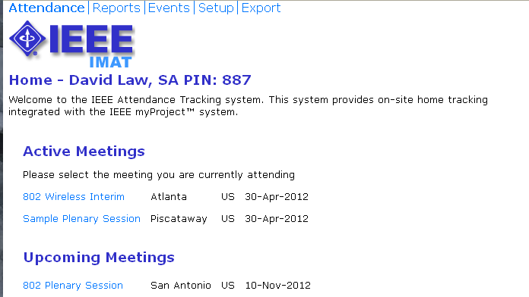
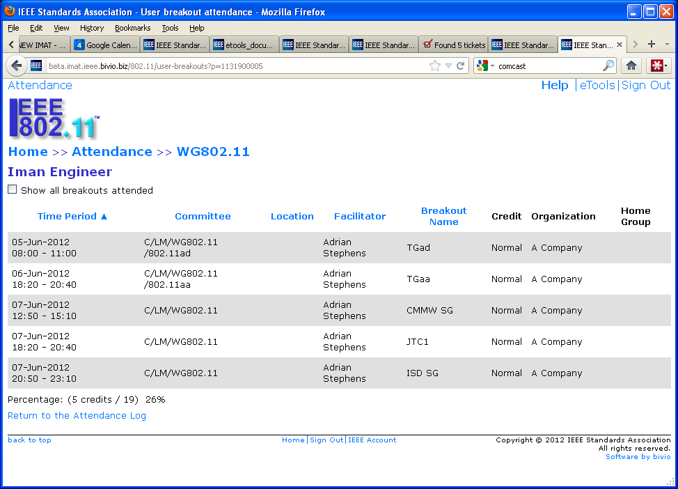
Select or Create a Session/Event
Click “Events” to create a new session/event or add meetings to an existing one

Slide 5
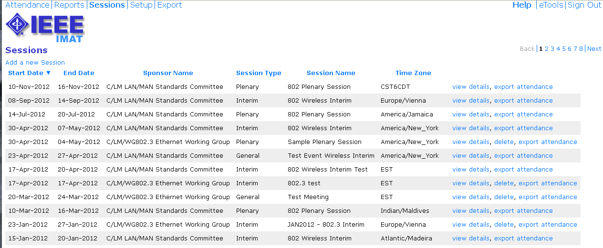
Select or Create a Session/Event
Click “Add a new session” to create a new session
Click “view details” to add to an existing session

Slide 6
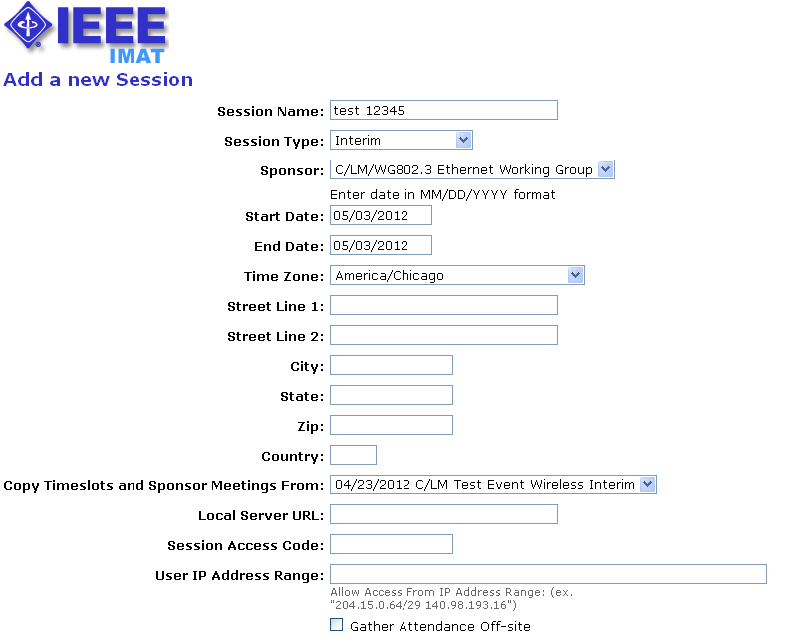
Add a New Session/Event
Add details such as: session type, start/end dates, time zone, location
Copy timeslots from an existing event
Leave “Local Server URL” blank

Slide 7
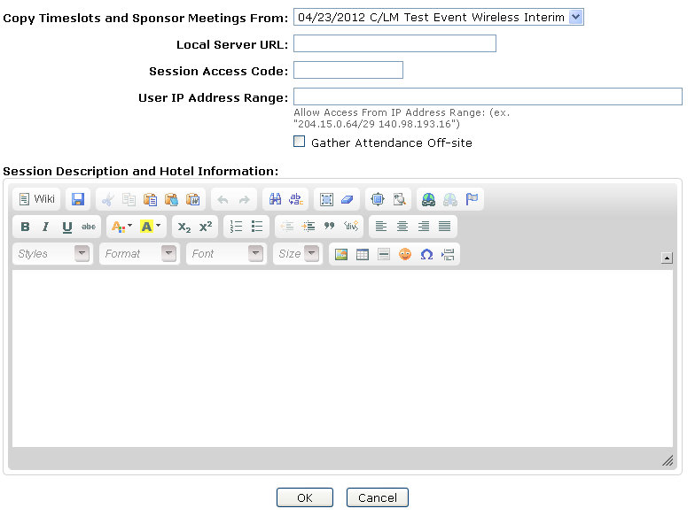
Add a New Session/Event
Restrict access by creating a session access code or requiring a specific IP range
Use this wiki to provide attendees with additional information about the venue

Slide 8
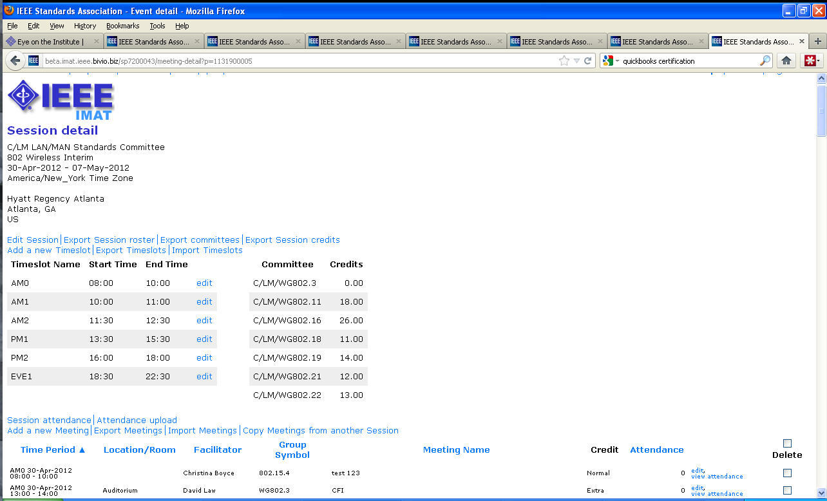
Session Details
View and edit session/event details
Add a timeslot or edit an existing one
Add a meeting or edit an existing one

Slide 9
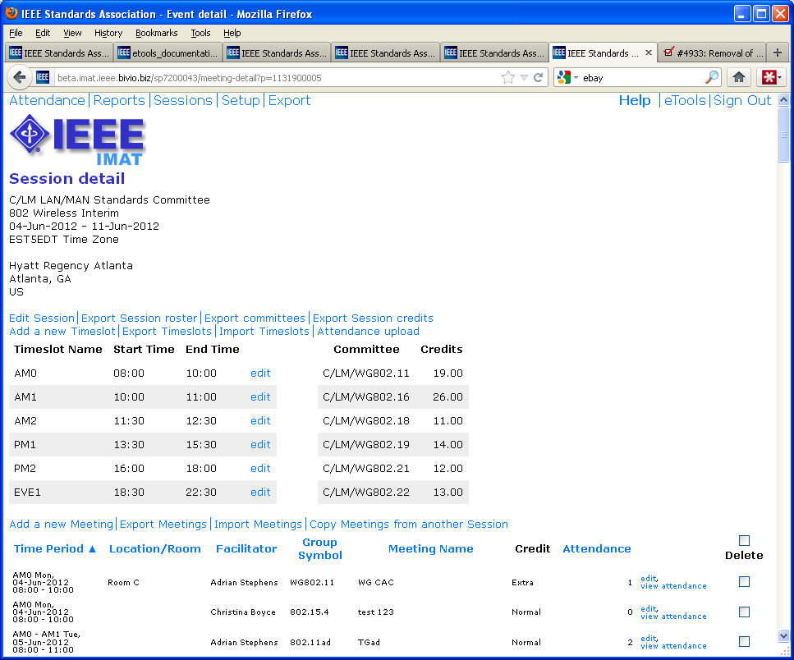
Import/Export
Export timeslots as a CSV file, edit in a spreadsheet and import for easier entry and editing
Export meetings as a CSV file, edit in a spreadsheet and import for easier entry and editing
Copy meetings from another session

Slide 10
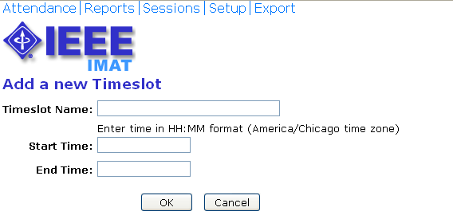
Add a Timeslot
Timeslots will be the same for all days of the session/event. Use generic names, e.g., “AM 1”
Enter times in 24 hour format, e.g., “14:00”.

Slide 11
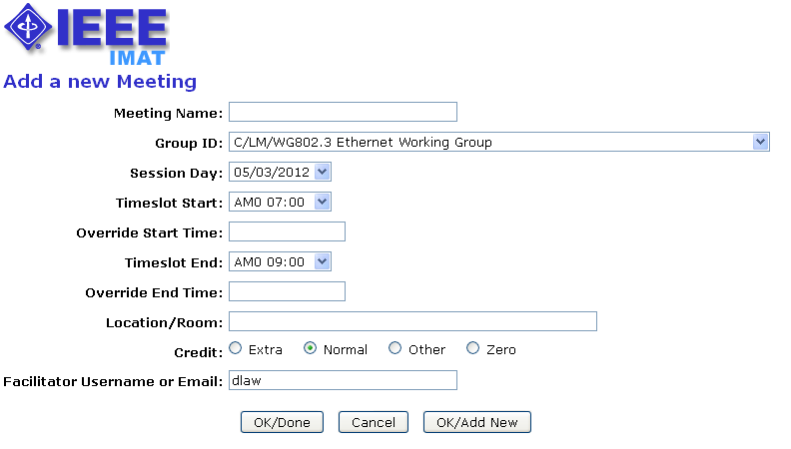
Add a Breakout/Meeting
Meetings can be associated with a working group or particular PAR/project
Select the timeslot for the start and end. You can span multiple timeslots.
Use the override fields to start/end at a different time than what is presented in the timeslot field
Enter the amount of attendance credit this breakout is to be given.
The facilitator should be the person chairing the meeting. This will default to the Working Group Chair.

Slide 12
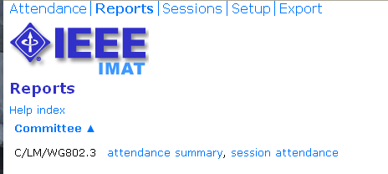
Reports Menu
Click “attendance summary” to see a summary of all event attendance listed by individual
Click “session attendance” to view attendance for a particular session

Slide 13
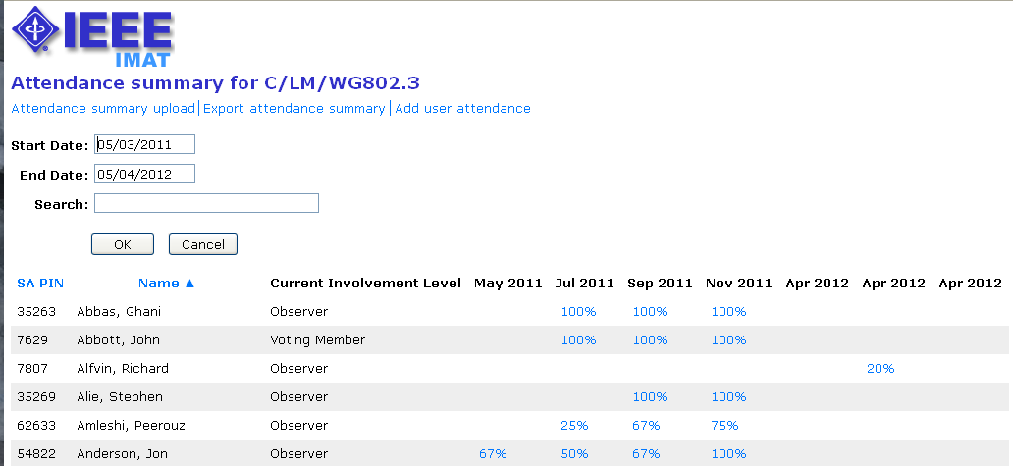
Attendance Summary
Click on the attendance percentage to see individual attendance detail for a particular event/session. You can also override the attendance percentage on this screen.

Slide 14
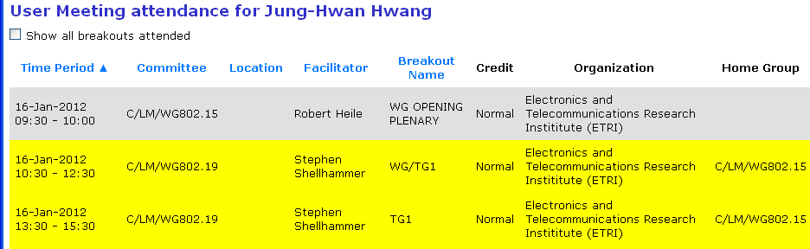
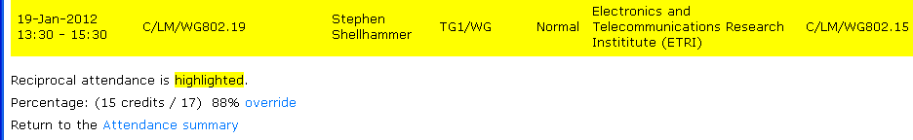
Attendance Detail
All attendance credited to the selected Working Group will be shown. Check the “Show all breakouts attended” box to show all breakouts attended at the selected event
Click to override attendance percentage

Slide 15
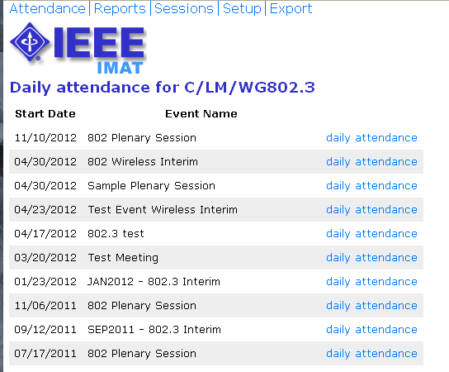
Event/Session Attendance
Click “daily attendance” to see the full daily attendance report for a particular event/session.

Slide 16
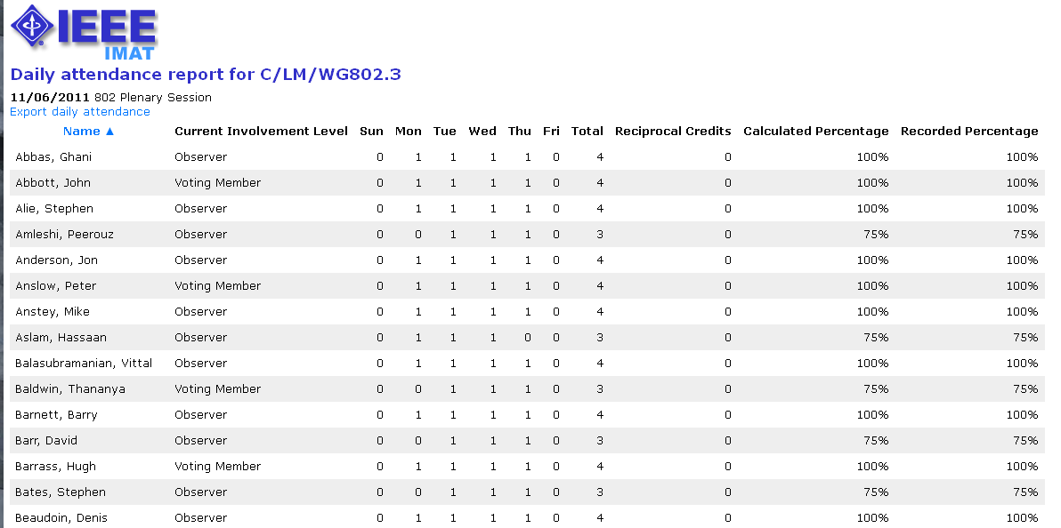
Event/Session Attendance
View the attendance report or export as CSV.

Slide 17
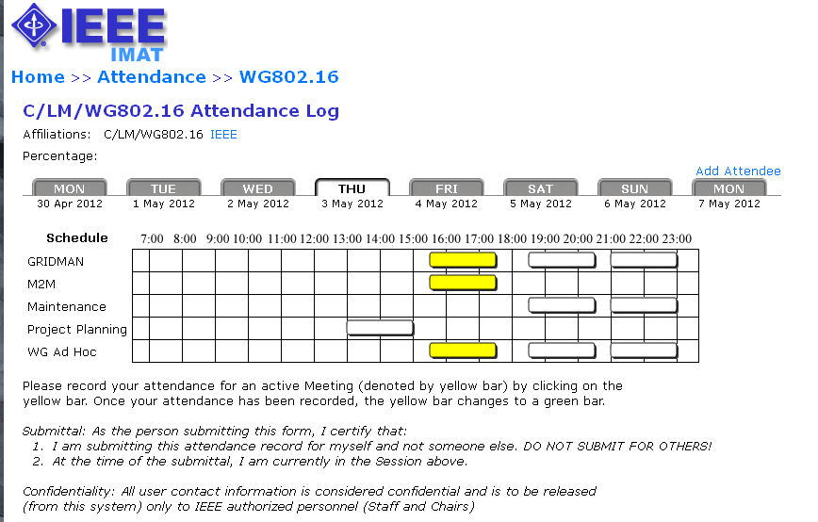
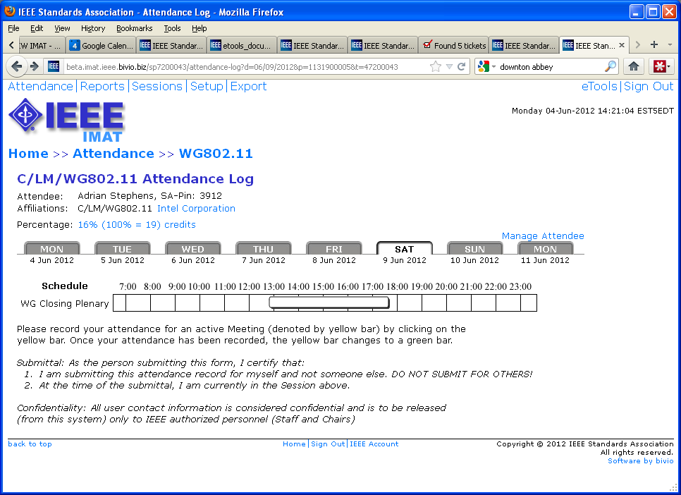
Manage Attendance
(during an event/session)
Select the event/session from the “Attendance” screen and click “Manage Attendee”

Slide 18
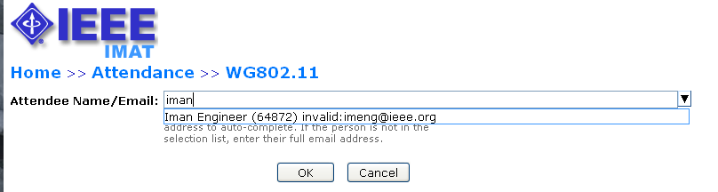
Manage Attendance
(during an event/session)
Enter the user email or search by name or SA pin

Slide 19
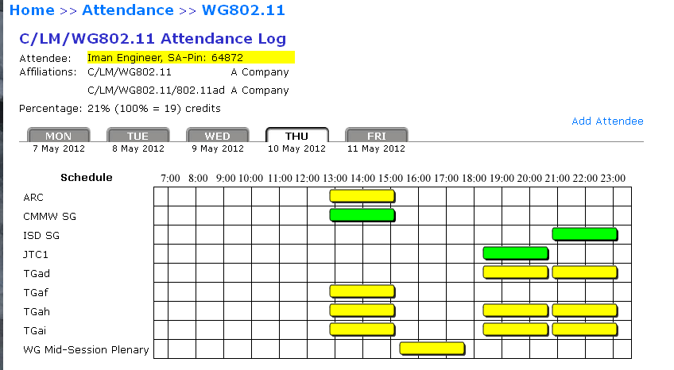
Add Attendance
(during an event/session)
Click the breakout/meeting to add attendance
You will be prompted to enter affiliation if one has not been declared
Attendance percentage will update accordingly

Slide 20
Add/Modify Attendance Percentage
From the “Attendance Summary” report: Click on “Add user attendance” to add a user. Click the attendance percentage and then click “Override” to modify a user’s attendance percentage.

Slide 21
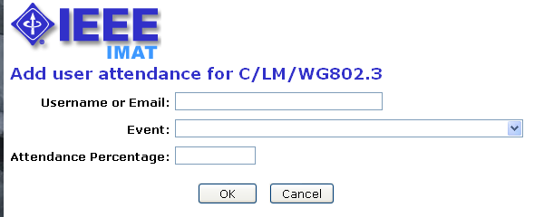
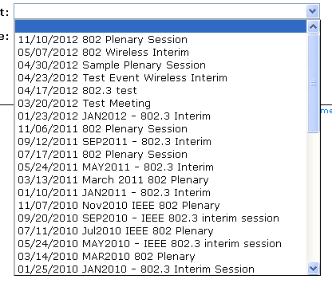
Add Attendance Percentage
Enter a username or email for the individual you would like to add
Select an event/session from the dropdown list
Enter an attendance percentage

Slide 22
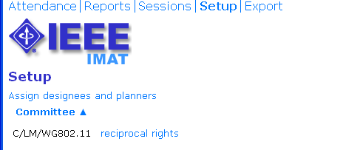
Setup
From the “Setup” screen, you can manage access for designees and planners and grant reciprocal attendance rights

Slide 23
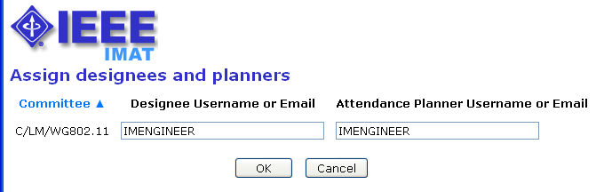
Assign Designees and Planners
Enter a username to assign the user as a designee or planner
Designees will be granted full manager access to IMAT
Planners will have access to attendance reports only

Slide 24
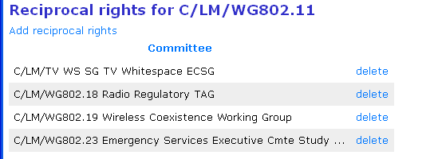
Manage Reciprocal Rights
Reciprocal rights allow attendees to receive credit towards maintaining voting rights in a group by attending another group’s meetings. This feature is only applicable for users who have “Voting Member” status entered in myProject™. Review the “Help” text on this page for more detail.

Slide 25
Questions?
Contact the Standards Solutions Support Team solutions-support@standards.ieee.org

