Slide 1
IEEE Standards Association
Logging meeting attendance using IMAT

Slide 2
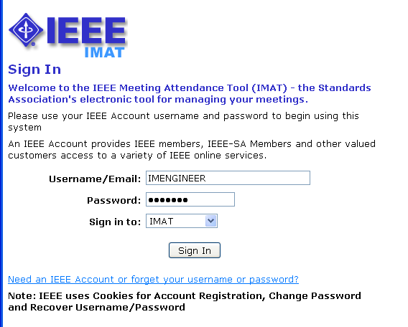
Sign in to IMAT
http://imat.ieee.org
Enter your IEEE Account username/email and password
If you need to create an account or forgot your password, click the link

Slide 3
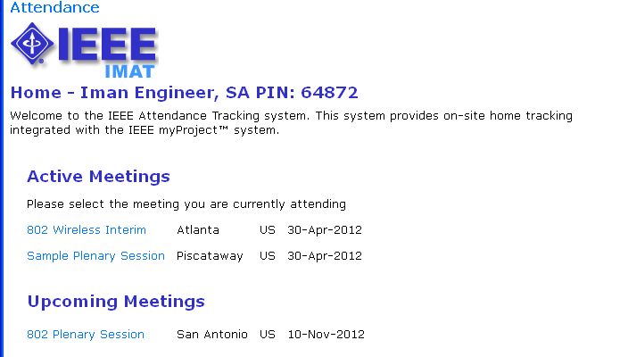
Select the meeting you are attending

Slide 4
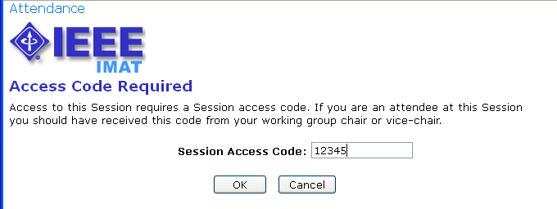
Input access code (if applicable)

Slide 5
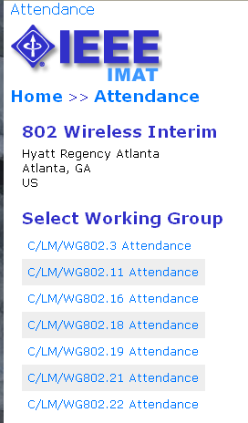
Select your working group
Select the working group you would like to claim attendance for.

Slide 6
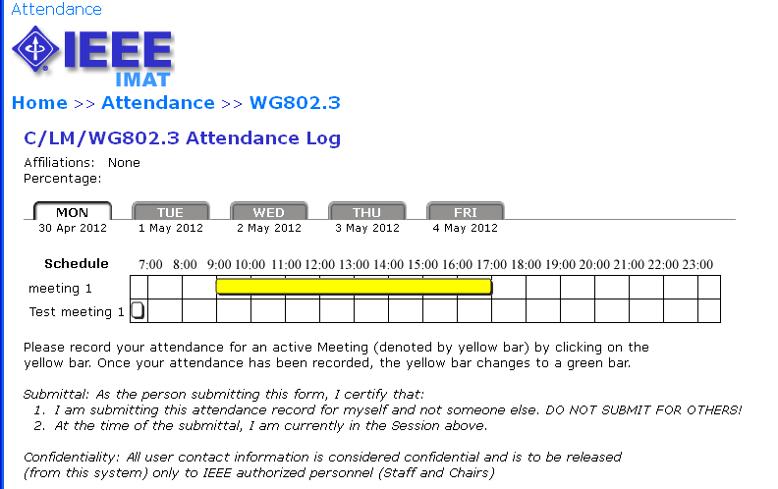
Click to log attendance
Active meetings will appear in yellow. You will only be able to log attendance for active meetings.

Slide 7
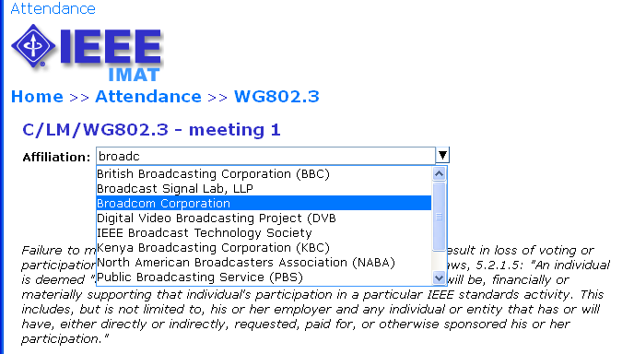
Declare affiliation
Type your affiliation and/or select from the list.

Slide 8
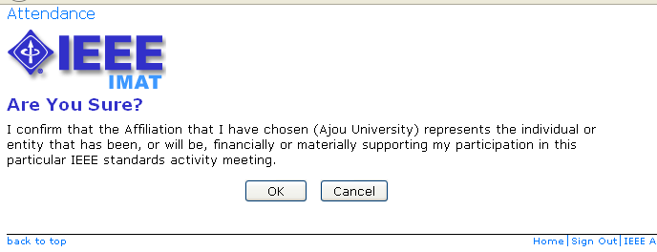
Declare affiliation
Confirm your affiliation.

Slide 9
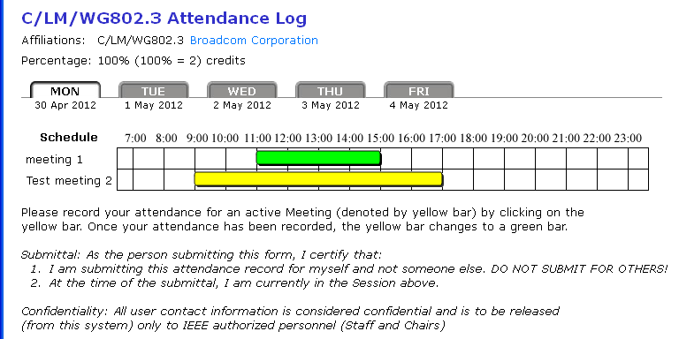
Attendance is recorded
Once attendance is recorded, the bar will change to green.

Slide 10
Overlapping meetings
Clicking on an overlapping meeting will remove any previously logged attendance.

Slide 11
Questions?
Contact : Gregory Marchini g.marchini@ieee.org

