Slide 1
IEEE Standards Association
Logging and Viewing Meeting Attendance Using The IEEE Attendance Tool

Slide 2
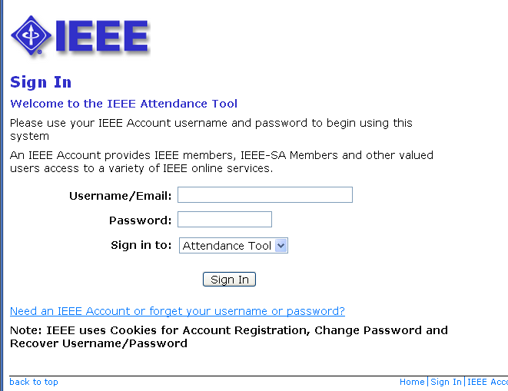
Sign in to Attendance Tool
http://imat.ieee.org
Enter your IEEE Account username/email and password
If you need to create an account or forgot your password, click the link

Slide 3
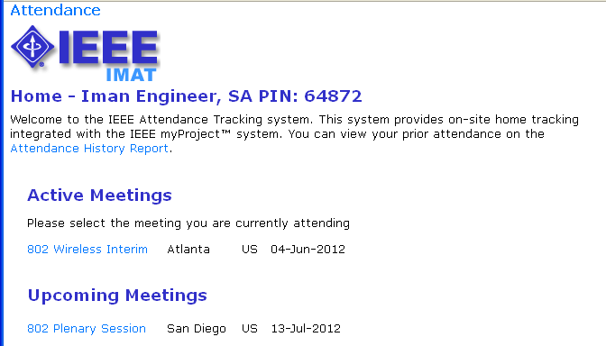
Select the meeting you are attending

Slide 4
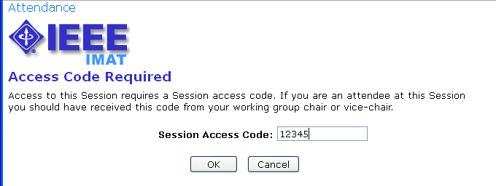
Input access code (if applicable)

Slide 5
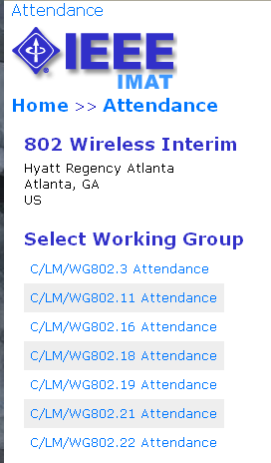
Select your working group
Select the working group holding the meeting you would like to claim attendance for.

Slide 6
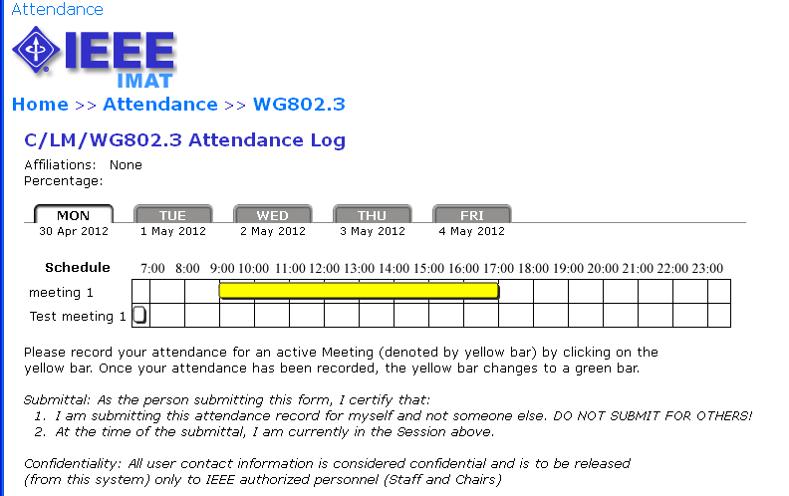
Click to log attendance
Active meetings will appear in yellow. You will only be able to log attendance for active meetings.

Slide 7
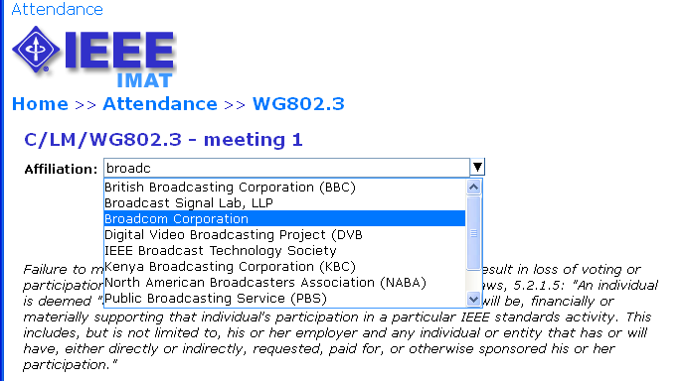
Declare affiliation
Type your affiliation and/or select from the list.

Slide 8
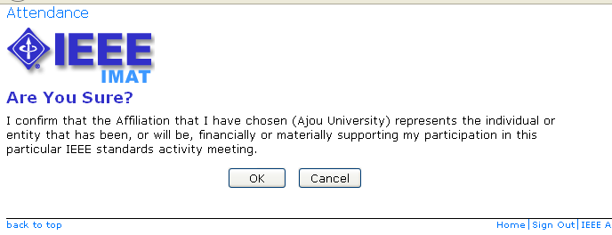
Declare affiliation
Confirm your affiliation.

Slide 9
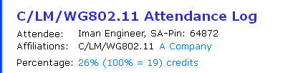
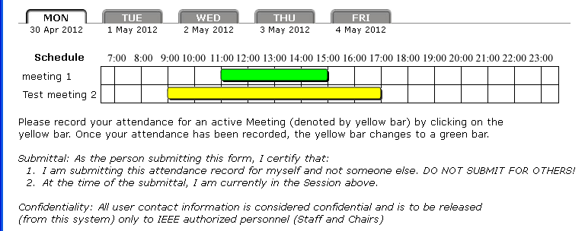
Attendance is recorded
Once attendance is recorded, the bar will change to green.

Slide 10
Overlapping Meetings
Clicking on an overlapping meeting will remove any previously logged attendance.

Slide 11
Viewing Attendance
Click on the attendance percentage to view your attendance for the meeting

Slide 12
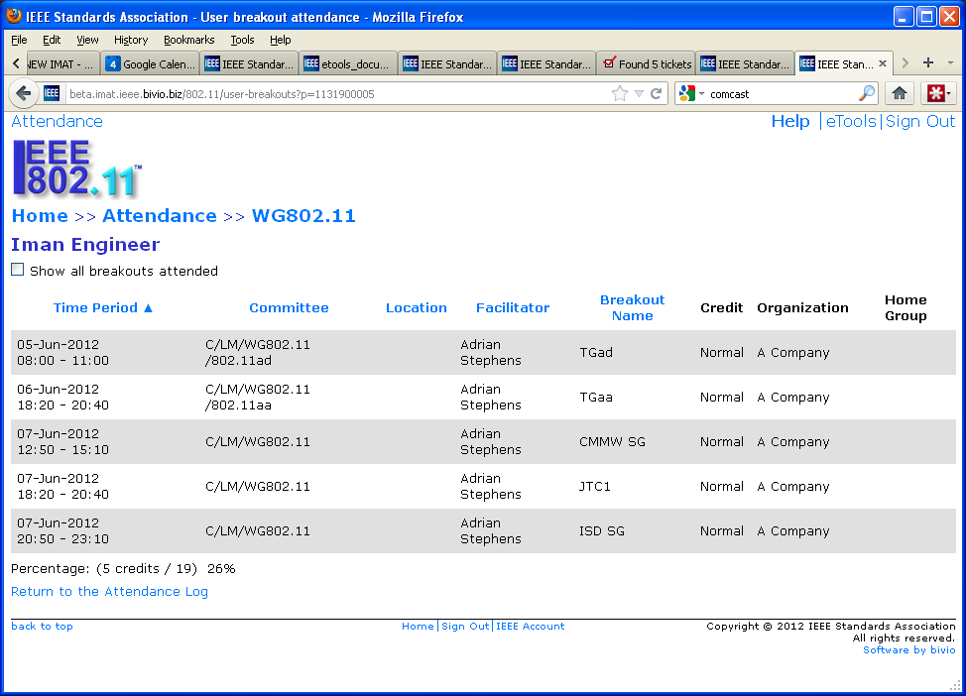
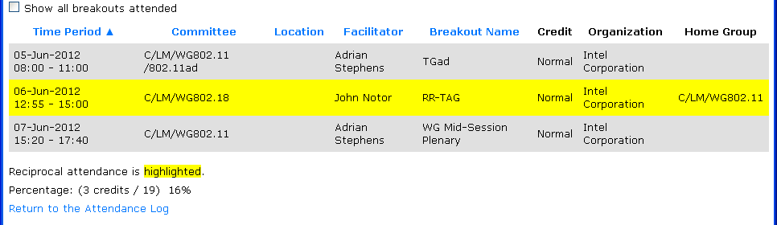
Viewing Attendance
All attendance credited to the selected Working Group will be shown. Check the “Show all breakouts attended” box to show all breakouts attended at the selected event

Slide 13
Viewing Attendance History
Click “Attendance History Report” to see attendance for past meetings

Slide 14
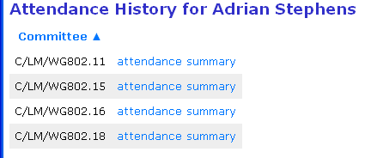
Viewing Attendance History
Select the Working Group you would like to view attendance for

Slide 15
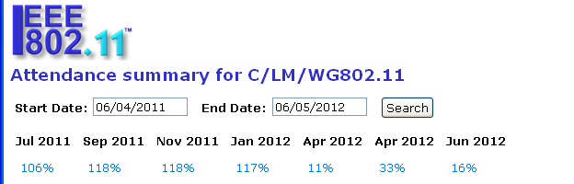
Viewing Attendance History
Specify a date range to view attendance
Click on the attendance percentage to view your attendance detail for the meeting

Slide 16
Questions?
Contact the Standards Solutions Support Team solutions-support@standards.ieee.org

